Slide 1
Privacy, Confidentiality and Ethics of Record Linkage
With thanks to more people than I can count, but especially Rayid Ghani, Arthur Kennickell, Frauke Kreuter, and George Putnam

Slide 2
Formulate Problem
Get Data
Store and Link Data
Process Data
Explore Data
Deeper Analysis (e.g. modeling)
Evaluate
Communicate
Database
Database
(postgres)
SQL
SQL
Python
(scikit learn)
Python
(scikit learn)
Python
(scikit learn)
Text Files
Python
Python
Python
(pandas)
(matplotlib)
Machine Learning
Machine Learning
Visualization
Web Scraping
Record Linkage
Visualization
Text Analytics
Experiment Design
APIs
Network Analysis
Inference
Spatial Analysis
Collaboration: “shared” folders in your project
Privacy, Confidentiality, Security

Slide 3

Key questions
What are the legal requirements?
What are the rules of engagement?
What are the best ways to provide access while also protecting confidentiality?
Are there reasonable mechanisms to compensate citizens for privacy loss?
How can we built trustworthy curators?
What do we (need to) know about the data generating process?
How can we increase linkage without increasing risks?

Slide 4
Key ideas
New types of data => enormous opportunity for public good
Three issues for privacy research
Access is critical for measurement and policy
Understand utility, risk and tradeoff
Protect output
Important and difficult agenda

Slide 5

Guiding principles

Slide 6
What is …
Privacy
includes the famous “right to be left alone,” and the ability to share information selectively but not publicly (White House 2014)
Confidentiality
means “preserving authorized restrictions on information access and disclosure, including means for protecting personal privacy and proprietary information” (McCallister, Grance, and Scarfone 2010).

Slide 7
Why confidentiality important
Promise to respondents
Ethical requirement
Legal requirement
Practical implications

Slide 8
Why access important
Data are dirty
Datasets not well defined entities
Linkages can be wrong
Outliers are where the action is

Slide 9


What do we mean by integrated data?
1 | 2 | 3 | 4 | 5 | 6 | 7 | 8 | 9 | 10 | 11 | 12 | 13 | 14 | 15 | 16 | 17 | 18 | 19
^{Aged}
^{CYFS}
^{Abuse Findings}
^{Care}
^{Education}
^{Youth Justice}
^{Income support}
^{Total cumulative paid ($1000)}
 |  | 6 |  |  |  | 18 |  |  | 37 |  |  | 53 | 58 | 71 | 120 | 126 | 127 | 142
Source: Sir Bill English, former NZ PM

Slide 10
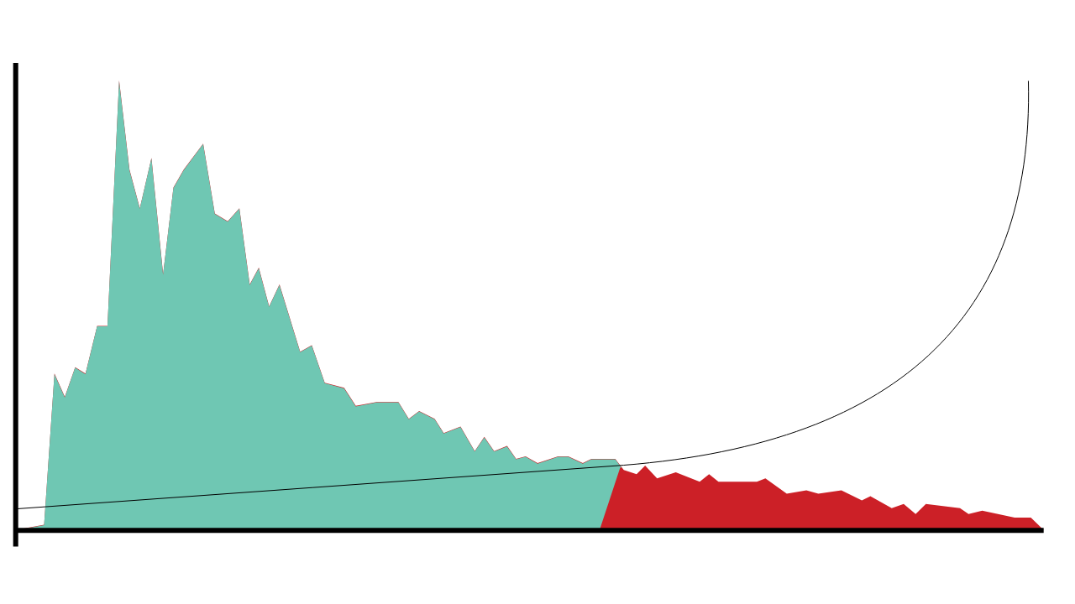

Understanding risk
The risk profile of this cohort reveals a long tail of increased risk.
2,500
The hypothetical cost effectiveness of interventions increases when they are delivered to the students who need them most.
48,077 low-risk students have an average risk of 27%
Number of students
1,250
6,990 high risk students have an average risk of 76%
0
0%
100%
Risk of not achieving NCEA2 by age 18

Slide 11
Understanding the cost
We can see the cost to the welfare and correctional systems of failing to support our young people to achieve in education.
Mean annual liability by qualitication level
Corrections Disclaimer: Cost data is provided by the Finance team in the Department of Corrections. Average daily service costs are based on annual apportionment of direct and total service costs per offender per day. It cannot be assumed that aggregating daily costs accurately represents the actual cost of any offender, or the actual cost increase/reduction to be expected by an increase/reduction in a particular offender cohort

Slide 12
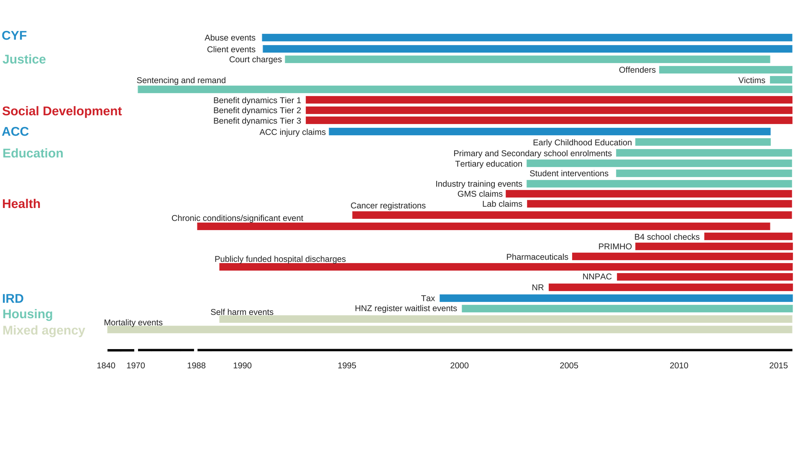
The Integrated Data Infrastructure (IDI)

Slide 13
The Data Exchange
Participants are formally
on-boarded and participate according to Agreements
NGO
DATA EXCHANGE
The data exchange manages the transfer of data from sending party to receiving party
NGO
AGENCY

Slide 14
Valuing the welfare system
Level I: Aggregate liability valuation Actuarially estimated liability for social welfare benefits Incorporate macroeconomic trends, policy changes, trends in experience and financial impacts of level III initiatives
Level II: Cohort liability estimates and KPIs
Apportion aggregate liability from Level I to statistically determined cohort groups
Set targets and monitor KPIs and liability by cohorts
Level III: Client level analytics (statistical modelling) Evaluate impact of initiatives Translate individual impacts to estimates of cohort liability

Slide 15
Aggregate liability valuation
Total liability
72.2 billion
$13.7 billion​
Increase due to policy package to reduce child poverty – because of the method we employ, this can be isolated
Liability decrease related to experience, $billions
Liability reduction
attributable to system reform
Updated model assumptions
Client numbers

Slide 16

Cohort liability estimates
Of that $72.2 billion, 75% is attributable to clients who entered the benefit system under the age of 20.
High-liability cohorts include:
Sole parents
People who churn in and out of the benefit system
Ex-prisoners on release
Young people with disabilities or chronic conditions, who want to work but need support to do so.

Slide 17

Reducing social harm from crime
Of the cohort born in 1978, the oldest generation for which full conviction data is available:
One in four people have a conviction
80%
One in three men have a conviction
of convictions went to individuals who were first convicted before the age of 20
One in two Maori or Pasifika men have a conviction

Slide 18
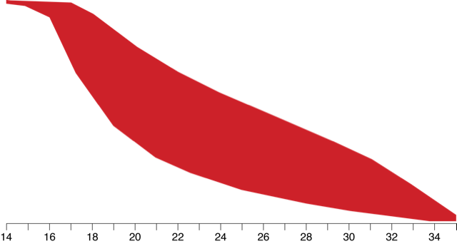
The data shows that desistance, not escalation, is the norm.
Criminal career finished
Most people stop offending quickly, and those who persist commit fewer offences over time.
Criminal career underway
Criminal career yet to start
Population: 10,000
Age

Slide 19
Seeing outside the silo
Integrated data generated insights into the relationship between traumatic brain injury and offending...
13% of the general population
36% of people charged in court
46% of people imprisoned
People charged in court who had a TBI were, on average,
3 years younger
at first charge
have a traumatic brain injury recorded in hospitalisation or ACC claims data.
Offenders with a recorded traumatic brain injury were more likely to have committed violent or sexual offences...
TBI
37%
38%
27%
No TBI
23%
35%
42%
… than offenders who had not.
Convicted for violent or sexual offence
Convicted for other offence
Not convicted

Slide 20

Seeing outside the silo
... and offenders' experiences of the mental health and education systems
Prevalence of mental health service use within 12 months of Justice interaction (2012)
60%
Of the 1500 prisoners born after 1990
69%
left school before they turned 18, compared with
32%
of the total NZ population
30%
51%
had been suspended from school
5%
compared to
of the overall population
0%
General population
Proceeded against
by police
Charged in court
Starting community sentence

Slide 21
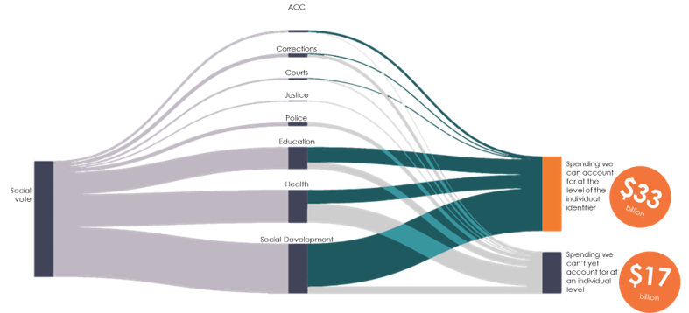
Understanding return on investment
We're able to link two thirds of service costs to individuals

Slide 22
Issues in Ethics
Privacy
Data Ownership
Bias, Equity, & Fairness
Transparency
Trustworthiness and Accountability

Slide 23
We need to be ok with not having answers but raising more questions that can be empirically informed

Slide 24
Most of the questions we’re answering here are not new
Ethical issues have always been there in policy but we are dealing with them now at a different scale and with a more data-driven view

Slide 25
Our policies need to reflect our values
What does fairness mean?
What do we mean by trustworthy?
Should our right to privacy matter more than our right to life? Or to healthcare?
Should we be allowed to use someone’s data just because we think it’s publicly available?

Slide 26
Common misconceptions
If I don’t use race in my analysis/models, then my analysis/models can’t be racist
If I use race in my analysis, then my analysis is always racist
If my actions aren’t happening on individuals, then I don’t need to worry about biased

Slide 27
Levels of control
Access Control (Not collecting my data)
Inference Control (not inferring something about me)
Action Control (not taking actions on me)

Slide 28
Bias, Equity, and Fairness
How do we define it?
How do we detect it?
How do we reduce/remove it?

Slide 29
How does Bias happen?
Developers/Data Scientists
Data
Complexity or flaws in Methodology
Entire analysis pipeline
Notes:
What data was considered relevant
How accurate and clean was it?
Sampling bias

Slide 30
Bias can be introduced in every step of this process
Get Data
Process Data
Explore Data
Modeling
Test
Communicate
Store and Link Data
Evaluate & Select
Deploy
Maintain

Slide 31
Many, Many, Many Bias Measures
Statistical/Demographic Parity
Impact Parity
False Discovery Rate Parity
False Omission Rate Parity
False Positive Rate Parity
False Negative Rate Parity
...

Slide 32
How can we audit our predictions/actions for biases?
Disparate Impact
Disparate Errors
False Positive Rate ratios for each group (male/female, afam/white,…)
False Negative Rate ratios for each group

Slide 33
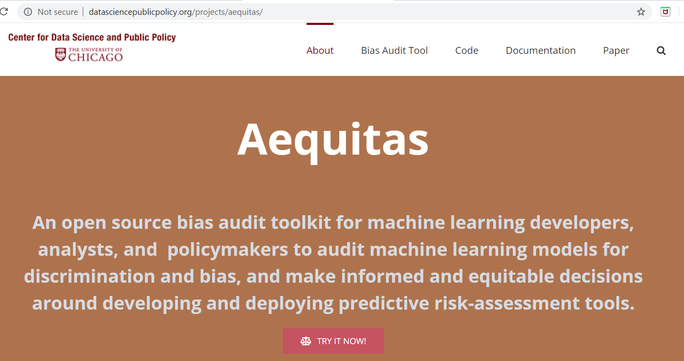
Aequitas: Bias Audit Tool
http://dsapp.uchicago.edu/aequitas

Slide 34
What does it take for an analysis to be transparent?
Code for the analysis
Model that was built
Data that was used
?

Slide 35
Trustworthiness and Accountability
Do policymakers understand what the analysis is doing?
Do action-takers understand the trust understand why they’re getting the recommendations they’re getting?
Do the people being acted on understand why?

Slide 36
Trustworthiness and Accountability
Who is accountable for the actions?
Who is coming up with the values encoded in the system?
How is the tradeoff between false positive and false negatives being set?

Slide 37
Explanations as a Trust-Creation Tool
We have to be able to explain
processes—what the algorithm does
how it does it
who controls the algorithm (sources of bias)
what data does it use (sources, kinds)
Biases (does it favor certain, and why)

Slide 38
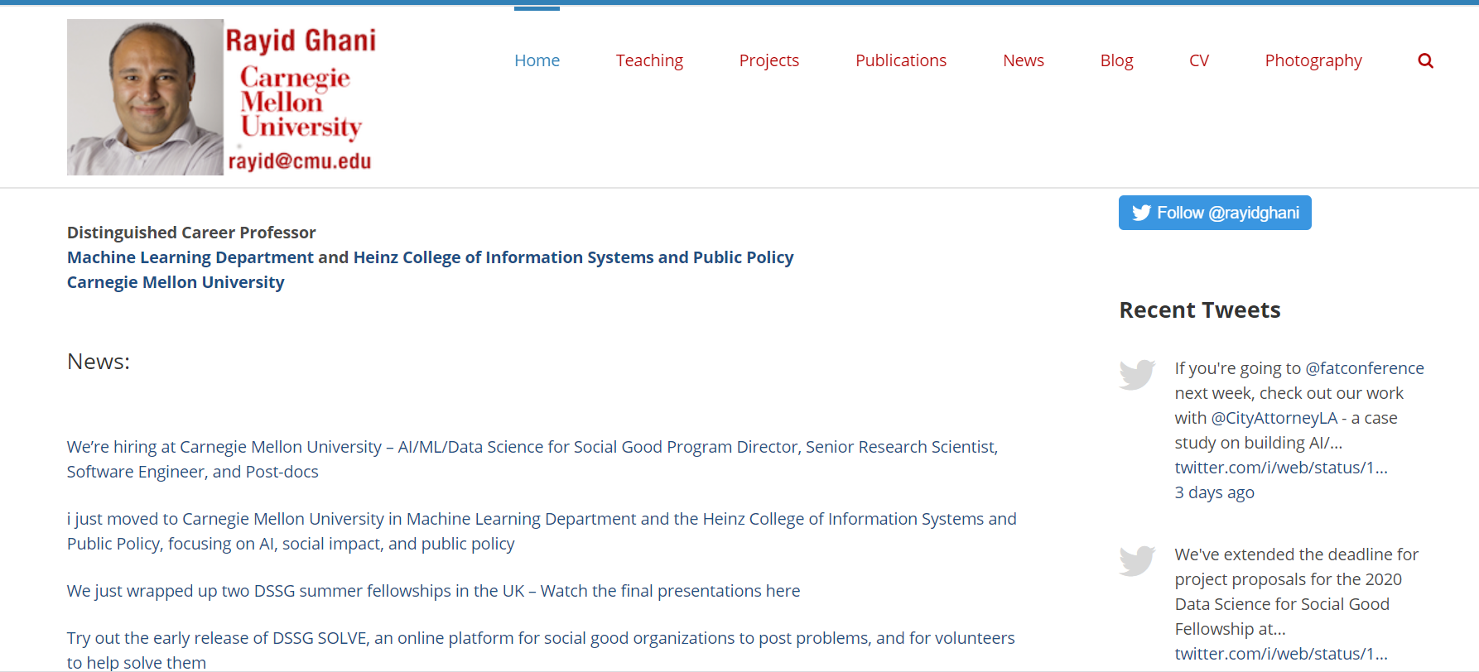
Lots of resources

