Slide 1
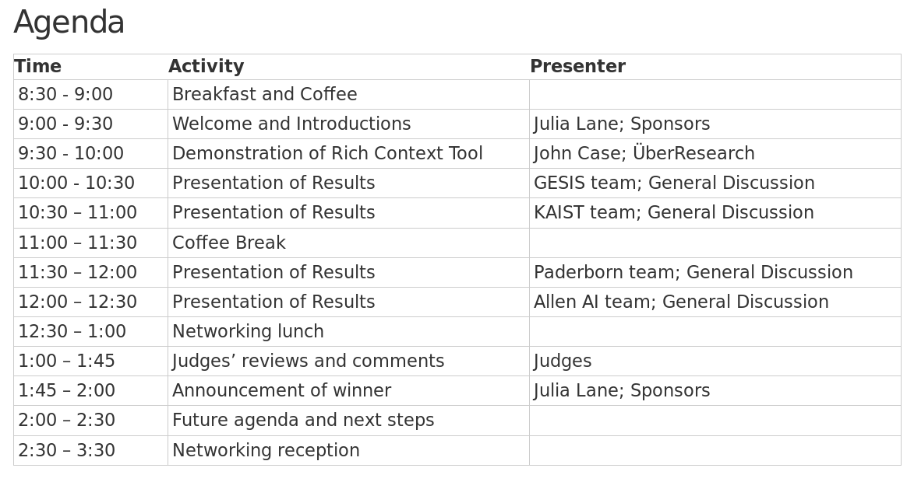

Slide 2
Team-GESIS@RCC
Results of Participation
Wolf Otto, 02/15/2019
Notes:
Intro Satz:
Dear RCC-Team, Dear Sponsors, RCC-phase-2-teams and Interested people the Research task of connecting Publication, Research Data and Research Concepts
Thank you for your Invitation to participate in Phase 2
I like to welcome

Slide 3
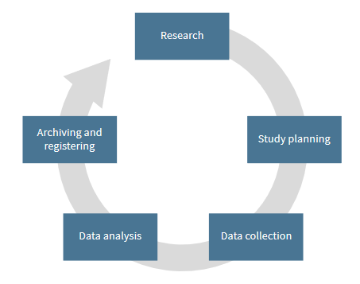
RCC-Team - Department - Institute
RCC-Team
Mixed team of seven Postgraduates and Postdocs
Andrea Zielinski, Behnam Ghavimi, Dimitar Dimitrov, Karam Abdulahhad, Katarina Boland, Narges Tavakolpoursaleh, Wolfgang Otto
Knowledge Technologies for the Social Sciences
Research data management along „research data lifecycle“
Information Extraction/NLP, Information Retrieval, Semantic Technologies
GESIS - Leibniz Institute for the Social Sciences
Largest European infrastructure institute for the social sciences
Research in social sciences and computer science
Notes:
More about GESIS
(> 400 staff, based in Mannheim and Cologne)
Research+
… and their intersection, e.g. Computational Social Sciences
Research Fields:
information extraction/NLP, information retrieval, semantic technologies (and their application to research data)
(and their application to research data)
What is Research Data:
“Research data”: survey, microdata, increasingly Web data; strategic focus on „digital behavioral data“ (social Web, etc)
NEXT SLIDE:
Motivation

Slide 4
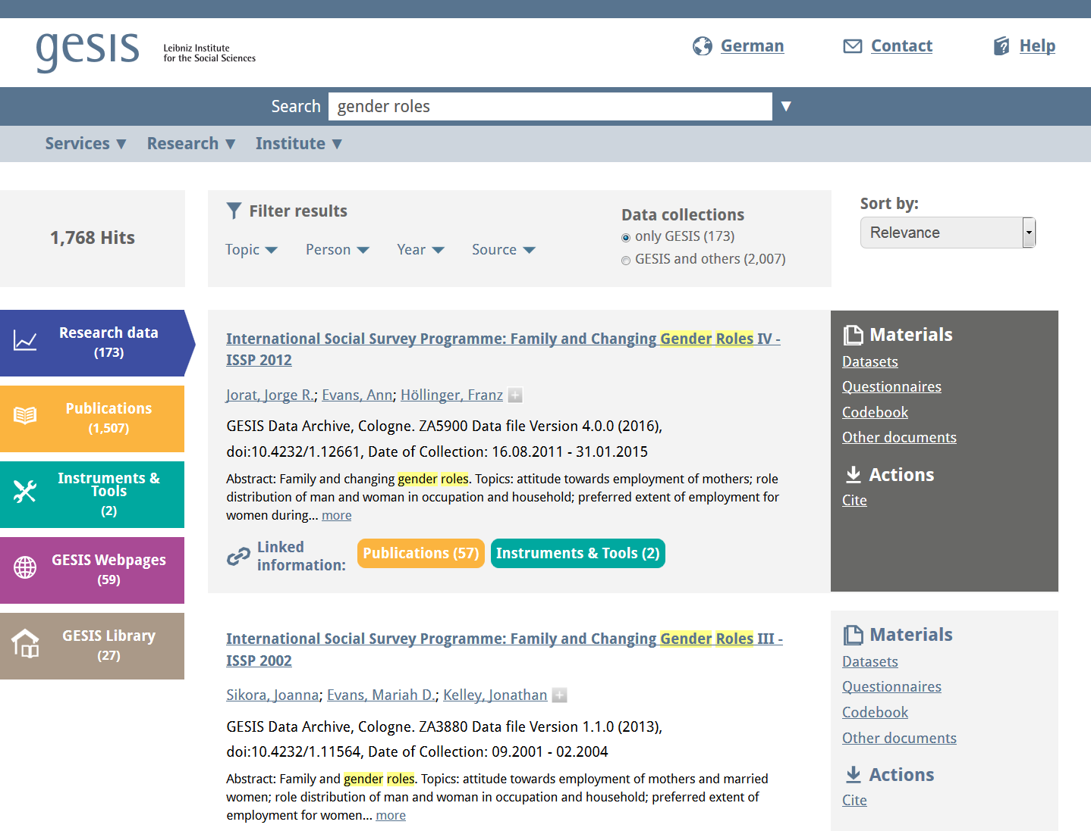
Screenshot of Gesis Search
Notes:
WHAT: Integrated search system for social science information
Launched last year
2. FOR: data sets, publications, questions from questionnaires, survey instruments and tools
3. LINKS:
Increase of visibility and possibilities for exploration
Log study support this (published soon)
4. Optional:
GESIS history in dataset extraction research:
Boland, Katarina, et al. "Identifying references to datasets in publications." International Conference on Theory and Practice of Digital Libraries. Springer, Berlin, Heidelberg, 2012.
Ghavimi, Behnam, et al. "Identifying and Improving Dataset References in Social Sciences Full Texts." arXiv preprint arXiv:1603.01774 (2016).

Slide 5
Tasks in the Rich Context Competition
Dataset Mention Identification
Research Field Classification
Research Method Identification

Slide 6
Dataset Mention Identification
Challenges
No standard way to cite
Researcher dependent “National Health and Nutrition Examination Survey” vs. “NHaNES”
Research community dependent E.g. Implicit References: “the monthly statistic“
Domain dependent Git citation in computer science vs. Surveys in Social Science
Ambiguity of Dataset mentions
“Midlife in the United States”
“WHO data”

Slide 7
Dataset Mention Identification
Example
All these issues are addressed in the current report, which is based on analysis of data obtained in the National Comorbidity Survey (NCS) (15). The NCS is a nationally representative survey of the US household population that includes retrospective reports about the ages at onset and lifetime occurrences of suicidal ideation, plans, and attempts along with information about the occurrences of mental disorders, substance use, substance abuse, and substance dependence.
National Comorbidity Survey (NCS)
NCS
Approach
Train a supervised NER classifier
Neural Network Approach (CNN)
Standard Implementation of Spacy NLP-Tool

Slide 8
Dataset Mention Identification
Create weakly labeled Dataset
Dataset Citation (RCC)
Publication id | Mention list | Dataset id
1059 | [ MTF, Monitoring the Future, …] | 2386
... | ... | ...
Text of Publication:
...
All these issues are addressed in the current report, which is based on analysis of data obtained in the National Comorbidity Survey (NCS) (15). The NCS is a nationally representative survey of the US household population that includes retrospective reports about the ages at onset and lifetime occurrences of suicidal ideation, plans, and attempts along with information about the occurrences of mental disorders, substance use, substance abuse, and substance dependence.
...
MTF
List of known Datasets (RCC)
National Health and Nutrition Examination Survey II, 1976-...
National Health and Nutrition Examination Survey II, 1976-1980: Health Hist…
National Health and Nutrition Examination Survey II, 1976-1980: 24-Hour Rec ...
National Health and Nutrition Examination Survey II, 1976-1980: Serum Choles...
National Health and Nutrition Examination Survey II

Slide 9
Dataset Mention Identification
Example
All these issues are addressed in the current report, which is based on analysis of data obtained in the National Comorbidity Survey (NCS) (15). The NCS is a nationally representative survey of the US household population that includes retrospective reports about the ages at onset and lifetime occurrences of suicidal ideation, plans, and attempts along with information about the occurrences of mental disorders, substance use, substance abuse, and substance dependence.
National Comorbidity Survey (NCS)
NCS

Slide 10
Dataset Mention Identification
Results
NER evaluation results on weakly labeled hold out:
 | strict | partial
precision | 0.49 | 0.51
recall | 0.87 | 0.90
Phase 1:
Rank of rating from four judges on ten publications:
Individual ranks: 1 / 2 / 4 / 1

Slide 11
Dataset Mention Identification
Results
Examples of newly found datasets
1958 Philadelphia Birth Cohort Study (16)
Patient’s and Physician’s Global Assessments (15)
National Survey of Adolescents (12)
First Austrian Dementia Report (9)
...
National Household Transportation Survey (1)
Iowa Transportation and Employment Survey (1)
California’s Health Interview Survey (1)
Annual Survey of Jails (1)
National Household Survey of Drug Abuse (1)

Slide 12
Research Field Classification
Example
Development Policy
EU Soft Power in the Eastern Neighbor- hood and the Western Balkans ...
European Politics
Approach
Multilabel Classification
fastText-Model

Slide 13
Research Field Classification
Used Dataset
Annotated Corpus as Reference
Social Science Open Access Repository (SSOAR)
Different classification schemes
Selected Classification Social Sciences
140 Classes and train/test set of 6000 Publications abstracts
Select the 44 Classes with more then 300 Training Examples

Slide 14


Slide 15
Research Field Classification
Used Dataset
Annotated Corpus as Reference
Social Science Open Access Repository (SSOAR)
Different classification schemes
Selected Classification Social Sciences
140 Classes and train/test set of 6000 Publications abstracts
Select the 44 Classes with more then 300 Training Examples

Slide 16
Research Field Classification
Results
f1-score of 0.52
94% of the publications are labeled
Phase 1: Rank of rating from four judges on ten publications:
3/3/1/1

Slide 17
Research Method Identification
Example
In the cross-sectional analysis, differences in the odds of being obese according to vehicle ownership were calculated in Stata (Version 7.0; Stata Corp., College Station, TX) using generalized estimation equations (GEE). We assumed a binomial distribution and used a logit link function and an exchangeable working correlation matrix.
cross-sectional analysis
generalized estimation equations (GEE)
binominal distribution
logit link function
correlation matrix
Notes:
Example from pub 987
'The Road to Obesity or the Path to Prevention: Motorized Transportation and Obesity in China'

Slide 18
Research Method Identification
Approach
Train NER-Classifier in a different domain
Semantic Classes: Theory, Model, Measure, Tool
Adapt to Social Science domain
Further training on a Social Science Corpus
Use Gazetteers and Word Embeddings
Post-process classification results
Filter by overlap with single words from controlled vocabulary (except stop words)
Define valid POS tag sequences

Slide 19
Research Method Identification
Expanding SAGE controlled Vocabulary
1,111 terms from SAGE
447 terms from the Statistics glossary
As well as 54 previously unseen manually-controlled terms found in SSOAR publications

Slide 20
Research Method Identification
Results:
Double Jeopardy, Aging as Leveler, or Persistent Health Inequality?
A Longitudinal Analysis of White and Black Americans (ID:180)
double jeopardy hypothesis
empirical tests
cross sectional analysis
statistical tests
In-depth interviews
Notes:
Aus publication 180:
[('double jeopardy hypothesis', 1, False), ('empirical tests', 1, False), ('cross-sectional analysis', 1, False), ('statistical tests', 1, False), ('Sample Data', 1, False), ('Statistics', 1, False), ('Nutrition Examination Survey', 1, False), ('In-depth interviews', 1, False), ('interviews', 1, False), ('Dummy variables', 1, False), ('Significance tests', 1, False), ('chi-square', 1, False), ('OLS', 1, False), ('Standard error', 1, False), ('Parameter', 1, False), ('aging-as-leveler hypothesis', 1, False), ('original hypothesis', 1, False)]

Slide 21
Research Method Identification
Results:
Phase 1: Rank of rating from four judges on ten publications:
Ranks: 1/1/1/1
Overall: first place

Slide 22
Lessons Learned
How to deal with sparse training data
How diverse citing culture of datasets is
Gold Standards make life easier

Slide 23
Future Research Agenda
Apply new methods in our Pipeline on SSOAR Corpus
Combine dataset and research method approaches
Use knowledge gain of our participation within GESIS infrastructure
Joined Work?
Create Reference Dataset Identification Corpus

Slide 24
Tasks in the Rich Context Competition
Dataset Mention Identification
Research Field Classification
Research Method Identification

Slide 26
GESIS Search
Integrated search system for
social science information
Contains: data sets, publications, questions from questionnaires, survey instruments and tools
Information items are linked
Increase of visibility and possibilities for exploration
Log study support this (published soon)
GESIS history in dataset extraction research:
Boland, Katarina, et al. "Identifying references to datasets in publications." International Conference on Theory and Practice of Digital Libraries. Springer, Berlin, Heidelberg, 2012.
Ghavimi, Behnam, et al. "Identifying and Improving Dataset References in Social Sciences Full Texts." arXiv preprint arXiv:1603.01774 (2016).

Slide 27
Dataset Identification
Solve Data Problem
Quality of re-annotations
 | Mention Lists | Dataset Titles
clean annotations | +/- | +
Clear defined Spans for dataset mentions | - | +/-
abbreviations included | + | -
year included | +/- | +
vague mentions included | + | -
scope of annotations | +/- | +

Slide 28
Challenges in Dataset Identification
The Art of citing Research Data
is correct citation of datasets is often entirely missing
Full name vs. Abbreviation vs. Vague link
“National Health and Nutrition Examination Survey” vs. “NHaNES” vs. “the monthly statistic“
Common way of citing specific datasets evolved
Linguistic Problems
disambiguation problem for Abbreviations: WHO data
Increasing number of datasets
Notes:
(Dara search net)

Slide 29
Dataset Mention Identification
Approach
Train a supervised NER classifier
Neural Network Approach
Standard Implementation (Spacy NLP-Tool)
Test on holdout set
Notes:
Problem of measuring Precision

Slide 30
Outline
Motivation (GESIS Search)
Challenges in Dataset Identification
Results of our Work
Dataset Extraction
Research Field Classification
Research Method Extraction
Lessons learned
Future Work

Slide 31
Summary of results
Mixed Approaches for Subtasks
Training data generation
Supervised classification
Controlled vocabulary generation
Named Entity Extraction (NER)
Multi-label Classification

Slide 32
Identification of Research Methods
Create an enriched controlled vocabulary
Assignment of semantic types (Measurement, Tools, Method and ..) (manualy)
Extracting term variants and abbreviations from social science text (semi-automatic)

Slide 33
Institute - Department - RCC-Team
GESIS - Leibniz Institute for the Social Sciences
Largest European infrastructure institute for the social sciences
Research in social sciences and computer science
Knowledge Technologies for the Social Sciences
Research data management along „research data lifecycle“
information extraction/NLP, information retrieval, semantic technologies
RCC-Team
Mixed team of seven Postgraduates and Postdocs
Andrea Zielinski, Behnam Ghavimi, Dimitar Dimitrov, Karam Abdulahhad, Katarina Boland, Narges Tavakolpoursaleh, Wolfgang Otto
Notes:
More about GESIS
(> 400 staff, based in Mannheim and Cologne)
Research+
… and their intersection, e.g. Computational Social Sciences
Research Fields:
information extraction/NLP, information retrieval, semantic technologies (and their application to research data)
(and their application to research data)
What is Research Data:
“Research data”: survey, microdata, increasingly Web data; strategic focus on „digital behavioral data“ (social Web, etc)
NEXT SLIDE:
Motivation

Slide 34
Dataset Mention Identification
Solve Data Problem
Generate weakly labeled training corpus
From Mentionlists (provided by RCC)
Publication: 1059
Mentionlist: [ MTF, Monitoring the Future, …]
Dataset: 2386
From dataset title list (provided by RCC)
National Health and Nutrition Examination Survey II, 1976-..., National Health and Nutrition Examination Survey II, 1976-1980: Health Hist…, National Health and Nutrition Examination Survey II, 1976-1980: 24-Hour Recall, Specific Food Item, National Health and Nutrition Examination Survey II, 1976-1980: Serum Cholesterol, ...
Notes:
title mapping:
4309 positive paragraphs in training set

Slide 35
Dataset Identification
Example
Data for this project were taken from the Youth Development Study (YDS) dataset title .

