Slide 1
Figure 1
Negative emotional experience
GBTX
Clinical depression

Slide 2
Figure 2
Records identified through database searching (n = 294)
Additional records identified through other sources (n = 248)
Identification
Records after duplicates removed (n = 363)
Screening
Records screened (n = 363)
Records excluded (n = 325)
Full-text articles assessed for eligibility (n = 38)
Full-text articles excluded (n = 30)
Eligibility
Studies included in qualitative synthesis (n = 8)
Included
Studies included in quantitative synthesis (meta-analysis) (n = 7)

Slide 3
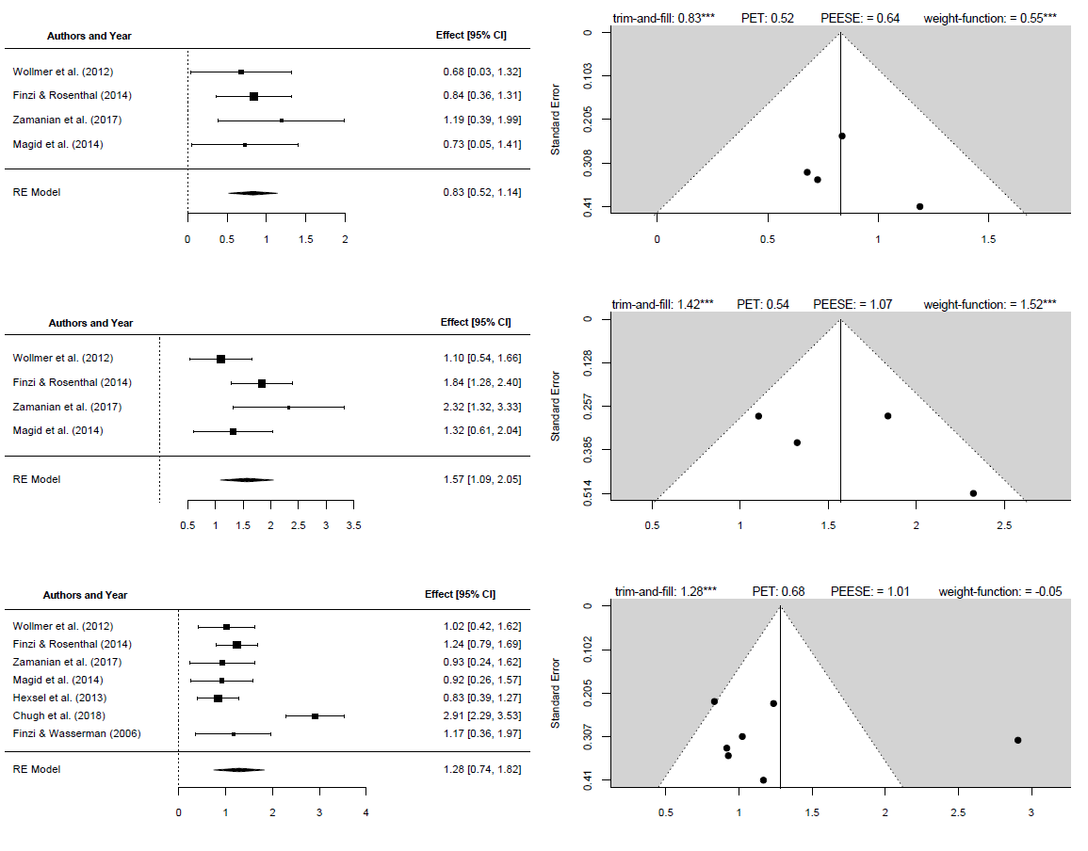
A: Difference in BTX vs. Placebo groups’ depression scores, Week 6
Figure 3
Note: this figure is mostly made in R. The highlighted panel titles are the only text that can be altered outside of R.
B: Pre-post difference in BTX groups’ depression scores, Week 6
C: All reported results combined
Standardized mean difference
Standardized mean difference

