Slide 1
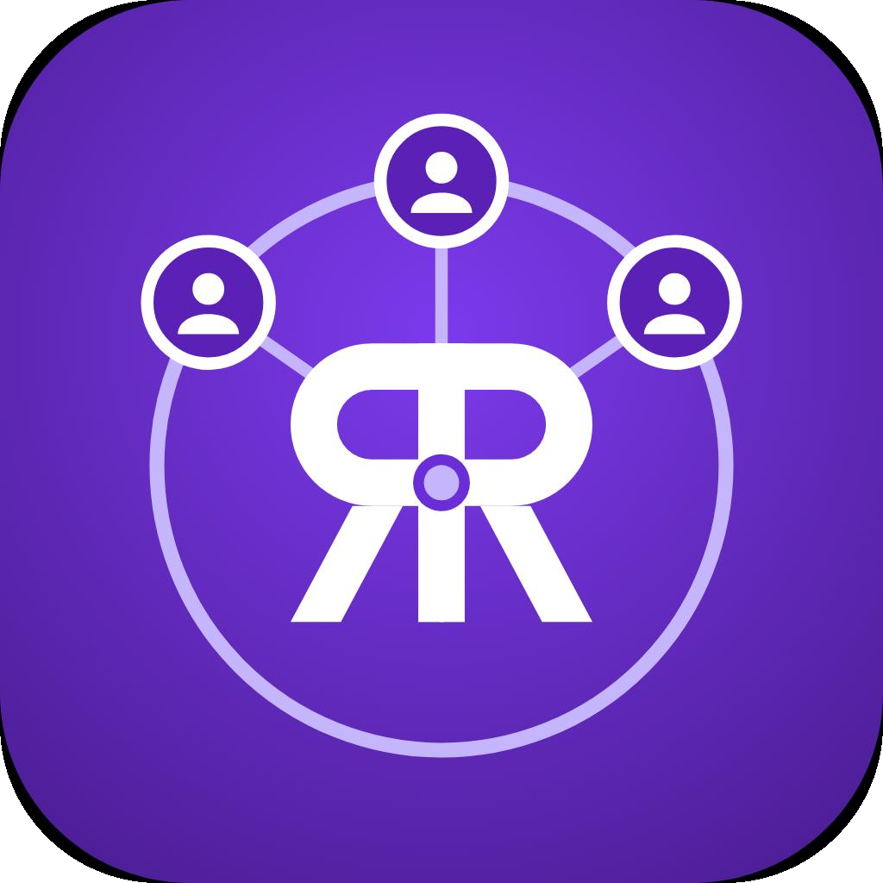
REMOTE ROLES HUB · TRAINING
CRM Fundamentals:
Monday.com to Salesforce
Building portable CRM skills from first lead to follow-up.
Remote Roles Hub
Remote Roles · Training Material

Slide 2
THE CORE IDEA
CRM turns scattered conversations into a process
Customer Relationship Management: a system for organizing customer information, conversations, tasks, and sales work.
One shared view
Clear ownership
Remote-ready follow-up
One shared view, consistent follow-up, clearer ownership, and better visibility into work in progress.
Tasks and sales work have clear owners, so teams can coordinate around the same customer context.
Write the next action so another teammate can pick up the thread.
Remote Roles Hub
Remote Roles · Training Material
02

Slide 3
Ten CRM terms you’ll use every day
Lead · Prospect
Contact · Account
Customer · Deal / Opportunity
A lead is a person or company that may be interested. A prospect is a lead with some fit or intent.
A contact is a person. An account is the company or organization connected to people and work.
A customer is someone who has bought. A deal or opportunity is a potential sale being worked.
Record · Field
Follow-up
A record is one saved entry. A field is one piece of data.
The next planned touch.
Remote Roles Hub
Remote Roles · Training Material
03

Slide 4

PIPELINE DISCIPLINE
Every opportunity moves through stages
Stage means “where the work is now,” not “what we hope happens next.”
New Lead
Contacted
Qualified
Meeting Booked
Then: Proposal Sent → Negotiation → Closed-Won or Closed-Lost.
Evidence: Each move should have evidence. Next action: Each opportunity needs a clear next action.
Remote Roles Hub
Remote Roles · Training Material
04

Slide 5

Lead source
Pipeline
DEMAND VS. PROGRESS
Where the person came from, such as a webinar, referral, or website form.
Campaigns create demand; pipelines track progress
Tracks individual opportunities after they enter the process.
Campaign
A coordinated effort with a target audience, source, call to action, and nurture plan.
Conversion rate
The share that completes the next desired action.
Campaigns generate or nurture interest. Pipelines track progress.
Remote Roles Hub
Remote Roles · Training Material
05

Slide 6




WORKFLOW LANGUAGE
Board · item · column
Status · owner · task
CRM workflow terms make ownership visible
Workspace, tracked entry, and data category.
Progress, responsibility, and planned work.
Good CRM work makes progress, responsibility, planned work, and data quality easy to see.
Automation · integration
Dashboard · data hygiene
Rules and connected tools that reduce manual work.
A visual summary built from accurate, complete, current, duplicate-free information.
Remote Roles Hub
Remote Roles · Training Material
06

Slide 7
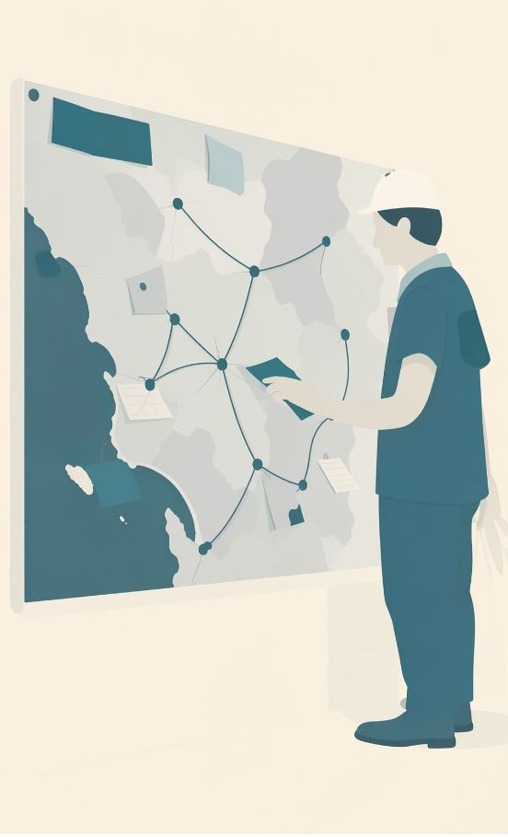
TOOL 01
Monday.com: a flexible board for lead work
Boards hold the workflow. Items can represent leads. Columns hold fields such as company, email, owner, status, and next step.
Status labels and deadlines make handoffs visible at a glance.
Remote Roles Hub
Company | Contact | Status | Owner | Next step
Acme | Jordan Lee | New Lead | Priya | Friday
Northstar | Sam Ortiz | Qualified | Mei | Tuesday
Illustrative mockup — exact fields depend on workspace setup.
Remote Roles · Training Material
07

Slide 8

PRACTICE ROUTINE
A simple Monday.com lead routine
Use the same rhythm every time: capture the context, make ownership visible, and leave a useful next action.
Add the lead and capture contact details.
Assign an owner and choose the current status.
Add a short note with context and source.
Create the next task and due date.
Update the status after each meaningful interaction.
Illustrative mockup: New Lead → Contacted, with a note and follow-up date.
Remote Roles Hub
08
Remote Roles · Training Material

Slide 9

TOOL 02
Salesforce: connected records for sales work
Salesforce commonly connects purpose-built records for leads, people, companies, opportunities, campaigns, tasks, reports, and dashboards.
Remote Roles Hub
Record | Example field | Connected work | What it helps you see
Lead | Owner | Activity | Who is working the early conversation
Account | Company | Contacts | Which people and work belong together
Opportunity | Stage | Next Step | Where a qualified deal stands
Remote Roles · Training Material
09
Illustrative mockup — standard relationships, features, and layouts depend on edition and configuration.

Slide 10
THE TRANSFERABLE SKILL
Same CRM habits, different structures
Conceptual links, not identical tools.
Monday.com: Often starts with a board, item, column, and status. Salesforce: Often connects purpose-built records such as Lead, Contact, Account, and Opportunity.
Transferable skills
Clean data entry · clear ownership · stage discipline · useful notes · next actions · timely follow-up
Monday.com | Salesforce
Item | Record
Status | Opportunity stage
Owner | Assigned user
Update | Activity or task
Conceptual mapping: both tools are configurable; this learning aid does not imply product equivalence.
Remote Roles Hub
Remote Roles · Training Material
10

