Slide 1

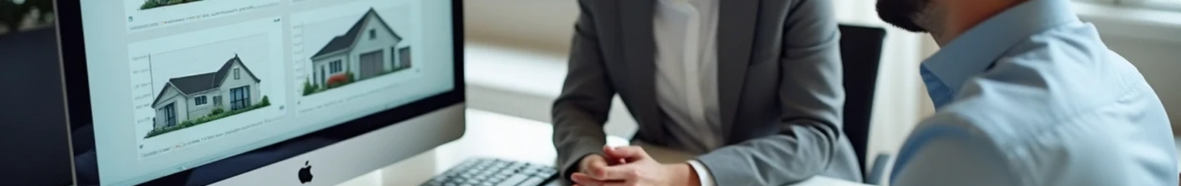


Effective Negotiation Techniques: Labeling in Real Estate
Author: uk**le@gmail.com
Created with Pi
Remote Roles · Training Material

Slide 2

CONTENTS
1. Introduction to Labeling
2. Utilizing Labeling to Manage Frustration
Remote Roles · Training Material

Slide 3

01
Introduction to Labeling
Remote Roles · Training Material

Slide 4

What is Labeling?
In a negotiation, labeling someone's emotions by saying phrases like “It seems like you think I'm being unfair” or “It sounds like you really understand this business” allows the seller an opportunity to clarify their thoughts and helps the negotiator better understand their perspective.
A label serves as a verbal acknowledgment of the other side's feelings or positions. Labels are utilized to neutralize negative emotions or reinforce positive ones, typically starting with:
"It seems like..."
"It looks like..."
"You look like..."
Remote Roles · Training Material

Slide 5




What is Labeling?
Example Phrases for Labeling
You may use these phrases while communicating with sellers:
1
2
"It seems like this house has really been a headache for you."
"It seems like you're not really that interested in selling?"
3
4
"It looks like you really need to get close to your asking price."
"It seems like you really want to sell this house and move on."
Remote Roles · Training Material

Slide 6
02
Utilizing Labeling to Manage Frustration
Remote Roles · Training Material

Slide 7

How to Address Seller Frustration
It's common to encounter frustrated or even angry sellers during calls. It's essential to recognize that there's often more behind their emotions, and using effective labeling can help de-escalate the situation.
Remote Roles · Training Material

Slide 8

How to Address Seller Frustration
Example of Labeling Frustration
Seller (frustrated): "The offers we've been getting are way below what we were hoping for, and I'm not going to sell it at a low ball price!"
You (labeling frustration): "It seems like you're feeling frustrated and discouraged because the offers you've received so far aren't meeting your expectations. Selling a house can be a tough process, especially when the offers don't reflect the value you see in your property."
In this scenario, you're acknowledging and labeling the seller's frustration regarding the specific challenges they face during the selling process. This can foster a sense of understanding and encourage the seller to be more open about their concerns or feelings.
Remote Roles · Training Material

Slide 9

What NOT to Do
It's crucial to avoid taking a seller's frustration personally. Responding rudely can harm the negotiation process. If you're unable to diffuse the situation effectively, kindly end the call with phrases such as: "It sounds like you may not be ready to sell right now, but if anything changes, I would be more than happy to talk to you about your house."
Remote Roles · Training Material

Slide 10

Thank You
Remote Roles · Training Material

