Slide 1


MODULE 3 · TRAINING REFERENCE
Property Condition
Assessment Guide
A conversational walkthrough for gathering accurate
property details from sellers — structured exterior
to interior, built for real estate VA calls.
PLATFORM
PURPOSE
FLOW
VERSION
Remote Roles Inc
Wholesale Offer Prep
Exterior → Interior
1.0
remoteroles.online
Remote Roles · Training Material

Slide 2
How to Use This Guide
Use the conversation prompts to guide sellers naturally — never read them verbatim. Record type, age and condition for every element.
1
Roof
2
Siding
3
Foundation
4
Windows
& Doors
5
Garage
6
HVAC
7
Plumbing
8
Electrical
9
Flooring
10
Kitchen
& Bath
›
›
›
›
›
›
›
›
›
EXTERIOR SYSTEMS
INTERIOR SYSTEMS
🏠 Outside-In Order
⏱ Capture Age & Condition
💬 Keep It Conversational
Always start from the roof and work your way down and inside. This mirrors how a visual inspection flows.
For every element, note: what type it is, roughly how old it is, and what condition you'd rate it — good, fair, or poor.
Don't fire off a list of questions. Use each prompt as a natural transition from one topic to the next.
Remote Roles · Training Material
remoteroles.online · Module 3 · Property Condition Assessment

Slide 3
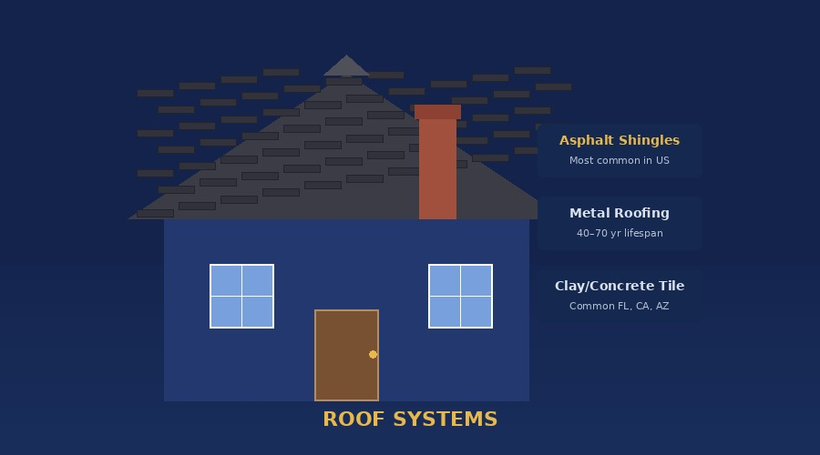
🏠
Roof
The single biggest repair line item — always establish type, age, and any known leaks.
CONVERSATION PROMPT
"Let's start at the top — do you know what the roof is made of, and roughly when it was last replaced?"
Shingles
Metal Roofing
Clay / Concrete Tile
Most common in US. 3-tab or architectural.
Standing seam or corrugated. Long lifespan.
Common FL, CA, AZ. Heavy — check structure.
⏱ 20–30 yrs
⏱ 40–70 yrs
⏱ 50+ yrs
💲 $5k–$15k replace
💲 $10k–$30k replace
💲 $15k–$40k replace
Wood Shake
Flat / TPO / EPDM
Slate
Cedar or redwood. Common Pacific Northwest.
Low-slope or commercial-style homes.
High-end natural stone. Needs specialists.
⏱ 20–40 yrs
⏱ 15–25 yrs
⏱ 100+ yrs
⚠ RED FLAGS
💲 $14k–$25k replace
💲 $5k–$18k replace
💲 $20k–$60k replace
Active leaks · Double-layered shingles · Storm/hail damage · Flat roof 15+ yrs
Remote Roles · Training Material
remoteroles.online · Module 3

Slide 4
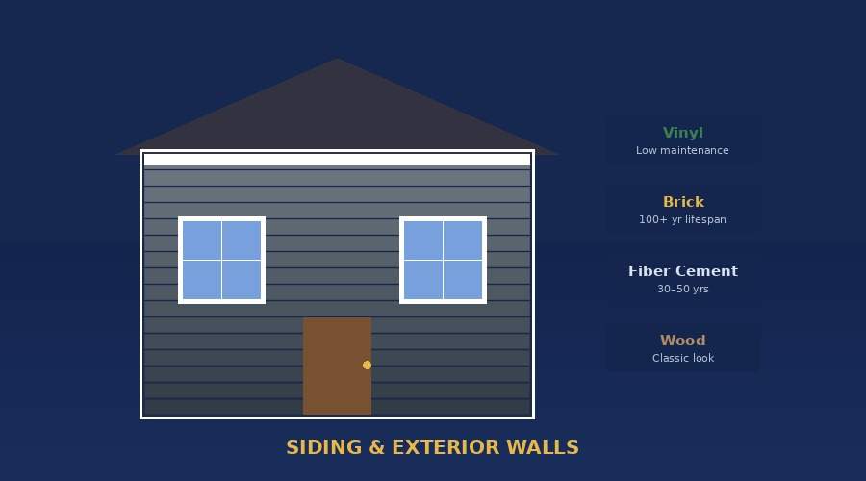
🧱
Siding & Exterior Walls
The home's outer shell — affects curb appeal, insulation, and moisture intrusion risk.
CONVERSATION PROMPT
"Moving to the outside walls — what does the exterior look like? Brick, siding, stucco? Would you say it's in good shape, or has it seen better days?"
Vinyl Siding
Brick / Veneer
Fiber Cement
Low maintenance, wide colors. Can crack in cold.
Durable, low maintenance. Watch mortar.
Resists moisture & pests. Premium option.
⏱ 20–40 yrs
⏱ 100+ yrs
⏱ 30–50 yrs
💲 $5k–$14k replace
💲 Tuckpointing $2k–$8k
💲 $8k–$20k replace
Wood Siding
Stucco
Aluminum Siding
Classic look. Check for rot and pest damage.
Common South/Southwest. Watch for cracks.
Older homes pre-1980. Often replaced with vinyl.
⏱ 20–40 yrs
⏱ 50–80 yrs
⏱ 30–50 yrs
⚠ WATCH FOR: Stucco cracks (moisture behind wall) · Wood rot · Full siding replacement = major budget item
💲 $8k–$22k replace
💲 Repair $3k–$10k
💲 $6k–$15k replace
Remote Roles · Training Material
remoteroles.online · Module 3

Slide 5
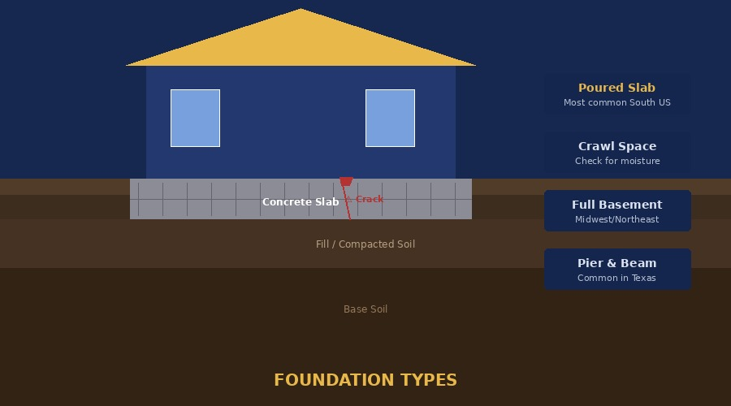
🏗️
Foundation
One of the highest-stakes items — issues here can make or break a deal.
CONVERSATION PROMPT
"Has there ever been any concern about the foundation — cracks in walls, doors that stick, or uneven floors? Sometimes those are the first signs."
Poured Concrete Slab
Crawl Space
Most common in South US. Hard to access plumbing.
Elevated, access underneath. Common Southeast. Check moisture.
⏱ 50+ yrs (if stable)
⏱ 50+ yrs
💲 Repair $3k–$25k+
💲 Encapsulation $5k–$15k
Full Basement
Pier & Beam
Midwest/Northeast. Watch for water & bowing walls.
Older style, common in Texas. Piers can settle or rot.
⏱ 50–100 yrs
⏱ 50+ yrs
💲 Waterproofing $5k–$20k
💲 Releveling $3k–$12k
SIGNS OF FOUNDATION ISSUES
· Diagonal cracks from corners of windows or doors
· Sticking doors or windows that won't close right
· Floors that feel springy, bouncy, or slope noticeably
· Visible gaps between walls and ceilings
Remote Roles · Training Material
remoteroles.online · Module 3

Slide 6
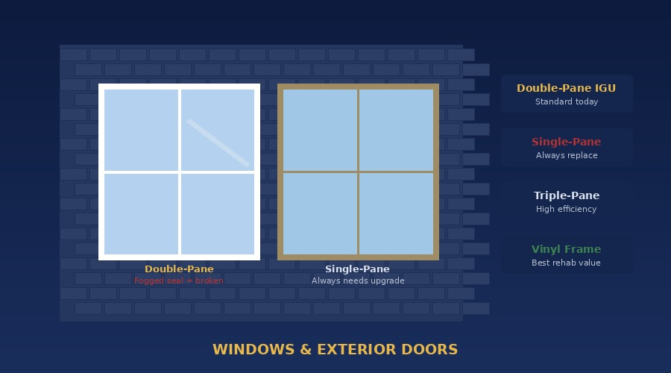
🪟
Windows & Exterior Doors
Affects energy efficiency, security, and curb appeal — can be a significant rehab line item.
CONVERSATION PROMPT
"How about the windows — are they original to the house or updated? Do they seal up well, or do you notice any drafts or fogging between the panes?"
Single-Pane
Double-Pane (IGU)
Triple-Pane
Poor insulation. Drafty. Always needs replacement.
Standard today. Fogging = broken seal.
High efficiency. Northern cold climates. Premium.
⏱ 20–30 yrs
⏱ 20–30 yrs
⏱ 25–35 yrs
💲 $4k–$15k full replace
💲 $200–$500 per window
💲 $400–$1,000/window
Vinyl Frame
Wood Frame
Aluminum Frame
Low-maintenance rehab staple. Best value.
Classic look. Prone to rot. Historic homes.
Durable but conducts cold. Common FL/AZ.
⏱ 20–40 yrs
⏱ 30+ yrs (maintained)
⏱ 20–30 yrs
💲 Most cost-effective
💲 $400–$1,200/window
💲 $300–$900/window
Single-pane · Foggy glass · Broken locks · Full home replacement = $12k–$25k
Remote Roles · Training Material
remoteroles.online · Module 3

Slide 7
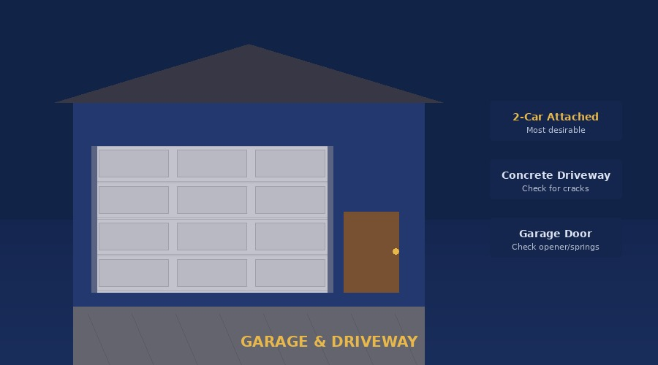
🚗
Garage & Driveway
Often overlooked but affects ARV and buyer perception significantly.
CONVERSATION PROMPT
"Does the home have a garage — attached or detached? And the driveway, concrete or asphalt? Any major cracks or anything like that?"
GARAGE — CAPTURE
DRIVEWAY — CAPTURE
· Attached, detached, or carport?
· Material: concrete, asphalt, gravel, pavers
· Number of car bays (1, 2, or 3)
· Cracks, potholes, heaving, or sinking
· Garage door — functional, automatic?
· Asphalt: when was it last sealed?
· Condition of door, springs, and opener
· Concrete: any deep cracks or root damage?
· Any water damage or cracks in slab
· Repair estimate: $500–$3k
· Finished or unfinished interior?
· Full replacement: $3k–$12k
📝 Note: 2-car attached garage adds meaningful value vs. detached or no garage.
Remote Roles · Training Material
remoteroles.online · Module 3

Slide 8
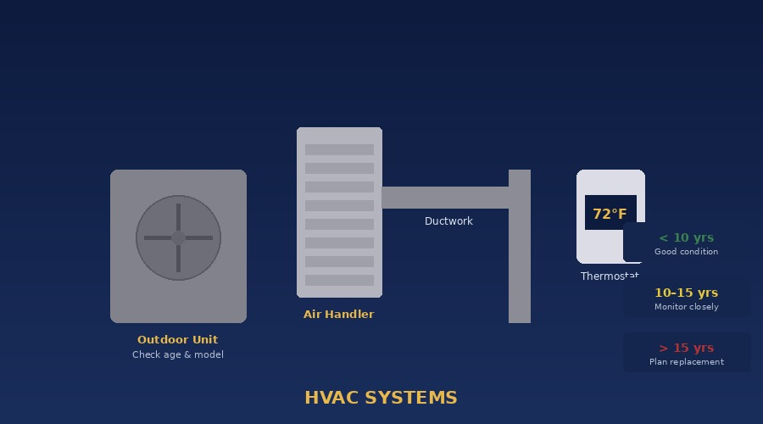
❄️
HVAC — Heating & Cooling
Mechanical system that significantly affects livability. Age and function are critical.
CONVERSATION PROMPT
"How does the house stay warm and cool — central air, window units, radiators? Do you know roughly how old the system is, and has it been giving any trouble?"
Central A/C + Furnace
Heat Pump
Most common combo. Check age of both separately.
Handles heating & cooling. Popular in mild climates.
⏱ 15–20 yrs
⏱ 15–20 yrs
💲 Replace $5k–$12k
💲 Replace $4k–$10k
Window / Mini-Split
Boiler / Radiator
Older homes without ductwork. Mini-split = modern.
Common in older Northeast. No cooling included.
⏱ 10–15 yrs
⏱ 20–30 yrs
💲 $700–$5k per unit
💲 Replace $3k–$8k
AGE GUIDE
< 10 years · Good — no action needed
10–15 years · Monitor closely
> 15 years · Budget for replacement
Remote Roles · Training Material
remoteroles.online · Module 3

Slide 9
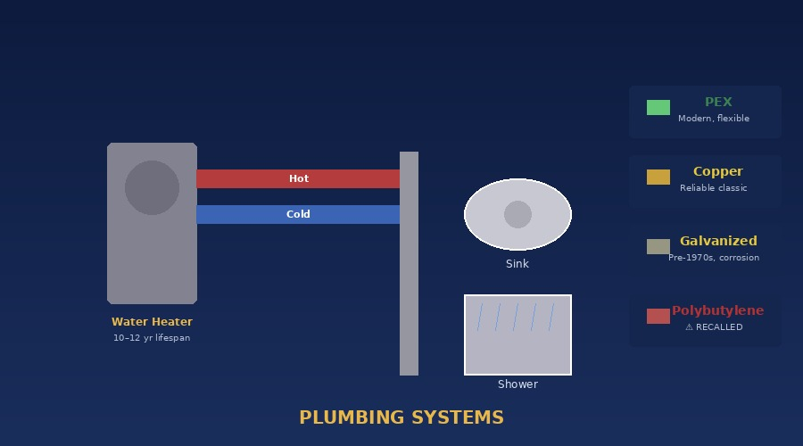
🚿
Plumbing
Pipe material and water heater age are the two most important data points.
CONVERSATION PROMPT
"Any plumbing issues — slow drains, low water pressure? Do you know what kind of pipes the house has? And when was the water heater last replaced?"
Pipe Type
Era
Concern Level
PEX (flexible)
1990s–present
✅ Low
PVC / CPVC
1970s–present
✅ Low
Copper
1960s–1990s
⚠ Low–Mid
Galvanized Steel
Pre-1970s
⚠ Medium
Cast Iron (drain)
Pre-1980s
⚠ Medium
Polybutylene (PB)
1978–1995
🚨 HIGH — Recalled
Lead Pipes
Pre-1950s
🚨 CRITICAL — Health hazard
📝 Also capture: Water heater age & type (tank vs tankless) · Sewer: public or septic
Remote Roles · Training Material
remoteroles.online · Module 3

Slide 10
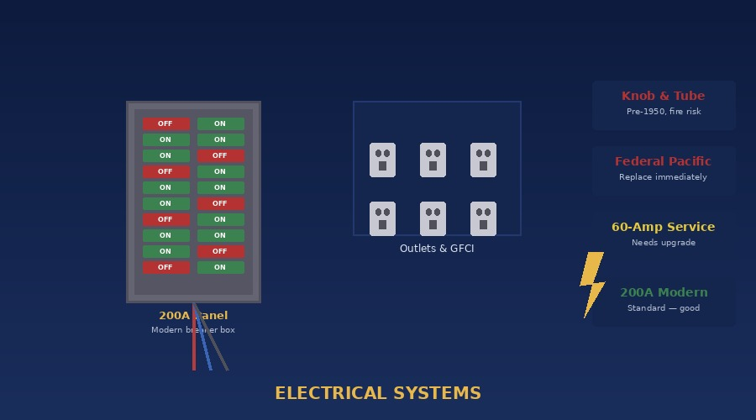
⚡
Electrical
Panel condition and wiring type are non-negotiable for any wholesale deal.
CONVERSATION PROMPT
"Do you know anything about the electrical — is it a breaker box or an older fuse box? Any circuits that trip often, or outlets that don't work?"
✅ 200A Breaker Panel
✅ 100A Breaker Panel
Modern standard — good
Older but functional
⚠ Fuse Box
🚨 Federal Pacific / Zinsco
Outdated — may need upgrade
Fire risk — replace immediately
WIRING RED FLAGS
· Knob & tube wiring (pre-1950) — major insurance flag
· Aluminum wiring (1965–1973) — fire risk at connections
· GFCI missing in kitchen or bathrooms — code violation
· Any DIY wiring — always flag for licensed inspection
Remote Roles · Training Material
remoteroles.online · Module 3

Slide 11
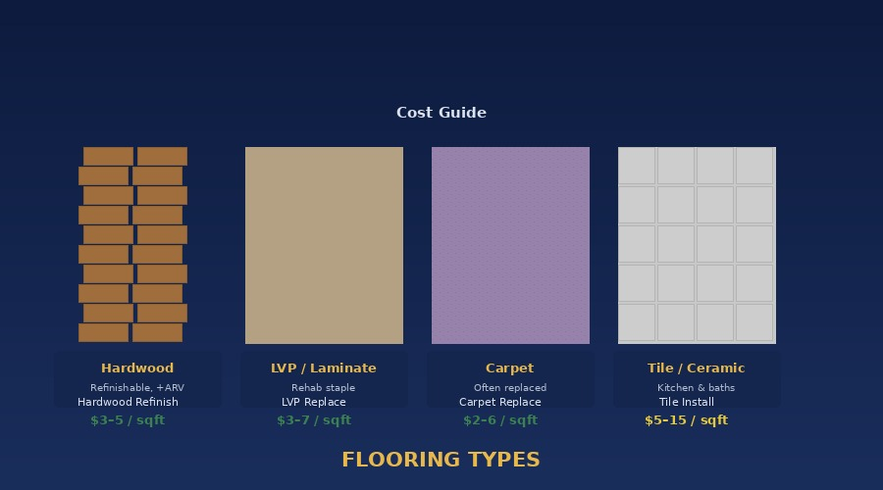
🪵
Flooring
Cosmetic but high-impact on rehab budget. Ask room by room if time allows.
CONVERSATION PROMPT
"What's the flooring like throughout the house — hardwood, carpet, tile? Is it in decent shape, or is that one of the things you know needs work?"
Hardwood
LVP / Laminate
High value. Can be refinished (adds ARV). Check for warping, pet stains.
Modern rehab staple. Waterproof (LVP). Easy install.
⏱ 50–100 yrs
⏱ 15–25 yrs
💲 Refinish $3–5/sqft
💲 Install $3–7/sqft
Carpet
Tile / Ceramic
Often replaced in rehabs. Note pet odor and heavy staining.
Durable in kitchens/baths. Cracked tiles common.
📝 Capture: Floor type per room · Any water stains, buckling, pet odor · Estimated sqft needing replacement
⏱ 5–15 yrs
⏱ 20–50 yrs
💲 Replace $2–6/sqft
💲 Install $5–15/sqft
Remote Roles · Training Material
remoteroles.online · Module 3

Slide 12
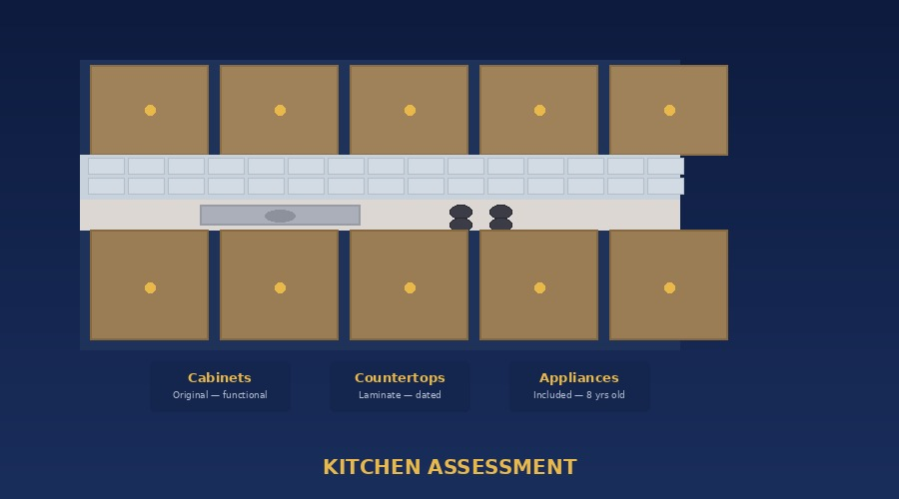
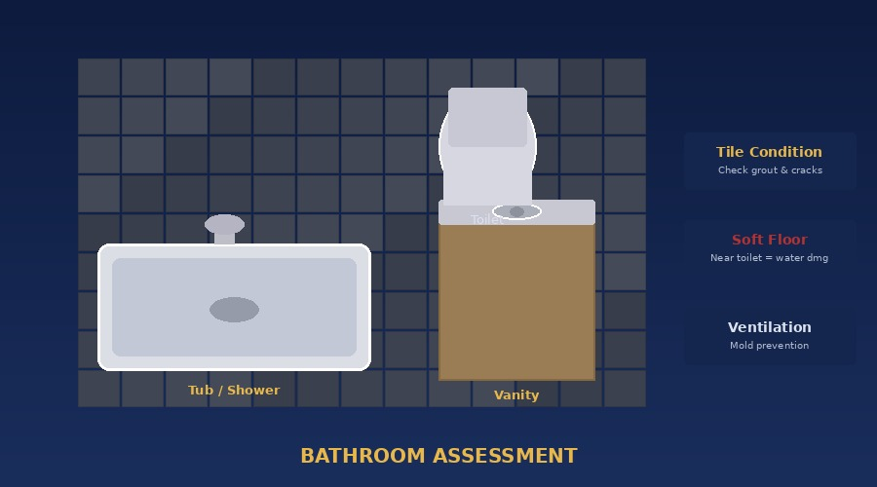
🍽️
Kitchen & Bathrooms
Highest ROI rooms in any rehab. Condition here drives both ARV and investor interest.
CONVERSATION PROMPT
"Let's talk about the kitchen — are appliances staying? What are the cabinets and countertops like? And how many bathrooms — are any updated?"
KITCHEN — WHAT TO CAPTURE
BATHROOMS — WHAT TO CAPTURE
· Cabinet condition (original, painted, or updated?)
· Count of full vs. half baths
· Countertop material (laminate, granite, quartz)
· Tub, shower, or combo — condition?
· Appliances included — age and condition
· Tile condition — cracking or missing grout?
· Any mold under sink or around dishwasher
· Soft floor near toilet = possible water damage
Kitchen
· Full kitchen reno range: $15k–$50k+
· Full bath reno range: $8k–$25k per bath
Combined kitchen + bath rehab can represent $40k–$100k+ on a full renovation.
Bathroom
Remote Roles · Training Material
remoteroles.online · Module 3

Slide 13
📊 Repair Budget Quick Reference
National average ranges for the US market. Always confirm with local contractor quotes.
Component
Cosmetic / Minor Fix
Moderate Repair
Full Replacement
Roof (Asphalt)
$500–$2,500
$3k–$6k
$8k–$18k
Siding (Vinyl)
$300–$1,500
$2k–$5k
$8k–$16k
Foundation
$500–$2k
$5k–$15k
$20k–$50k+
Windows (full home)
$500–$2k
$5k–$10k
$12k–$25k
HVAC System
$200–$1k
$2k–$5k
$6k–$15k
Plumbing (repiping)
$200–$1,500
$3k–$8k
$8k–$20k
Electrical Panel
$200–$800
$2k–$4k
$4k–$10k
Flooring (1,500 sqft)
$1k–$3k
$4k–$8k
$10k–$20k
Kitchen Remodel
$2k–$6k
$10k–$20k
$25k–$60k
Bathroom Remodel (each)
$1k–$3k
$5k–$10k
$12k–$30k
Remote Roles · Training Material
remoteroles.online · Module 3 · Property Condition Assessment Guide

Slide 14
✅ Pre-Call Checklist
Run through this before every property condition call.
CRM open
Zillow / Google Maps
☐
☐
Property address and seller name pulled up before dialing.
Property opened visually — confirm beds, baths, sqft, and year built.
Note-taking template
Repair estimate sheet
☐
☐
Exterior sections ready first: roof, siding, foundation, windows, garage.
Open and ready to fill in dollar amounts as you gather info.
Introduction script
Timer visible
☐
☐
Lead with rapport — not a questionnaire. Build trust before the list.
Aim to complete the full walkthrough in 12–18 minutes.
Follow-up email ready
☐
Post-call summary template open to send immediately after the call.
Remote Roles · Training Material
remoteroles.online · Remote Roles Inc · Property Condition Assessment · Module 3

