Slide 1





Remote Roles Inc
COLD CALLING TRACK · WEEKLY TRAINING
The Art of
Cold Calling
Core skills & practical execution — from the first “hello” to a confident next step.
Remote Roles Training
Notes:
Welcome everyone. Today is all about cold calling — the skill behind almost every outbound role we place people into. We'll cover what a cold call really is, how you sound, how you connect, how you lead the call with a script, and then on Day 2 we move into role play with ChatGPT.

Slide 2





Today's roadmap
WHAT WE'LL COVER
01
02
03
04
05
Foundations
How you sound
How you connect
How you lead
Role play lab
What cold calling really is and its six core pillars
Tonality, energy and confidence on the phone
Active listening, empathy and rapport
Script navigation, openings and objections
Practising with ChatGPT and getting feedback
Day 2
Notes:
Here's the road for today. Foundations first, then how you sound, how you connect and how you lead the call. The role play lab with ChatGPT is our Day 2 session.

Slide 3
01 · FOUNDATIONS
What cold calling really is
Your only job in the first moments: earn the next 30 seconds.
Notes:
Before tactics, let's agree on what a cold call actually is — because most people get this wrong, and it shows in how they sound.

Slide 4




What cold calling really is
01 · FOUNDATIONS
A conversation — not a performance
A permission-based interaction — not a demand
A discovery call — not a sales pitch
YOUR GOAL
Earn the next 30 seconds — not close immediately.
Notes:
A cold call is a conversation, not a performance. It's permission-based — you ask, you don't demand. And it's a discovery call, not a pitch. Your goal is never to close in the first minute. Your goal is to earn the next 30 seconds, then the next.

Slide 5



The six core pillars of cold calling
01 · FOUNDATIONS
01
02
03
Tonality & energy
Active listening
Empathy
How you sound decides whether they keep listening.
Hear what they mean, not just what they say.
Acknowledge their reality before you ask for anything.
04
05
06
Rapport building
Objection handling
Script navigation
Make them feel safe and understood, not sold to.
Treat every objection as a request for clarity.
Flexible, not robotic — a map, not a cage.
Notes:
These six pillars are what we'll build today: tonality and energy, active listening, empathy, rapport building, objection handling, and script navigation — flexible, never robotic. Every great call you'll hear uses all six.

Slide 6
02 · HOW YOU SOUND
Tonality, energy & confidence
How you sound matters more than what you say.
Notes:
Now the part prospects judge first: your voice. Before they process a single word, they've already decided how they feel about you.

Slide 7





Key elements of tonality
TONALITY
How you sound matters
more than what you say.
Pace
Pitch
Calm, unhurried, intentional.
Natural and warm — avoid sounding rehearsed.
Volume
Smile in your voice
Confident, not overpowering.
People can hear it.
Notes:
Four elements of tonality. Pace: calm, unhurried, intentional. Pitch: natural and warm — the moment you sound rehearsed, they stop trusting you. Volume: confident, not overpowering. And smile while you talk — people genuinely hear it.

Slide 8



What good tonality sounds like
TONALITY
Curious
Confident
Relaxed
not desperate
not aggressive
not rushed
Prospects hear your tone before they hear your words.
Notes:
Good tonality is curious, not desperate. Confident, not aggressive. Relaxed, not rushed. Read each pair out loud both ways so the room can hear the difference.

Slide 9


Energy & confidence on calls
ENERGY & CONFIDENCE
Energy
Energy is emotional clarity, not loudness.
Match the prospect's energy, then gently lead it upward.
Confidence
Comes from clarity, not arrogance.
CONFIDENCE SOUNDS LIKE
“I'll be brief.”
“If this isn't relevant, we can hang up.”
“Does that make sense so far?”
Notes:
Energy isn't volume — it's emotional clarity. Meet the prospect where they are, then lift them gently. Confidence comes from clarity, not arrogance. Notice how confident the three lines are: they give the prospect control, which is exactly why they work.

Slide 10





Listen to live recordings
HANDS-ON PRACTICE
Play live recordings to hear tonality, energy and empathy in action — all of which sit at the core of cold calling.
LISTEN FOR
Tonality
Energy
Empathy
Active listening
Notes:
Play two or three real call recordings. After each one, ask the room: what did you notice about the tonality? The energy? Where did you hear empathy? Pause recordings at key moments to discuss.

Slide 11

03 · HOW YOU CONNECT
Listening, empathy & rapport
This is where sales actually happen.
Notes:
Sounding good gets you heard. Listening, empathy and rapport are what get the prospect to open up — and that's where sales happen.

Slide 12




What active listening means
ACTIVE LISTENING · WHERE SALES HAPPEN
Listen to understand,
not to reply.
PICK UP ON
Tone changes
Hesitation
Frustration
Interest cues
Notes:
Active listening is listening to understand, not to reply. Train your ear for four signals: a change in tone, hesitation, frustration, and interest cues. Each one tells you what to ask next.

Slide 13

Active listening phrases
ACTIVE LISTENING
“That makes sense.”
“I hear you.”
“So what you're saying is…”
“Can you tell me a bit more about that?”
Notes:
Four phrases that show the prospect you're actually listening. Have the room say each one out loud — they should sound natural, not scripted.

Slide 14



Correct response vs. reactive response
ACTIVE LISTENING
REACTIVE RESPONSE
AVOID
CORRECT RESPONSE
USE
“No, that's not what I meant.”
“That's a fair point.”
“Actually, you're wrong.”
“I understand why you'd feel that way.”
“You're not alone in that.”
Correct responses validate first, explain second.
Notes:
Reactive responses make the prospect defensive — you've turned the call into an argument. Correct responses validate first and explain second. Practise swapping each reactive line for a correct one.

Slide 15


Empathy in cold calling
EMPATHY
Empathy is acknowledging
the prospect's reality.
EXAMPLES
“I imagine you get calls like this often.”
“This might not be a priority right now.”
“I'll keep this short and respectful of your time.”
Empathy lowers defenses and builds trust.
Notes:
Empathy is simply acknowledging the prospect's reality: they're busy, they get these calls, this might not be a priority. Saying it out loud lowers their defenses and builds trust faster than any pitch.

Slide 16


Rapport building
RAPPORT · WITHOUT SMALL-TALK OVERLOAD
WHAT RAPPORT IS
HOW RAPPORT IS BUILT
Feeling safe,
not entertained
1
Using their name naturally
2
Mirroring language and pace
Feeling understood,
not sold to
3
Commenting on context, not personal life
EXAMPLE
“Sounds like your team is stretched thin right now.”
Notes:
Rapport isn't about being entertaining or small talk. It's about the prospect feeling safe and understood. Use their name naturally, mirror their language and pace, and comment on their context — their business, their situation — not their personal life.

Slide 17




Go over rapport-building topics
HANDS-ON PRACTICE
Work through rapport-building topics together — and keep every one tied to the prospect's context.
KEEP IT ABOUT
Their name
Their language & pace
Their context — not their personal life
Notes:
Go over rapport-building topics as a group. For each topic, ask: does this connect to the prospect's context, or is it drifting into personal small talk?

Slide 18
04 · HOW YOU LEAD
Scripts, openings & objections
A script is a map — not the journey.
Notes:
You now know how to sound and how to connect. Next: how to lead the call with a script, open with confidence, and handle objections.

Slide 19
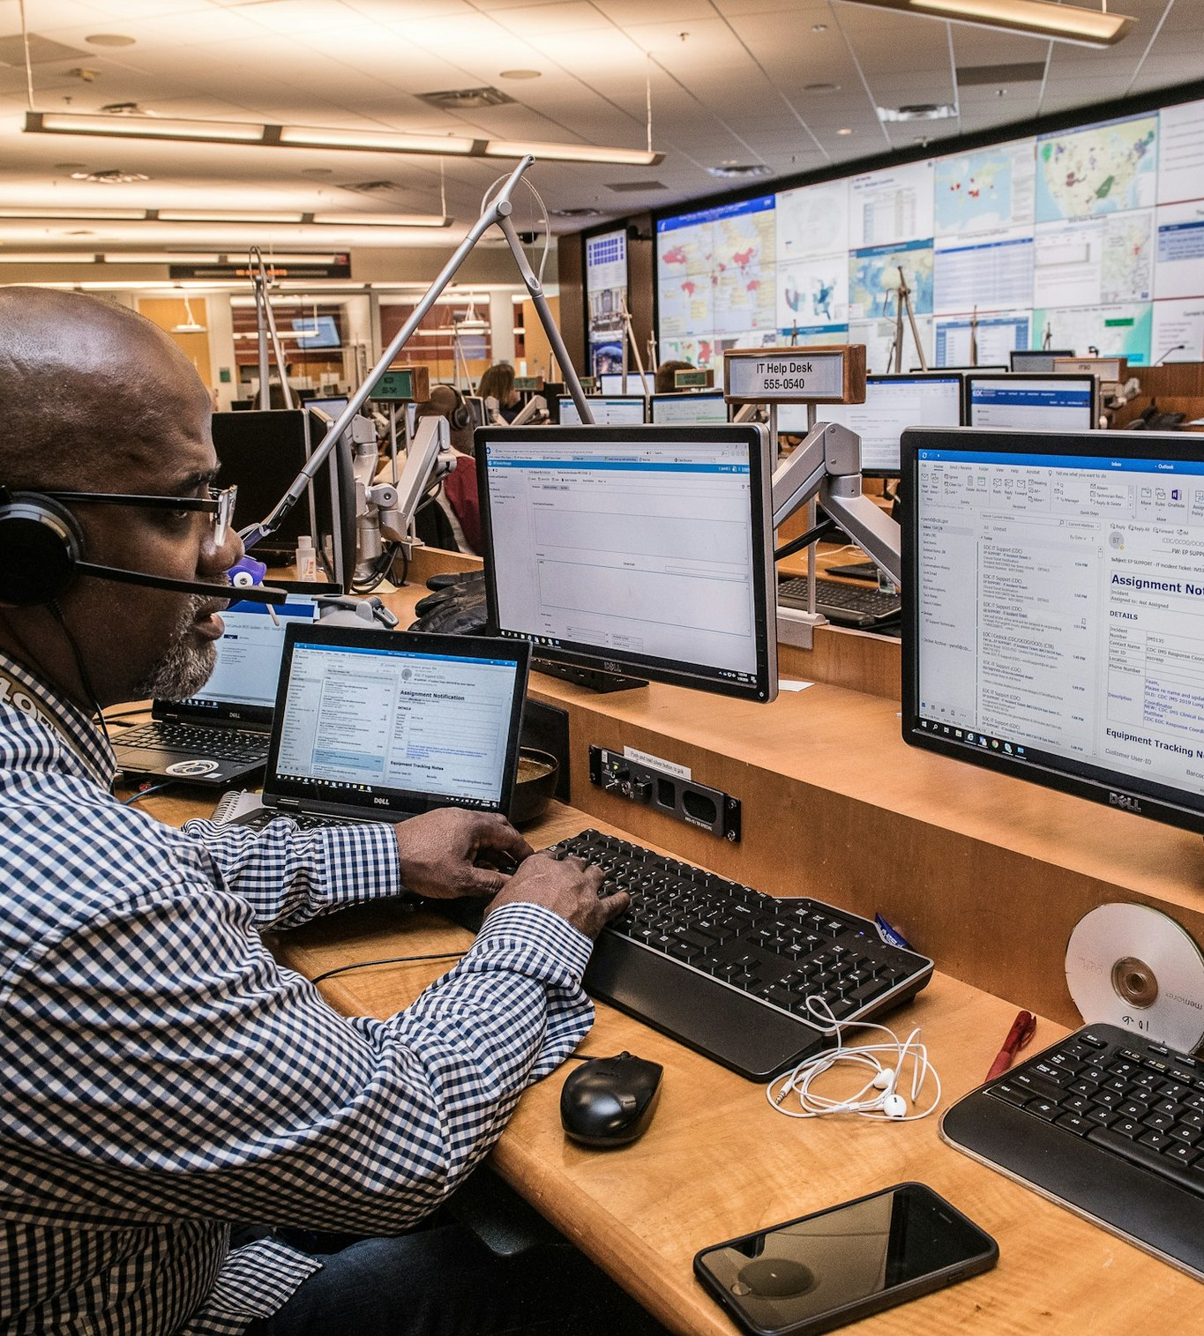


What a script is — and isn't
SCRIPT NAVIGATION · THIS IS CRITICAL
WHAT A SCRIPT IS NOT
Something to read word-for-word
Something to cling to when you're nervous
WHAT A SCRIPT IS
A map, not the journey
A structure to return to after interruptions
Notes:
This is critical. A script is not something to read word for word, and it's not a safety blanket. It's a map — it shows you where you're going, and gives you a structure to come back to every time the prospect takes you off course.

Slide 20

How to navigate a script confidently
SCRIPT NAVIGATION
1 KNOW THE INTENTION, NOT JUST THE WORDS
2 IF YOU'RE INTERRUPTED
Opening
=
Permission + Context
Acknowledge
Respond
Return
Middle
=
Discovery + Value
EXAMPLE
“That's fair. Just to finish the thought…”
Close
=
Next Step
Notes:
Know the intention behind each part of the script. The opening earns permission and gives context. The middle is discovery and value. The close is always a clear next step. When you get interrupted: acknowledge, respond, then return to where you were.

Slide 21
Cold call opening structure
COLD CALL OPENING · CORE
Open with confidence
and respect.
01
Greeting + name
“Hi Sarah, this is ___ calling.”
02
Permission
“Do you have 30 seconds…”
“Hi Sarah, this is ___ calling. I know I caught you out of the blue — do you have 30 seconds, or should I call back?”
03
Reason for the call
One clear sentence on why you're calling.
04
Soft exit
“…or should I call back?”
This immediately establishes confidence and respect.
Notes:
The core opening has four parts: greeting and name, permission, the reason for the call, and a soft exit. The soft exit — 'or should I call back?' — sounds risky, but it's what makes the prospect relax. It shows confidence and respect in one line.

Slide 22
Objection handling: core principle
OBJECTION HANDLING
Objections are requests for clarity, not rejection.
PROSPECT
WRONG
CORRECT
“I'm not interested.”
“But let me just explain…”
“That's fair. Before I let you go, can I ask — is it timing, or relevance?”
PROSPECT
WRONG
CORRECT
“Send an email.”
“Okay.”
“Happy to. So I don't send something irrelevant, what should I focus on?”
Notes:
Objections aren't rejection — they're the prospect asking for clarity. Pair up: one person reads the objection, the other gives the correct response. Then swap. Notice how both correct answers end with a question that keeps the conversation going.

Slide 23
Q & A
Questions &
discussion
Ask all your questions freely!
Notes:
Open the floor. A good warm-up question: which part of the call are you most nervous about right now — the opening, or the objections?

Slide 24
05 · ROLE PLAY LAB · DAY 2
Using ChatGPT for role play
Unlimited reps. Zero judgment. Instant feedback.
Notes:
Day 2 is all about reps. We'll use ChatGPT as a practice prospect so you can rehearse as many calls as you need before the real thing.

Slide 25



Why ChatGPT for role play
ROLE PLAY LAB · DAY 2
Unlimited practice
No judgment
Run as many calls as you need, any time.
Make mistakes in private and go again.
Adjustable difficulty
Immediate feedback
Turn the prospect from friendly to tough.
Get notes on your call the moment it ends.
Notes:
Why ChatGPT? Unlimited practice, no judgment, adjustable difficulty, and immediate feedback. It's a practice partner that never gets tired of hearing your opening.

Slide 26




Your core role play prompt
ROLE PLAY PROMPT · CORE
HOW TO USE IT
COPY & PASTE INTO CHATGPT
Attach your script
You are a skeptical customer. I will act as a cold caller calling you for the first time. I have also attached my cold calling script above.
I will go ahead and read my cold calling script. Your job is to respond naturally and raise objections such as “too expensive”, “I am not interested”, “Is this a scam?”, “Why are you calling me?” and “How did you get my number?”
Keep the conversation realistic and object at least two times. Give it your best shot — and if I am able to convince you, proceed with the call and sign up with me.
Upload or paste your cold calling script first.
Paste the prompt
Copy the prompt exactly as written.
Run the call
Read your script and handle every objection.
Notes:
This is the core prompt. Attach your script, paste this in, then read your script as if it's a live call. ChatGPT will play a skeptical prospect and object at least twice. If you handle the objections well, it will let you 'sign them up'.

Slide 27

Set up ChatGPT for role play
HANDS-ON PRACTICE
Get every team member set up, then walk through the role play process together.
01
Download ChatGPT
Every team member installs it on their phone or laptop.
02
Walk through it together
Step through the role play process as a group.
03
Run the first call
Attach your script, paste the core prompt and start.
Notes:
Make sure everyone has ChatGPT downloaded before moving on. Share your screen and walk through one full role play: attach the script, paste the prompt, run the call, then ask for feedback.

Slide 28




The correct way to interact during role play
ROLE PLAY · HOW TO PRACTISE
01
02
03
04
Don't restart
Recover naturally
Practise pauses
Acknowledge first
When you mess up, keep going. Real calls have no do-overs.
Acknowledge the slip and carry on, like on a live line.
Let silence work for you after you ask a question.
Acknowledge what they said before you respond.
Treat every role play like a real call.
Notes:
How you practise is how you'll perform. Don't restart when you mess up — recover naturally. Practise pauses, and always acknowledge before you respond.

Slide 29
Two prompts for honest feedback
ROLE PLAY FEEDBACK
PROMPT 1 · FEEDBACK
PROMPT 2 · SCORECARD
“After the role play, give feedback on my:”
“Score my performance from 1–10 in:”
Tonality
Confidence
Opening
Rapport
Active listening
Objection handling
Listening
Energy
Script navigation
Objection handling
BEST FOR
THEN TELL ME
Quick notes after every practice call.
What to improve · What to keep · One sentence I could say better
Notes:
After every role play, use one of these two prompts. Prompt 1 gives quick feedback across the five skills. Prompt 2 scores you from 1 to 10 and tells you what to improve, what to keep, and one sentence you could say better. Use Prompt 2 on the calls you plan to submit.

Slide 30

Your Day 2 assignment
ASSIGNMENT · DAY 2
01
Record 2–3 role play calls
Run full calls from opening to next step.
02
Use the provided ChatGPT prompt
Attach your script and paste the core prompt.
03
Focus on three things
Calm energy · Listening over talking · Script flexibility
04
Submit recordings for review
Send them in so we can give you feedback.
Notes:
Your assignment: record two to three role play calls using the ChatGPT prompt. Focus on calm energy, listening more than you talk, and using your script flexibly. Submit the recordings for review.

Slide 31
Remote Roles Inc
Thank you.
Now pick up the phone — and earn the next 30 seconds.
remoteroles.online · careers@remoteroles.online
Notes:
Thank everyone. Remind them the role play recordings are due, and that every rep they do on ChatGPT makes the first real call easier.

