Slide 1
Comparative deep learning models for the automated classification of client onboarding document images
R. Hlumbene · C. Sibanda
Student numbers: 42452422 · 56543115
ITRI626 practical project · Group 2
North-West University · 2026
Notes:
Good day everyone. We are Group 2, and our project compares deep learning models for classifying the document images that clients submit when they open an account. Over the next few minutes we will walk you through the problem we set out to solve, how we prepared the data, how we trained three different families of model and why we made the choices we did, and finally which model we would put into production and why.

Slide 2
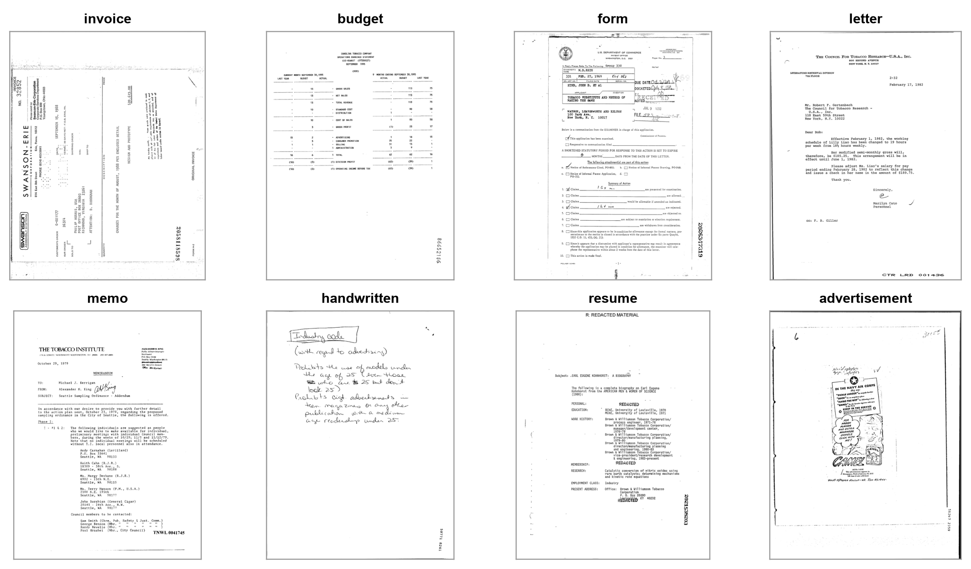
Sorting onboarding pages by how they look
Clients upload scanned or photographed pages, and every page has to be sorted before any checks can start
We assign each page to one of eight document types from its visual appearance alone, with no text recognition
Confident predictions are routed automatically; uncertain pages are flagged for human review
Two deliberate look-alike pairs: invoice ↔ budget and letter ↔ memo
Advertisement stands in for the irrelevant upload a real queue must reject
One page from each class · RVL-CDIP (Harley, Ufkes & Derpanis, 2015)
Notes:
Think about what happens when a new client opens an account. They upload a stack of pages: invoices, letters, forms, sometimes a handwritten note, and occasionally something completely irrelevant. Before anyone can verify anything, someone has to sort those pages. Our goal was to automate that first step. The model looks only at the image of the page, without reading any text, and decides which of eight document types it is. If it is confident, the page is routed automatically; if not, a person reviews it. We chose the classes on purpose: invoice and budget look very similar, and so do letter and memo, so the task is genuinely hard. Advertisement plays the role of the page that should not be there at all. All pages come from the public RVL-CDIP dataset, which you can see examples of on the right.

Slide 3
A clean dataset with no leakage between splits
16,000
20,134
0
300
pages · 8 classes × 2,000
near-duplicate pages removed by perceptual hashing
source documents shared between training and test
test pages per class, never seen until the final evaluation
Grouped by source document: every page of a document lands in the same split
Stratified by class: exactly 300 test pages per class, so accuracy is not skewed
Checked every time: an overlap check runs before each evaluation, and a unit test proves it rejects a leaky split
Frozen: split files are committed with seed 626, so every model sees identical pages
Notes:
A model's score only means something if the test pages are truly new to it, so we spent real effort on the data. We took eight of RVL-CDIP's sixteen classes and capped each at two thousand pages, giving sixteen thousand in total. Along the way, perceptual hashing found and removed just over twenty thousand near-duplicate pages. The most important decision was how to split: pages from the same source document always stay together, so the model can never see one page of a document in training and a sibling page in the test. That gives seventy percent for training, fifteen for choosing the best checkpoint, and fifteen held out until the very end, with exactly three hundred test pages per class. An overlap check runs before every evaluation, and the split files are committed, so all three models were trained and tested on exactly the same pages.

Slide 4
Three model families, one shared training recipe
1
Baseline CNN
2
ResNet50
3
ViT-B/16
Trained from scratch
ImageNet-pretrained CNN
Pretrained vision transformer
4 convolutional blocks · 1.2 M parameters · learning rate 1e-3
23.5 M parameters · stem to layer2 frozen · learning rate 3e-4
85.8 M parameters · learning rate 3e-5 · weight decay 0.05 · mixed precision
Why: Our reference point: how far can a small network get with no prior knowledge?
Why: The standard transfer-learning workhorse: strong features at modest cost
Why: Self-attention can relate distant parts of a page, such as a header and a table
Shared by all three
224-pixel input · AdamW with cosine learning-rate schedule · class-weighted loss · early stopping on validation macro-F1 · light augmentation (±5° rotation, brightness and contrast, blur, 85–100% crops) · one seed (626) for everything
Notes:
We compared three families of model, each chosen to answer a question. The baseline is a small four-block CNN trained from scratch. It tells us how far you get with no prior knowledge, so we can measure what pretraining actually buys. ResNet50 is the classic transfer-learning network: it starts from ImageNet weights, we froze its early layers, which already detect generic edges and textures, and fine-tuned the rest. ViT-B/16 is a vision transformer; self-attention lets it relate distant parts of a page, like a header and a table, which we expected to help on the look-alike classes. Pretrained models get much smaller learning rates so they adjust their knowledge rather than overwrite it. Everything else was kept the same for all three: the same input size, optimiser, schedule and augmentation. Augmentation is deliberately light, small rotations and lighting changes, because real scans are slightly skewed but never upside down. And we always kept the checkpoint with the best validation macro-F1, never the test score.

Slide 5
Six evaluated training runs and what each taught us
Run | Epochs | Wall-clock | What we learned
Baseline v1 | 25 | 2 h 13 m | First full run on a CPU desktop, batch 8
Baseline v2 | 12 | 1 h 02 m | Warm start + gentler augmentation: +0.005
Baseline v4 | 25 | 39 m | Re-run on the T4 so all families share one setup
Swin-T | 15 | not logged | 3× smaller transformer, 0.023 behind ViT
ResNet50 | 20 | 35 m 39 s | Best at epoch 18
ViT-B/16 | 15 | 49 m 25 s | Best at epoch 14
Hardware lesson: a one-epoch benchmark showed the laptop CPU was ~9× slower than the desktop, so the pretrained models were trained on a Colab Tesla T4 GPU.
Notes:
We did not get here in one go. The baseline alone was trained three times. The first run, on a CPU desktop, took over two hours and reached 0.827 macro-F1. For the second run we warm-started from the best first-run weights, padded pages to keep their proportions, and softened the augmentation; that added about half a point. We then timed a single epoch on a laptop and found it roughly nine times slower than the desktop, which told us the large pretrained models had to go on a GPU. So we moved to a Tesla T4 on Colab and retrained the baseline there as version four, so that all three families share the same hardware and batch size and the comparison is fair. Version four is the baseline you will see in the results. We also tried Swin-T, a smaller transformer; it was good but stayed about two points behind ViT, so ViT remained our transformer entry. The pattern is clear: every pretrained run beats every from-scratch run.

Slide 6
Pretraining gives a head start from epoch one
0.78
macro-F1 after one epoch for both pretrained models, against 0.48 for the scratch CNN
0.007
final ViT training loss, while validation loss levelled near 0.58: the training set was memorised
Still rising
validation F1 kept improving anyway, so we kept the best-validation checkpoint (ViT epoch 14, ResNet epoch 18)
Notes:
This chart shows how each model learned, measured on the validation pages after every epoch. The difference at the start is striking: after a single epoch both pretrained models are already near 0.78, while the scratch network is below 0.5 and needs more than twenty epochs to climb past 0.82. Its curve is also much bumpier, because it is learning what a document looks like from nothing. The pretrained models did overfit: ViT's training loss fell almost to zero while its validation loss flattened. But validation F1 kept improving, so the memorisation did not stop it generalising. That is exactly why we select the checkpoint on validation macro-F1 and use early stopping, rather than simply taking the last epoch.

Slide 7
Results on 2,400 unseen test pages
ViT-B/16
88.29%
accuracy · macro-F1 0.883
ResNet50
87.42%
accuracy · macro-F1 0.874
Baseline CNN
83.13%
accuracy · macro-F1 0.831
Pretraining adds about 0.05 macro-F1, almost all of it on the business documents: invoice +0.106, budget +0.087, form +0.078 (baseline → ViT).
Notes:
Here are the final scores, each measured once on the twenty-four hundred held-out pages. ViT-B/16 is the most accurate at 88.3 percent, ResNet50 is less than a point behind at 87.4, and the scratch baseline reaches 83.1. The per-class chart tells the more interesting story. On the easy, distinctive classes on the right, resume, advertisement and handwritten, all three models are within about three points of each other; even the small network handles them well. The gap opens on the left, on form, budget and invoice. These are the tabular business documents, and that is where pretraining earns its keep: invoice improves by more than ten points from the baseline to ViT. It is also worth noticing that the two pretrained models split the wins four classes each: ViT takes form, budget, invoice and resume, and ResNet50 takes letter, memo, handwritten and advertisement.

Slide 8
Where the models still get confused
405
302
281
Baseline CNN
ResNet50
ViT-B/16
misclassified pages out of 2,400
Tables look alike. At 224 pixels, invoice, budget and form are all grids of numbers and lines
Letters vs memos differ mainly in the header block
So: low-confidence pages in these classes are the ones to send for human review
Notes:
No model is perfect, so we looked at where the mistakes actually happen. Out of twenty-four hundred test pages the baseline gets 405 wrong, ResNet50 302 and ViT 281, and the errors are not random. Most of them fall within the triangle of invoice, form and budget. Shrunk to 224 pixels, all three are essentially grids of numbers and ruled lines, and even a person would have to look closely. The second cluster is letter versus memo, which differ mostly in the header at the top of the page. Pretraining roughly halves several of these confusions, but it does not remove them. For the real system this tells us exactly where the human-review step belongs: uncertain pages in these classes should go to a person rather than being routed automatically.

Slide 9
Our choice for the intake queue: ResNet50
−0.009
4.1× faster
macro-F1 behind ViT-B/16 (0.874 vs 0.883)
3.26 ms per page against 13.37 ms
3.6× smaller
4 of 8
90 MB and 23.5 M parameters against 327 MB and 85.8 M
classes won outright: letter, memo, handwritten, advertisement
When would we pick ViT-B/16 instead? Where every extra point on invoice, budget and form matters more than throughput and model size.
Notes:
So which model would we actually deploy? On accuracy alone ViT-B/16 wins, but only by 0.009 macro-F1, less than one percentage point. To get that, it takes four times longer per page and is almost four times bigger. An onboarding intake queue is measured in pages per second and has to run on ordinary infrastructure, so ResNet50 gives us nearly all of the accuracy at a fraction of the cost. It also wins four of the eight classes outright. In the chart, the best place to be is the top-left corner, high accuracy at low cost, and ResNet50 sits closest to it. That is why ResNet50 is our recommendation. ViT is still a defensible choice for a setting where accuracy on the business documents is worth more than speed and size, and the difference between them is small enough that the deployment constraint should decide.

Slide 10
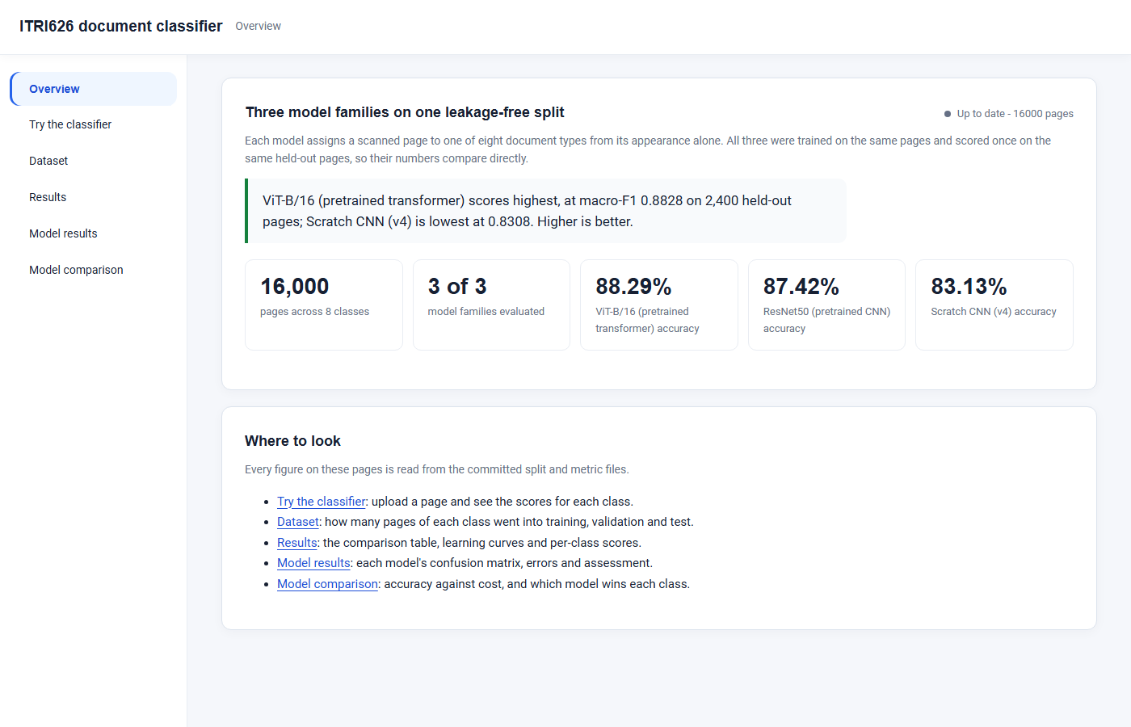
What we take away from this project
1
Pretraining matters most where pages look alike
+0.05 macro-F1 overall, +0.08 to +0.11 on invoice, budget and form
2
ResNet50 balances accuracy and cost
Within 0.009 of the best model at a quarter of the inference time
3
The numbers are trustworthy
Grouped split, overlap check before every evaluation, 122 unit tests
Our dashboard shows every result and classifies an uploaded page live
4
Limits and next steps
1,400 training pages per class; archive scans, not real onboarding uploads. Next: more data, a confidence threshold for review, and testing on real client pages
Thank you · Questions welcome
Notes:
To bring it together. First, pretraining clearly pays off, and it pays off most exactly where the task is hardest, on the business documents that look alike. Second, the most accurate model is not automatically the right one; for an intake queue, ResNet50 gives the best balance. Third, we can stand behind these numbers: the split is grouped by source document, the overlap check runs before every evaluation, and the metrics are unit-tested. We are also honest about the limits. Each class had only fourteen hundred training pages, and these are archive scans rather than real onboarding uploads, so the next steps are more data, a confidence threshold that sends uncertain pages to a person, and testing on real client documents. Everything we showed today is also in our dashboard, which can classify a page live. Thank you, and we are happy to take your questions.

