Slide 1
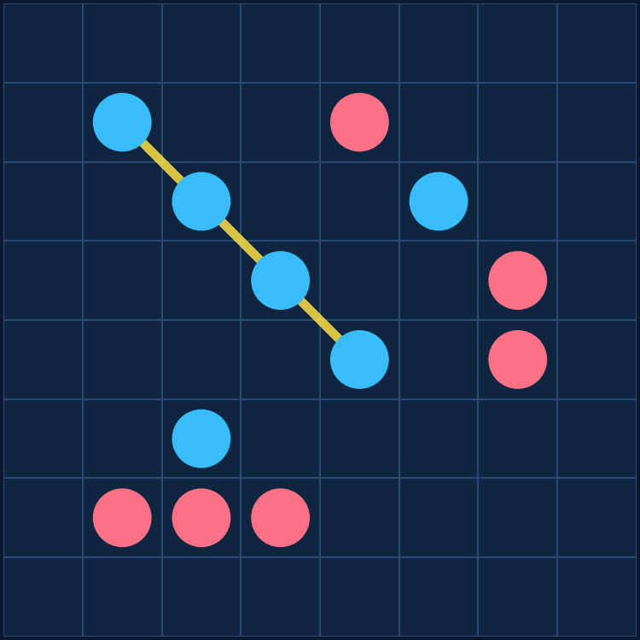
ORIGINAL GAME · SELF-PLAY REINFORCEMENT LEARNING
C_lines
Teaching an agent an original board game — and proving it improves with experience
Colile Sibanda
North-West University · ITRI 616 — Artificial Intelligence 1
8×8 board · points-until-full · run_pts_002 (10,000 self-play games)

Slide 2
PROBLEM DEFINITION
The game: C_lines on an 8×8 board
Open placement Players alternate, placing one stone on ANY empty cell — no gravity, no column rule.
1
Board fills Play continues until all 64 cells are filled.
2
Line scoring Score for straight runs (any direction) of length 3–8; longer lines worth far more (3→0.25 … 8→5.0).
3
Win condition Highest total score when the board fills wins; a tie-break removes draws.
4
Why it's hard 64 opening moves; must build your lines AND block the opponent over a 64-move horizon.
5
Yellow = a scoring line of four
C_lines · ITRI 616 · Colile Sibanda
2

Slide 3
TASK · EXPERIENCE · PERFORMANCE
The learning problem — TEP framework
Task
Experience
Performance
T
E
P
Choose the placement that maximises the final score margin (own − opponent). Category: sequential DECISION-MAKING / CONTROL — not classification, not prediction.
Self-generated games: a short warm-up vs Random & Heuristic, then SELF-PLAY against frozen past versions. As the agent improves, so do its opponents — an automatic curriculum.
Four metrics, every 100 games: win rate vs Random, vs Heuristic, an Elo rating, and win rate vs a 4-ply Alpha-Beta search.
Goal of the assignment: demonstrate that performance improves with experience.
C_lines · ITRI 616 · Colile Sibanda
3

Slide 4
TECHNICAL UNDERSTANDING
The algorithm: a self-play Deep Q-Network
10-channel
board state
→
Residual CNN
(4 blocks, 64ch)
→
Q-value
per cell
→
ε-greedy
move
learning loop: transitions stored in a replay buffer feed gradient updates
Why DQN?
Reward design
Sequential control with delayed reward
A move's value only emerges when the board fills
Q-learning's TD target is built for this credit assignment
No labelled 'correct' moves exist for an original game
Dense delta-score shaping: change in (own − opponent) score each move
Plus a terminal ±1 for win / loss
Perfectly aligned with the objective — every step points to the same goal as the outcome
C_lines · ITRI 616 · Colile Sibanda
4

Slide 5
TECHNICAL UNDERSTANDING
Three implementation choices that made it work
Negamax value target
The next position is the OPPONENT's, so the bootstrap is subtracted, not added: target = r − γ·max Q(s′). The single most important correctness detail.
Double DQN + Huber loss
Online net selects the action, target net evaluates it — cutting overestimation. Huber loss keeps updates stable against large TD errors.
D4 symmetry augmentation
Every board is also 7 rotations/reflections — multiplying training data eightfold for free.
Plus: target-network sync, gradient clipping, plateau LR decay, and snapshotting every 1,000 games into 10 playable difficulty levels.
C_lines · ITRI 616 · Colile Sibanda
5

Slide 6
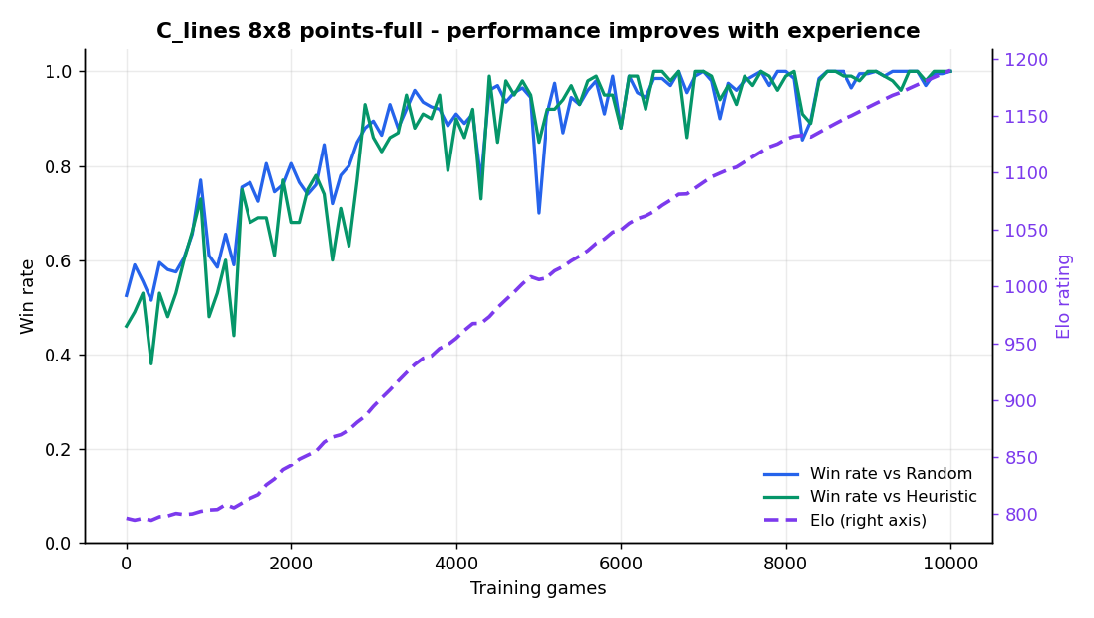
RESULTS & ANALYSIS
Result: performance improves with experience
796 → 1190
Elo (monotone, +394)
53% → 100%
Win rate vs Random
46% → 100%
Win rate vs Heuristic
C_lines · ITRI 616 · Colile Sibanda
6

Slide 7
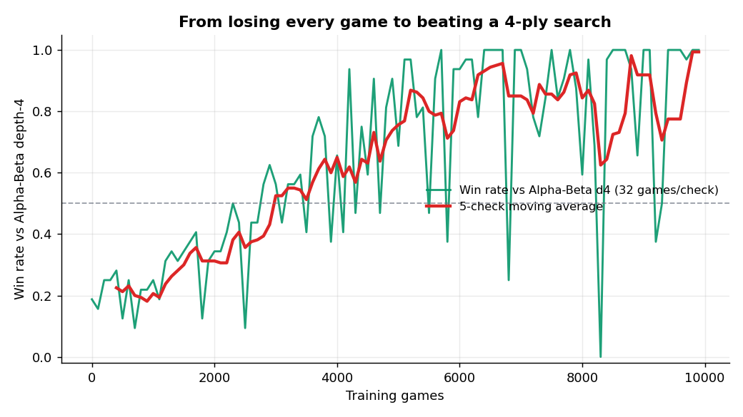
RESULTS & ANALYSIS
The decisive test: beating a 4-ply search
vs Alpha-Beta
depth-4
an opponent the agent NEVER trains against
19% → 100%
win rate
−0.83 → +1.17
score margin (sign flips)
C_lines · ITRI 616 · Colile Sibanda
7

Slide 8
RESULTS & ANALYSIS
Every difficulty level is a stage of learning
Checkpoint | Games | Elo | WR vs Random | WR vs Heuristic
Start | 0 | 796 | 53% | 46%
gen_002 | 2,000 | 842 | 81% | 68%
gen_004 | 4,000 | 954 | 91% | 90%
gen_007 | 7,000 | 1,092 | 100% | 100%
gen_010 (final) | 10,000 | 1,190 | 100% | 100%
The registry assigns each snapshot's difficulty from its measured Elo — so a 'harder' level is literally a later stage of learning.
C_lines · ITRI 616 · Colile Sibanda
8

Slide 9
CRITICAL THINKING
Critical analysis
Was it well-posed?
Did it improve?
Yes — by design. The reward (score margin) IS the win condition, so there's no gap between training and grading.
Unambiguously — all four metrics rise TOGETHER, the signature of real learning, not noise.
Assumptions
Limitations
Perfect information, deterministic placement, self-play as a sufficient curriculum, Markov state.
One configuration; single seed (no variance band); depth-4 isn't perfect play; per-snapshot WR is noisy — hence Elo as the headline.
C_lines · ITRI 616 · Colile Sibanda
9

Slide 10
REFLECTION
What the project taught me
Correctness beats complexity
The hardest part wasn't the engineering — it was getting the two-player value target right. A subtle error in the objective is more damaging, and harder to spot, than any missing feature: the code runs, the loss falls, it just learns the wrong thing.
Measurement is part of the method
Win rate is noisy and saturates. Adopting Elo as the primary metric gave me one smooth curve I could trust. I now decide how I'll measure before I train.
Engineering discipline pays off
One config file, full CSV logging, a snapshot registry — so when it finally worked I could prove it with reproducible figures, regenerable with one command.
C_lines · ITRI 616 · Colile Sibanda
10

Slide 11
IN ONE SENTENCE
A self-play DQN learned an original board game from a blank slate to out-playing a 4-ply search — clear, quantitative evidence that performance improves with experience.
1,190
100%
10,000
final Elo
vs Random, Heuristic & AB-d4
self-play games
Reproduce: python -m src.training.train --games 10000 --size 8 --benchmark alphabeta_d4
Thank you — questions welcome.
C_lines · ITRI 616 · Colile Sibanda
11

