Slide 1
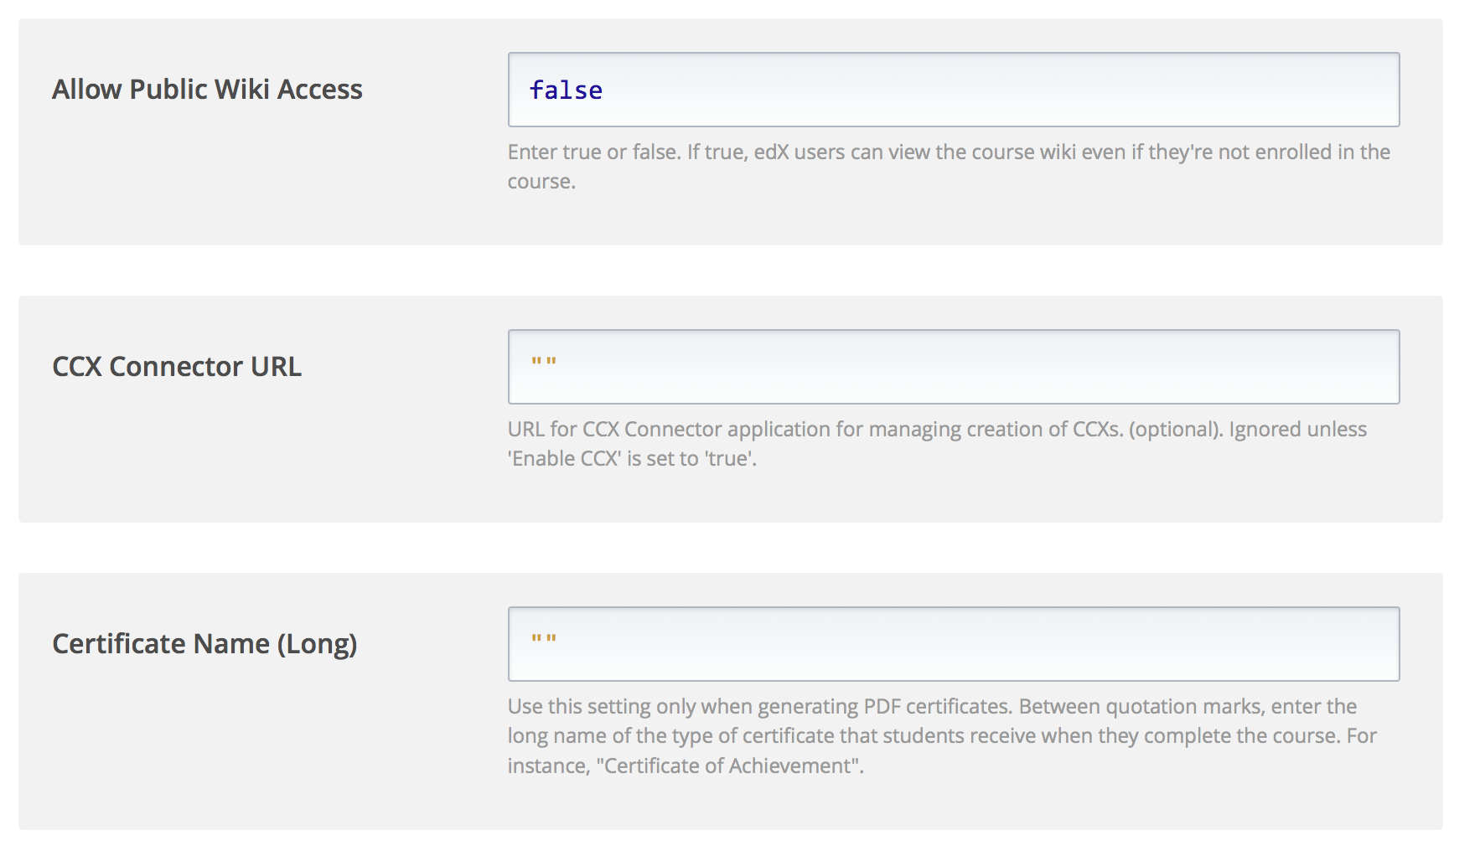
Global CSS File
URL for the CSS file to be included in all units and pages. Use /static/filename.css to access Files & Uploads, or specify full URL for externally-hosted files.
Global Javascript File
URL for the javascript file to be run on all units and pages. Use /static/filename.css to access Files & Uploads, or specify full URL for externally-hosted files. See documentation for details.

