Slide 1
U of C Mingle
Stage 4
Group 3.5

Slide 2
Work Development
We used Adobe XD for our prototype because it was most supported and recommended.
We focused first on making the different ‘screens’ for different tabs, and slowly flesh them out following the low-fi prototype. Overall, this does not require as much creativity.
Then, we realized the need for consistency of the design, and used an icon pack that is still present in the final prototype. This actually streamlined the process by a decent margin.
The biggest difference between the low-fi and hi-fi prototype is the addition and complexity of colors. As a ‘grayscale’ design is very undesirable, we added some colors that would match the intended user base (in this case, a red/yellow palette).

Slide 3
Main Critiques from the Heuristic Evaluation on our Prototype
Critical issues
Variety of bugs regarding links between buttons and pages; either dead or wrong links
Switching “daily” to “weekly” view to better match its function
Changing icons (including the flag icon) to more intuitively represent their function
Secondary issues
Flexibility - possible features for power users to quicken work-flow
Extending our recent announcements feature, possibly to include all announcements
Aesthetic choices - specifically the colour scheme and possible changes to be less jarring

Slide 4
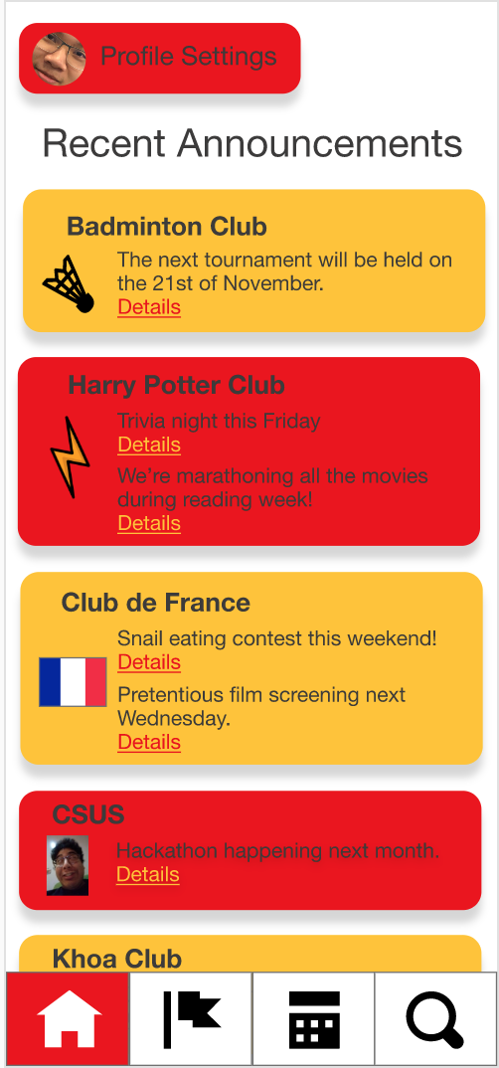
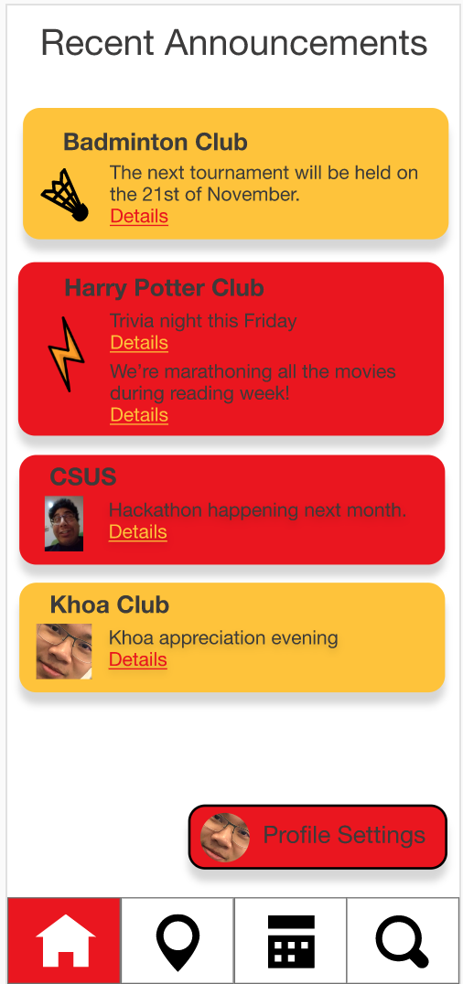
Changes Resulting from Heuristic Evaluation

Slide 5
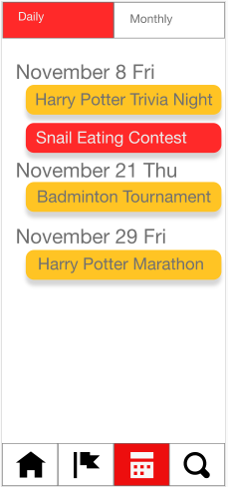
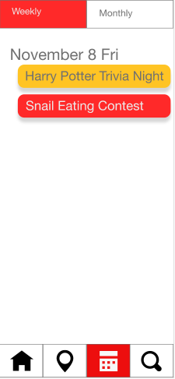
Changes Resulting from Heuristic Evaluation

Slide 6
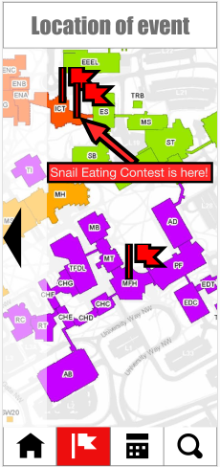
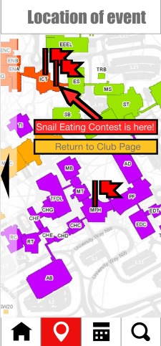
Changes Resulting from Heuristic Evaluation

Slide 7
Final Prototype for this Deliverable
https://xd.adobe.com/view/7f4c9a6e-5a7e-4b28-5f93-39eb5dffd701-097d/screen/1e2ed035-abc3-47f2-af0c-8000e1c9b81e/Search

