Slide 1
Project3—Predictive Model
Group11

Slide 2


01
Baseline Model
02
Model 1
03
Model 2
Columbia University

Slide 3
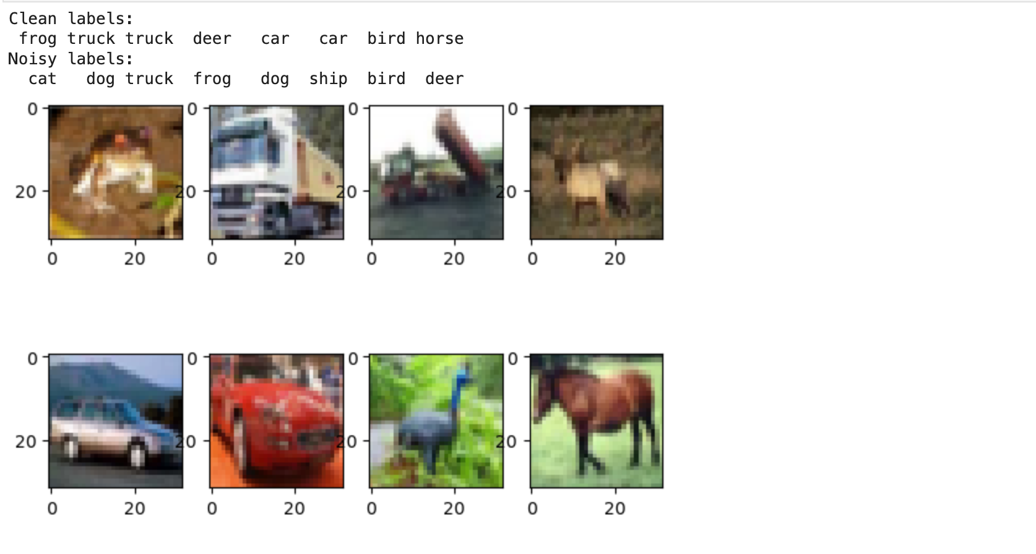
Baseline Model

Slide 4
Model 1_CNN
Attempt | ACC | Upgrades
1 | 10.00% | Basic cnn with few layers.
2 | 44.14% | Three sets of convolutions; Max pooling layers; Filter starting at 32 and going up to 6 Flattening layer followed by two dense layers
3 | 38.60% | Introducing dropout / early stopping

Slide 5
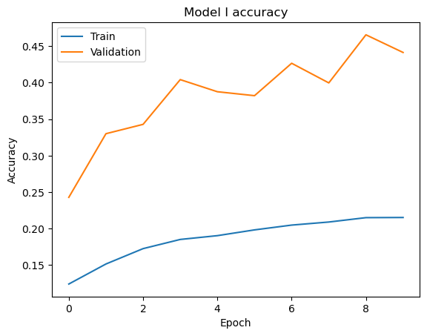
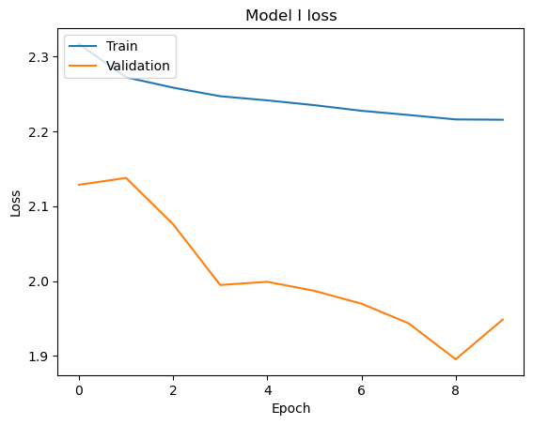

Slide 6
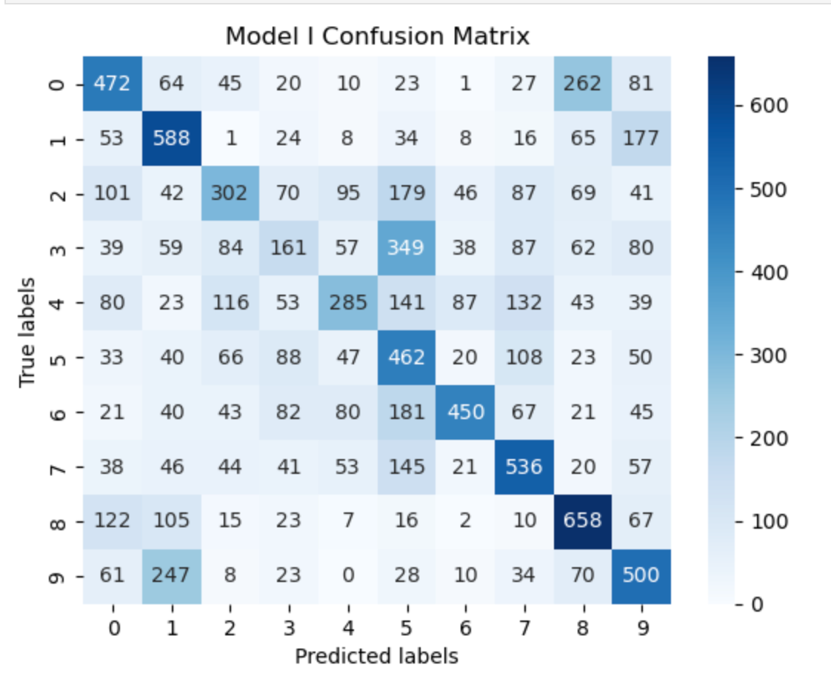

Slide 7
This model can be further improved through several following means:
Data augmentation of the images
More sophisticated weights and layers
More training data and more training time

Slide 8
Model 2_Advanced CNN
Unclean to Clean Label NN
Advanced CNN
Image Classifier

Slide 9
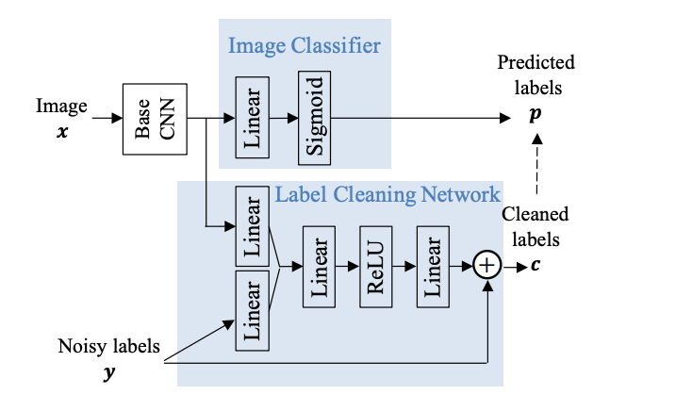
Model 2_Part1 Unclean to Clean Label NN
Multi-task label cleaning network
Incorporating the noisy labels as part of the network input might help the model consider label noise during feature extraction

Slide 10
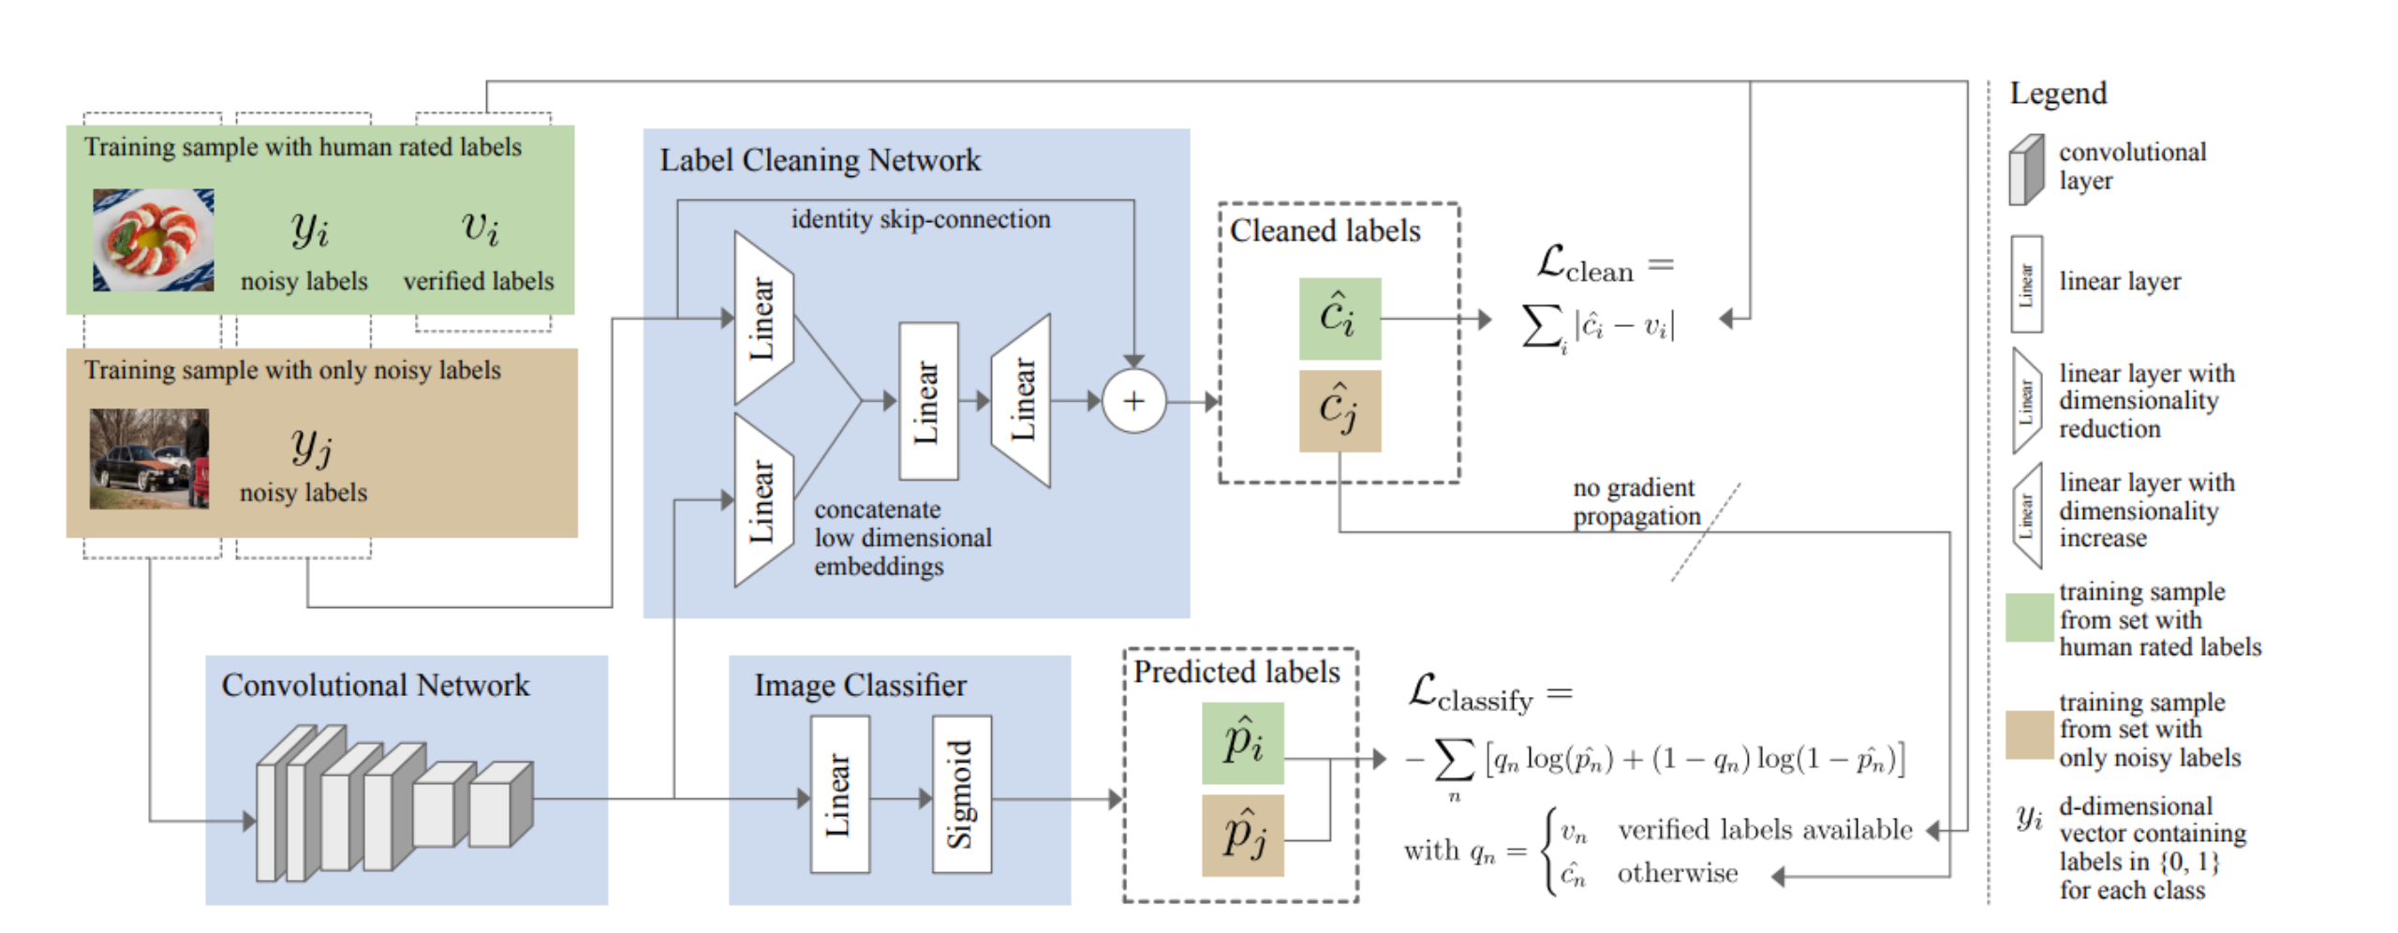
Model 2_Part1 Unclean to Clean Label NN

Slide 11
Model 2_Part2 Image Classifier
In this part, we clones an existing neural network model (referred to as model1) to create a new model (model2) with the same architecture.
This cloning process is done to demonstrate that any improvements in performance come from cleaning the labels, not from any adjustments to the model itself.

Slide 12
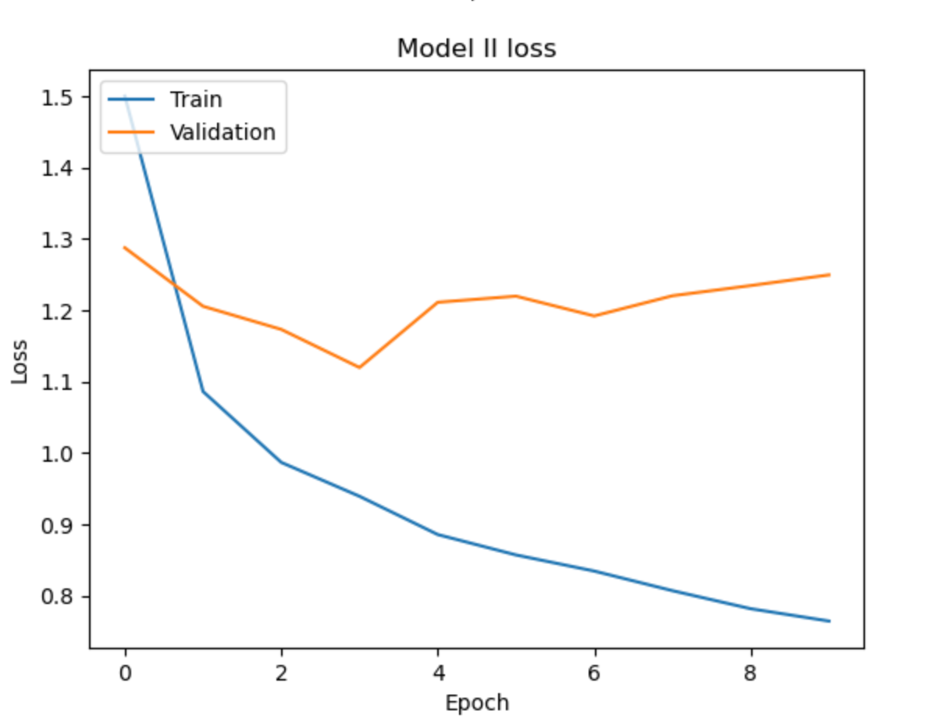
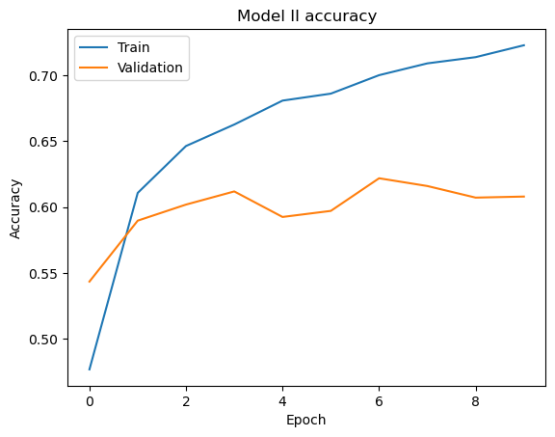

Slide 13
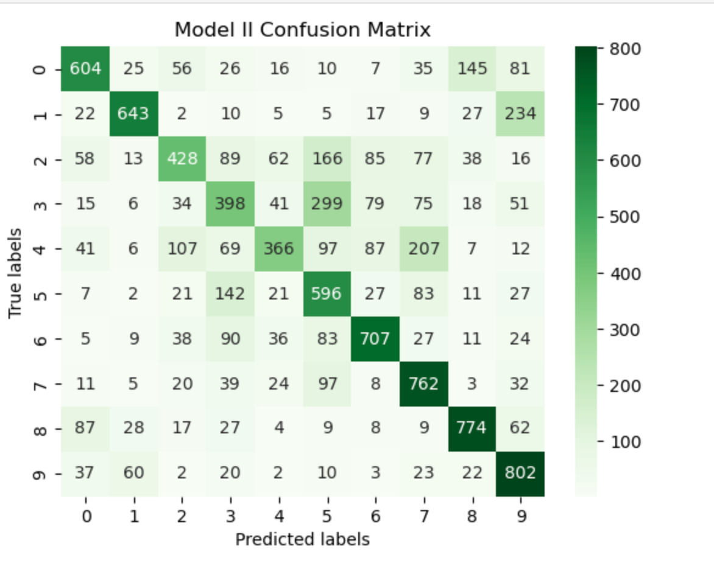

Slide 14
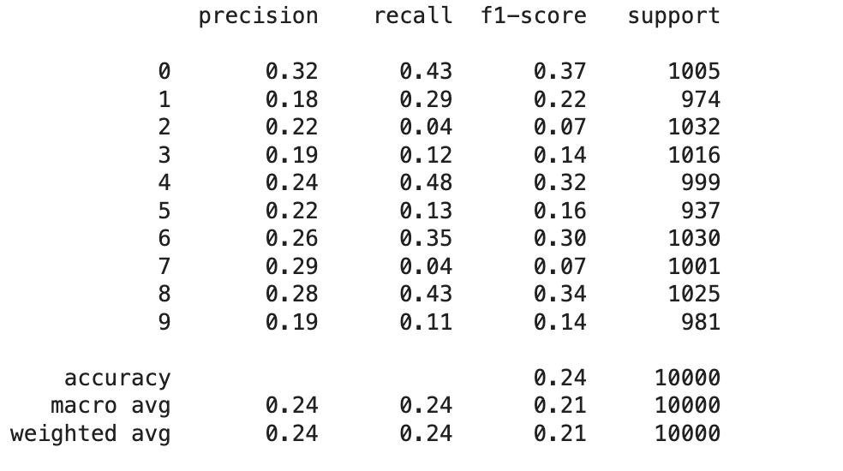
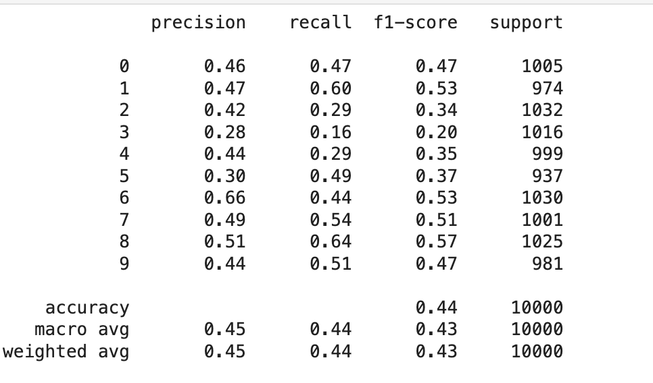
Evaluation
Baseline Model
Model 1

Slide 15
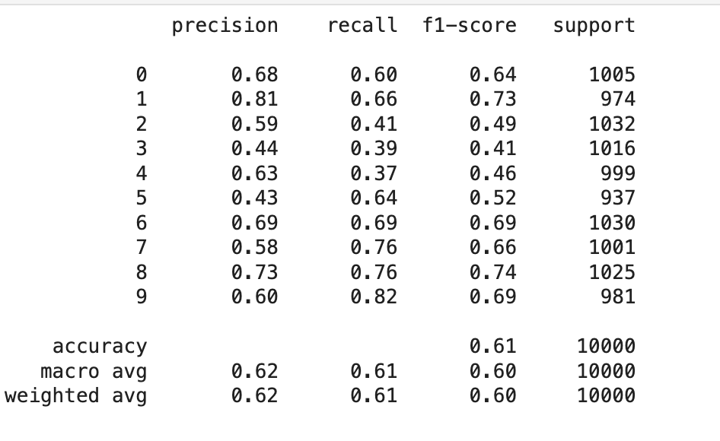
Evaluation
Model 2

Slide 16
Evaluation
Model 2

Slide 17
Future Explore
Data augmentation: rotation, scaling, cropping, or color transformations
Regularization techniques: Try other regularization techniques such as L1 and L2 regularization to prevent overfitting
Advanced optimizers:Try using different optimizers, such as RMSprop or AdamW, and adjust the learning rate and other hyperparameters.
Transformer architecture: Consider incorporating elements of the Transformer architecture, such as multi-head self-attention mechanisms, to enhance the model's performance.
Try combining CNN and Transformer models: Using CNNs to extract features and then using Transformers to process these features.

