Slide 1
Beyond the Model
The critical role of data filtering in clinical machine learning
Noah Subedar*, Colin Campbell*, Wenjing Zhang, Dan Perri, Sarah Culgin, Andrew Hamilton-Wright
University of Guelph · St. Joseph's Healthcare Hamilton · McMaster University * equal contribution
MIMIC-III · 46,032 ICU stays · 7 vitals × 24 hours · 11 filters · 2 tasks
Notes:
— Talk is about preprocessing, not models. Nobody needs to have read the paper.
— One sentence of framing: every clinical ML paper opens with a filtering pipeline, and almost none of them report what the pipeline removed.
— Two co-first authors; work is a Guelph / St. Joe's Hamilton collaboration.
— Set expectation: I will show you the paper's result in about six minutes, then spend the rest on the part we could not fit in eight pages.

Slide 2
THE CLAIM
Filtering is a modelling choice, not data cleaning
Anything that discards or edits observations based on their values changes the distribution — by definition.
It changes the task
Removing hard cases, flattening variance, or separating class distributions makes a benchmark easier without making a model better.
It is not task-neutral
The same filter can improve mortality prediction and degrade prolonged-stay prediction on the very same feature matrix.
It is rarely reported
Pipelines standardise preprocessing for comparability, but do not characterise how those choices changed the difficulty of the problem.
So the question is not “did filtering help?” but “is it still the same problem?” This talk gives you three ways to check, and argues the third one — simply counting what you removed — is the one people skip.
Notes:
— Core argument in one line: a filter that selects on values cannot be distribution-neutral. That is arithmetic, not an empirical claim.
— Left panel: the failure mode is a benchmark that gets easier. If you are allowed unlimited preprocessing you can drive accuracy anywhere you like.
— Middle panel: preview of a result — same 168 features, same patients, two labels, and filters that move the two in opposite directions.
— Right panel: standardised pipelines (MIMIC-Extract, the benchmark suites) fix preprocessing so studies are comparable — which is a different goal from knowing what the preprocessing did.
— Land the framing question. Everything after this is evidence for it.

Slide 3
SETUP
One cohort, one model, eleven filters
Each filter is applied independently to the unfiltered data, so every arm is a clean single-filter comparison against the same baseline.
46,032
MIMIC-III ICU stays, first 24 hours
7 × 24
vitals × hours → a 168-dim feature vector
2
binary tasks: prolonged ICU stay, in-hospital mortality
13
arms: raw, 7 vitals, all-vitals, and 4 post-aggregation filters
 | Prolonged ICU stay | In-hospital mortality
Positive class | ICU time > 3 days | died before discharge
Prevalence | 37.5% | 9.7%
Baseline accuracy | 0.6936 ± 0.0025 | 0.6868 ± 0.0308
Baseline macro F1 | 0.6870 ± 0.0016 | 0.5542 ± 0.0180
Evaluation
• Random forest, 300 trees
• Stratified 5-fold × 4 repeats = 20 fits per arm
• Folds drawn once on the raw cohort, keyed by admission id, and inherited by every arm
• Decision threshold by Youden's J on an inner-validation slice
Notes:
— Cohort: every admission with vitals in the first 24 hours; 46,032 stays.
— Feature vector is deliberately dumb — flatten the 24×7 grid to 168 numbers. A forest does not care about hour ordering, and the point of the study is the preprocessing, not the architecture.
— Two tasks chosen because they have very different base rates: ~37% vs ~10%. Mention that mortality being at 10% is why the threshold matters.
— The design detail that makes everything downstream legitimate: the cross-validation partition is drawn ONCE on the unfiltered cohort and keyed on admission id. Every filtered arm inherits the fold each patient was in. Arms are therefore paired by construction — that is what licenses McNemar.
— Youden's J on an inner split, never on test. Mention in one sentence: it picks the operating point that maximises sensitivity + specificity − 1, and in our experiments it did about as well as SMOTE or oversampling.
— Each filter is applied to the raw data independently — they are not stacked.

Slide 4
THE FILTERS
Eleven filters, three levels of damage
The level a filter operates at — not its threshold — decides whether it can delete a patient.
Filter | Stage | Level | Threshold
heart rate | pre | VALUE | [1, 600] bpm
systolic BP | pre | VALUE | [1, 400] mmHg
diastolic BP | pre | VALUE | [1, 300] mmHg
mean BP | pre | VALUE | [1, 300] mmHg
respiration rate | pre | VALUE | [1, 70] breaths/min
temperature | pre | VALUE | [21, 50] °C
oxygen saturation | pre | VALUE | [1, 100] %
all vitals | pre | VALUE | union of the seven
fill missing data | post | FEATURE | k = 3, ≥ 2 known points
long missing segment | post | RECORD | ≥ 10 consecutive missing/zero hours
long gap | post | RECORD | ≥ 2 consecutive all-blank hours
high invalid data | post | RECORD | > 10% of the 168 cells invalid
What each level can do
VALUE
Drops individual out-of-range readings from an hour's list. The hour keeps its other readings. The patient always stays.
FEATURE
Fills empty cells. Changes what the model sees; removes nothing.
RECORD
Deletes the entire patient from the dataset.
Everything in this talk follows from that last row. Hold onto it — we come back to it on the slide after next.
Notes:
— Do not read the table out. Point at the Level column — that is the only column that matters for the rest of the talk.
— Seven per-vital range filters: physiologically implausible readings only. The bounds are deliberately loose, not tight. Heart rate up to 600 because ventricular fibrillation genuinely reaches ~500 bpm and we want to keep it. We are removing sensor artifacts, not unusual patients.
— All vitals = union of the seven; it is the composite arm.
— Fill missing data is its own category — it edits cells, never patients.
— The three record-level filters are the ones inherited straight from generic ML practice: if a row looks incomplete, drop the row.
— Flag the asymmetry: the value filters have physiological justification. The record filters have only a data-tidiness justification.

Slide 5
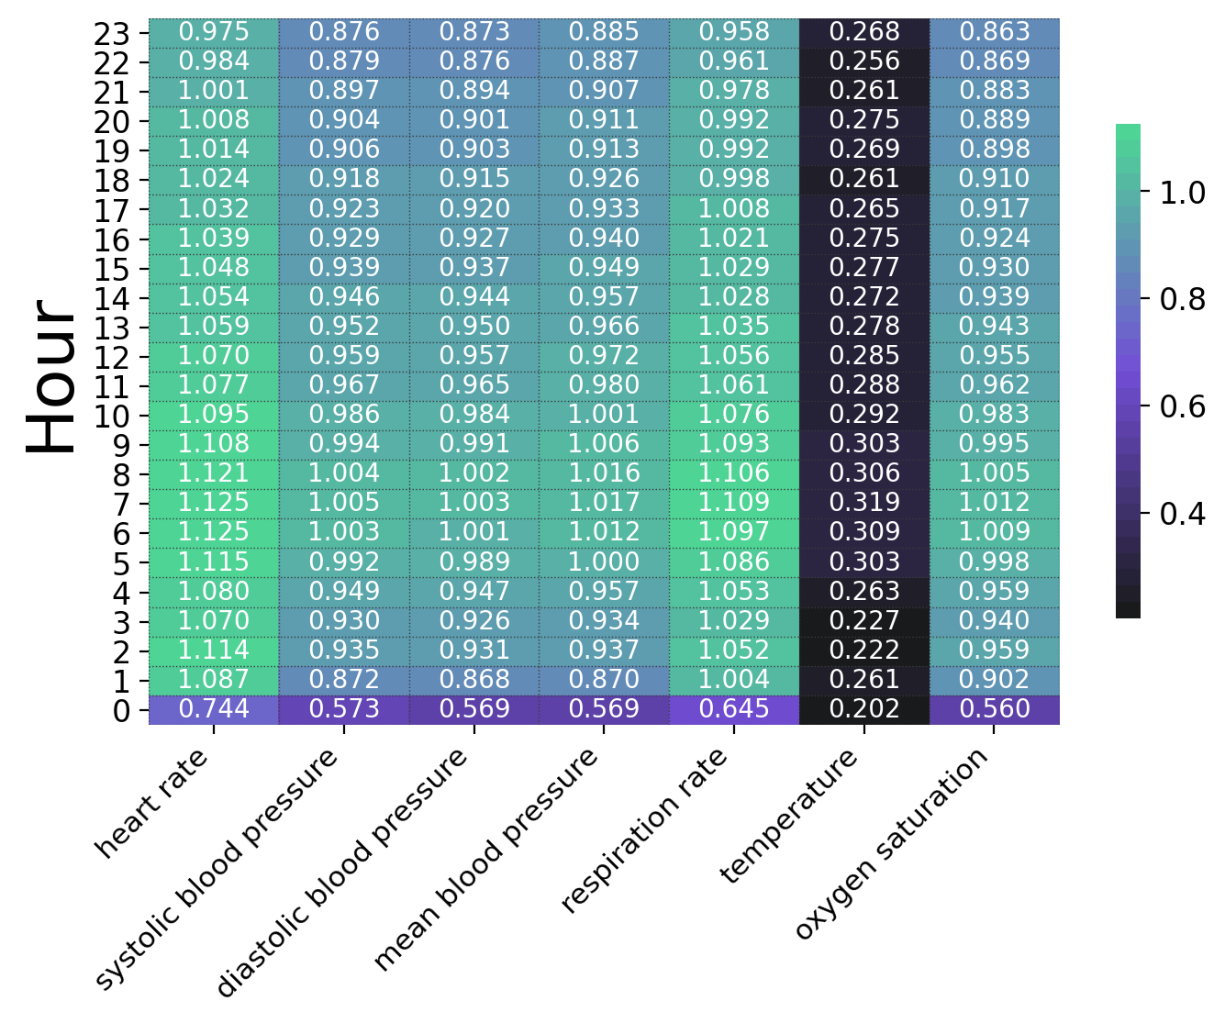
WHY FILTER AT ALL
The raw data really is broken
Heart rate, MIMIC-III. A filter that touches 0.04% of readings changes the feature distribution beyond recognition.
 | Readings | Max | Mean | Median | Std
(a) raw measurements | 1,158,296 | 9,999,999 | 98.6 | 86 | 9,291.5
(b) after the heart-rate range | 1,157,789 | 459 | 90.0 | 86 | 24.4
(c) mean-aggregated, before | 45,985 | 555,652 | 105.3 | 87.1 | 2,590.9
(d) mean-aggregated, after | 45,989 | 251.5 | 93.2 | 87.1 | 25.5
A maximum of 9,999,999 bpm is a charting sentinel, not a patient. Removing 507 readings out of 1.16 million takes the maximum to 459 and the standard deviation from 9,291 to 24.
This is the case for filtering, and it is a good one. Nobody should train on a heart rate of ten million.
Mean observations per vital-hour cell, unfiltered
But measurement density is wildly uneven — so the same filter removes far more from heart rate than from temperature, and “one filter, applied uniformly” is already not a uniform intervention.
Notes:
— Start here so nobody thinks the paper is anti-filtering. It is not. The raw data contains values that are physically impossible.
— Table III walks the heart-rate column: raw readings, then after the range filter, then the same two after mean-aggregating to one number per patient-hour.
— The number to say out loud: 507 readings removed out of 1,158,296 — four hundredths of one percent — and the standard deviation collapses from 9,291 to 24. That is a value-level filter doing exactly what it should.
— Heatmap: mean number of measurements per vital per hour. Heart rate is monitored continuously; temperature is spot-checked. Roughly 4x difference.
— Consequence to state: a fixed rule applied to all seven vitals lands unevenly. And the sparser the vital, the more each removed reading costs — if a lab is drawn twice a stay, dropping one is dropping half the signal.
— Bridge: so filtering is necessary and it is not neutral. How do we tell the two apart?

Slide 6
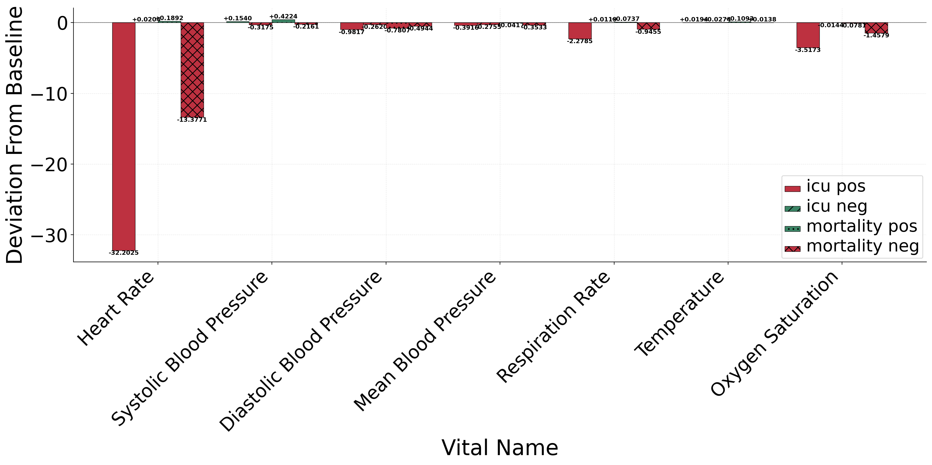
PAPER RESULT · DISTRIBUTION
Filtering moves the class centroids
Per-vital centroid shift from the unfiltered baseline after the all-vitals outlier filter, split by outcome class.
How to read it
• Physiological outliers are one-sided — nobody charts a heart rate of minus 200 — so removing them moves the mean, and moves it in a direction that depends on the vital.
• Heart rate and oxygen saturation shift most, because that is where the extreme artifacts live.
• The bars within a vital are the four outcome sub-populations. When they move by different amounts, the filter has treated the classes differently.
A shift is not automatically a problem. It becomes one when the classes move differently — that is separation being manufactured or destroyed by preprocessing.
Notes:
— This is the paper's first diagnostic: compute a per-vital centroid for each outcome class, before and after the filter, and plot the difference.
— Explain the one-sidedness in a sentence: implausible values cluster at one end of a distribution, so trimming them is not a symmetric operation.
— Heart rate and SpO2 dominate — consistent with Table III on the last slide.
— The key reading skill: look ACROSS the four bars within one vital, not at the height of any single bar. Common movement is fine. Divergent movement means the filter is doing something class-dependent.
— For all-vitals specifically, the movement is largely common — which is the signature of legitimate artifact removal. Contrast is coming.

Slide 7
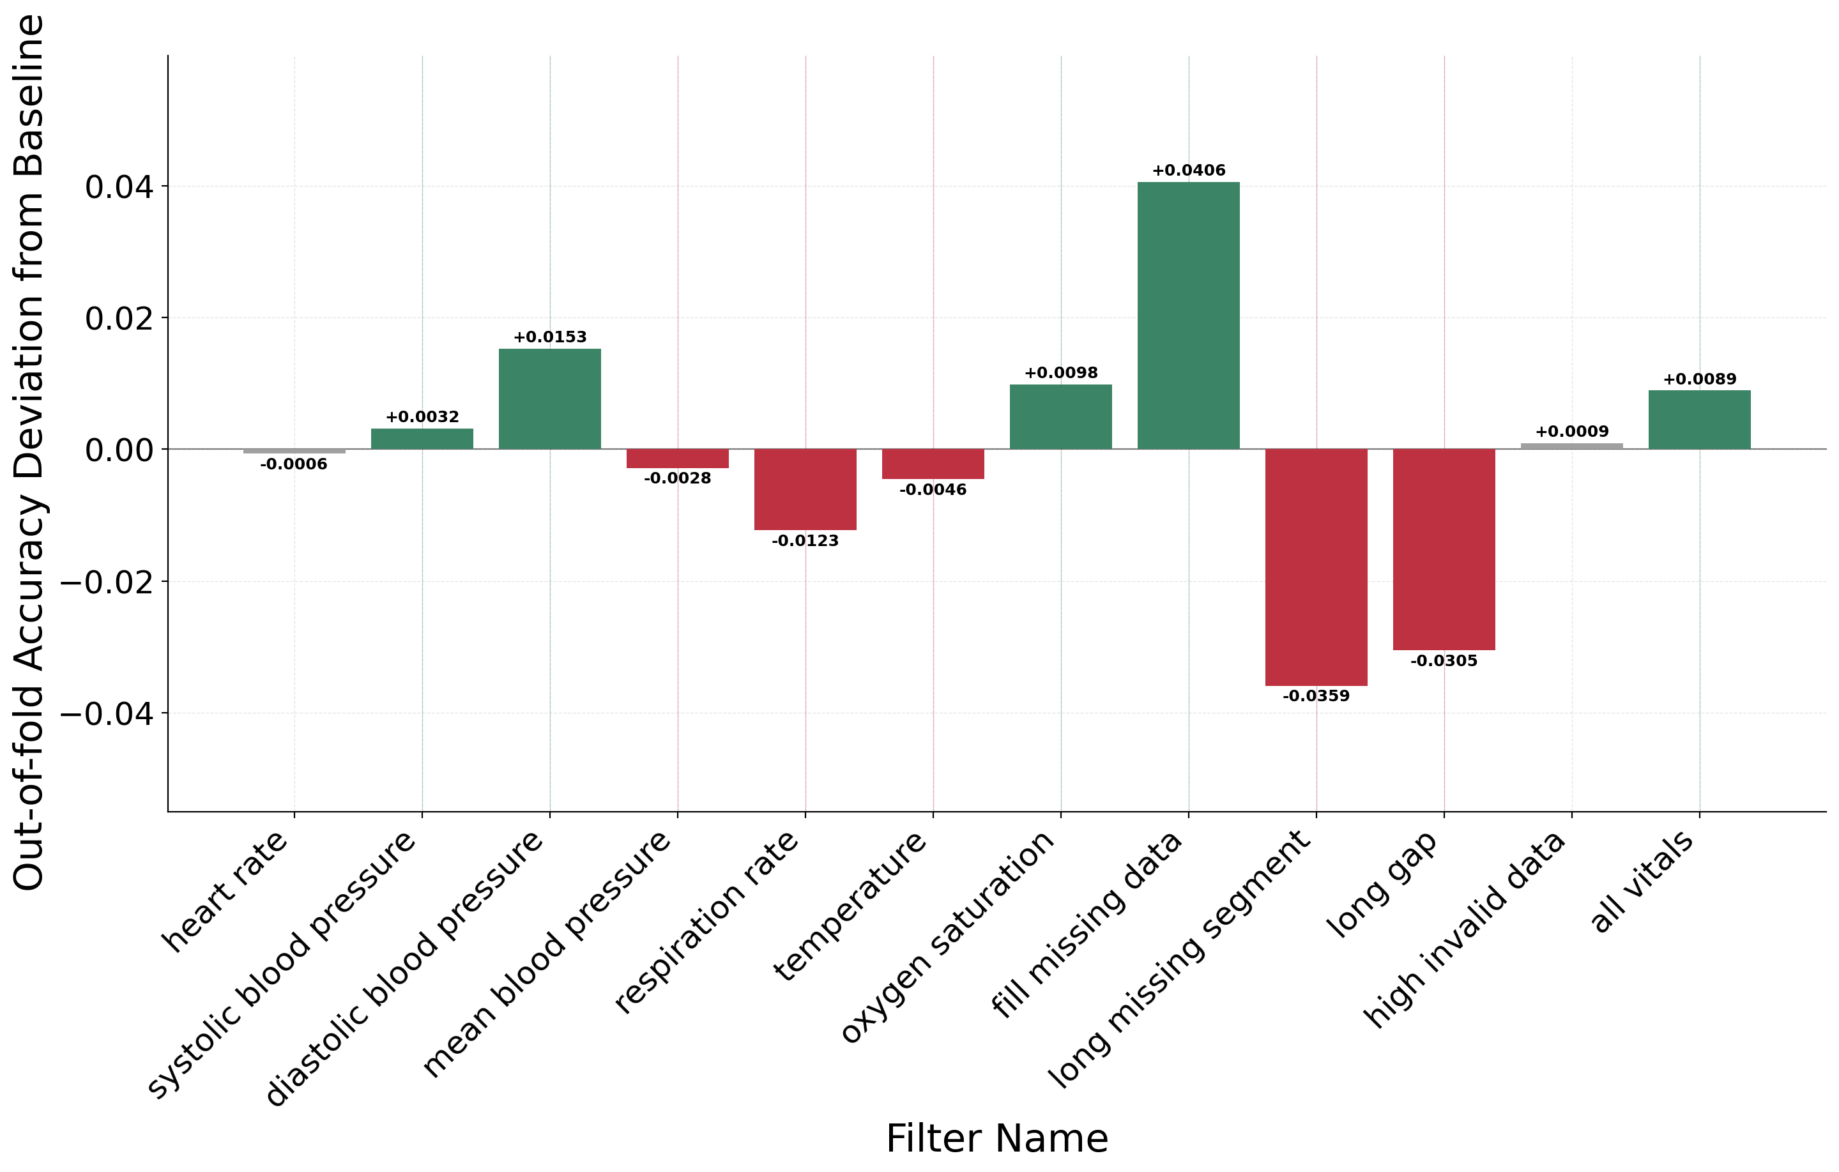
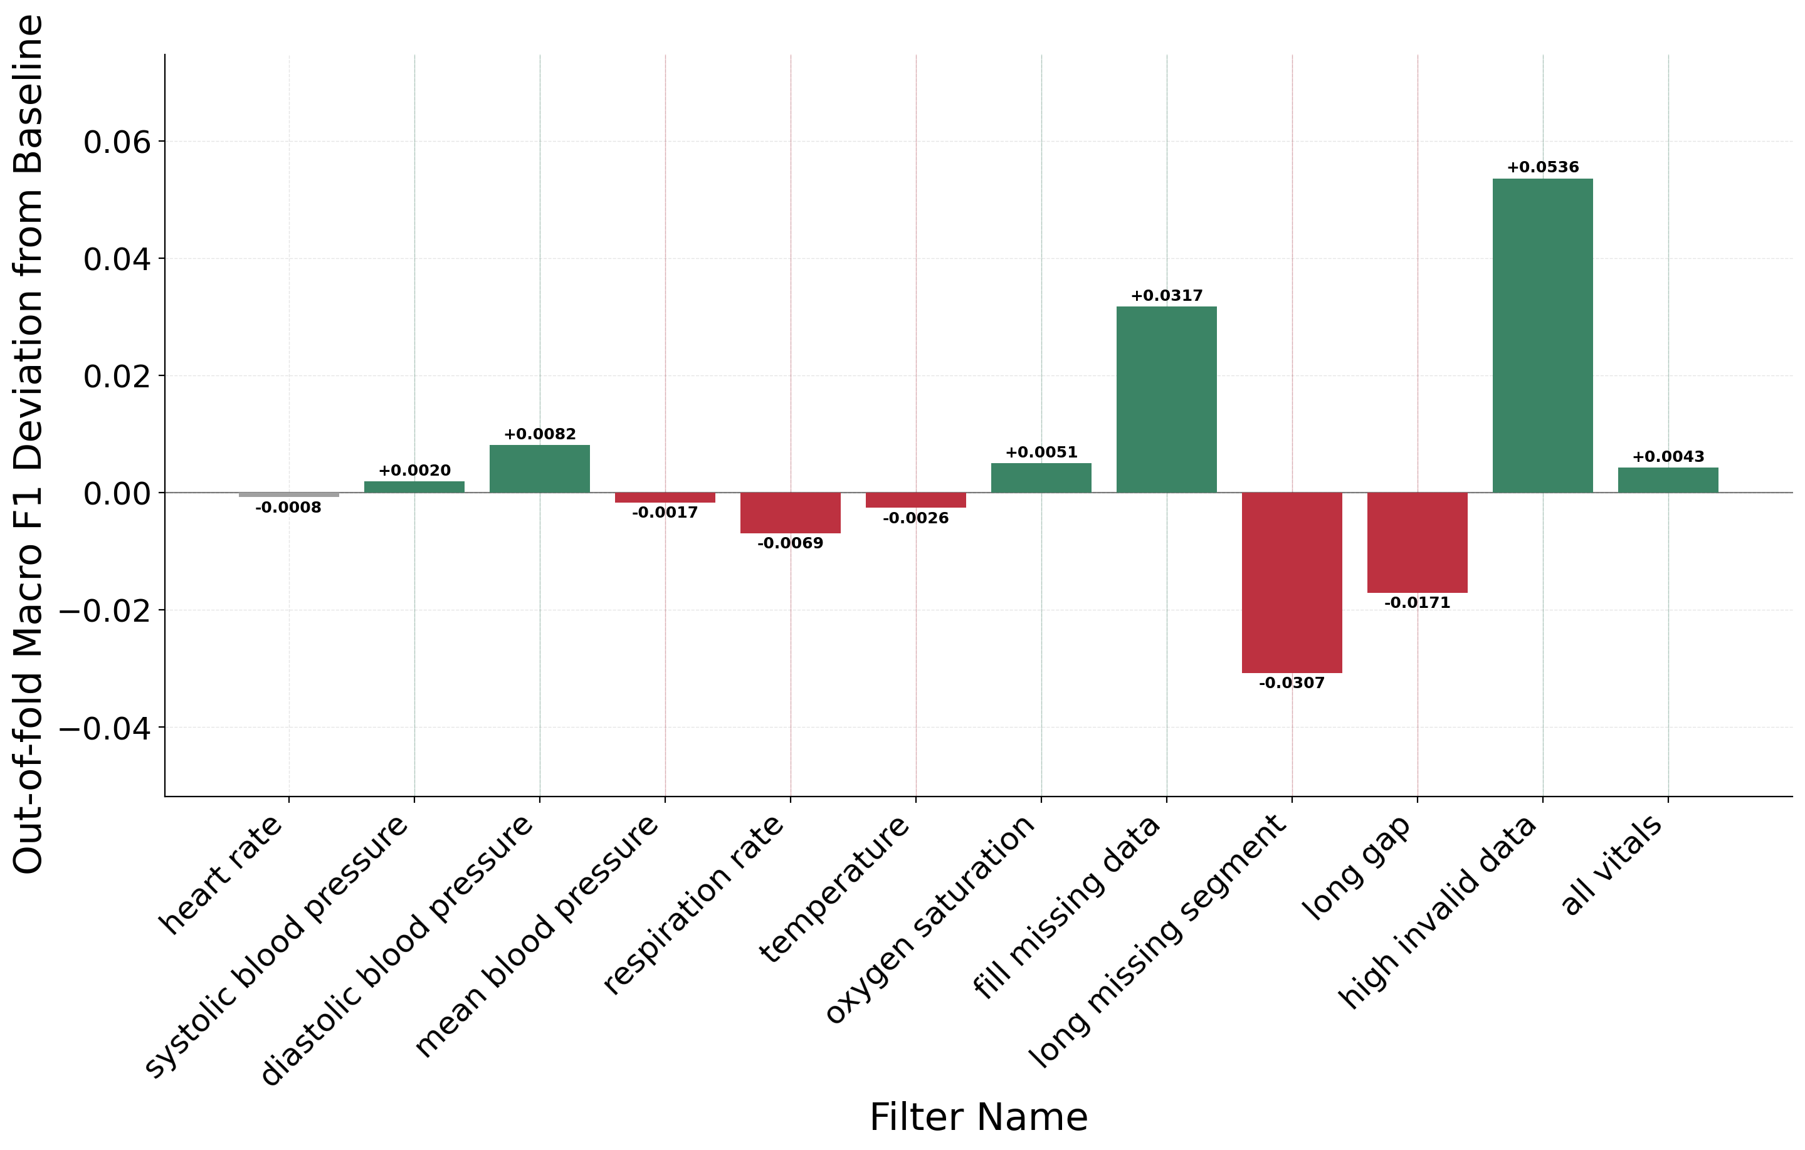
PAPER RESULT · DIFFICULTY
And it changes how hard the task is
Deviation from the unfiltered baseline, in-hospital mortality, mean aggregation. Left: accuracy. Right: macro F1.
Some filters move accuracy up and some move it down, and the spread — -0.0359 for long missing segment to +0.0406 for fill missing data — is comparable to the gap between competing model architectures on this task. A reader who is shown only the winning number cannot tell which of the two they are looking at.
Notes:
— Same model, same folds, same patients wherever the arm allows it. The only thing that changes between bars is which filter was applied.
— Point out that bars go both ways. Filtering is not monotonically good or bad.
— Best and worst arm for mortality accuracy: fill missing data at +0.0406, long missing segment at -0.0359.
— The uncomfortable comparison to make out loud: that spread is the same order as the improvements papers claim from new architectures. If two groups pick different filters, the model comparison between them is partly a preprocessing comparison.
— Do NOT yet explain why the record-level bars behave the way they do — that is slides 9 through 12. Just flag that they are the big ones.

Slide 8
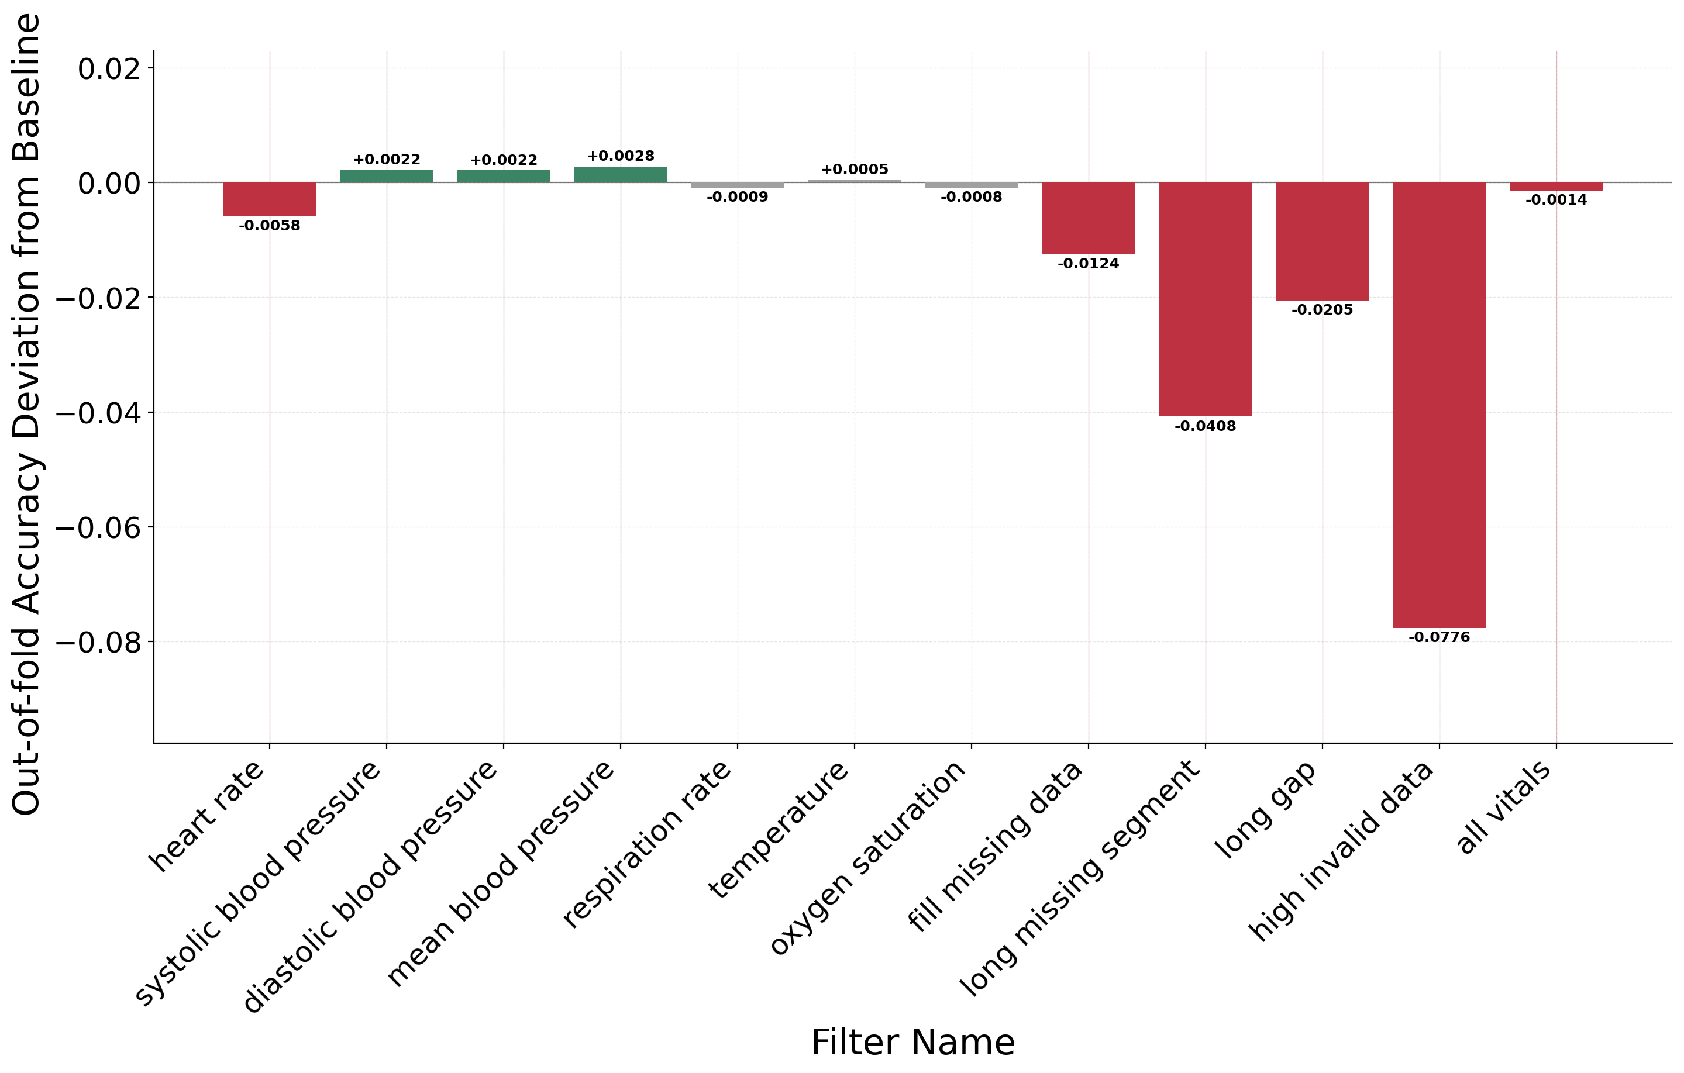
PAPER RESULT · TASK DEPENDENCE
The same filter, opposite signs
Accuracy deviation for both tasks. Identical feature matrix, identical folds, identical filters — different answers.
In-hospital mortality
Prolonged ICU stay
Filter | Δ accuracy, mortality | Δ accuracy, ICU stay
fill missing data | +0.0406 | -0.0124
oxygen saturation | +0.0098 | -0.0008
all vitals | +0.0089 | -0.0014
Why: the value-level filters remove implausible readings regardless of which class the patient belongs to. If those artifacts happened to separate the classes, removing them uncovers the real difficulty. If they obscured them, removing them helps.
Notes:
— Two tasks, one feature space, one preprocessing pipeline. They still disagree about which filters help.
— 5 of the nine non-record arms flip sign between the two tasks. Read one or two off the table.
— Mechanism: the filters do not know the label. They remove artifacts wherever the artifacts are. Whether that helps depends on whether the artifacts were accidentally carrying class information.
— Clinical point worth making explicitly: even where the all-vitals filter costs a little accuracy on the ICU task, you still want it. A deployed model must never key a decision on a physiologically impossible value. Benchmark accuracy is not the only objective.
— This is the last of the paper's published results. Transition line: all of this is measured on datasets of very different sizes — and the paper never had room to say how different.

Slide 9
THE PART THAT DID NOT FIT
How many patients survive each filter?
The paper reports what each filter does to the distribution. It never reports what each filter does to the sample size.
0
records removed by all 7 vital filters, all-vitals, and fill-missing — combined
−15,003
long missing segment → 31,029 left
−25,709
long gap → 20,323 left
−44,663
high invalid data → 1,369 left
The split is total
Ten of the thirteen arms keep every single patient. Three keep 67%, 44% and 2.97%.
The high-invalid-data threshold reads as conservative — it allows up to 16 of a record's 168 cells to be blank. In this cohort that keeps 1,369 of 46,032 stays.
Notes:
— This is the slide the talk exists for. Pause on it.
— Left number first: the seven per-vital filters, the all-vitals composite and the imputation arm remove zero patients between them. Not 'few'. Zero.
— Then the three record-level filters: 15,003 / 25,709 / 44,663 stays deleted out of 46,032.
— High invalid data keeps 1,369 patients — under 3% of the cohort.
— Make the threshold point carefully, because it is counter-intuitive: the rule is 'drop a record if more than 10% of its 168 cells are blank or zero'. On paper that sounds permissive. In ICU data, where temperature is spot-checked and any given vital is silent for hours at a time, almost every real record fails it.
— Nobody writing that filter intends to delete 97% of their data. The threshold looks conservative and the outcome is not — which is exactly why it has to be measured rather than reasoned about.
— Bridge: so what were the value-level filters doing all this time?

Slide 10
FOR CONTRAST
What a value-level filter actually touches
Individual readings removed as physiologically implausible, across the whole cohort. No patient is dropped by any of these.
6.69M
vital-sign readings in the cohort
21,930
removed by the seven filters combined
0.33%
of all readings
0
patients removed
Two filters, two worlds
A value-level filter edits 0.33% of the readings and keeps every patient. A record-level filter edits nothing and deletes up to 97% of the cohort.
Both are called “filtering”, and in a methods section both get one sentence.
Notes:
— Total readings across the seven vitals: 6,685,415. Removed: 21,930.
— Respiration rate and systolic BP dominate — those are the channels where implausible values are actually charted.
— The seven per-vital counts sum exactly to the all-vitals total; the build asserts that, so the accounting is complete.
— The comparison to land: three hundredths of one percent of readings versus up to 97% of patients. These are not the same kind of operation, and a methods section that lists them in one sentence hides that.
— If asked about the per-vital differences: it tracks how the vital is measured and charted, not how noisy the physiology is.

Slide 11
THE CONSEQUENCE
And the survivors are not a random sample
Class prevalence in the cohort each filter leaves behind. Record-level filters select on monitoring density — which tracks how sick the patient is.
Cohort | Stays | ICU stay | Mortality
raw / value-level | 46,032 | 37.5% | 9.7%
long missing segment | 31,029 | 38.8% | 10.2%
long gap | 20,323 | 50.2% | 10.9%
high invalid data | 1,369 | 60.6% | 19.4%
The prolonged-stay task starts as a 37.5% minority-class problem and ends as a 60.6% majority-class one — a +23.0-point swing. Mortality prevalence roughly doubles. That is not the same prediction problem with cleaner inputs; it is a different problem.
Notes:
— This is the mechanism slide. Take it slowly.
— The record filters select on data density: a record survives if it was monitored densely and continuously.
— In an ICU, monitoring density is not random. It tracks acuity, and gaps track transfers, imaging, theatre — things that happen to sicker patients.
— So filtering for complete records is, in effect, filtering on the outcome. Missingness here is informative — MNAR in the standard terminology — and complete-case analysis on MNAR data is selection bias.
— Numbers: ICU prevalence 37.5% → 60.6%. Mortality 9.7% → 19.4%.
— The ICU one is the striking one: the positive class goes from minority to majority. Any metric with a base rate in it is now measuring a different thing.
— Note the direction is the opposite of naive intuition — you might expect dropping incomplete records to remove the sickest patients. It enriches for them, because sick patients get watched more closely.

Slide 12
THE CONSEQUENCE
So the bar charts are not comparing like with like
The same filters, measured twice: against the baseline on the full cohort, and against the baseline on exactly the patients each filter kept. Mortality, mean aggregation.
Arm | Scored on | Δ accuracy, as plotted | Δ accuracy, vs the same survivors
all vitals | 46,032 stays | +0.0089 | +0.0090
fill missing data | 46,032 stays | +0.0406 | +0.0404
long missing segment | 31,029 stays | -0.0359 | +0.0384
long gap | 20,323 stays | -0.0305 | +0.0302
high invalid data | 1,369 stays | +0.0009 | +0.1980
What to do instead
• Report the surviving n, and its class prevalence, beside every metric.
• For a record-level filter, score the baseline on the same survivors before subtracting anything.
• Treat macro F1 with care: it averages per-class F1, so doubling the positive rate moves it whatever the model does.
• Prefer threshold-free metrics when the cohort moves under you.
For the two full-cohort arms the columns agree to four decimals — same patients, so the subtraction was always clean. For all three record-level arms they disagree in sign.
High-invalid-data is the extreme case. On the 1,369 patients it kept it beats the baseline by +0.1980 — but those are patients the baseline finds hard, scoring 0.5106 on them against 0.6868 overall.
The plotted +0.0009 is those two effects cancelling. It is a fact about which patients ended up in the denominator, not about what the filter did to the model.
Notes:
— This is the caveat slide, and it is the strongest evidence in the talk for the whole argument.
— Two columns. The first is what our Figure 5 plots: each arm against the baseline's score on all 46,032 patients. The second scores the baseline on exactly the patients that arm kept, so the record set is identical.
— For the value-level arms the two agree to four decimals — as they must, because the cohorts are the same. That is the control.
— For the three record-level arms the sign flips. Read as plotted, they look like the filters that damage mortality prediction most. Measured on their own survivors, all three improve it.
— High invalid data: +0.198 on the patients it kept. The baseline manages 0.511 on those same 1,369 patients against 0.687 across the cohort — they are a genuinely harder subgroup, consistent with the prevalence doubling.
— So the plotted +0.0009 is two large effects cancelling. Nothing about it is a statement about the filter.
— Precision point if pressed: the two columns come from different prediction rules — the plotted one uses per-fold thresholds, the paired one a consensus vector — so compare delta with delta, not delta with absolute. The like-for-like comparison inside each column is what carries the argument.
— Right-hand panel is the practical ask. None of it is expensive.

Slide 13
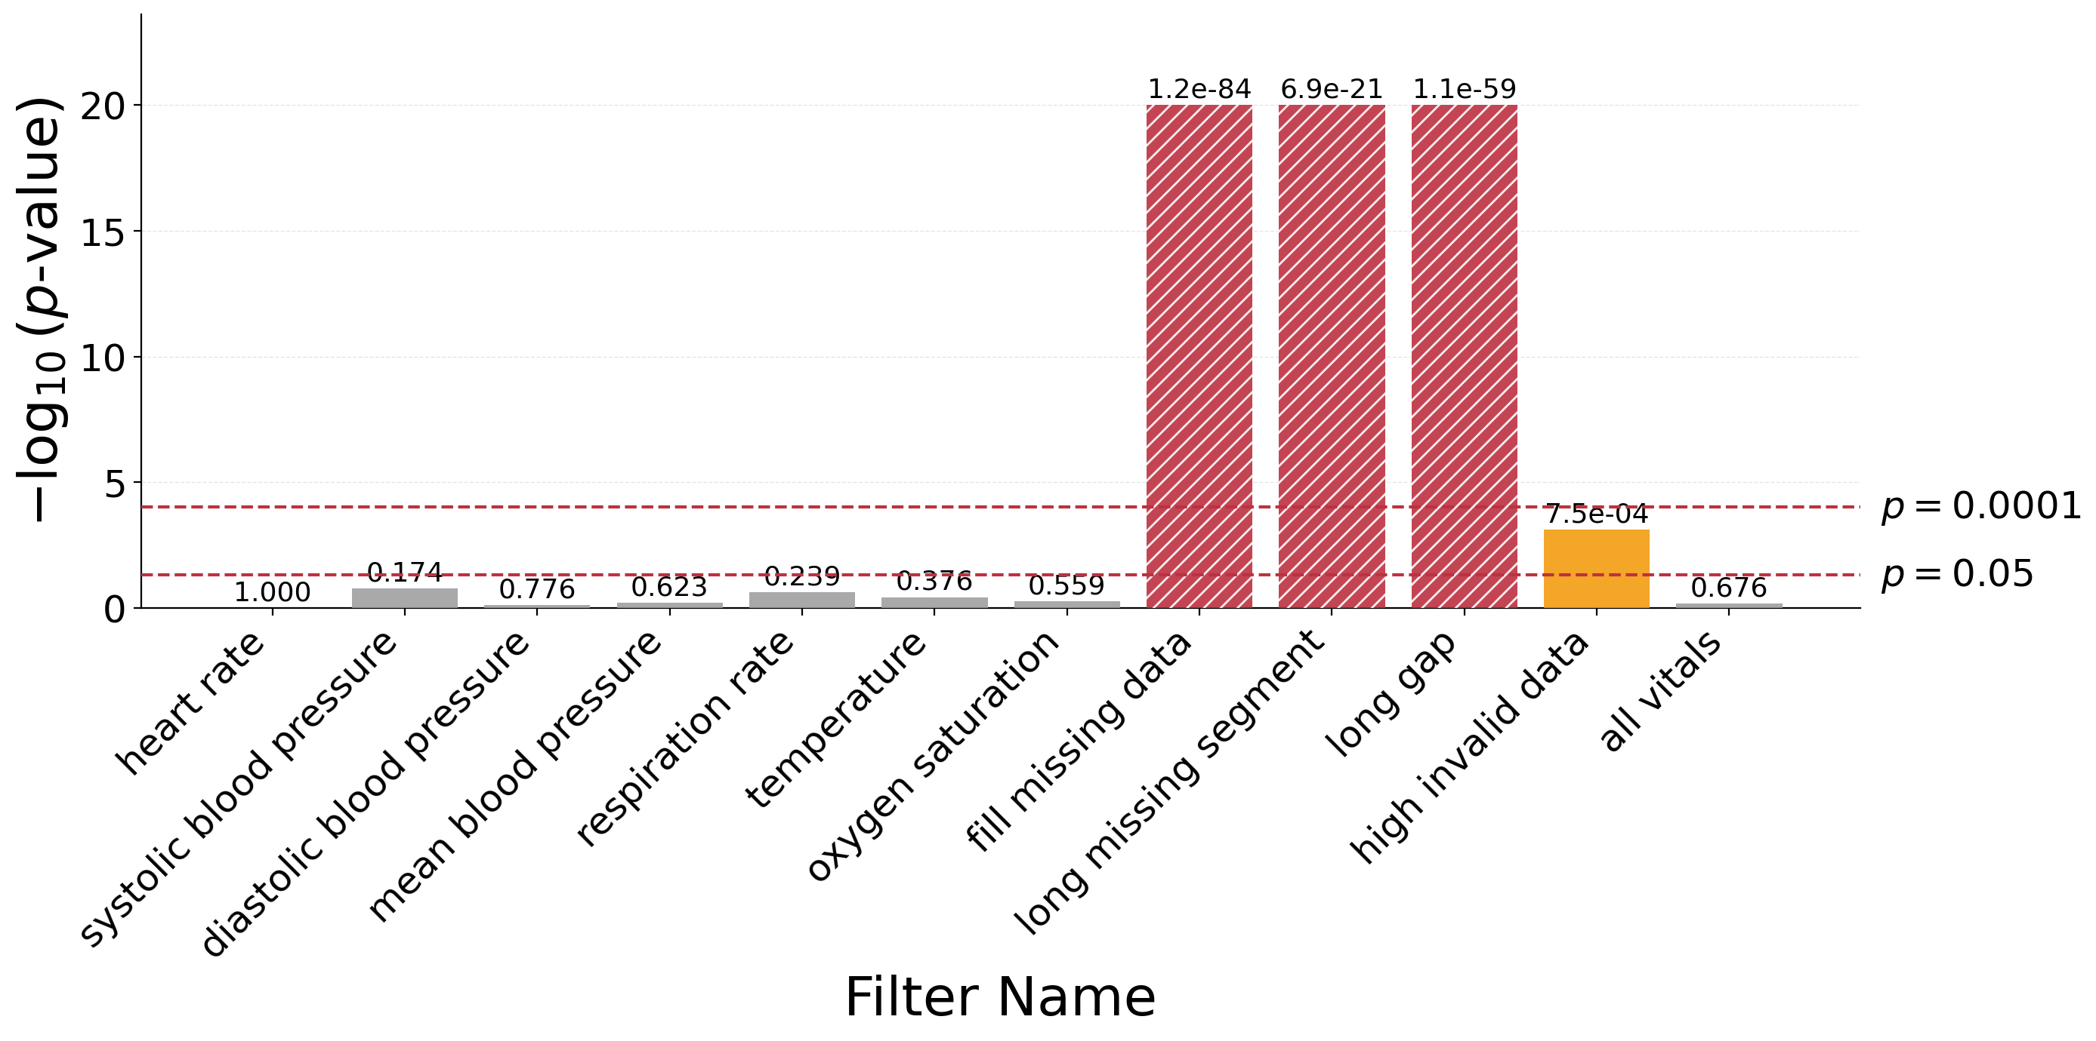
THE DIAGNOSTIC
McNemar: did the prediction pattern change?
A paired test on the records both models scored. Bars are −log₁₀(p) against the unfiltered baseline; in-hospital mortality.
The test in one paragraph
Take the records both models predicted. Count the ones the filter fixed (n₀₁) and the ones it broke (n₁₀). Under the null they are exchangeable, so the p-value is an exact binomial test on n₀₁ / (n₀₁ + n₁₀) against ½.
Agreements are ignored entirely. The test sees only the disagreements — which is what makes it powerful, and what makes it fragile when the paired sample shrinks.
Every arm here is scored at the baseline's threshold, so the comparison isolates the filter rather than the operating point.
The dashed lines are p = 0.05 and p = 0.0001. Between them, a filter is worth investigating; below the second, it has changed the model's behaviour so much that it is hard to argue the problem survived intact.
Notes:
— This is the paper's second diagnostic, and the stats bit I said I would explain. Keep it to about forty seconds.
— McNemar is paired and non-parametric. It ignores every record the two models agree on and asks whether the disagreements are symmetric.
— Say why paired matters: the two models see the same patients in the same folds, so an unpaired accuracy comparison would throw away that structure.
— The two thresholds are ours, chosen in advance: 0.05 as the usual bar, and 1e-4 as 'this is no longer the same problem'.
— Technical note if anyone asks: every arm is re-scored at the BASELINE's decision threshold. Each arm picks its own Youden threshold, and if you let that move too you end up measuring the operating point rather than the filter. Holding it fixed isolates the filter.
— Point out what is NOT significant here: with the threshold held fixed, none of the seven per-vital filters changes the prediction pattern. The tall bars are the imputation arm and the record-level arms.
— Then set up the next slide: there is a reason the record-level bars behave the way they do, and it is not the one you would guess.

Slide 14
THE PART THAT DID NOT FIT
McNemar only ever sees the survivors
The paired sample is the intersection of the two arms — so a record-level filter shrinks the test at the same time as it changes the data.
Arm | Paired n | n₀₁ fixed | n₁₀ broke | p (mortality) | p (ICU stay)
all vitals | 46,032 | 818 | 836 | 0.676 | 0.810
fill missing data | 46,032 | 4,635 | 2,944 | 1.2e-84 | 4.5e-11
long missing segment | 31,029 | 1,128 | 725 | 6.9e-21 | 0.514
long gap | 20,323 | 352 | 925 | 1.1e-59 | 0.600
high invalid data | 1,369 | 115 | 173 | 7.5e-4 | 0.515
Significance tracks the
sample, not the damage
• Held at one threshold, none of the seven per-vital filters is significant on either task (p from 0.17 to 1.00). They edit values without changing behaviour.
• Long-missing-segment deletes 15,003 stays and reaches p = 6.9e-21 on 31,029 pairs.
• High-invalid-data deletes 44,663 — three times as many — and manages only p = 7.5e-4 on 1,369 pairs.
• More damage, weaker evidence. The test rewards a large intersection, and deleting records is how you lose one.
High invalid data on prolonged icu stay: accuracy -0.0776, and yet p = 0.515 — not significant. The test is run on the 1,369 patients that survived. The 44,663 it deleted cannot disagree with anything.
That is the asymmetry to remember: a record-level filter is tested only on the records it approved of. Its most consequential act — deleting 44,663 patients — is invisible to the test, and shrinking the sample costs the test the power to notice what is left.
Notes:
— Second centrepiece. The question I get asked about this paper is why the record-level McNemar results are so extreme.
— First, the control that makes the rest readable: with every arm scored at the same threshold, not one of the seven per-vital filters produces a significant change on either task. Filters that edit a third of one percent of readings do not change what the model does. Good — that is what a well-behaved filter should look like.
— What is left significant is the imputation arm, on the full cohort, and the record-level arms on mortality.
— Now the mechanism. The test is computed on the intersection of the two arms. For a record-level filter that intersection IS the survivor set.
— So the filter's largest single act — deleting 44,663 patients — contributes exactly nothing to the p-value. The test cannot see a patient who is not there. It is scored entirely on the records the filter approved of.
— Read the two p columns side by side. On prolonged ICU stay all three record-level arms come back non-significant — including the one that deleted 97% of the cohort and moved the class balance from 38% to 61%.
— That is the sentence to land: a filter can delete almost all of your data, transform the base rate, and still test as 'no significant change in prediction pattern'. The silence is lost power, not a clean bill of health.
— And the ordering on mortality makes the same point positively — long-missing-segment deletes a third as many patients as high-invalid-data and gets a p-value seventeen orders of magnitude smaller, because it kept 31,000 pairs instead of 1,369.
— General lesson for an ML audience: a paired significance test on filtered data answers a question about the survivors. It is structurally silent about selection — and selection is usually the larger effect.

Slide 15
THE METHOD
Three questions, asked together
No single one of these separates cleaning from distortion. Read side by side, they do.
 | Centroid shift | McNemar | Record accounting
all vitals | moves; the one class-differential shift (heart rate) traces to removing extreme outliers | p = 0.676, on all 46,032 stays — not significant | 0 records removed; 21,930 readings edited
high invalid data | large, and opposite in sign between the mortality classes | p = 7.5e-4, but on only 1,369 stays | 44,663 records removed; prevalence 38% → 61%
The first row is what artifact removal looks like: a distribution shift you can explain physiologically, no significant change in prediction pattern (p = 0.676), and a cohort that is untouched.
The second row is what problem-alteration looks like: a class-dependent shift, a p-value computed on 3% of the data, and a cohort whose base rate has moved by tens of points.
The paper published the first two columns. The third is free — it is a call to len() — and it is the one that explains the other two.
Notes:
— Pull the talk together. Two worked examples, three columns each.
— All vitals: centroids move, but the four outcome groups move together; McNemar not significant on the full cohort (p = 0.676) — the model's predictions do not change; zero records lost. That is a filter removing sensor artifacts. Keep it — and keep it even where it costs accuracy, because a clinical model must not key on impossible values.
— High invalid data: centroids move in opposite directions for the mortality classes; p computed on 1,369 patients; 97% of the cohort gone and the base rate transformed. That is a filter changing the problem.
— The honest summary of our own contribution: the centroid and McNemar diagnostics are useful, and neither would have told us what the record count told us in one line.
— Say the punchline plainly: the cheapest diagnostic in this talk is counting your rows before and after, and it is the one nobody reports.

Slide 16
IMPLICATIONS
What this means if you are comparing models
For algorithm comparison
• Two studies with different filters may be solving problems of different difficulty on the same database.
• A reported gap can be preprocessing rather than model quality.
• Filtering choices belong in the comparison, not just the model card.
For clinical usefulness
• Missingness in an EHR is informative — absence reflects clinical decisions and patient acuity.
• Complete-case filtering therefore selects on acuity, and quietly excludes intermittently monitored patients.
• High benchmark numbers on a heavily filtered cohort do not imply readiness on the ward.
Our recommendation: prefer filters justified by physiology over filters justified by tidiness, and report the cohort you were left with as carefully as you report the metric you got on it.
Notes:
— Left panel is the ML-methods argument, and it is the one this audience should care about: cross-study comparisons silently include a preprocessing comparison.
— Right panel is the clinical argument. MNAR — missing not at random — is the technical term; in an ICU, whether a measurement exists is a clinical decision, so absence carries signal.
— That is why complete-case filtering is selection bias here rather than housekeeping, and it is what our prevalence numbers demonstrated directly.
— Limitation to state honestly: hourly flattening smooths away sub-hourly volatility and the informative-missingness pattern itself. Preserving sampling dynamics is future work.
— Also honest: one database family, seven vitals, two tasks, one classifier.

Slide 17
Three things to take away
1 Filtering is a modelling choice.
It changes the distribution, the difficulty, and — as we saw — the population. Treat it as part of the method, not as housekeeping.
2 Level matters more than threshold.
The seven value-level filters edited 0.33% of readings and removed no patients. One record-level filter removed 44,663 of 46,032.
3 Count what you removed.
Report the surviving n and its class prevalence beside every metric. It costs nothing, and it explains results that the distribution and significance diagnostics leave mysterious.
Toolbox, figures and every number in this talk are open source. Questions welcome.
Notes:
— Keep this to thirty seconds; leave time for questions.
— One: filtering is a modelling choice.
— Two: the level a filter operates at predicts its damage far better than how conservative its threshold looks. The 10%-invalid rule sounded generous and removed 97% of the cohort.
— Three, and the ask: count what you removed, and print it next to your metric.
— Likely questions to have answers ready for: why a random forest (robustness to irrelevant features on a mixed-density 168-dim vector, and the study is about preprocessing not architecture); why not just loosen the record-level thresholds (you can, and it helps, but any record-level rule selects on monitoring density and so on acuity); does this hold on MIMIC-IV and eICU (the pipeline supports both, the numbers here are MIMIC-III).

