Slide 1
User Experience Insights in LLM Platforms: A Comparative Analysis of ChatGPT and Claude
Group16: Xinyu Lin and Yujing Jiang
Date: 12/3/2024

Slide 2
Project Description
Why: Using user experiences to refine and advance LLMs paid services
What we are focusing:
What is the user experience regarding LLM paid services?
How do users emotionally perceive and respond to these services?
Which specific features and aspects of premium services are most valued by users?
How to do: Sentiment Analysis and Text Mining
Platforms | Data Source | Data Quantity |  | Number of variables
 |  | ChatGPT | Claude
YouTube | YouTube API | 1080 | 1080 | 4
Reddit | Reddit API | 3559 | 2006 | 6
App store | RSS API | 193 | 219 | 3
Google play | Google Play Scraper library | 1902 | 1109 | 11

Slide 3
key features in
Chatgpt user comments
across four platforms
key features in
Claude user comments
across four platforms

Slide 4
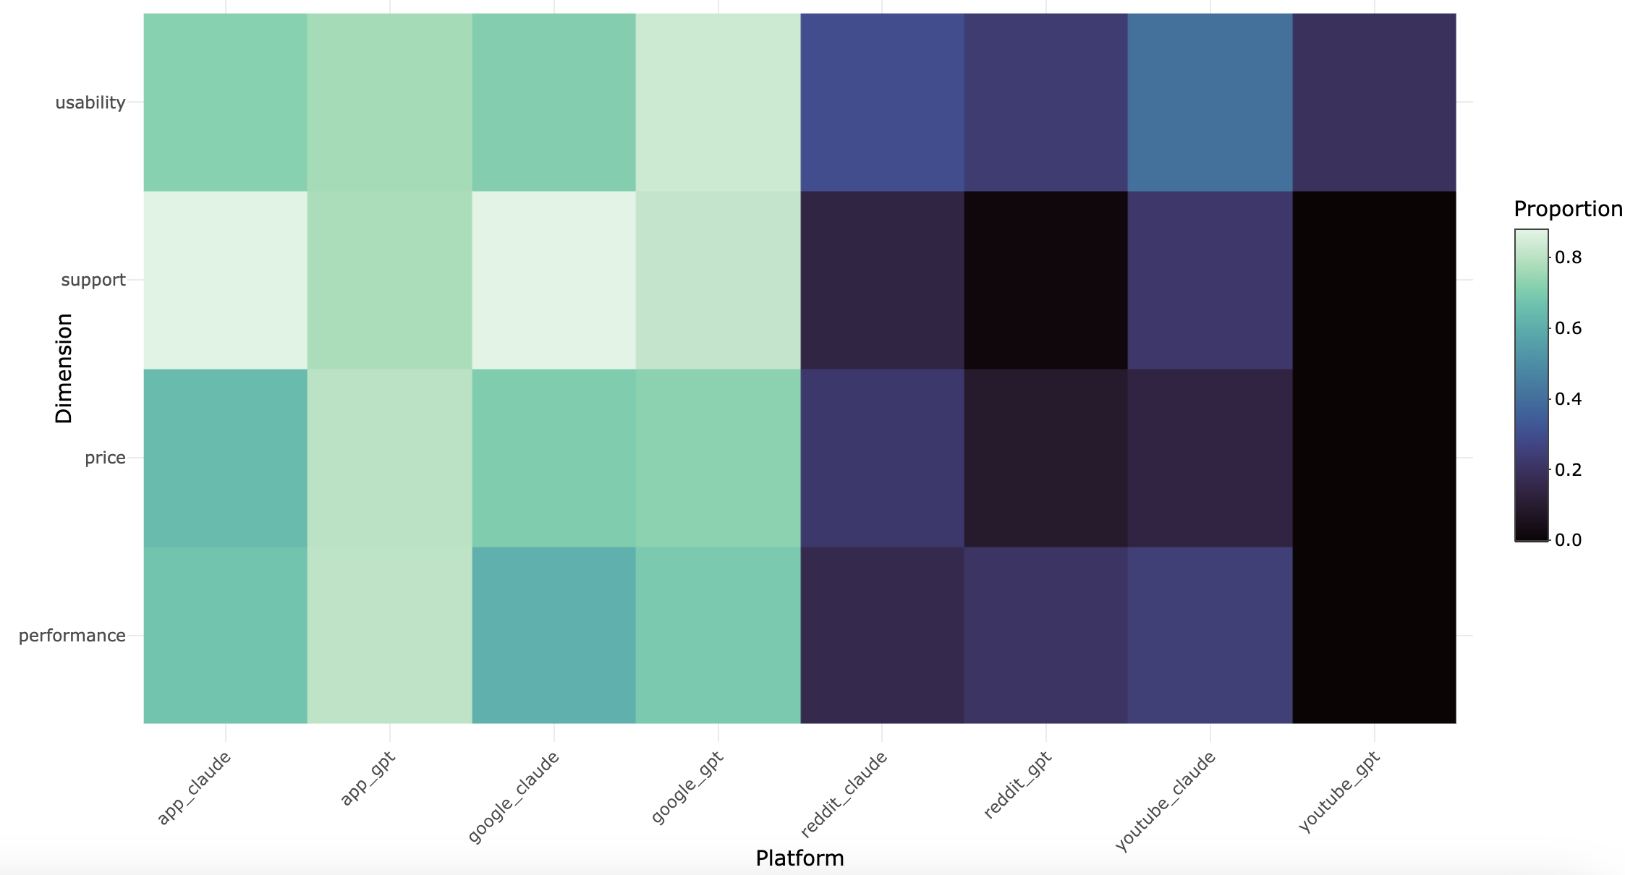
Sentiment Proportions by Dimensions

Slide 5
Thank you!

