Slide 1
CS510 PA4
Colin Eason, Haiming Tan, Matthew Morel

Slide 2
Scope
Pedestrian domain
Non-BoW approach
Simplify tracking
Evaluation : compare system parameters

Slide 3
Actions : Basic Approach
Collect tracklets in sliding window
- Used tracker from PA3
Compute PCA Eigenvectors
Compare with known action video samples
- SVD based principle angles

Slide 4
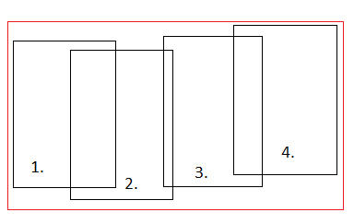
Tracklets

Slide 5
Training Data
Created video samples
- Tried to vary background and clothing
Sorted into training and test
- single actions vs multiple
Cut out interesting snippets
- 5 to 8 per action
Pre-compute PCA eigenvectors
- all 3 video cube slices

Slide 6
Evaluation
Same “ground truth” tool
Only considered action labels per frame
Ignored results until full video cube captured (45 frames)
- Large influence on short test samples
Three variations:
- Full system
- Edge images
- No use of velocity information

Slide 7
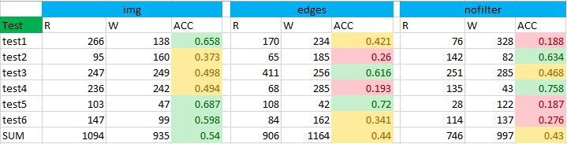
Results : Accuracy

Slide 8
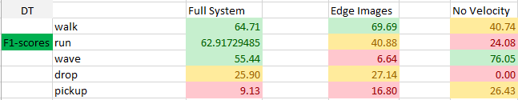
Results : F-Score Comparison

Slide 9
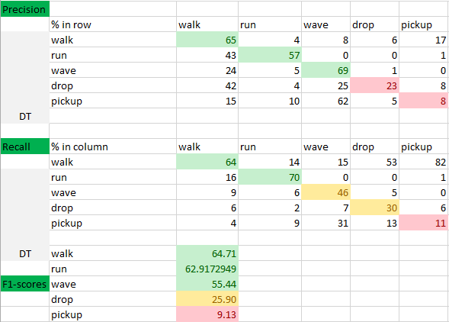
Results : Full System

Slide 10
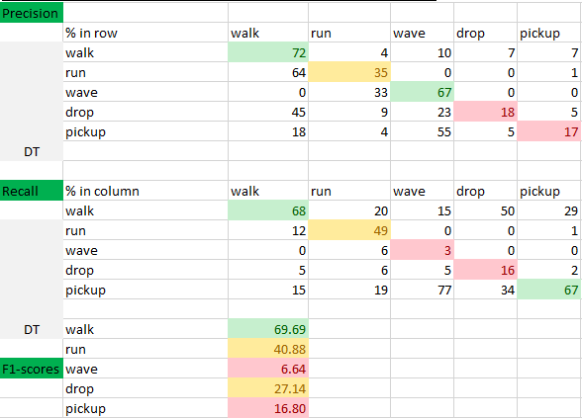
Results : Edge Images

Slide 11
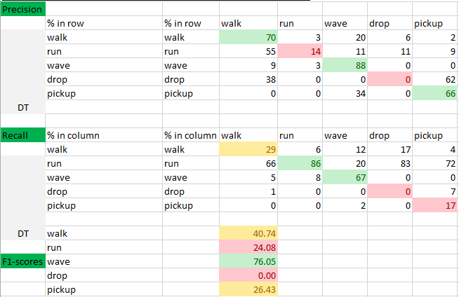
Results : No Velocity Information

Slide 12
Improvements
Velocity data
- Helps classify motion based actions (i.e. run vs walk)
Edge images
- Might cut down on clothing/background sensitivity
Clustering
- Speed up classification time
Smoothing
- HMM : reduce classification noise

Slide 13
References
[1] David S. Bolme et al. "Visual Object Tracking using Adaptive Correlation Filters“
[2] I. Laptev and T. Lindeberg; "Space-Time Interest Points" (2003), in Proc. ICCV'03, Nice, France, pp.I:432-439.[3]

