Slide 1

Moody’s Analytics Hack Day 2020
{ Virtual
Office }

Slide 2

Justin Whitehouse (Benevolent Leader)
Project management
Collision detection
Level design
Graphics
Neil Murphy (Graphics Monkey)
NPC design
Graphics
Dean Lambert (Unity Maestro)
Behavioral programming
Movement programming
Camera management
Graphics
Colin Carson (Plumber)
Communications programming
Graphics
Conrad Visagie (Sage Council)
Unity research
{ Virtual
Office }

Slide 3



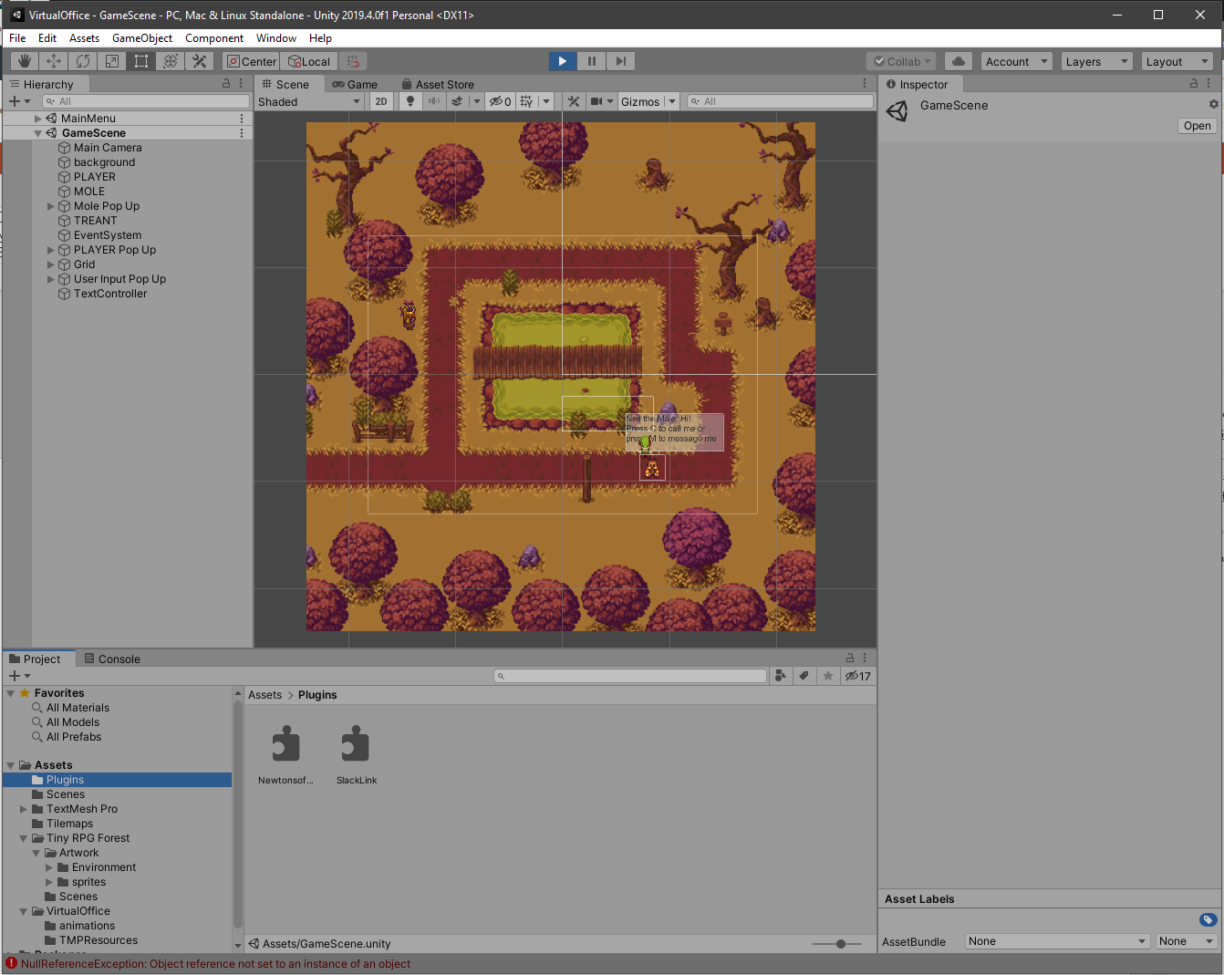
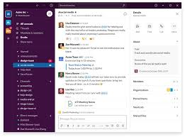
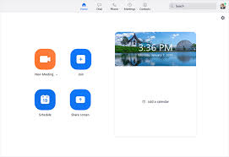
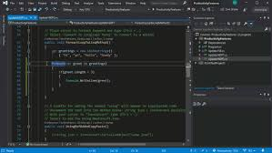

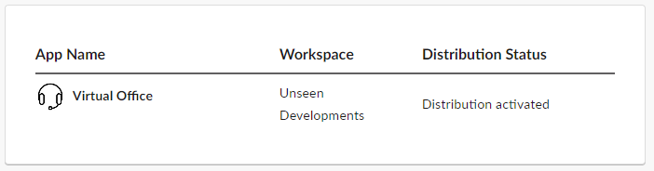

Channel List
User List
User Presence
Group Chat
Graphics Tile Set
Direct Messages
Zoom Invitation
Audio Files
C# Scripts
C# Slack plugin

Slide 4



