Slide 1
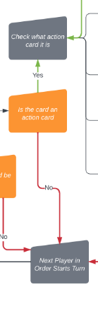
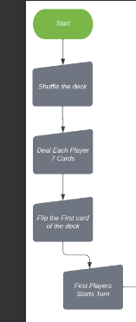
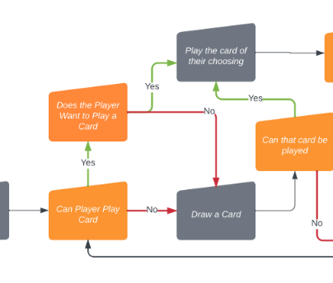
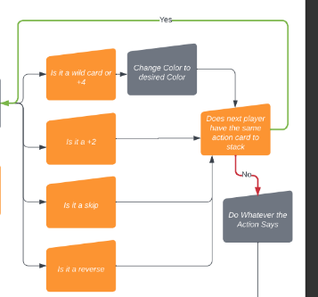
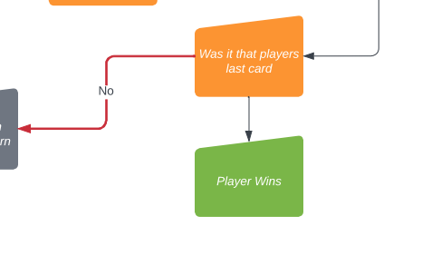
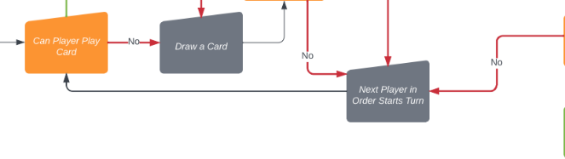

Simple Storyboard Template for PowerPoint
The first player sees if they can play a card then decides if they would like to play it or not. If not they draw a card and check if that can be played and if it can they play it.
Checks if the card played was an action card and if it is it moves to the next step and if it wasn’t the turn is over. If the player never played a card the turn also ends.
The game starts with shuffling the deck and then dealing each player 7 card. Flip the first card of the deck then the game begins.
It checks what action card it is an performs the action. Also it check if the next player in the order has the same type of card to stack. After that it performs the action
It checks if the card that was played was that players last card and if it was they win
It then moves on to the next player and starts over again

