Slide 1

With Agile Development - Communication is The Key
Colin Eberhardt
Technical Architect
Scott Logic Ltd.

Slide 2

We’re all doomed!
200% of projects overrun their budget
125% of software projects fail
…
Source: Wikipedia

Slide 3
What is Agile Development?
Requirements
Waterfall
Design
Implementation
Release
Design
Agile
Iterative
Collaborative
Adaptive
Lightweight
Frequent releases
Requirements
Implementation
Release

Slide 4
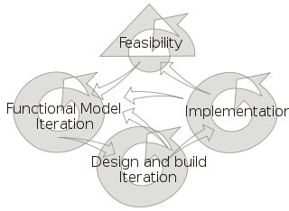
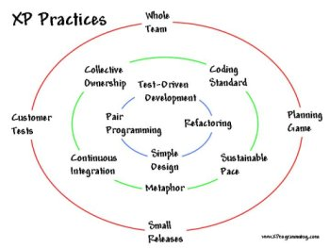

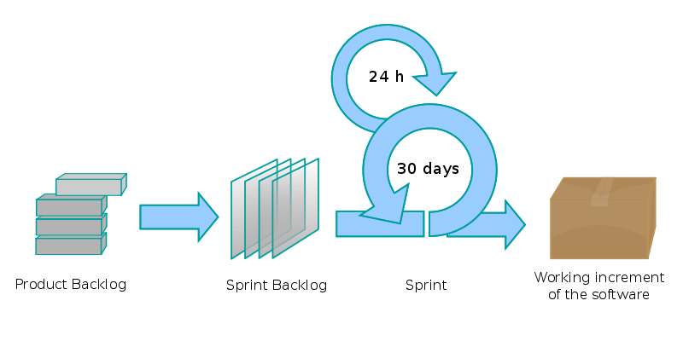
Which methodology?
DSDM ?
XP ?
Does it really matter?
SCRUM ?

Slide 5

Scott Logic - Diversity
Diverse range of clients
Diverse range of methodologies
Global: New York, Tokyo, Denmark, …
Diverse range of projects
Small / large
Long / short
Remote working
Timezone / culture / language
Communication
Provides us with a range of experiences
Good and bad!

Slide 6


Challenges to project success
Requirements
Understanding
Accommodating change
Capturing correctly
Estimation
Expert estimation is dominant approach
Typically over-optimistic
It is not easy!

Slide 7

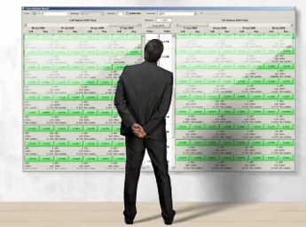
Case Study
Danish Investment Bank
Online Investment Bank
Their software is key to their success
FX Options Board Project
4 months to live
SCRUM process

Slide 8



Project structure
Small teams (3-6 people)
Split across sites
Component focussed
Business Owner
Front end-team
3-6 Developers
Back-end team
3-6 Developers

Slide 9

Project lifecycle – kick-off
Lightweight requirements
Typically a few mock-ups and a perhaps some text
Visual mock-ups double as marketing tools
Assemble teams
Initial milestones determined
Milestones are used as progress markers
Initial backlog of tasks constructed
High level
Component focussed
Measured in days

Slide 10

Project lifecycle – start of Sprint
Sprint = iteration
Select high-level tasks
Based on priority and milestones
Breakdown and estimate
Create low level tasks
Estimate as a team
Results in “buy-in”
Measure in hours

Slide 11
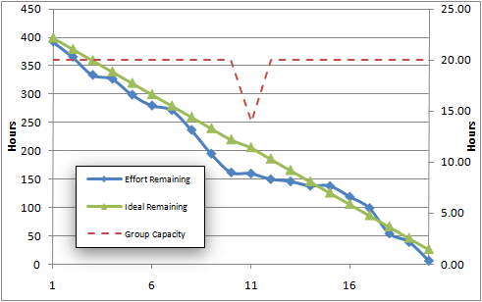
Project lifecycle – daily meetings
Daily team meetings
Brief discussion of progress
Re-estimation of tasks

Slide 12
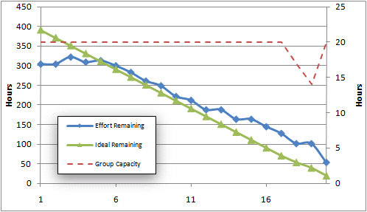
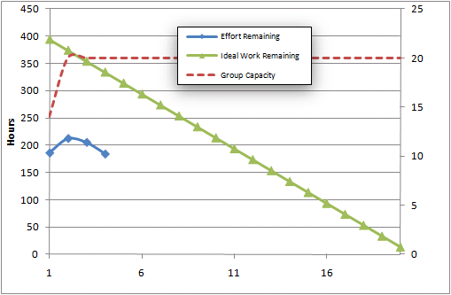

Project lifecycle – The burndown
Communicates progress
Visible to Developers
Visible to Business Owner
Visible to Peer-teams
Continually re-assessed
Each day the effort remaining is your best guess
Visible impact of changed requirements
Retrospective
A great tool for analysis

Slide 13

Case study
Process has been a success over 4 projects (to date)
Another 3 in progress
This is a particularly process-aware client

Slide 14

Tackling the challenges
… through communication
Requirements
Allow them to evolve
Milestones, burndowns, releases, encourage communication with the business owner
Wrong moves are acceptable!
Estimation
Collaborative
Team buy-in
Sprint retrospective
Estimation errors are measureable

Slide 15
Which methodology?
DSDM ?
XP ?
Does it really matter? …
NO!
SCRUM ?

Slide 16

Conclusions
Iterate
Communicate
Succeed

