Slide 1
Cross Platform XAML Applications
Colin Eberhardt
Technical Architect, Scott Logic Ltd.
w: http://www.scottlogic.co.uk/blog/colin/
t: @ColinEberhardt

Slide 2
Introduction
Why cross-platform?
Fundamental framework differences
Practical approach
Pitfalls
Resolving the pitfalls
Example Application

Slide 3










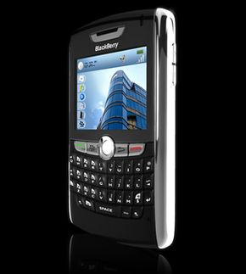


Platform Explosion!
Mosaic
Chrome
Windows
Flash
FireFox
Android
WWW
IE
WAP
Silverlight
1980
1990
2000
2010
Desktop
iPhone
Laptop
BlackBerry
iPad
Netbook
Notes:
Why cross platform?
A few years back software was constrained to the desktop
Increased processor power, battery life, miniaturisation, connectivity => platform explosion
Greater user expectations

Slide 4

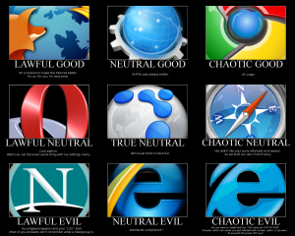


Multi-platform Development
Notes:
We’ll assume that you have determined which platforms to target, and you are in a multi-platform context
The problem:
Different platforms require different technologies, different developer skills, and often different teams.
Need to coordinate features between teams
Mobile space is even worse!
Developing for multiple platforms is costly
I have done multi-platform development the ‘traditional’ way
I have also written cross-platform applications / components

Slide 5

XAML Technologies
Silverlight
Silverlight
WPF
Notes:
Which platform can each XAML technology address?
Notice the phone has become a WP7 device!
WPF can be used on desktop and in the browser as an XBAP
Silverlight can be used OOB on desktop

Slide 6
Why are they different?
Windows Presentation Foundation
Released 2006 (Avalon)
Part of the .NET framework
Runs on Windows machines only
Silverlight
Released in 2008 (WPF/E)
Silverlight is size limited
Silverlight ~ 5MBytes
WPF ~ 75 Mbytes
Runs within the browser
Available for Macs

Slide 7
Framework Differences
WPF
3D APIs
Stylus support (InkCanvas)
More controls
Windows OS only
Access to ‘old’ .NET APIs
Silverlight
Windows and MAC OS
Browser ‘sandbox’
Browser APIs, JavaScript etc …
Out of browser support

Slide 8
Framework Convergence
Silverlight v4
Dependency Object binding
StringFormat
Implicit Styling
Silverlight v5
Implicit DataTemplates
MarkupExtensions
DataContextChanged event
Multiple mouse clicks!
WPF v4
VisualStateManager
WPF
Silverlight
Notes:
Windows Phone 7 SL3 => SL4

Slide 9
The Problem
The “good” bits
WPF
Silverlight
WP7

Slide 10

Practical Steps
Different ‘top level’ classes
⇒ Extensive use of UserControls
Silverlight is a subset of WPF
⇒ Silverlight project is the ‘primary’ project
⇒ WPF files “Add As Link”
Let’s give it a go …
Notes:
WPF has Windows, Silverlight has Pages

Slide 11
Quick summary
Different ‘top level’ classes
⇒ Extensive use of UserControls
Silverlight is a subset of WPF
⇒ Silverlight project is the ‘primary’ project
⇒ WPF files “Add As Link”
Issues so far …
⇒ Compatible Resource URIs
⇒ Design-time data relative URIs
Notes:
WPF has Windows, Silverlight has Pages

Slide 12
The Differences
1. ‘Big picture’ differences
2. The detail …
WPF
Silverlight
WP7
Notes:
Assuming we are happy with targeting the common APIs …

Slide 13
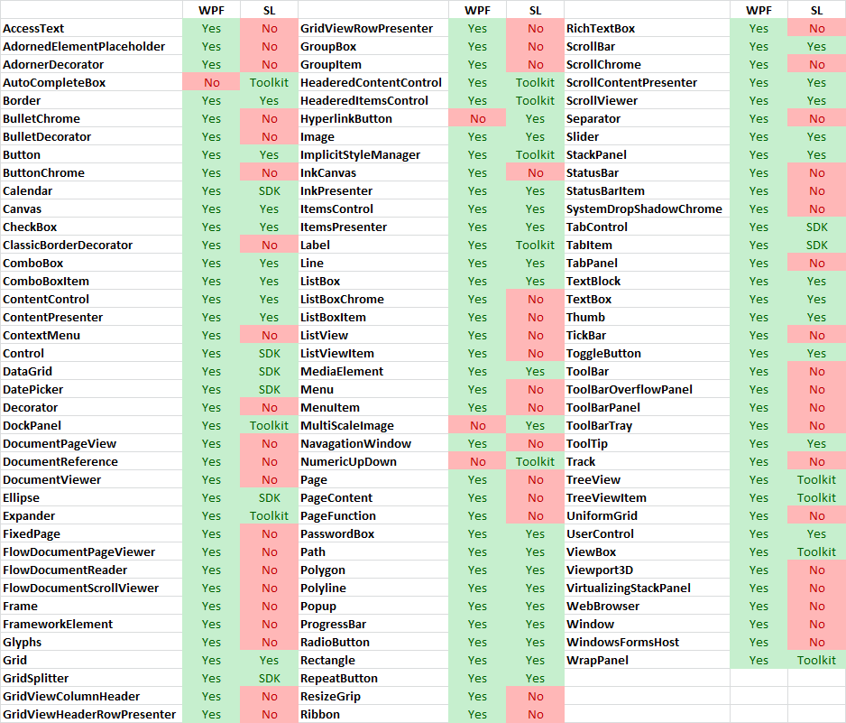
Controls

Slide 14
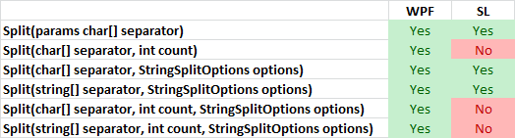
.NET Framework

Slide 15
Control Lifecycle
<UserControl Loaded="UserControl_Loaded">
<my:MyControl Loaded="MyControl_Loaded />
</UserControl>
UserControl Constructor
MyControl Constructor
MyControl Loaded
UserControl Loaded
MyControl OnApplyTemplate
UserControl Constructor
MyControl Constructor
MyControl OnApplyTemplate
MyControl Loaded
UserControl Loaded
Notes:
Things that are not directly documented

Slide 16
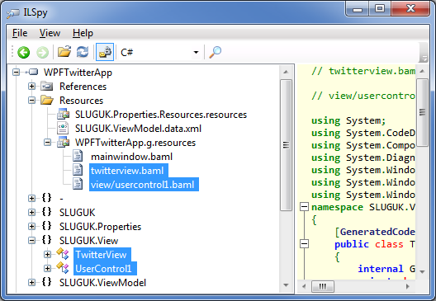
Linked XAML Resources
It’s in the wrong place!!!

Slide 17
Resolving Pitfalls
Linked files
Compiler directives
Partial classes
GoF patterns - adapter

Slide 18
Pitfalls
Framework
DefaultStyleKey
Resource loading
Generic.XAML
Binding differences
BindingMode (default TwoWay WPF)
DPs
WPF has value coercion, read-only properties
Property metadata allows you to add change handlers
Other APIs
Differences in DataGrid

Slide 19
DefaultStyleKey
#if !SILVERLIGHT /// <summary> /// Static initializer for the Gravatar type. /// </summary> static Gravatar() { DefaultStyleKeyProperty.OverrideMetadata(typeof(Gravatar), new FrameworkPropertyMetadata(typeof(Gravatar))); } #endif /// <summary> /// Initializes a new instance of the Gravatar control. /// </summary> public Gravatar() { #if SILVERLIGHT DefaultStyleKey = typeof(Gravatar); #endif }

Slide 20
Linked XAML Resources
<ResourceDictionary
xmlns="http://schemas.microsoft.com/winfx/2006/xaml/presentation"
xmlns:x="http://schemas.microsoft.com/winfx/2006/xaml"> <ResourceDictionary.MergedDictionaries>
<ResourceDictionary
Source="/MySilverlightApplication;component/generic.xaml"/>
</ResourceDictionary.MergedDictionaries>
</ResourceDictionary>
http://devblog.ailon.org/devblog/post/2010/01/13/Writing-WPFSilverlight-compatible-code-Part-6-Adding-XAML-files-as-links.aspx

Slide 21
TargetType
<Style x:Key="MyButtonStyle" TargetType="{x:Type Button}">
TergetType has a TypeConverter

Slide 22
Generic.xaml
<ResourceDictionary xmlns="http://schemas.microsoft.com/winfx/2006/xaml/presentation" xmlns:x="http://schemas.microsoft.com/winfx/2006/xaml"> <ResourceDictionary.MergedDictionaries> <ResourceDictionary Source="/Controls.Gravatar;component/generic.xaml"/> </ResourceDictionary.MergedDictionaries> </ResourceDictionary> http://devblog.ailon.org/devblog/post/2010/01/13/Writing-WPFSilverlight-compatible-code-Part-6-Adding-XAML-files-as-links.aspx

Slide 23
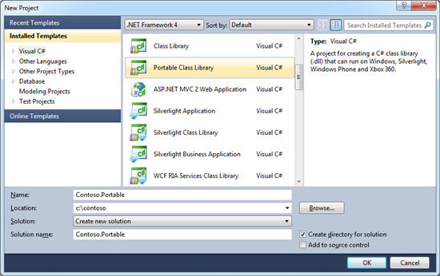
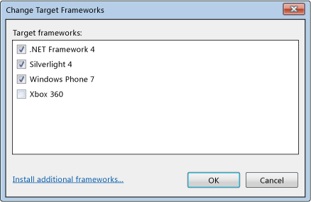
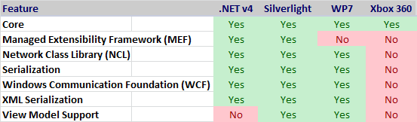
Portable Class Library
http://blogs.msdn.com/b/bclteam/archive/2011/01/19/announcing-portable-library-tools-ctp-justin-van-patten.aspx

Slide 24
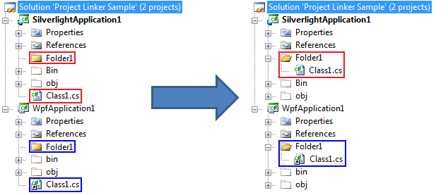
Project Linker
http://msdn.microsoft.com/en-us/library/ff648745.aspx

Slide 25
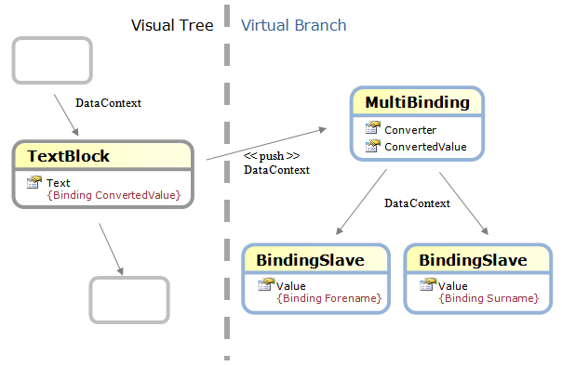
MultiBinding

Slide 26
MVVM WPF
XAMLFinanceViewModel
1
1
TabbedItems
FloatingItems
*
NamedViewModelBase
PriceListViewModel
HeatMapViewModel
InstrumentViewModel

Slide 27
MVVM Silverlight
XAMLFinanceViewModel
1
TabbedItems
http://silverlight.codeplex.com/workitem/5052
*
NamedViewModelBase
PriceListViewModel
HeatMapViewModel
InstrumentViewModel

Slide 28
MVVM WP7
XAMLFinanceViewModel
NamedViewModelBase
1
1
PriceListViewModel
HeatMapViewModel
InstrumentViewModel

Slide 29
Silverlight and WPF code reuse pitfalls
(http://www.sharpgis.net/post/2009/02/06/Silverlight-and-WPF-code-reuse-pitfalls.aspx)
Writing WPF / Silverlight compatible code
http://devblog.ailon.org/devblog/post/2009/11/02/Writing-WPFSilverlight-compatible-code-Part-1-The-Big-Picture.aspx
Guidance on Differences Between WPF and Silverlight, Wintellext LLCert
http://wpfslguidance.codeplex.com/releases/view/30311
http://nerddawg.blogspot.com/2008/03/silverlight-2-demystifying-uri.html

