Slide 1
bail
run & profile
run
run
parse
generate
compile
Baseline compiled code
compile
Ion-compiled code
Characters
AST
Bytecode

Slide 2
bail
run & profile
run
run
parse
generate
compile
Baseline compiled code
compile
Ion-compiled code
Characters
AST
Bytecode
asm.js

Slide 3
garbage collection
parse
re-optimise
compile + optimise
execute

Slide 4
garbage collection
parse
re-optimise
compile + optimise
execute
decode
execute
compile + optimise

Slide 5
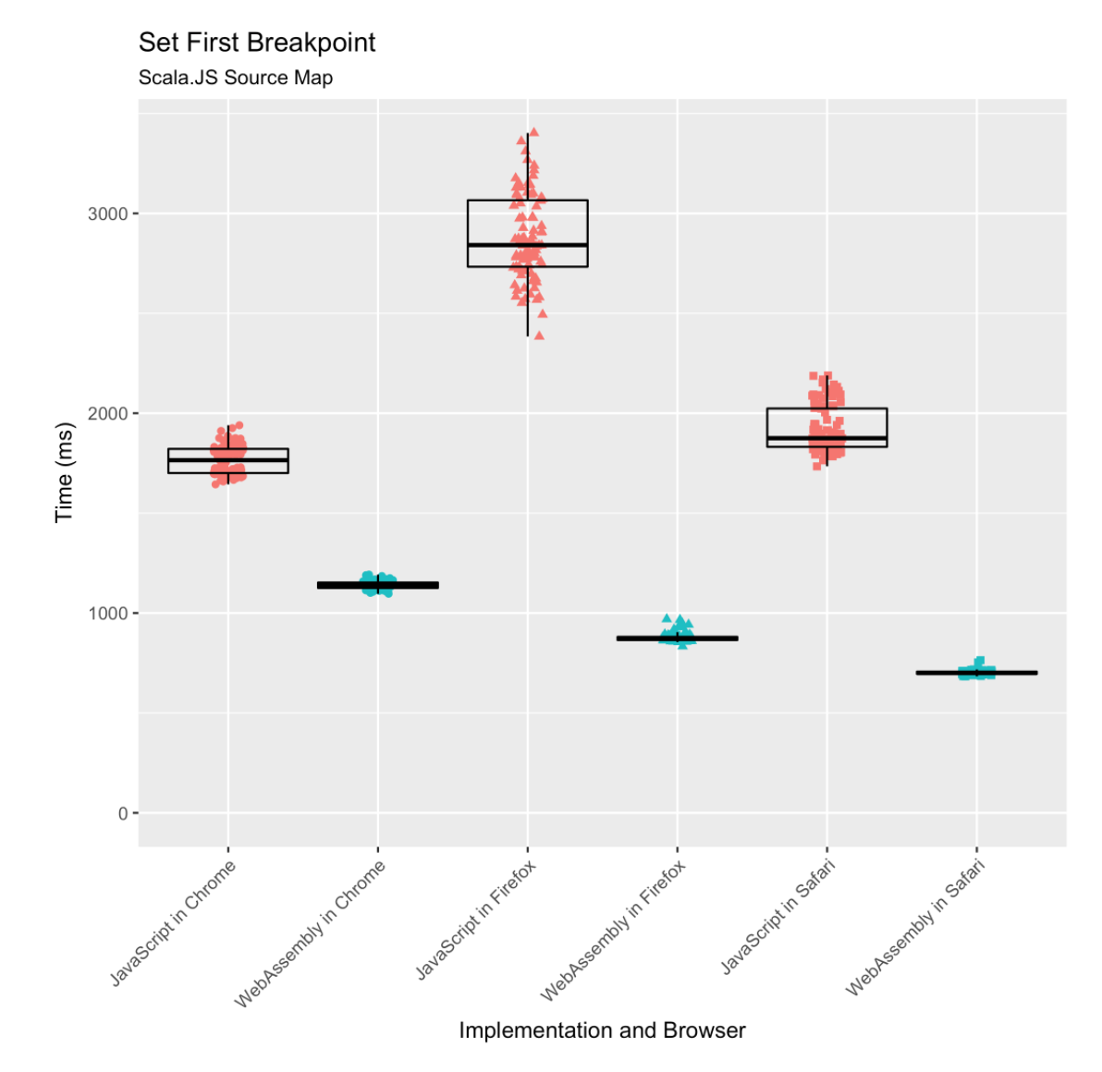
Chrome
FireFox
Safari
3s
JavaScript
WebAssembly
2s
1s
0s

