Slide 1


bdl: Interface and tools to Local Data Bank API
Krzysztof Kania

Slide 2
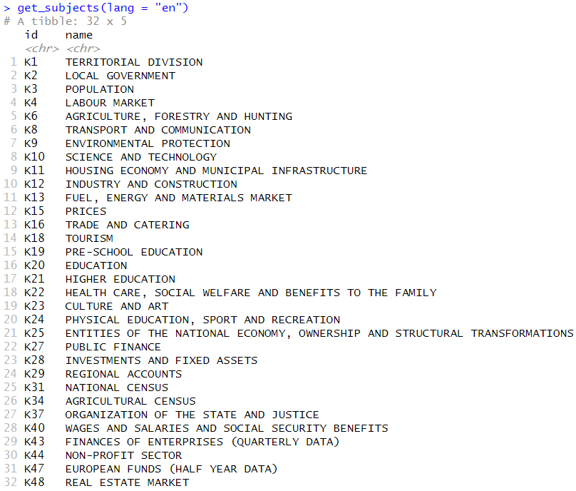
About Local Data Bank
~40 000 variables
More info at:
https://bdl.stat.gov.pl/BDL/start

Slide 3
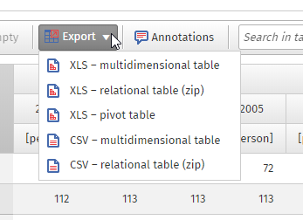
Back in the days…
get_data_by_unit(unitId = c("020800000000", ”023200000000"),
varId = "60559")
https://api.stat.gov.pl/Home/BdlApi

Slide 4
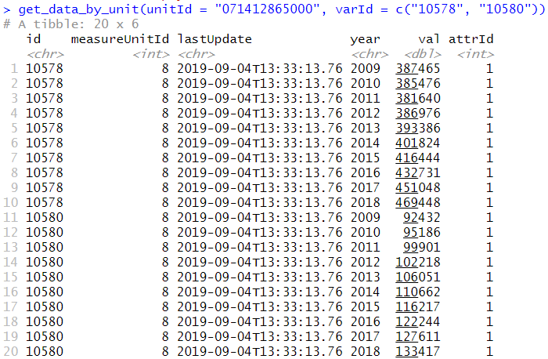
Downloading data
Example: passenger cars with engines smaller than 1399 cm3 (varId = 10578) and bigger than 2000 cm3 (varId = 10580) in Warsaw, all available years

Slide 5
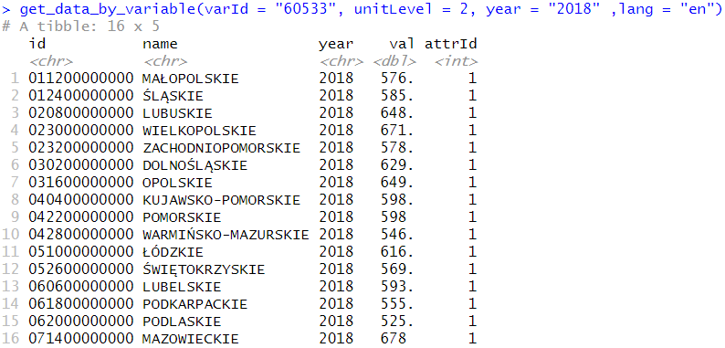
Downloading data
Example: passenger cars per 1000 population in all voivodships in 2018
More info at:
https://bdl.stat.gov.pl/BDL/start

Slide 6
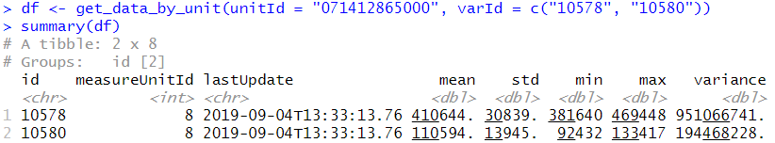
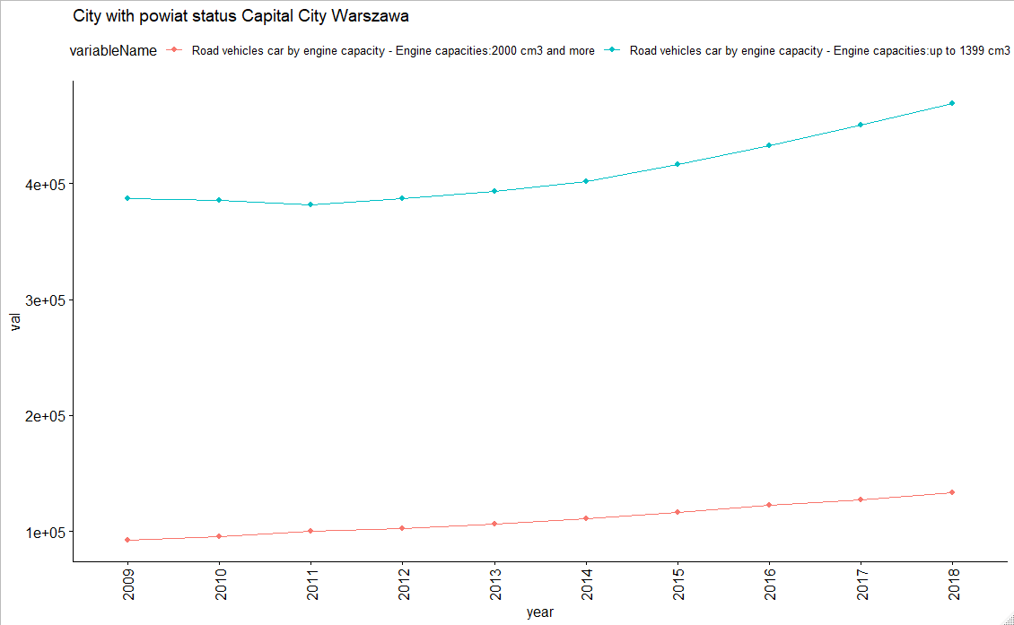
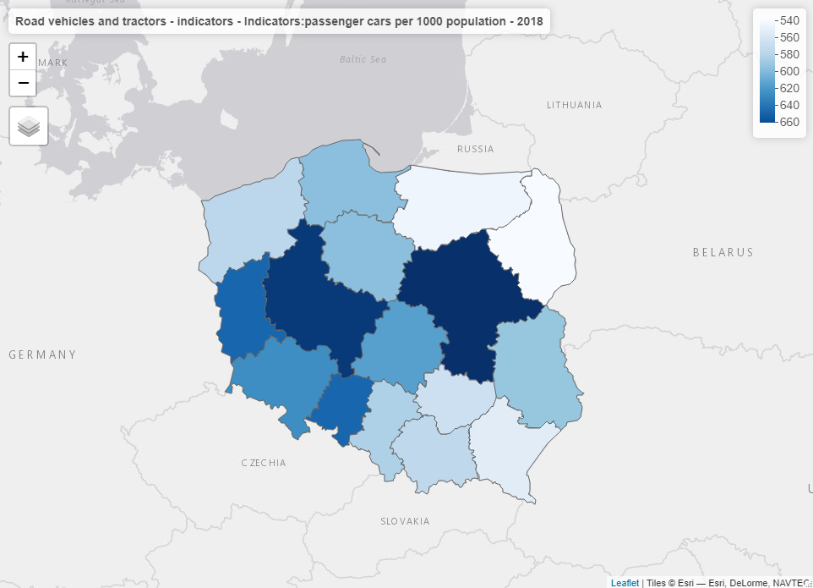
Some tools
Built-in summary
Quick-plotting functions
Map generation

Slide 7
Thank you for youR attention
GitHub:
https://github.com/statisticspoland/R_Package_to_API_BDL
CRAN:
install.packages("bdl")

