Slide 1
How to deal with nested lists in R?
}
Using the purrr, furrr and future packages in practice.
Lidia Kołakowska • Data Scientist, Sotrender
Why R? 2019 Conference • Warsaw, 29.09.2019
Notes:
Hello! Welcome to my presentation. My name is Lidia Kołakowska, I work as data scientist at Sotrender.
let's start with a question: Which one of you was frustrated with working with nested list or lists in general?
in today's presentation I'll try to show you how deal with nested list in R and which packages are helpful in these cases

Slide 2
Data set
Downloaded data on social issues, elections or politics ads from Facebook Ad Library API
Return the respons in JSON format
Facebook allows publish articles or research about or related to the use of the Ad Library API e.g. political advertising analysis
Notes:
at first, let's look at the data set which has been used for examples in this presentation.
They have been downloaded from Facebook Ads Api.
the data relates to political advertising on facebook.
what is important, you can publish the results of analyses based on them,
I encourage you to try your hand at it

Slide 3
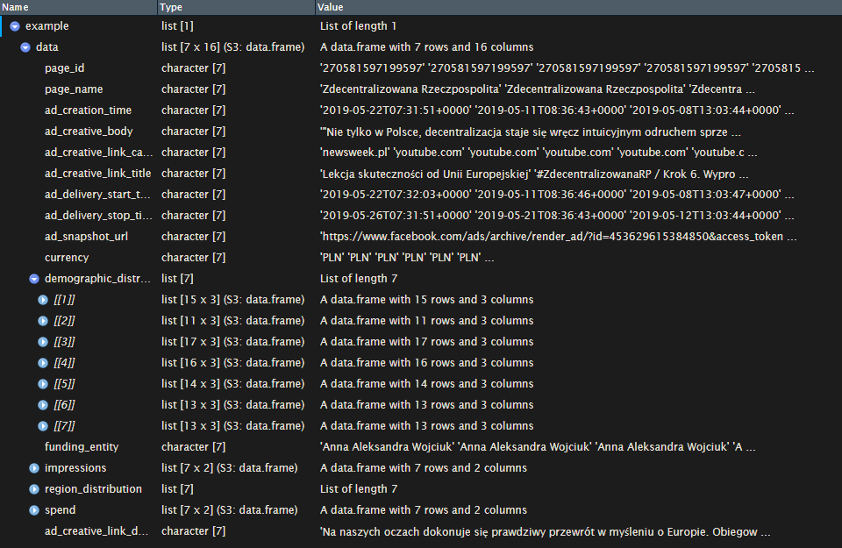
Example nested list loaded from JSON
Notes:
here is an example of a loaded file to R from downloaded JSON.
As you can see It contains information about one advertising account for which the results were returned from API.
the elements of this list are not only vectors but also the date frames.
What's more, there are more lists nested in them, for example a list item named “demographic distribution”,
we can see other nested data frames with data about demography of the recipients of individual advertisements
To be honset, it looks complicated for beginner user of R

Slide 4
Nested lists
Elements of list e.g. demographic_distribution are data frames – we cannot easily flatten them into a data frame
Custom ids are needed for elements in nested list elements to connect them to the parent elements
Notes:
What made it complicated?
As I said before, some elements are lists of data frame, so we can't easily just flatten them and we need to think on another way to make one data frame from this data.
The solution that I propose is to combine the data into a data frame, I will give a custom id to elements of list to merge them with others

Slide 5
How to deal with data in nested list?
Notes:
But… my first thought in this project was exactly this sentence.
If you think the same thing now, don't worry, I'll show you how to handled it.

Slide 6

Key packages
purrr
future
furr
/tidyverse/purrr
/HenrikBengtsson/future
/DavisVaughan/furrr
Notes:
Please Focus on these three packages: All are available on github
purrr - toolkit which you can use to working with list, contains map() family functions, i use it to iterate over list, and sine i use it i’ve forgot about for loop
The second one
future - R package that allows you to execute parallel processing
furrr - the combination of the first two packages, basically this package maps purrr’s family functions on future’s parallel processing capabilities.
furrr has been designed to work identically to purrr and it’s syntax is so easy,
you will see in the exmaples

Slide 7
Environment setup
# load environment and necessary packages
library(dplyr)
library(jsonlite)
library(purrr)
library(fs)
library(furrr)
library(future)
# define project path and data directory
proj.dir = "/home/lkolakowska/path/to/your/project”
data.dir = proj.dir %>%
paste0("data/")
Notes:
so let’s get started with sniped of code!
here is loading of all necessary libraries, in addition to the above we need package to load jsons - jsonlite,
fs – is packges to work with system directories and files
and of course dplyr.
I set up project directory and subdirectory with downloaded data

Slide 8
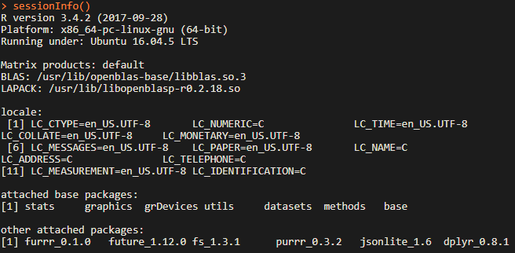
Environment
Notes:
Next let’s have a look on sessions info.
What is important in this example linux was operating systems system. it matters if we work with future package.
Because there are few diffrente ways to parallel procesing. Here we use multicores, on Windows you can use clusters instead

Slide 9
Loading data into R
# load data from json format
data.microtargeting = data.dir %>%
# get a list of subdirecories
dir_ls %>%
# get paths to json files in subdirectories
map(~dir_ls(.x, regexp = "json")) %>%
unlist() %>%
# load data from jsons into lists
map(fromJSON) %>%
# get only „data” element of every list
map("data")
Notes:
To work on data we need to load the into R. I do this in pipe.
Here are defined path to data directory, then we get list of subdirecotires.
Then funcion get paths to json files in subdirectories
Iteratin over list map load json files
Then get only data element from every json as list
Data is loaded data.microtargeting variable next step: add custom ids with anonymous functions

Slide 10
What are anonymous functions?
They are used in apply() functions family
In purrr packages they are user-specified, one-sided formula
They have no identity and no name
They will not live in the global environment
Notes:
next step: add custom ids with anonymous functions
They most frequency used by R user in apply functions family
The advantage of these functios is fact that they are user specifated and can be one –side formulas
They have no name and identity so they will not live in the glob environmet

Slide 11
Examples
# example list with numbers
your.list = [0, 1, 1, 2, 3, 5, 8, 13, 21, 34, 55, 89, 144, 233, 377]
# one line formula example
purrr::map(your.list, ~.x * 0.75)
# transfer data frame as result of operations on data
purrr::map(your.list, function(single.element){
df = single.element * 0.75
return(df)
})
Notes:
Here are some examples of anonymous functions usage in combination with purrr package

Slide 12
When should you use
anonymous functions?
„When it’s not worth the effort to give it a name"
Hadley Wickham
Notes:
You can maybe ask
When should you use anonymous functions?
As Hadley Wickham says When it’s not worth the effort to give it a name

Slide 13
Example use of anonymous functions
# add custom ids to nested data frames
data.microtargeting = data.microtargeting %>%
# unfilter empty elements from list with data
purrr::compact() %>%
# get every data frame of list and add custom id as new columnto them
map(function(df) {
# create vector with sequence of row numbers
custom_ad_id = seq(1, nrow(df), by = 1)
# combine custom id with unique ad id
df = df %>%
mutate(ad_id = paste0(page_id, "_", custom_ad_id))
return(df)
})
Notes:
let's return to the example!
data.microtargeting is list of lists with data from API
First, we want to have only items with data in our list, there was also empty json returned from api
so we unfliter them with compact function from purrr package
After that we want to ad custom id to every element in the list as new column of the data frame
That give us unique id for every row (unqiue ad data) in all list with all data

Slide 14
The process takes too long…
Notes:
if you are an experienced R user, you definitely know that this operation can take a long time.
Why we don’t seepd up a proces?
The second questions is… How to do this?

Slide 15
Let’s parallel code!
What it gives us?
Speed up processing
Decrease memory footprint
Avoid data transfer
Notes:
The answer is to paralel code!
What it gives us? Main advantages are
Speed up processing
Decrease memory footprint
Avoid data transfer

Slide 16
Parallel programming using pipe in R
# set up parallel processing with numer of multicores
plan(multicore=6)
data.microtargeting = data.microtargeting %>%
purrr::compact() %>%
# change purrr function to furrr function equivalent
future_map(function(df) {
custom_ad_id = seq(1, nrow(df), by = 1)
df = df %>%
mutate(ad_id = paste0(page_id, "_", custom_ad_id))
return(df)
}, .progress = TRUE)
Notes:
Let’s use it in our pipe code snipet.
There is exactly same operation but with parallel programming.

Slide 17
Parallel programming using pipe in R
# set up parallel processing with numer of multicores
future::plan(multicore=6)
data.microtargeting = data.microtargeting %>%
purrr::compact() %>%
# change purrr function to furrr function equivalent
furrr::future_map(function(df) {
custom_ad_id = seq(1, nrow(df), by = 1)
df = df %>%
mutate(ad_id = paste0(page_id, "_", custom_ad_id))
return(df)
}, .progress = TRUE)
Notes:
Here you can see hightlighted parts that changed.
The most important thing is to define plan(). It’s function from future package. Here we set up proces for 6 multicores.
Other change is future map function from furr package. It doesnt work in paralel way without plan function defined.
Syntax looks exactly the same as in map function.
Other nice functionallity of this function is progres bar, which you can add by .progres argument.

Slide 18
Summary
Working with nested lists can be very efficient
First perform operations on the individual elements of the list, only then combine them into one large data frame
Speed up your work by performing a parallel programming
Notes:
summarizing

Slide 19
Resources that made it easier to create this presentation
H. Bengtsson, „Future: Parallel & Distributed Processing in R for Everyone”, eRum 2018, Budapest
H. Bengtsson, „Future: Friendly Parallel Processing in R for Everyone”, SatRday Paris 2019
M. Jones, „Quick Intro to Parallel Computing in R”, 2017
L. Singham, „Anonymous Functions in R and Python”, 2017
H.Wickham, „Advanced R” - Functional programming
Cool but useless, „Anonymous Functions in R - Part 1”, 2019

Slide 20


Thanks!
I am Lidia Kołakowska
You can find me at
/in/lidia-kolakowska/
/lidkol

