Slide 1
A Case Study for Image Classification using Transfer Learning
Olgun AYDIN
Senior Data Scientist

Slide 2
Content
Introduction
Deep Neural Networks
Transfer Learning
Case Study

Slide 3
Introduction
Deep Learning (DL) is rising star of Machine Learning (ML) and Artificial Intelligence (AI) domains and it has been proven that deep neural networks(DNN) are one of the most crucial inventions for the 21th century.
Nowadays, DNNs are being used as a key technology for many different domains: self-driven vehicles, smart cities, security, automated machines.
For the purpose of this use case, DNN has been trained by using images of products on the store shelves as input, product categories (cereals, milk, soda, etc.) as label . Transfer Learning(TL) has been used during to train such a deep neural network predicts product category regarding given image of product.

Slide 4
Introduction
For the training of the DNN, open source Freiburg Grocery Dataset has been used. The VGG16 network, developed by Oxford University researchers, has been used to perform TL.
Due to the nature of TL, it is necessary to freeze some layers and retrain them with a new structure. For this purpose, only the final layer has been frozen first, then the last five layers have been frozen. These networks have been trained using different combinations of epoch and batch sizes.
After comparing the performance of those networks, best performed model has been used for creating user interface.
Shiny application has been created to provide user interface to end users. This Shiny application basically calls the trained model and predicts product class for the image uploaded by the user.

Slide 5
Deep Neural Networks
DNN is an ML method that allows computers to learn from experience and understand the world in the context of a hierarchy of concepts. Because the computer collects information from the experience, it is not necessary to specify all the information required by the computer.
The focus is on three main architectures. These with Convolutional Neural Networks (CNN) which are generally used for image related tasks, Long-Term Memory Networks (LSTM) and Recurrent Neural Networks (RNN) which are often used to model time series.

Slide 6
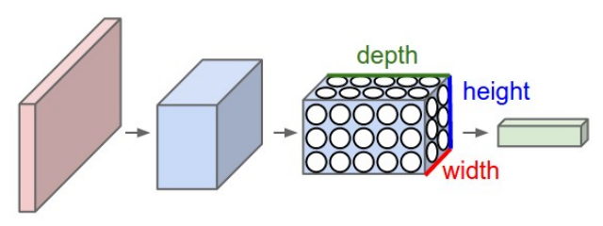
Convolutional Neural Networks
CNN is the most advanced form of feed-fed neural networks and gives very successful results in image recognition.
In this structure, the picture is divided into pieces and the parts are filtered, there is a reduction in the picture according to the size of the applied filter

Slide 7
Recurrent Neural Networks
RNN is a network structure in which the feedback from the intermediate layers to the input units or to the previous intermediate layers is made.
These kinds of neural networks have dynamic memories. The output of neurons does not only depend on the current input values, but also depends on the previous input values.
These networks are particularly effective in estimating the time series of various types (Goodfellow and et al. 2016).

Slide 8
Long Short Term Memories
LSTM is a variant of RNN. LSTM was proposed by Sepp Hochreiter and Bergen Schmidhuber in the late 90s in order to develop a network that learned the long-term relationships in the data set.
LSTMs are designed to avoid long-term dependency problems.
All recurrent neural networks have the form of recurring modules of a neural network. In standard RNNs, this repetitive module is simple as a single tan layer.
LSTM networks also have repetitive modules that resemble chains as in RNNs. However, the repeating modules have a different structure than the RNN structure.
Instead of a single neural network layer, there are four layers that interact in a very special way (Greff and et al. 2015).

Slide 9
Transfer Learning
TL attempts to change this by developing methods for using past experiences to transfer the information learned in one or more tasks and to improve learning on a related task.
The techniques that provide information transfer aim to make ML as efficient as human learning. Transfer methods are heavily dependent on ML algorithms used to learn tasks.

Slide 10
Transfer Learning
Usually these algorithms can be considered as extensions. Some studies in TL are in the context of inductive learning and include expanding well-known classification and inference algorithms such as neural networks, Bayesian networks and Markov Logic Networks.
Another main area of usage is in the context of reinforcing learning and includes the expansion of algorithms such as Q-learning and policy search (Torrey and Shavlik, 2010).

Slide 11
Case Study
Within the scope of this study, a data set called Freiburg Groceries Dataset was created and used for in-store image classification problems consisting of 5000 pictures (De Biasio, 2019).
The Freiburg Groceries Dataset consists of 4947 images of 25 grocery classes, with 97 to 370 images per class. Figure 8 shows an example of images from the data set and Figure 9 shows an overview of the number of images per class. Images were collected using four different smartphone cameras at various stores in Freiburg, Germany.

Slide 12
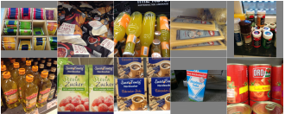
Case Study
The images vary in the degree of clutter and real-world lighting conditions, ranging from well-lit stores to kitchen cupboards. Each image contains one or multiple instances of one of the 25 classes. All images are in size of 256×256 pixels (Jund, 2016).

Slide 13
Case Study
Store layout and product placement has always been an important factor to increase product sales for retailers.
Managing product placement over hundreds of products is a challenging task using relograms and planograms.
For the purpose of this use case, DNN was trained by using photographs of products and store shelves that are the only inputs of the process. TL was used during the training of the network.

Slide 14
Case Study
For the training of the DNN, open source “The Freiburg Groceries Dataset” was used. In this study to identify product categories of an object on given photo, TL was used during the training of networks.
The data set was divided into two sets as a training and validation set.
On the top of Google Cloud Engine, TL was carried out using the VGG16 network with the help of the Tesla K80 Graphics Processing Unit (GPU) in the ecosystem created on the Linux Ubuntu 16 OS.

Slide 15
Case Study
In this context, at the beginning last layer was frozen first and trained networks with following configurations;
batch size 500 and number of epoch 10,
batch size 800 and number of epoch 10,
batch size 1000 and number of epoch 10,
batch size 800 and number of epoch 15,
batch size 1000 and number of epoch 15

Slide 16
Case Study
Then, last 5 layers were frozen with following configurations;
batch size 500 and number of epoch 10,
batch size 800 and number of epoch 10,
batch size 1000 and number of epoch 10,
batch size 800 and number of epoch 15,
batch size 1000 and number of epoch 15.

Slide 17
Case Study
Training process was done using Keras Python library. As discussed in section 2.3.1, Keras provides flexible, easy to use environment. It’s also possible to use state-of-the-art architectures on the top of Keras.
Using the VGG architecture is very easy with the Keras deep learning library to apply TL. Keras provides an interface for loading and using pre-trained models.

Slide 18
Case Study
With this interface, a VGG model can be created and used as a starting point using pre-trained weights or used as a direct model for classification of images.
The Keras enables the use of both the 16-layer and the 19-layer version of the VGG through the VGG16 and VGG19 classes.
VGG 16 model can be created as follows;
from keras.applications.vgg16 import VGG16
model = VGG16()

Slide 19
Case Study
When the above command is run for the first time, Keras will download the weight files from the Internet and save them in the ~ /.keras/models directory on the computer.
Standard Keras tools can be used to examine the model structure. For example, a summary of the network layers can be obtained as follows.
from keras.applications.vgg16 import VGG16
model = VGG16()
print(model.summary())

Slide 20
Case Study
Following command can be used to freeze the last layer. This is basically just a simple for loop.
for layer in model.layers[:-1]:
layer.trainable = False
Following command can be used to freeze the last 5 layers. This is basically simple for loop.
for layer in model.layers[:-5]:
layer.trainable = False

Slide 21
Case Study
Afterwards custom layers can be created and used instead of frozen layers. Following command can be used to adding custom layers
model.add(layers.Flatten())
model.add(layers.Dense(1024, activation='relu'))
model.add(layers.Dropout(0.5))
model.add(layers.Dense(25, activation='softmax'))

Slide 22
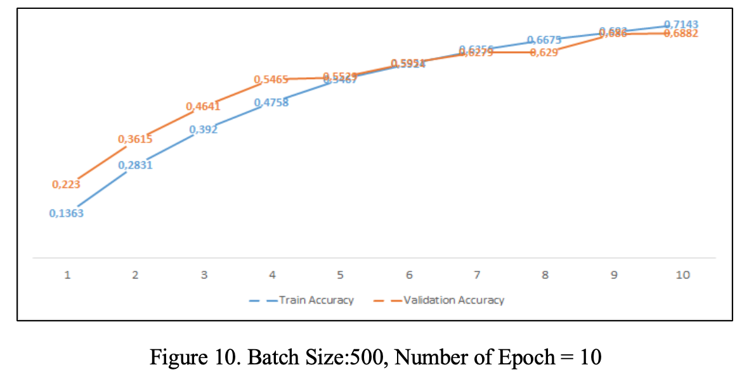
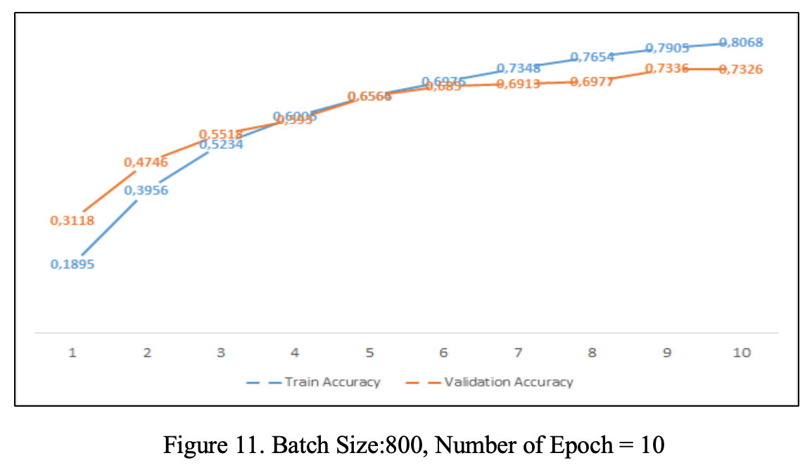
Case Study

Slide 23
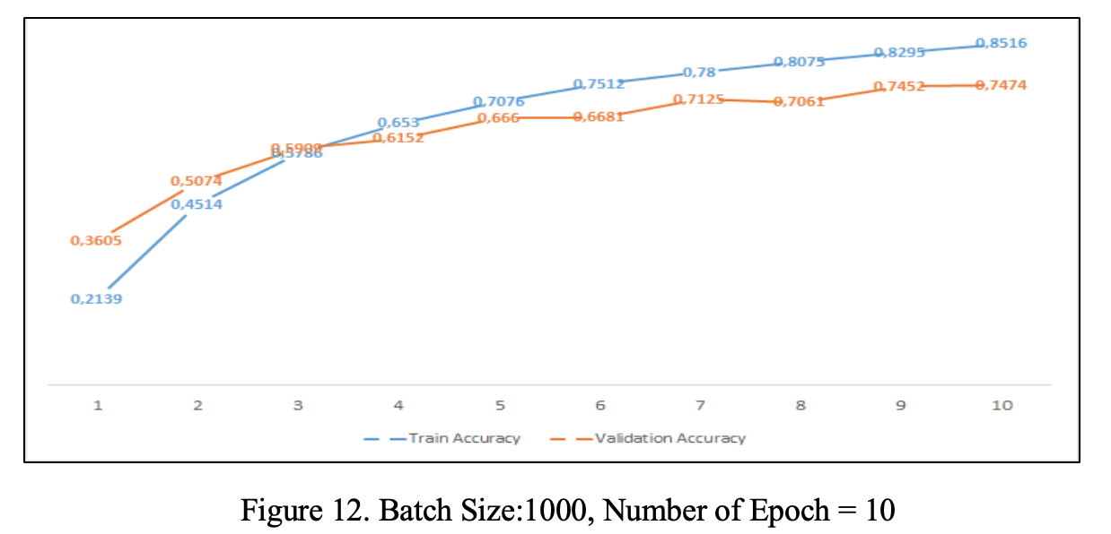
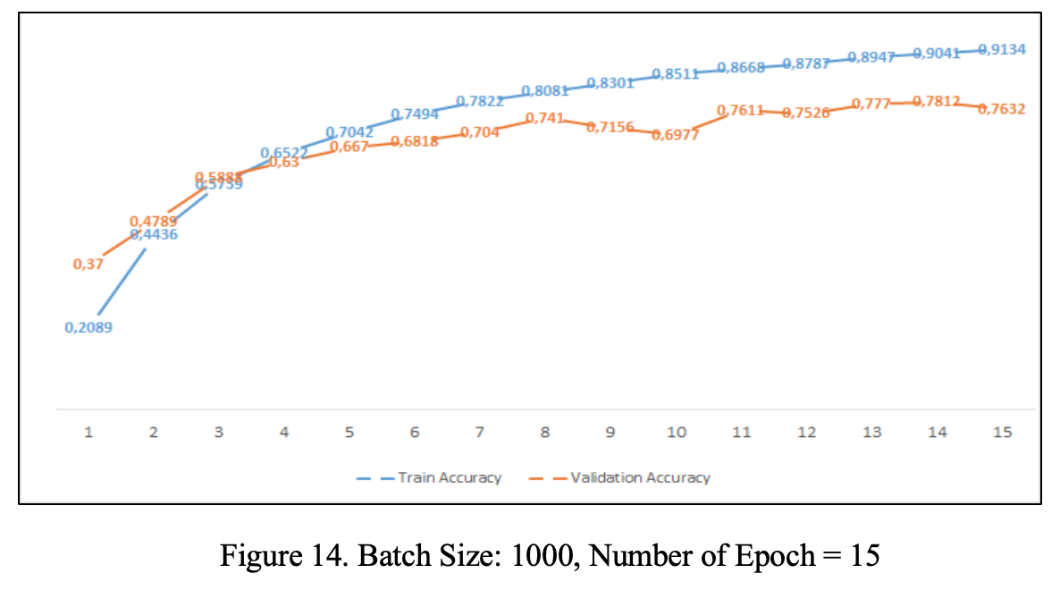
Case Study

Slide 24
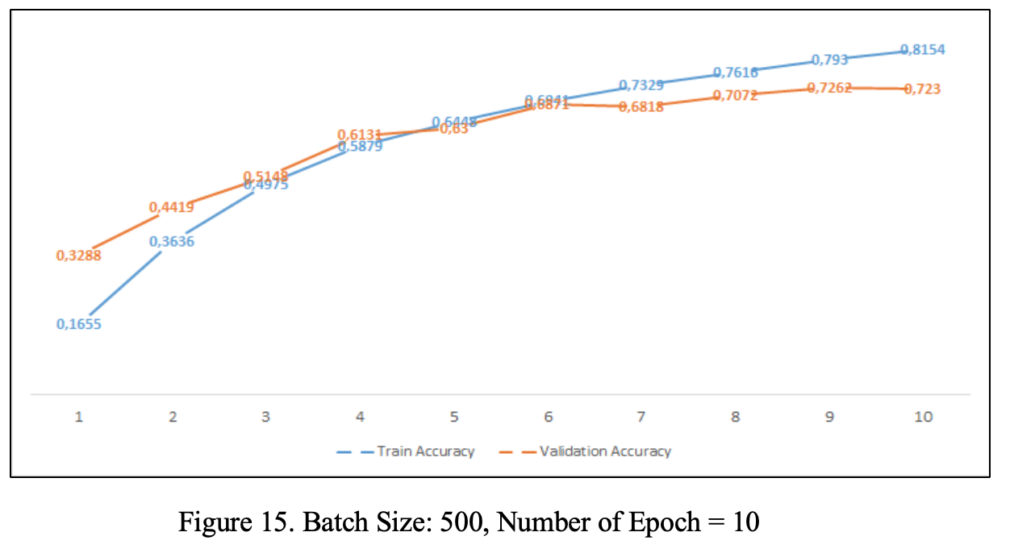
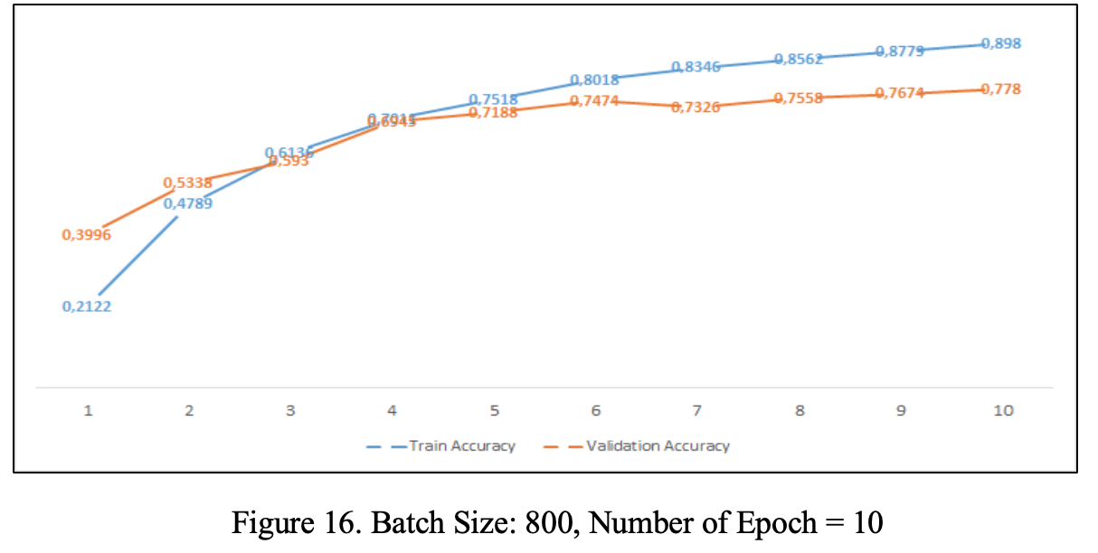
Case Study

Slide 25
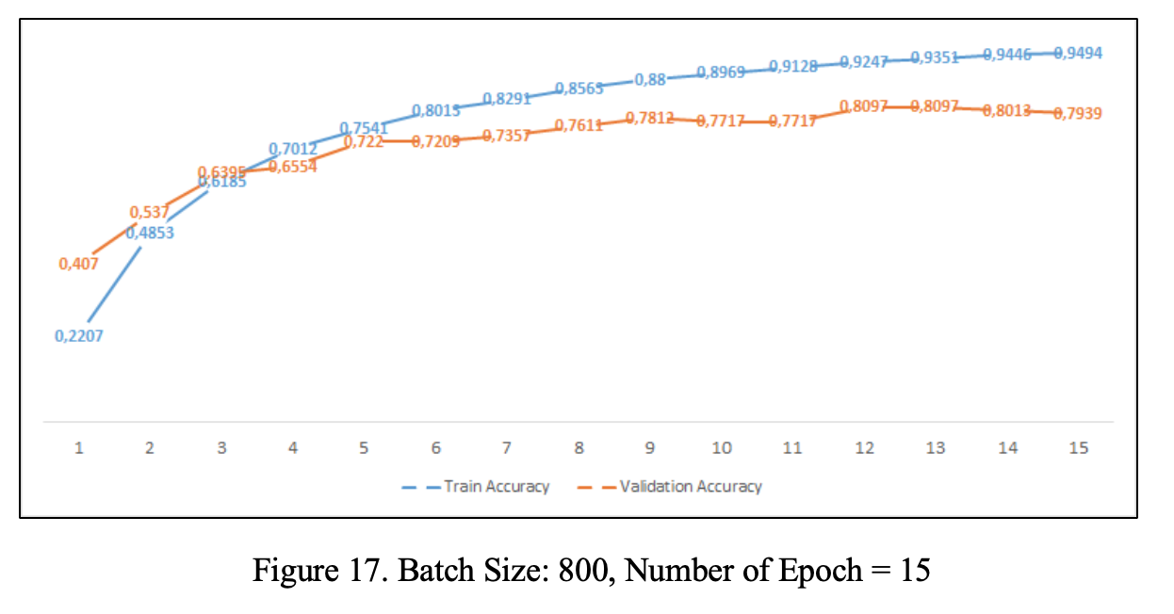
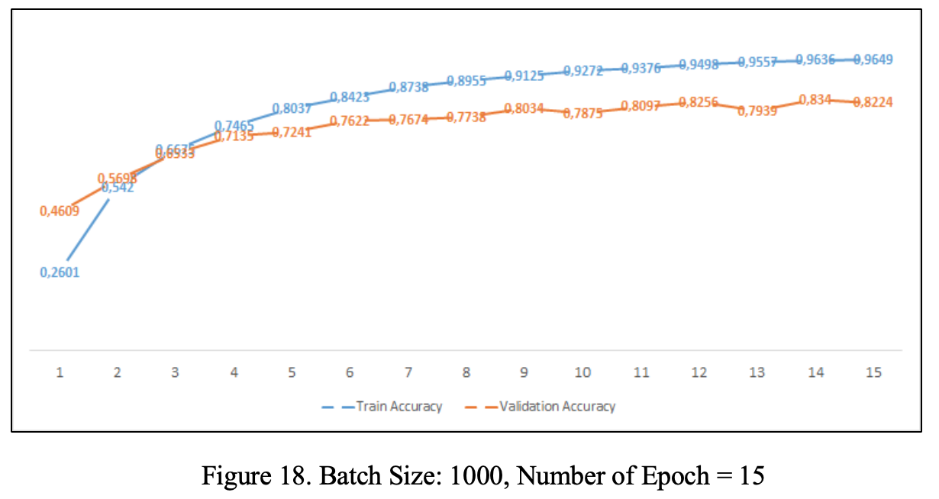
Case Study

Slide 26
Thank you
For any questions, please don’t hesitate to send me email.
Olgun AYDIN, olgun.aydin@pwc.com

