Slide 1


D3 + DALEX = ?
Hubert Baniecki
WhyR? 2019
Warsaw 29.09.2019

Slide 2


JavaScript library for producing dynamic, interactive data visualisations
Operates on HTML, CSS and SVG
Simple plots or advanced visualisations
Descriptive mAchine Learning EXplanations R package
Explainable AI and Interpretable ML area
Wrapper for other packages, that produce local and global model explanations

Slide 3



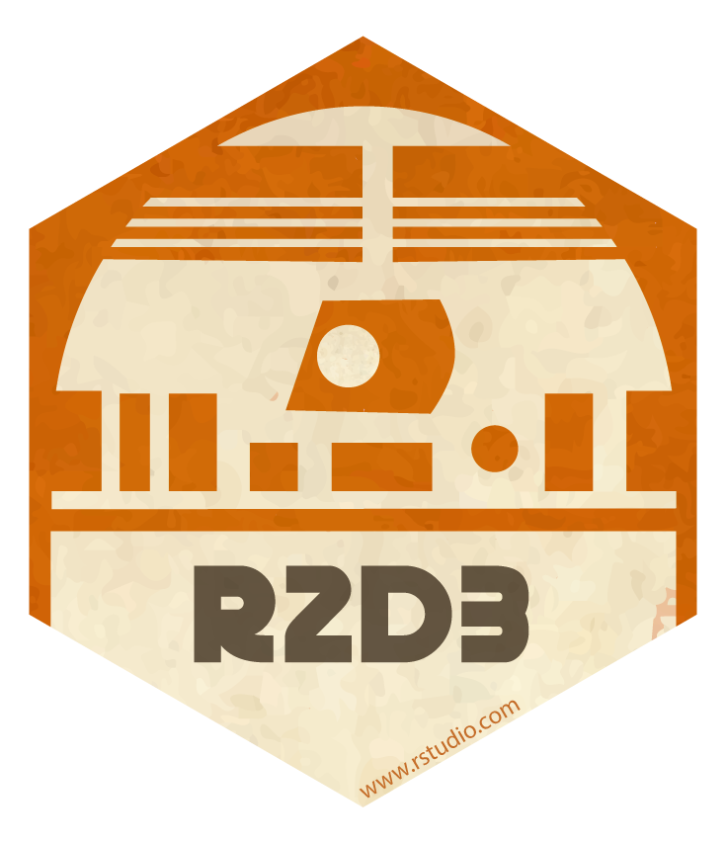
plotD3 – new form of explanation

Slide 4
Interactivity adds another dimension
tooltip, clickable legend, mouseover highlight, animation

Slide 5

D3 + DALEX = Interactive Studio with Explanations for ML Predictive Models
in R

Slide 6
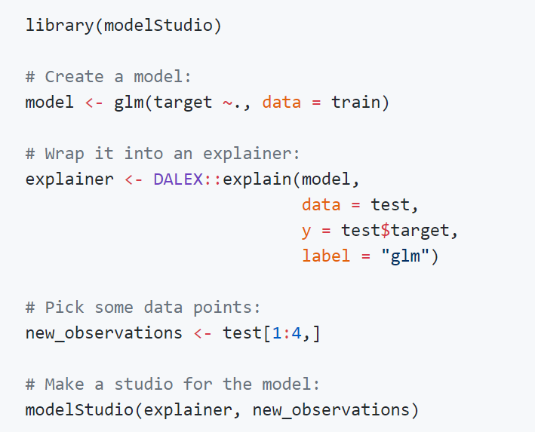
Basic Workflow:
Create a model
Wrap it into an explainer
Pick some data points
Use modelStudio

Slide 7
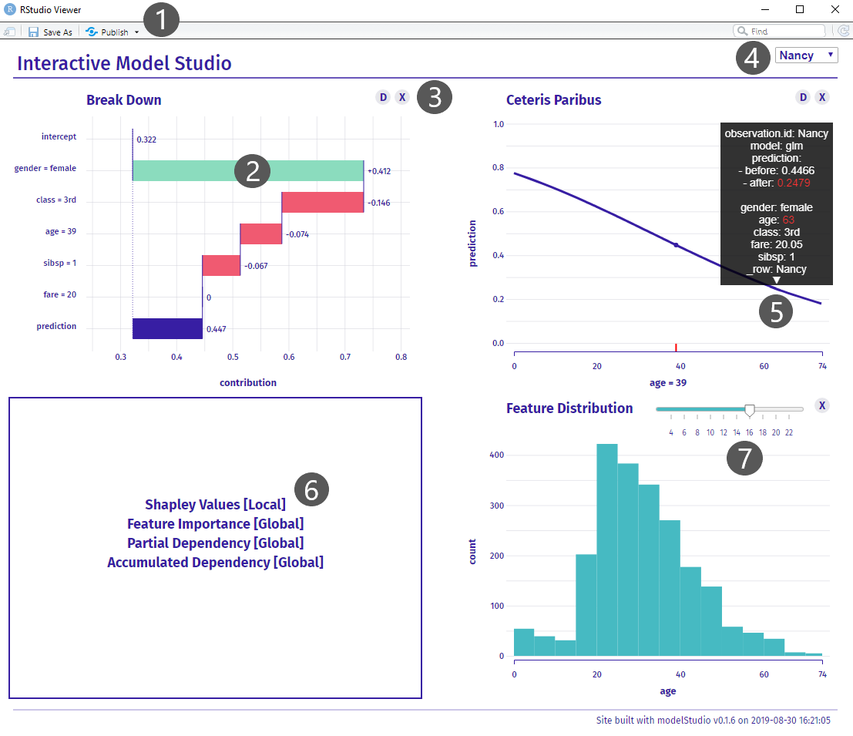
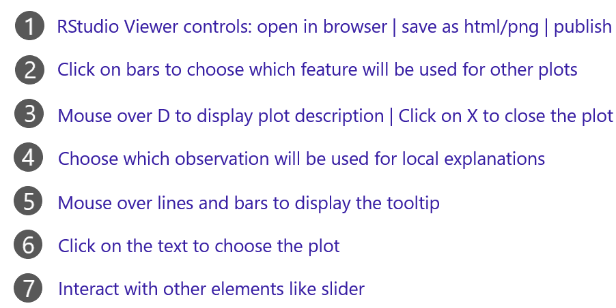
Cheat Sheet

Slide 8
WhyModelStudio?
Less time coding = More time analysing
Wider context = Better explanations
Advantages:
Automation
Customisation
New information
Engaging experience
Save, send, share

Slide 9
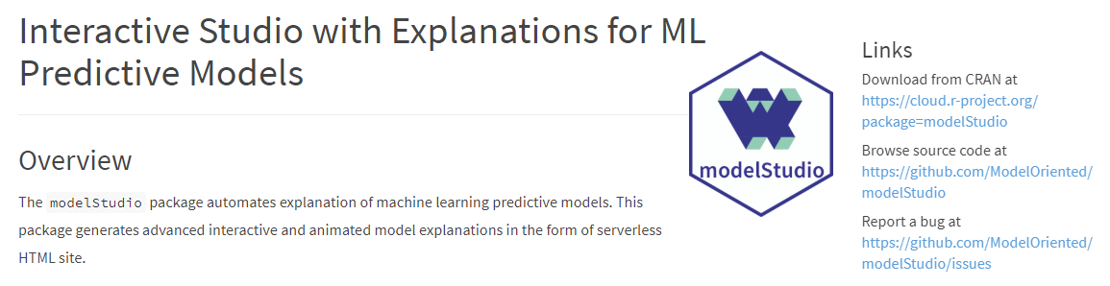


https://github.com/ModelOriented/modelStudio
References:
modelStudio cran.r-project.org/package=modelStudio
DALEX github.com/ModelOriented/DALEX
Model Oriented github.com/ModelOriented
DrWhy github.com/ModelOriented/DrWhy
r2d3 rstudio.github.io/r2d3/
Predictive Models: Explore, Explain, and Debug pbiecek.github.io/PM_VEE/
D3.js d3js.org
Contact:
github.com/hbaniecki
linkedin.com/in/hubert-baniecki

Slide 10
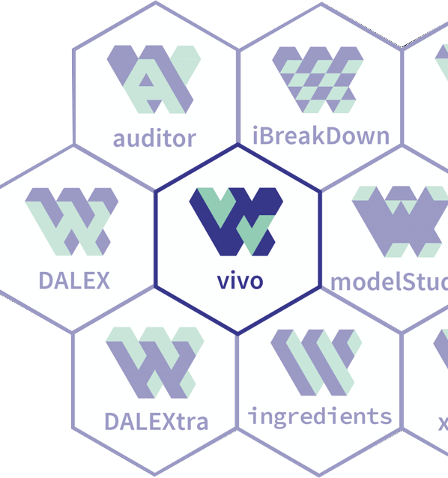

MI2DataLab research lab is looking for you!
Are you intreseted in XAI, AutoML, AutoEDA other innovations in the next generation of ML?
Come to us
http://bit.do/MI2isHiring
Your
project

