Slide 1
Natural Language Processing for Screenplays
Colin Clemence
DSI_SM_01

Slide 2
Objectives
Explore and Compare unique characteristics of screenplays to identify if the writers have unique thumbprint in their style.
Visualize Topic Models from the documents

Slide 3
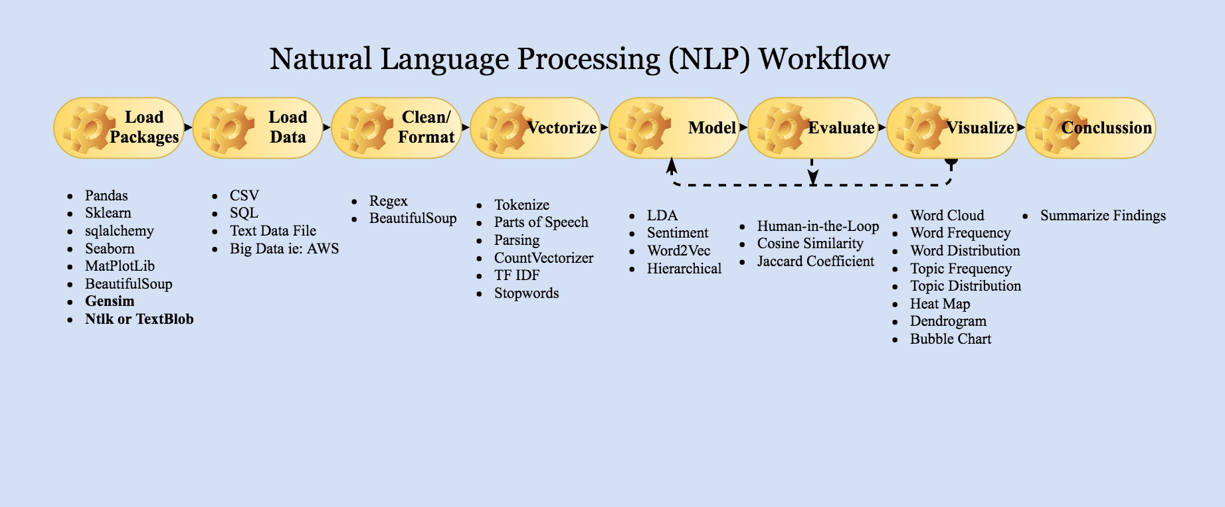
Process

Slide 4
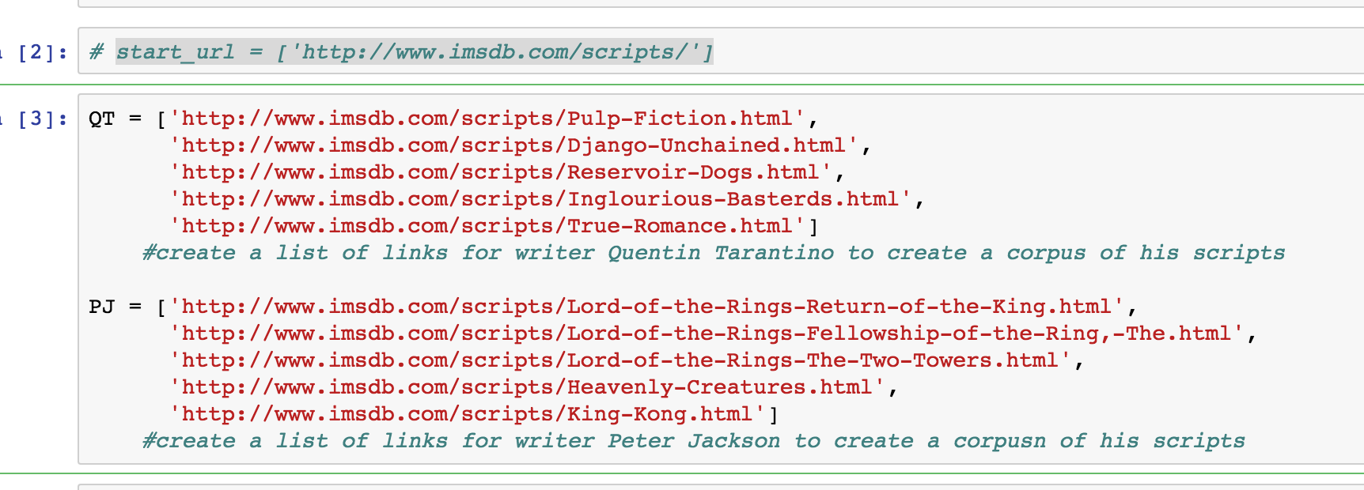
Data/ Web Scrape
Data Source: International Movie Script Database
Packages Utilized: Requests and BeautifulSoup

Slide 5
Model Insights
Latent Dirichlet Allocation (LDA): Topic Modeling
CountVectorizer: Uni-Gram and N-Gram Distributions
Doc2Vec: Distribution Characteristics within Documents
Word2Vec: Pair Associated Words and Topics

Slide 6
Blockers
Cleaning the HTML to Vectorize
Formatting Documents into the Corpus
Applying the Corpus to other models
Time

Slide 7
Conclusion
Minimum Viable Product: This capstone presentation is more of a milestone on the journey toward a deeper understanding of Natural Language Processing and my ultimate goals:
Build a recommender system to recommend films using LDA topic modeling to find similar topics/ writers
Predict IMDB Rating
Predict probability of Best Screenplay Oscar by profiling past 10 years of Oscar Winners of Best Screenplay

