Slide 1
Intelligent Robots Lab
Prof. Qi hao
03/05/2019
Brief introduction to MATLAB
How to program your homework
Robotics System Toolbox

Slide 2

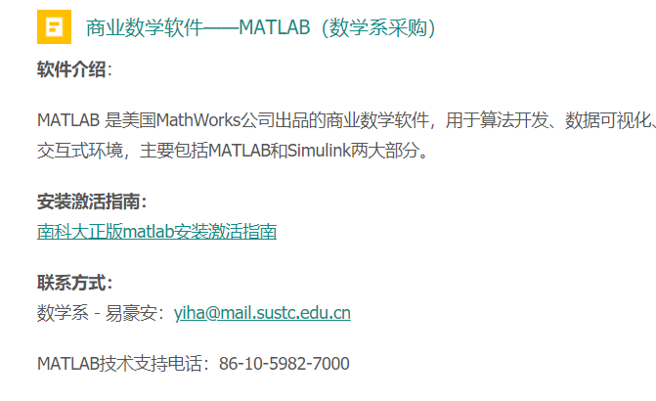
A brief introduction to MATLAB
The abbreviation of “matrix laboratory”
A commercial software provides matrix-based language to express computational mathematics
Fortunately, SUSTech have bought official copyrighted MATLAB for teaching and researching. You can log in the library and download it.
http://lib.sustc.edu.cn/page/id-251.html?locale=zh_CN
Use your student mail account to acquire the license. Please follow the guidance.

Slide 3
A brief introduction to MATLAB
MATLAB language is a kind of interpret language (scripting language).
It treats every object as a matrix. Matrix calculations are extremely easy.
Many built-in functions for algorithms and visualization
Add-on toolboxes for a wide range of engineering and scientific applications (with similar style)
Either type a statement in command window or organize it in a .m file, than run it.
Where to learn MATLAB properly:
https://www.mathworks.com/help/matlab/getting-started-with-matlab.html

Slide 4
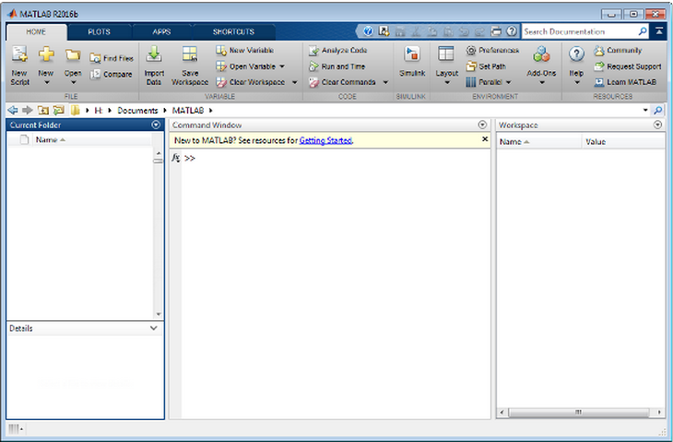
A brief introduction to MATLAB
Command Window
Current Folder
Workspace
Details
Access your files
Enter commands
Explore data that you create or import from files

Slide 5
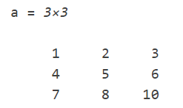
A brief introduction to MATLAB In command window
Create a variable of matrix
Enter
dimension
It will show your result directly in a matrix format.
Try to use a semicolon (;) at the end of the statement.
Use a(m,n) to call or access the element amn in the matrix “a”.

Slide 6
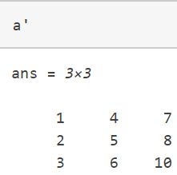
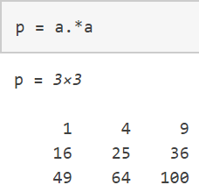
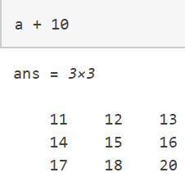
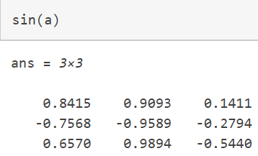
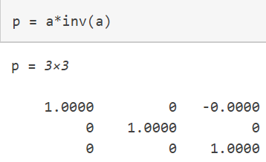
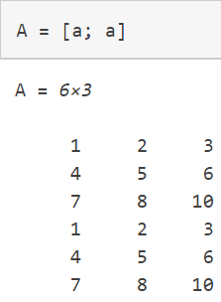
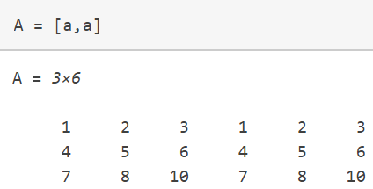
A brief introduction to MATLAB In command window
Matrix calculation
Transpose
Element-wise multiplication
(also division, power)
Element-wise plus
Element-wise mathematic function
Matrix multiplication & inversion
Free concatenation

Slide 7
A brief introduction to MATLAB In a script
A script is a file with a .m extension that contains multiple sequential lines of MATLAB commands and function calls.
To create a new script:
To run you script:
edit script_name
or
In HOME -> New Script icon
MATLAB will add a .m extension automatically.
script_name
or
press the Run button

Slide 8
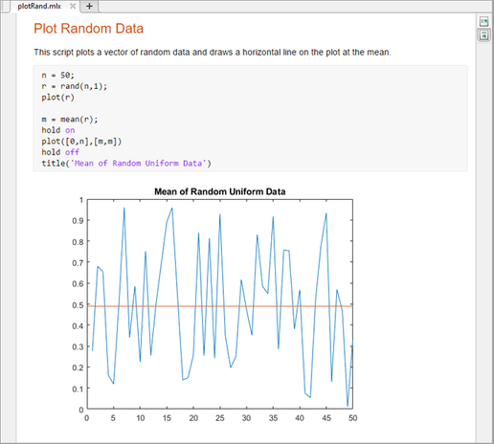
A brief introduction to MATLAB In a live script
You can also use a live script to make you code and output more pretty. Just like Jupyter Notebook to Python.

Slide 9
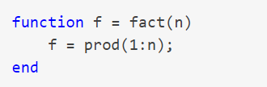
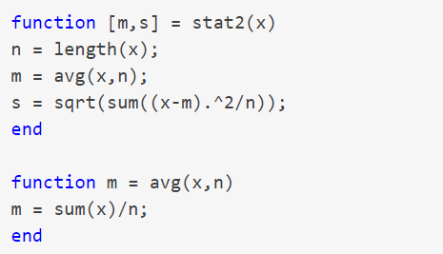
A brief introduction to MATLAB In function
Create a function in a function file by New -> Function, function name must be the same with the file name.
Return multiple outputs with [one, two] as output
fact.m
One function file can have multiple functions, but except the one has the same name with the file, all are local functions
Local function can only called by other functions in the same function file.
Functions can also be put in the end of a script and called by the script itself.
stat2.m

Slide 10
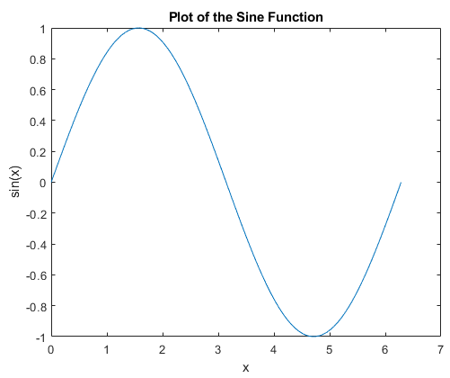

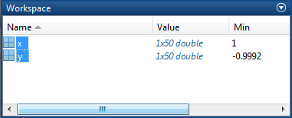
A brief introduction to MATLAB functions may helpful in your homework
plot(X, Y, LineSpec)
Also you can use tab Plots
X and Y should be vectors and the line is drawn by connecting each point specified by (x_i, y_i).
2. Click the plot you want
1. Choose the vectors

Slide 11
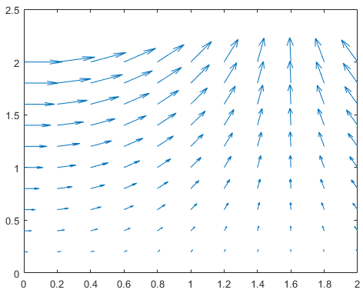
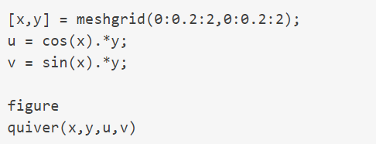
A brief introduction to MATLAB functions may helpful in your homework
quiver(x, y, u, v)
A quiver plot displays velocity vectors as arrows with components (u,v) at the points (x,y)
meshgrid() expands the two vectors into two matrices.

Slide 12
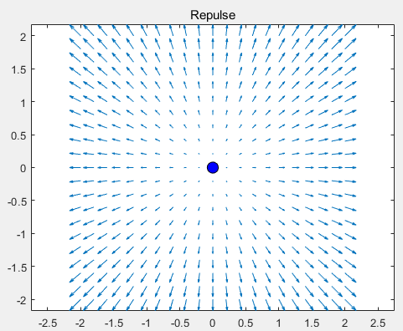

A brief introduction to MATLAB functions may helpful in your homework
quiver(x, y, u, v)
The potential function:
$$P= x^{2}+y^{2}$$

Slide 13
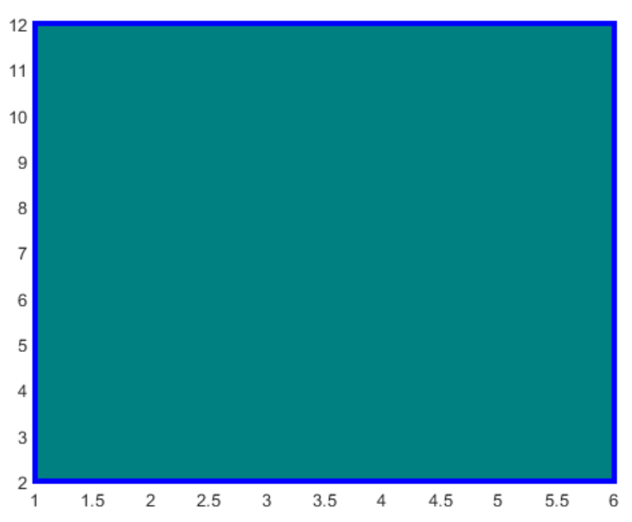
A brief introduction to MATLAB functions may helpful in your homework
rectangle(x, y, u, v)
Other functions
Create rectangle with sharp or curved corners
Manipulate the MATLAB documentation
Use help command
help plot

Slide 14
MATLAB Robotics System Toolbox
In lab00, we have explored the basic aspects of MATLAB Robotics System Toolbox (MRST). Now that you have learned how ROS works, see if you have a better understanding of MRST.
rosinit
exampleHelperROSCreateSampleNetwork
rosnode list
rostopic list
rostopic info /pose
rosnode info /node_1
rosservice list
rosservice info /add
rostopic type /pose
rosmsg show geometry_msgs/Twist
rosmsg show geometry_msgs/Vector3
exampleHelperROSShutDownSampleNetwork
rosshutdown

Slide 15
MATLAB Robotics System Toolbox
In lab00, we have explored the basic aspects of MATLAB Robotics System Toolbox (MRST). Now that you have learned how ROS works, see if you have a better understanding of MRST.
rosinit
exampleHelperROSCreateSampleNetwork
rosnode list
rostopic list
rostopic info /pose
rosnode info /node_1
rosservice list
rosservice info /add
rostopic type /pose
rosmsg show geometry_msgs/Twist
rosmsg show geometry_msgs/Vector3
exampleHelperROSShutDownSampleNetwork
rosshutdown
That are all ROS commands !
The processes of publishing/subscribing… are all similar.

Slide 16
MATLAB Robotics System Toolbox
Get MRST add-on
In lab00, we have explored the basics of MRST. If you have not been familiar with it yet, please go back to lab00 and do the task again.
Connect your MATLAB with ROS
In Home -> Add-Ons icon, search for Robotics System Toolbox and install it.
An advantage is that you can connect MATLAB with ROS via MRST, for quickly implementing your algorithms.
MATLAB will create a node called global node registered with Master and communicate with ROS.
Attention : our project 01 will be out this lab. You will implement your reactive paradigm algorithms in a Gazebo simulator and make your robot achieve the target.

Slide 17
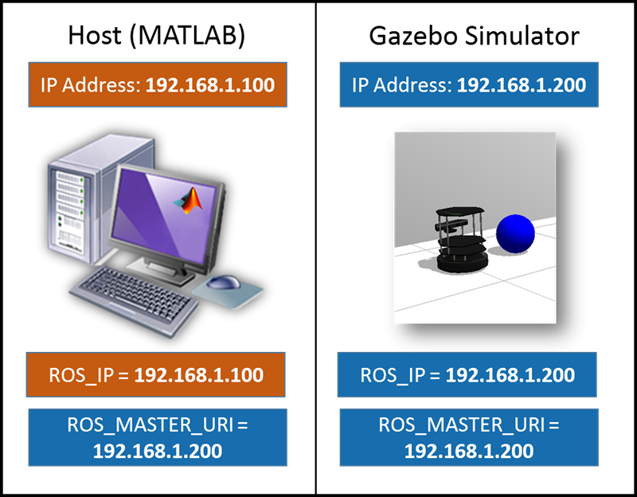
MATLAB Robotics System Toolbox
Connect your MATLAB with ROS
Set the correct environment variables in both Host and Simulator (they can also be in same OS or VM in same machine).
In MATLAB:
In Simulator:
Or you can write it in file ~/.bashrc
setenv('ROS_MASTER_URI','http://192.168.1.200:11311’);
setenv('ROS_IP','192.168.1.100’);
$ export ROS_IP=192.168.198.128
$ export ROS_MASTER_URI=http://192.168.198.128:11311
:11311
:11311

Slide 18
MATLAB Robotics System Toolbox
Connect your MATLAB with ROS – in simulator system
Clone Gazebo simulator packages for TurtleBot3 from https://github.com/ROBOTIS-GIT/turtlebot3_simulations.git to your /src directory than catkin_make.
Use these commands to open a Gazebo empty world with a TurtleBot3
Edit it with the barriers and obstacles you design (you can learn how to edit and save a world, refer to http://gazebosim.org/tutorials?cat=connect_ros). If you do not want to edit yourself, use provided world turtlebot3_world by substitute the launch file with turtlebot3_world.launch.
Write this in ~/.bashrc for convenience
$ export TURTLEBOT3_MODEL=burger
$ roslaunch turtlebot3_gazebo turtlebot3_empty_world.launch
For further reference about TurtleBot3 Gazebo packages : http://emanual.robotis.com/docs/en/platform/turtlebot3/simulation/#

Slide 19
MATLAB Robotics System Toolbox
Connect your MATLAB with ROS – in MATLAB
Init your global node in MATLAB
Verify your connection, try:
see if the gazebo nodes or topics are there.
rosinit('192.168.1.200', 'NodeHost', '192.168.1.100');
The output: Initializing global node /matlab_global_node_xxxxx with NodeURI http://192.168.1.100:xxxxx/
rostopic list
rosnode list

Slide 20
MATLAB Robotics System Toolbox
Communicate with Gazebo
Create nodes/publishers/subscribers to acquire states of turtlebot and control it. For example:
Node = rosmatlab.node('Test','http://localhost:11311');
Sub = Node.addSubscriber('/chatter','std_msgs/String',10);
Sub.setOnNewMessageListeners({@test_fun});
linkStates = rossubscriber('/gazebo/link_states')
stateData = receive(linkStates)
velpub = rospublisher('/cmd_vel')
velmsg = rosmessage(velpub);
velmsg.linear.x = 0.3
Helpful information about MRST in https://www.mathworks.com/help/robotics/index.html
You may find those two topics useful to acquire turtlebot states and control it

Slide 21
Lab2 Project Part I
Content: following the MATLAB system toolbox tutorial and implement your differential drive robot.
Goal: learn how to use MATLAB simulator to help you implement algorithms quickly; help you to build a algorithm test platform.
Requirement: i) Plot the waypoints and simulate path following
ii) make sure you get your partner. You can distribute your MATLAB and Gazebo anyway you like (like VM, both in Linux or two machines).
Time: this part of project lasts for 2 weeks due on 2019/3/19

Slide 22
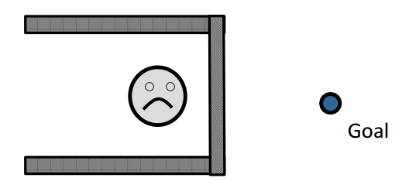
Lab2 Project Part II
Content: following the MATLAB & TurtleBot3 Gazebo Simulator connection and communication tutorial and implement your HW01 reactive paradigm algorithms in TurtleBot3 Simulator to show how your turtlebot achieving the goal and avoid or escape from local minima.
Goal: learn how to use MRST and simulator to help you implement algorithms quickly; help you to build a algorithm test platform.
Requirement: i) the map you edit could not be simpler than this figure
ii) make sure you get your partner. You can distribute your MATLAB and Gazebo anyway you like (like VM, both in Linux or two machines).
Time: this part of project lasts for three weeks due on 2019/3/26

Slide 23
Lab 2 Project
Tips: i) if you don’t know how to do it. Try to figure the MRST tutorial on Internet;
ii) run your algorithm on MATLAB and get information of turtlebot pose from Gazebo as it has the ground truth. Don’t just read the pose in your MATLAB.
iii) if you use the provided map, the coordinates of each model can be get from MATLAB function or simply look up the information from Model on the left menu bar of Gazebo.

