Slide 1
Car Matching : Let the computer pick your perfect car.

Slide 2

The Journey
Of making a car matching algorithm

Slide 3
Data Gathering
Tried to scrape different websites with information all over the place and not uniform across sites, or even one site for that matter.
Lesson 1 → If someone is selling the data as a download, the data is probably hard to get.
Lesson 2 → Even if you end up paying for data, it might not be complete or perfect

Slide 4

“Data is messy”
Every Instructor we have had.

Slide 5
Got a working dataframe
Had to clean up the missing values
Get newer cars 2018 and 2019
Split up the categorical and the numerical
Convert metric to USA standards
Get dummies for features

Slide 6
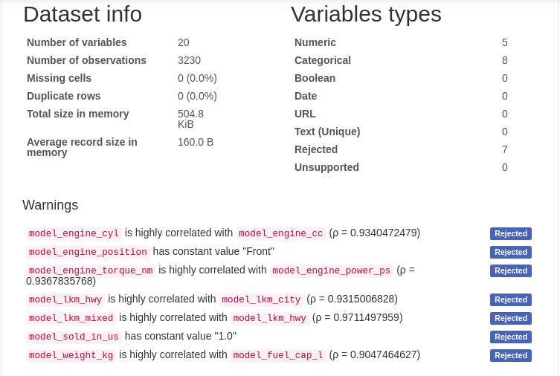
Pandas Profiling

Slide 7
Scaling the data
Scaled the data 3 ways:
Standard Scaling
Robust Scaler
Power Transformer - Yeo-Johnson

Slide 8
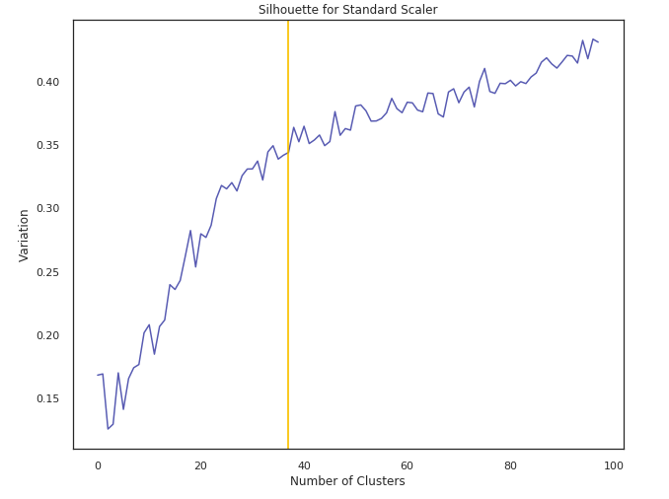
Vertical line at 37 clusters

Slide 9
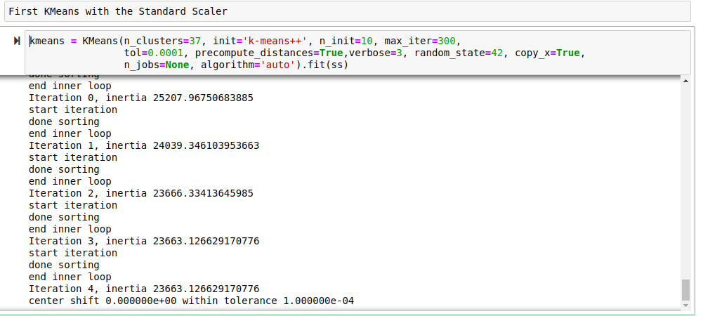

Slide 10
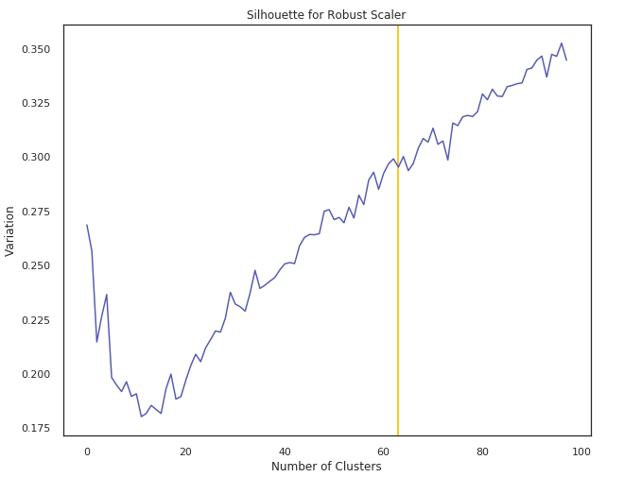
Vertical line at 63 clusters

Slide 11
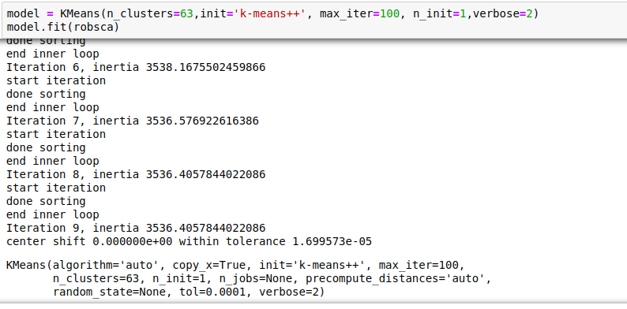

Slide 12
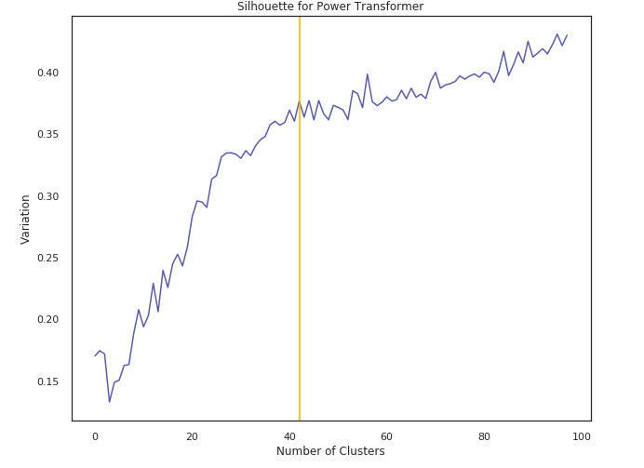
Vertical line at 42 clusters

Slide 13
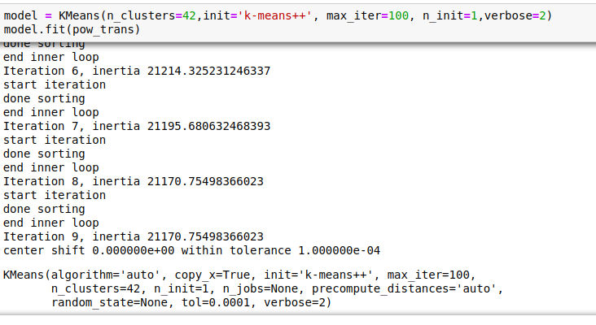

Slide 14

Training the Clustering
Model
KMeans
DBSCAN

Slide 15
Clustering Models
KMeans
A simple unsupervised learning algorithm that is used to solve clustering problems based on K number of clustoid centers and then assigning the points to these clusters.
DBSCAN
Density-Based Spatial Clustering of Applications with Noise. Finds core samples of high density and expands clusters from them. Good for data which contains clusters of similar density.

Slide 16

Choosing which scaler with DBSCAN works best
Choosing Dodge Dart for baseline:
Standard Scaler
Output:
('Honda', 'Accord'), 6),
(('Mazda','Mazda3'), 3),
(('Kia', 'Optima'), 3)
Robust
Output:
(('Dodge', 'Grand Caravan'), 24),
(('Audi', 'A5'), 6),
(('BMW', '6 Series'), 4)
Power Transformer
Output:
(('Honda', 'Accord'), 6),
(('Toyota', 'Camry'), 3),
(('Toyota', 'Corolla'), 3)

Slide 17
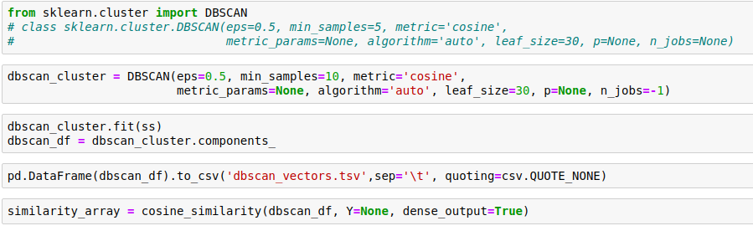
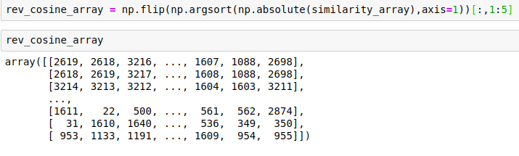

Slide 18

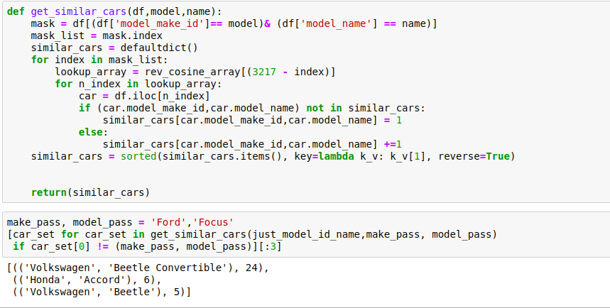
Car Matching

Slide 19
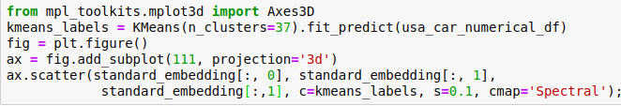
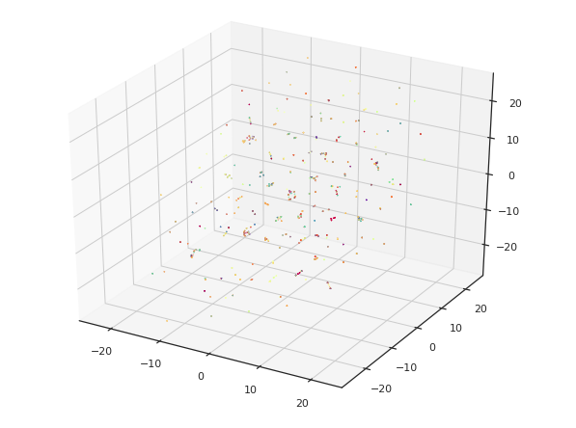
Attempting UMAP locally

Slide 20
Tensor Flow

Slide 21
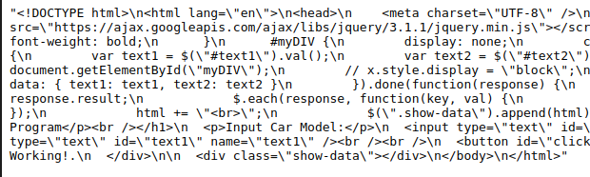
ToDo additions:
Flask Api
Place your screenshot here

Slide 22
Let’s Try it out !

Slide 23
Business Thoughts
If you could train the model so well that from only a few questions you could get the user his perfect car.
Ideally use data already available on the customer and store preferences like age, children, where they live, any past dmv records, and traffic citations.
You could get everyone their perfect car and maybe just maybe the roadways might be a little better. :)

Slide 24

THANKS!
Any questions?
Data Engineering -- 65%
Data Science -- 30%
Presentation -- 5%

Slide 25

CREDITS
Special thanks to all the people who made this even close to possible:
Richard Chan (For trying to teach me Flask)
Skylar English
Lauren Moran
Jeff James

Slide 26
Parting Note:
Resources on my github : https://github.com/ColinMaloney
Jupyter Notebooks
1Flask Restful Api
Datasets
Tensorflow
UMAP 3D renderings

