Slide 1
Using GPT-2 and NLP for creating TV Scripts

Slide 2
Idea Conception
1
TABLE OF CONTENTS
High level Overview
2
3
Website Demo
4
Parting Thoughts

Slide 3
1
Why TV Scripts?

Slide 4
Business Opportunity:
The TV industry is valued at 260 Billion a year.*
Some script writers have fetched over 100,000 dollars for one script
Better and more creative TV will only help the industry grow even more
With the rapid rise of streaming services , they are projected to bring in 91 Billion in 2019
*according to https://www.statista.com/

Slide 5
Secondly
I love TV.
I enjoy what people create with the medium.
I was super interested in the power of GPT-2

Slide 6
2
High level overview

Slide 7
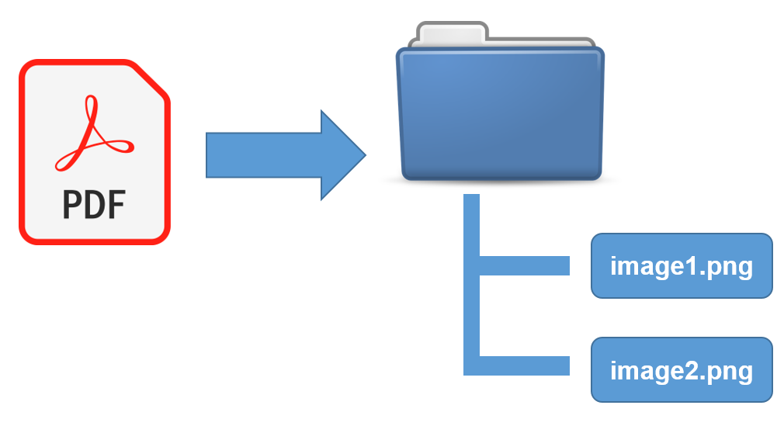
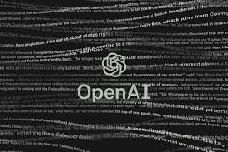





Overview Process
Some scripts were in PDF format
PDF2
image
BS4
Fed into the train.py
PYtesseract
Pil
Creating
Text files
Adding the needed <|endoftext|>
For GPT-2
Web Scrape sites with TV scripts
GPT-2
Use GPT -2 script encode.py to convert text to trainable format
NPZ convert
Anvil
Used Anvil to build a website through python

Slide 8
GPT -2 “Generative Pretrained Transformer 2” uses a framework with 12 layers to predict the next word in a series of text. It uses this to write new ideas and tries to be coherent.

Slide 9
This model uses a generative pretrained neural network to make predictions. The model learns to make better predictions the more it's used in a training set. A pretrained model is a simple model which can be built from scratch by the trained classifier. In this case, the model learns to make more accurate predictions, which gives it an overall longer training history and faster model training. In practice the model's training times are quite a bit shorter than in other models and the accuracy is pretty good.
This model is a more expressive model with over 60GB of data. It's a pretty good model at making predictions about what words you're trying to predict.

Slide 10
Actually that last slide was created by GPT-2 after prompting it with the slide before.
So as you can see, it can do really well at language prediction and modeling .

Slide 11
3
Website Demo
Hosted by Anvil.

Slide 12
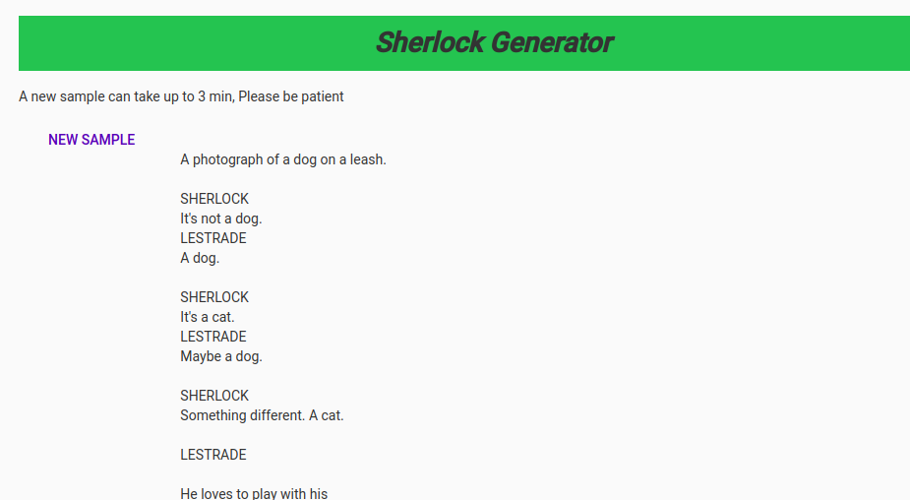
3 Generators
Sherlock Holmes , Friends , and Rick and Morty
Has a starting base of 14 scripts per generator.
You can make a new sample as well

Slide 13
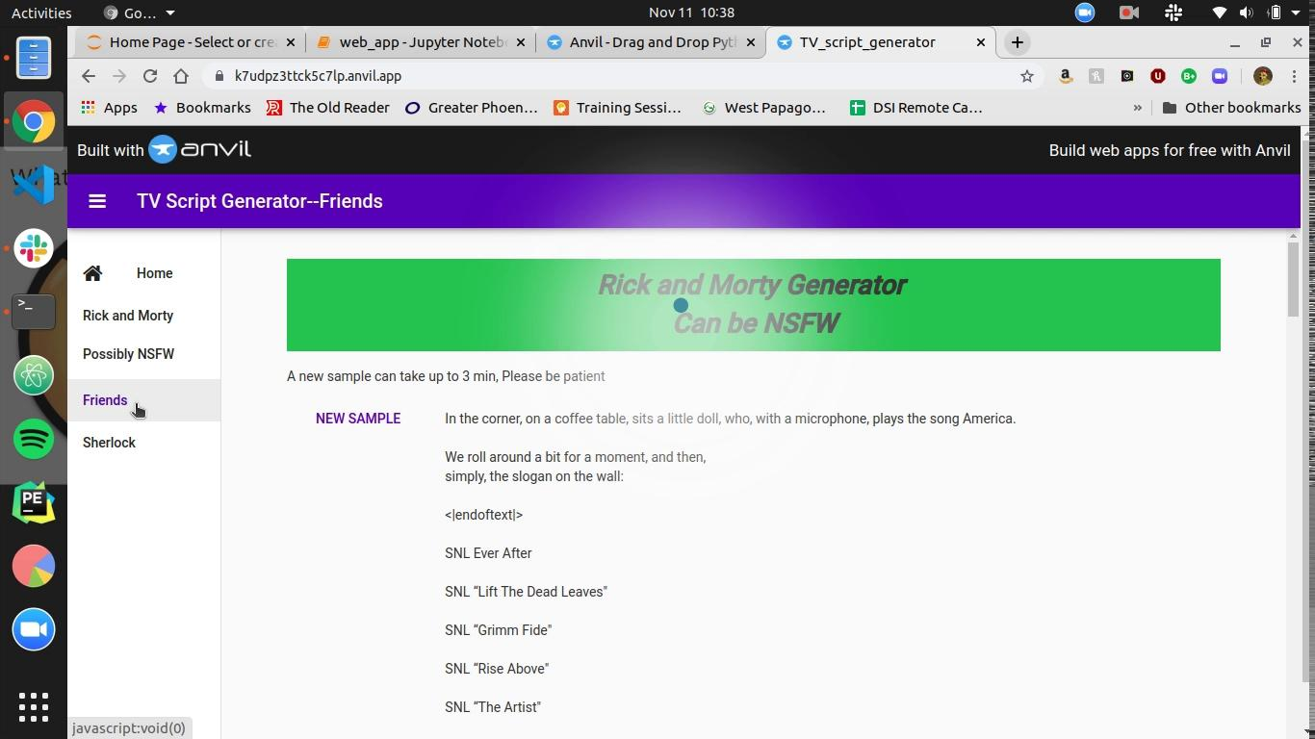
Web App
https://K7UDPZ3TTCK5C7LP.anvil.app/XS4WTRXBSXMD4GOKUECDICL2

Slide 14
Some Sample Scripts
Sherlock
Friends
LESTRADE
You're still a soldier,
Sherlock. You've just got
blood on your hands and feet.
SHERLOCK
Blood on your hands and feet.
LESTRADE
But you can’t return to your
military post. The risk
is there. You'll be back in
the army within a week.
SHERLOCK
And you can’t return to your service -
LESTRADE
You can return to your service - serve.
Ross: Chandler, I love you. You're a great guy.
Chandler: I love you too.
Ross: What?
Chandler: I just love you.
Ross: Really?
Chandler: It's just I didn't get it. Chandler, to be blunt, you
remember this is a new experience.
Ross: Okay.
Chandler: Ah, what we're talking about is dating.
Ross: Yeah.
Chandler: And you're dating somebody.
Ross: Oh, yeah, I'm dating someone in New York.
Chandler: Oh yeah, I know.
Ross: You know, I-I was just thinking. I-I was thinking...
Chandler: Oh yeah, I'm sure it's true, we're all just dating, you know.
Ross: Well, I guess maybe you're just dating someone in New York.
Chandler: Oh yeah, yeah, sure, I think it's just me. No-no way. No way no. I mean, you're
just... I... I mean, I don't think this is about me, you know.
Ross: No, no, this is just...
Chandler: Oh, that's... that's the whole point.

Slide 15
4
Future Work
As of Nov 5th Open AI has released their full version trained on 1.5 Billion parameters
Right now could be used to help Human writers if they have writer's block or help suggest the next line in their story

Slide 16
THANKS
Does anyone have any questions?
colinmaloney@gmail.com
https://github.com/ColinMaloney
Galvanize DSI 2019

Slide 17
RESOURCES
Open Ai
@article{radford2019language,
title={Language Models are Unsupervised Multitask Learners},
author={Radford, Alec and Wu, Jeff and Child, Rewon and Luan, David and Amodei, Dario and Sutskever, Ilya},
year={2019}
}

