Slide 1

Rubik’s Cube solving machine
Colin Roskos
Winsten Coellins

Slide 2
Contents
Mechanic Review
Schematic
Lessons Learned
Future Implementation
Code Review:
Rubik’s Cube Representation (CLF)
Motor Driver Representation (CLF)
Solver (CLF)
Video of Operation
Lessons Learned
Problems Overcome
Problems Still to Overcome
Future Implementations/Features
Questions
CLF:
Code Review
Lessons Learned
Future Implementations

Slide 3
Mechanic Review

Slide 4
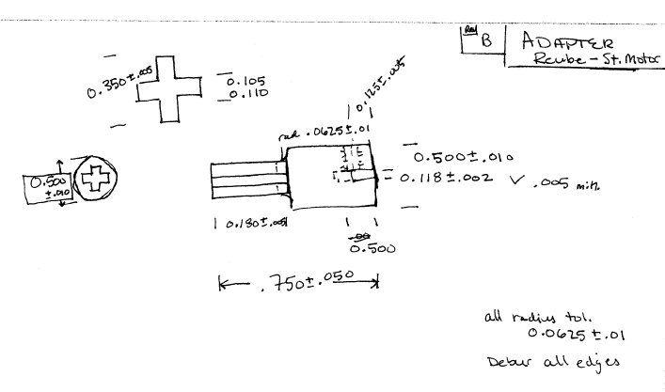
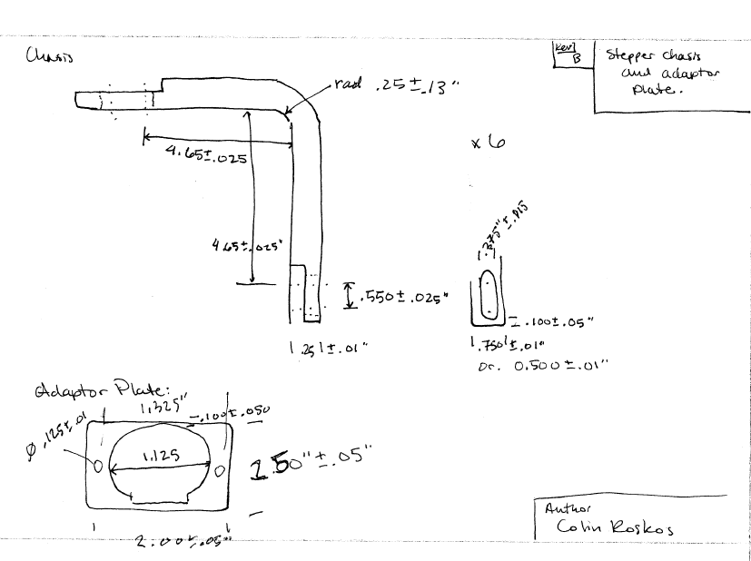
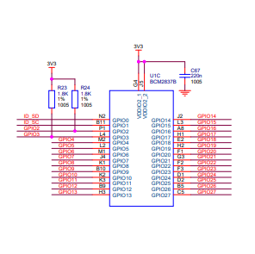
Mechanim/schematic
Motor | In1 | In2 | In3 | In4
M0 – W | 3 | 5 | 7 | 11
M1 – R | 13 | 15 | 19 | 21
M2 – B | 23 | 29 | 31 | 33
M3 – G | 8 | 10 | 12 | 16
M4 – O | 18 | 22 | 24 | 26
M5 – Y | 32 | 36 | 38 | 40
New adaptor and Chasis
- Modified to fix issues with original design.
To Motor

Slide 5
Lessons Learned
Test mechanical portion as you go.
Original chassis idea would not work
Remember the cube edges rotate.
This led to the adaptors I made to be too short.

Slide 6
Future
Larger and Faster Stepper Motors
I don’t need as fine of steps as the current motor gives me. A 1.8° per step would work just fine.
A metallic chasis in stead of a wooden one
This will give more precision and adjustability to the frame.
A longer, better made adapter, with set screw.
Using a press or solder fit did not work well in this implementation.
A proper slip fit and set screw would have worked best.

Slide 7
Code review

Slide 8
Rubik’s cube representation
Code Review
Lessons Learned
Future
Cube Object
An Object made up of six Face Objects
rotate, set_cell, get_cell, and cube_print functions public
Face Object
No public functions
Made up of a Face color and eight cells
Cell is represented as an integer.
* Show code RubicksCube.py
Using simplified representations is better than more complicated representations.
A better print function; The current implementation can be a little confusing.

Slide 9
motor representation
Code Review
Lessons Learned
Future
A step series in List() to represent stepper signal order.
Attaches to Raspberry Pi directly
User should only use quarter_turn(), but all class functions are available.
* Show code PIMotors.py
Check the step order required by the motor, Some have half-step (the ones I used) some have full-step.
Check the fastest update limit for motors in stead of finding these experimentally.
Add ability for in position to check if motor is where it is expected to be.

Slide 11
Solver
Top Cross
Top Corners
Second Row
Bottom Cross
Complete

Slide 12
Top cross
Code Review
Lessons Learned
Future
* Solver.py
Modifying a general code for working with any of the four primary orientations.
None for side

Slide 13
Top Corner
Code Review
Lessons Learned
Future
Corner in position – if not oriented correctly, remove from position
From bottom to corner - three implementations.
* Solver.py
Making sure to consider every orientation and how the solutions to other orientations occurs before coding is beneficial and can reduce code time.
None for side

Slide 14
Second row
Code Review
Lessons Learned
Future
Only 2 locations with 2 orientations plus the rotation of the cube.
Few variations
Bottom – Left or right orientation
Side – In position or backwards
* Solver.py
This was a good starting point, but with the bottom being completed first, this was an easier task.
None for side

Slide 15
bottom cross
Code Review
Lessons Learned
Future
Create a cross
Position edges in correct location
* Solver.py
Interpreting orientation is a big deal.
‘L’ direction specifically
None for side

Slide 16
Finish cube
Code Review
Lessons Learned
Future
Selection of starting corner
Mechanism for switching corners
Orienting the corners
* Solver.py
Keeping orientation of a cube that is upside-down is difficult, use a physical representation with orientation.
None for side

Slide 17
Solver as a whole
Lessons Learned
Future Implementation
Keeping organization of side structure is important.
Having a physical model representation is valuable.
Documentation on orientation of the cube needs to be very clear to be helpful.
Short-cut algorithms
No cube is more than 20 moves from solution.

Slide 18
Operation

Slide 19
Lessons Learned
Problems Overcome
Still to Overcome
Finding a way to visualize and remember orientation reliably.
Reducing steps further.
Stepper motor consistency.
Fix wiring and other physical implementation issues.

Slide 20
Future implementations
Better, faster, stepper motors.
Better prototype board.
Improved power source.
Improved solution algorithm
Improved chassis and adapter designs

Slide 21
?

Slide 22
Sources
https://ruwix.com/the-rubiks-cube/how-to-solve-the-rubiks-cube-beginners-method/
RPi.GPIO Library: https://pypi.org/project/RPi.GPIO/
Rubik’s Cube Image: https://www.rubiks.com/media/catalog/product/cache/9c57e2fe71f8a58f6afba681a0a15dd4/r/u/rubik-3x3-solved.jpg

