Slide 1
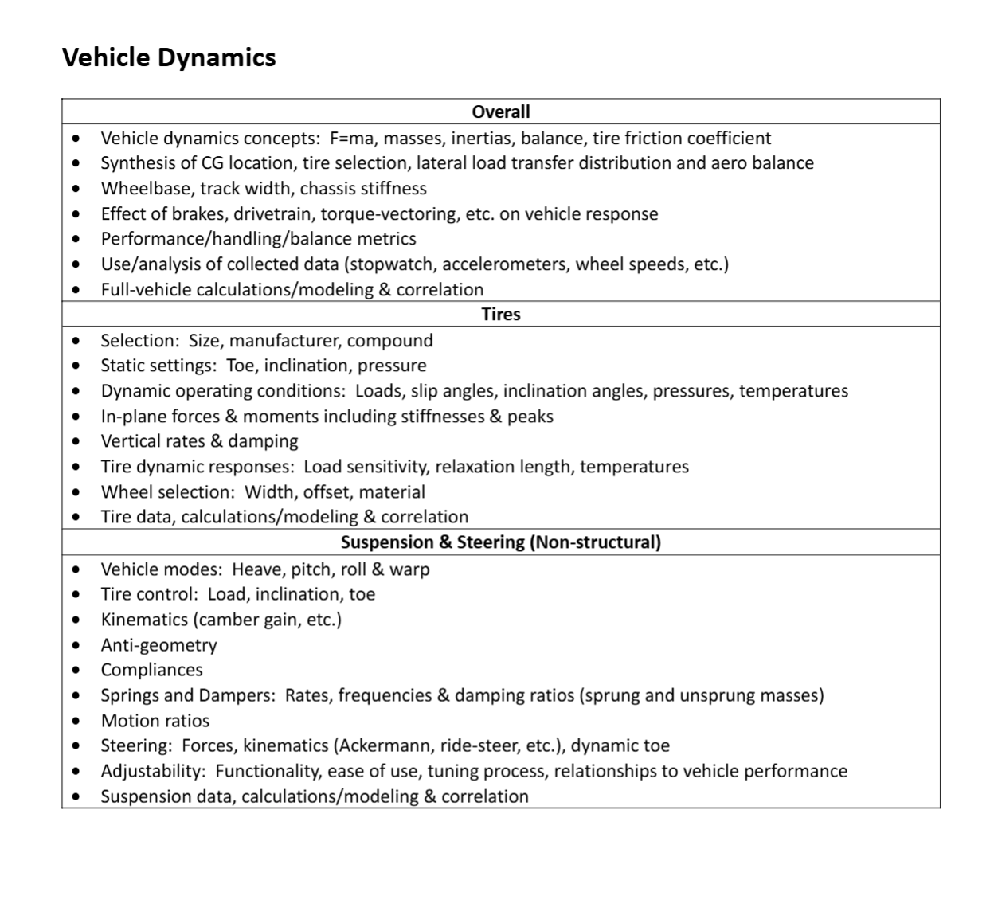
main vehicle goals of light vehicle and tight responsive corning, dictated by suspension and powertrain (we have aggressive aero, moderate vehicle roll and soft suspension, tiny 1 cyl engine, we are not grip limited compared to 4 cyl teams)
needs weights, total grip sustained with and without aero (mu) and balance
Then talk about cg, track and wheelbase
Handling metrics and oversteer alongside as driver feedback and testing we got into tire temps and 4 point steady state MF5 tire model with roll, slip and aero loading to set base for tuning
Tire/Kinematics:Progressive motion ratio, different front and rear nominal but same progressive shape resulting in gradual breakaway due to greater loading. Also no anti squat bc we are power limited and don’t have too much longitudal accelartion weight transfer to worry about, not an issue, 50% anti dive for front wing stability, total shifts pitch center foreward
Model
4 point MF5 steady state, roll slip and aero, targeting apex of cornering and steady state.
Limitations is the model will overfit as MF5 does not have a drop off, no transients modeled
Can predict vehicle beta, which gave to aero subteam to get expected sideslip on aero package.
Can tell which wheel will load the greatest force, Rear outside based on having rear biased cg. Can tell which axel will saturate first predicting slight mechanical oversteer on the car, this is what driver see.
Used to target baseline before driver feedback and tuning
Can also shows operating conditions of tires by mapping to the pacejaka curves, see circled curves
Validates how aero increases total grip by shifting the operation conditions to higher speed and steering
Newton rhapson method to find equilibrium of tires, inherently will overfit as shown by large extrapolation

Slide 2
Vehicle dynamic concepts: F= ma, M= <400lbs and about 250kg with a light driver. Max A had an aggressive goal of 2 g based on tire theoretical grip, we measured with no aero 1.55 sustained and 1.96 peak and expect higher sustained. Our tire coeeficient is 1.55 sustatined and with more load it will increase
CG location is rearward at about 55% rear biased with driver. Aero is front balanced at 60% front wheels. Both due to packaging of engine and turbulence of air. This is allowed to gradually shift cg foreward by making the car dynamic cg move foreward as car moves quicker, tending to shift balance. (see saturation mapping) Lateral force is due to springs and tire grip
Wheelbase = 1562, Track = 1200, Chassis Stiffness = 2297 Nm/deg (Rear roll 515)
Brakes shift dynamic cg foreward and acceleration backwards causing dive and squat, also it loads the tire eplipse to have less lateral grip, we run anti dive for aero compliance and we have no anti squat
Handling tends slight oversteer based on Cg synthesis and larger rear wheel rates accounting for cg, progressive rates allow slow breakaway of rear tires to get grip out of high speed turn exits
DATA… Tire temps allowed camber adjustments up to our maximum which the drivers were comfortable with and then stopwatch allowed driver testing of skidpads and autocross with results and bias in tuning.
Full Vehicl modeling occurred with 4 wheel coupled pointmass with MF5 Tires fitted to TCC data and custom steering and camber curves alongside aero. Also 4 wheel independent slip.
Tires: R20s 16x7.5-10 for the cold temperature performance. Decided between LC0 and R20s as with LC0 being theoretically faster, the temperature operated better in the cold startup (see data)
Final Setup => no toe f/r, 1.25deg front camber, 1.5 deg rear camber, 10-12psi range (See setup sheets)
Dynamic operation conditions, (see tire maps, slip maps, camber curves and temp data)
In plane moments ???, have moments of tires summing to equal yaw in solver to seek equilibrium to get steady state (will oversolve as tires break away after a point)
Vertical rates and dampenings (modeled as point in suspension calculations thus not modeled, but would serve as soften up the suspension in whole by adding a spring in series, didn’t have the best way to test these?
Load sensitivity of .974 this is why we are running soft spring rates as our loading of normal force is to this power causing less mu for greater load. Temps
Size of tire chose the smallest for powertrain output and for lowest relaxation lengths. We do not spin tires throughout acceleration as we are running a smaller engine and lighter weight. Fits with goal of car.
Tire data TCC eq, see eq
Heave pitch roll, and warp, chassis is magnitude stiffer than our suspension setup based on our torsion test result in little warp, heave is targeted about 60mm of heave to satisfy the rules, squat from multiple years on engine platform does not squat a full 60 mm, largest heave is dive which is why we run 50% anti dive for aero, roll is expected about 3 deg of roll which is large amount of roll because of our soft springs allowing small offset of grip (see tire maps)
Tire loading, see spring rates and tire maps
Kinematics, see camber curves and points, front are similar to rear and small amounts of roll center migration, progressive rates
Expecting alrger dive than squat and aero compensated anti dive of 50%, platform built on this for multiple years, no antisquat. Our entry and exit has not been bad in the past. Our drivers like the exit of the car and the rear outside tire being very grippy
Compliances: NA rn
Sping and dampers, see rates and progressive rate allows the gradual slip on our rear tires coming out of turns where drivers can feel and control the break away
Motion ratios, higher but compensated by stiffer springs and by better mounting, see rear node, mid beam bending of the bellcrank was structurally sound
Steering, 0 ackerman, and see geometry. Drivers love how the steering feels and the caster causing grip going around a hairpin
Adjustability of toe/tie rods, bell cranks, springs, dampers, camber shims, and rideheigt
Data, tire and laptime collected to test trends of data. Simulation served as a baseline for design then field tested based on feedback and lap times. Have tire temp data. Modeling done as 2d front and rear kinematics, 3d dampening, 2d steering, all incorporated in the 4 wheel model. (will have code available.)

Slide 3
Tires: R20s 16x7.5-10 for the cold temperature performance. Decided between LC0 and R20s as with LC0 being theoretically faster, the temperature operated better in the cold startup (see data)
Final Setup => no toe f/r, 1.25deg front camber, 1.5 deg rear camber, 10-12psi range (See setup sheets)
Dynamic operation conditions, (see tire maps, slip maps, camber curves and temp data)
In plane moments ???, have moments of tires summing to equal yaw in solver to seek equilibrium to get steady state (will oversolve as tires break away after a point)
Vertical rates and dampenings (modeled as point in suspension calculations thus not modeled, but would serve as soften up the suspension in whole by adding a spring in series, didn’t have the best way to test these?
Load sensitivity of .974 this is why we are running soft spring rates as our loading of normal force is to this power causing less mu for greater load. Temps
Size of tire chose the smallest for powertrain output and for lowest relaxation lengths. We do not spin tires throughout acceleration as we are running a smaller engine and lighter weight. Fits with goal of car.
Tire data TCC eq, see eq
Vehicle dynamic concepts: F= ma, M= <400lbs and about 250kg with a light driver. Max A had an aggressive goal of 2 g based on tire theoretical grip, we measured with no aero 1.55 sustained and 1.96 peak and expect higher sustained. Our tire coeeficient is 1.55 sustatined and with more load it will increase
CG location is rearward at about 55% rear biased with driver. Aero is front balanced at 60% front wheels. Both due to packaging of engine and turbulence of air. This is allowed to gradually shift cg foreward by making the car dynamic cg move foreward as car moves quicker, tending to shift balance. (see saturation mapping) Lateral force is due to springs and tire grip
Wheelbase = 1562, Track = 1200, Chassis Stiffness = 2297 Nm/deg
Brakes shift dynamic cg foreward and acceleration backwards causing dive and squat, also it loads the tire eplipse to have less lateral grip, we run anti dive for aero compliance and we have no anti squat
Handling tends slight oversteer based on Cg synthesis and larger rear wheel rates accounting for cg, progressive rates allow slow breakaway of rear tires to get grip out of high speed turn exits
DATA… Tire temps allowed camber adjustments up to our maximum which the drivers were comfortable with and then stopwatch allowed driver testing of skidpads and autocross with results and bias in tuning.
Full Vehicl modeling occurred with 4 wheel coupled pointmass with MF5 Tires fitted to TCC data and custom steering and camber curves alongside aero. Also 4 wheel independent slip.
Heave pitch roll, and warp, chassis is magnitude stiffer than our suspension setup based on our torsion test result in little warp, heave is targeted about 60mm of heave to satisfy the rules, squat from multiple years on engine platform does not squat a full 60 mm, largest heave is dive which is why we run 50% anti dive for aero, roll is expected about 3 deg of roll which is large amount of roll because of our soft springs allowing small offset of grip (see tire maps)
Tire loading, see spring rates and tire maps
Kinematics, see camber curves and points, front are similar to rear and small amounts of roll center migration, progressive rates
Expecting alrger dive than squat and aero compensated anti dive of 50%, platform built on this for multiple years, no antisquat. Our entry and exit has not been bad in the past. Our drivers like the exit of the car and the rear outside tire being very grippy
Compliances: NA rn
Sping and dampers, see rates and progressive rate allows the gradual slip on our rear tires coming out of turns where drivers can feel and control the break away
Motion ratios, higher but compensated by stiffer springs and by better mounting, see rear node, mid beam bending of the bellcrank was structurally sound
Steering, 0 ackerman, and see geometry. Drivers love how the steering feels and the caster causing grip going around a hairpin
Adjustability of toe/tie rods, bell cranks, springs, dampers, camber shims, and rideheigt
Data, tire and laptime collected to test trends of data. Simulation served as a baseline for design then field tested based on feedback and lap times. Have tire temp data. Modeling done as 2d front and rear kinematics, 3d dampening, 2d steering, all incorporated in the 4 wheel model. (will have code available.)

Slide 4
Heave pitch roll, and warp, chassis is magnitude stiffer than our suspension setup based on our torsion test result in little warp, heave is targeted about 60mm of heave to satisfy the rules, squat from multiple years on engine platform does not squat a full 60 mm, largest heave is dive which is why we run 50% anti dive for aero, roll is expected about 3 deg of roll which is large amount of roll because of our soft springs allowing small offset of grip (see tire maps)
Tire loading, see spring rates and tire maps
Kinematics, see camber curves and points, front are similar to rear and small amounts of roll center migration, progressive rates
Expecting alrger dive than squat and aero compensated anti dive of 50%, platform built on this for multiple years, no antisquat. Our entry and exit has not been bad in the past. Our drivers like the exit of the car and the rear outside tire being very grippy
Sping and dampers, see rates and progressive rate allows the gradual slip on our rear tires coming out of turns where drivers can feel and control the break away
Motion ratios, higher but compensated by stiffer springs and by better mounting, see rear node, mid beam bending of the bellcrank was structurally sound
Steering, 0 ackerman, and see geometry. Drivers love how the steering feels and the caster causing grip going around a hairpin
Adjustability of toe/tie rods, bell cranks, springs, dampers, camber shims, and rideheigt
Data, tire and laptime collected to test trends of data. Simulation served as a baseline for design then field tested based on feedback and lap times. Have tire temp data. Modeling done as 2d front and rear kinematics, 3d dampening, 2d steering, all incorporated in the 4 wheel model. (will have code available.)
Vehicle dynamic concepts: F= ma, M= <400lbs and about 250kg with a light driver. Max A had an aggressive goal of 2 g based on tire theoretical grip, we measured with no aero 1.55 sustained and 1.96 peak and expect higher sustained. Our tire coeeficient is 1.55 sustatined and with more load it will increase
CG location is rearward at about 55% rear biased with driver. Aero is front balanced at 60% front wheels. Both due to packaging of engine and turbulence of air. This is allowed to gradually shift cg foreward by making the car dynamic cg move foreward as car moves quicker, tending to shift balance. (see saturation mapping) Lateral force is due to springs and tire grip
Wheelbase = 1562, Track = 1200, Chassis Stiffness = 2297 Nm/deg
Brakes shift dynamic cg foreward and acceleration backwards causing dive and squat, also it loads the tire eplipse to have less lateral grip, we run anti dive for aero compliance and we have no anti squat
Handling tends slight oversteer based on Cg synthesis and larger rear wheel rates accounting for cg, progressive rates allow slow breakaway of rear tires to get grip out of high speed turn exits
DATA… Tire temps allowed camber adjustments up to our maximum which the drivers were comfortable with and then stopwatch allowed driver testing of skidpads and autocross with results and bias in tuning.
Full Vehicl modeling occurred with 4 wheel coupled pointmass with MF5 Tires fitted to TCC data and custom steering and camber curves alongside aero. Also 4 wheel independent slip.
Tires: R20s 16x7.5-10 for the cold temperature performance. Decided between LC0 and R20s as with LC0 being theoretically faster, the temperature operated better in the cold startup (see data)
Final Setup => no toe f/r, 1.25deg front camber, 1.5 deg rear camber, 10-12psi range (See setup sheets)
Dynamic operation conditions, (see tire maps, slip maps, camber curves and temp data)
In plane moments ???, have moments of tires summing to equal yaw in solver to seek equilibrium to get steady state (will oversolve as tires break away after a point)
Vertical rates and dampenings (modeled as point in suspension calculations thus not modeled, but would serve as soften up the suspension in whole by adding a spring in series, didn’t have the best way to test these?
Load sensitivity of .974 this is why we are running soft spring rates as our loading of normal force is to this power causing less mu for greater load. Temps
Size of tire chose the smallest for powertrain output and for lowest relaxation lengths. We do not spin tires throughout acceleration as we are running a smaller engine and lighter weight. Fits with goal of car.
Tire data TCC eq, see eq

Slide 5
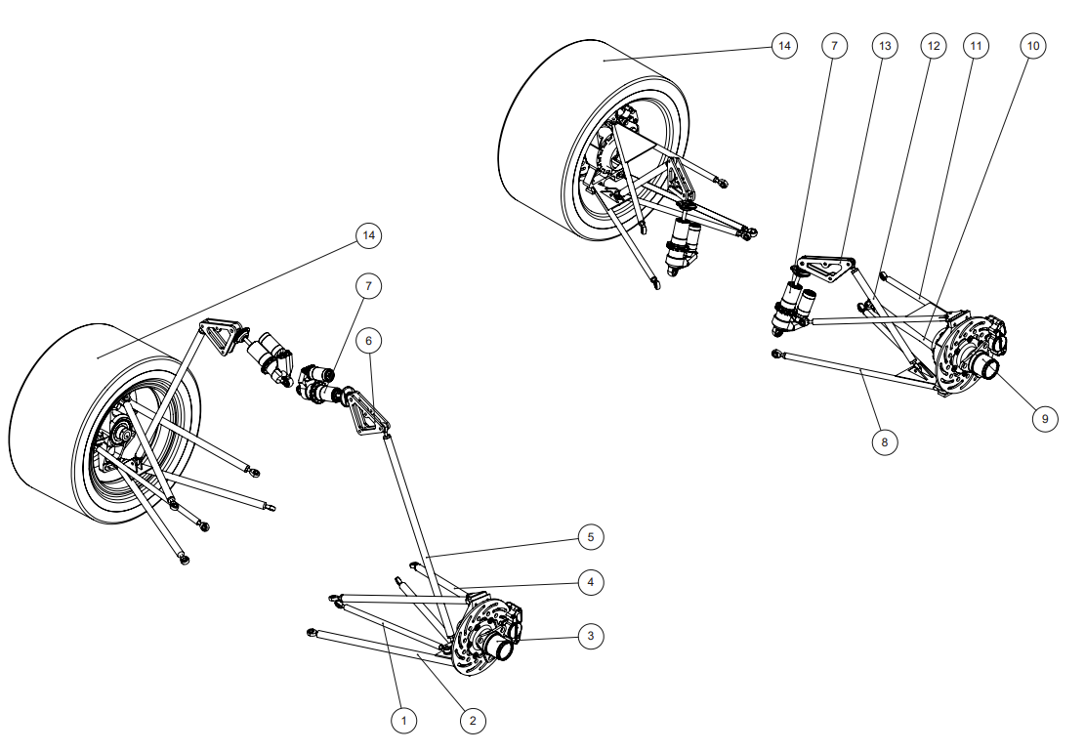
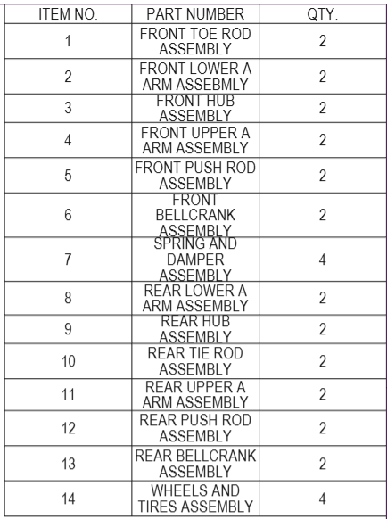
Vehicle Dynamics Design Overview
Design
Tire driven suspension design originating from Hoosier R20s
Double wishbone architecture with front and rear pushrods enabling controllable camber gain and motion ratio tuning
Iteration on previous years geometry and dampening platforms
Build
Designed for easy manufacturability and hardware standardization
Multiple jigs used to ensure accuracy in manufacturing
Testing/Validation
Car done early for structural shakedown and tuning
Suspension setup sheets for each event
Data acquisition systems including lap time, tire pyrometer, steering angle and 6-axis accelerometer to show speed, tire utilization, and inputable handling metrics
Goals
Target 2g lateral force from tires and 5.2s skidpad (no aero), 4.9s (aero)
Steady state simulations to predict slight oversteer handling
Quantify aero grip increases

Slide 6
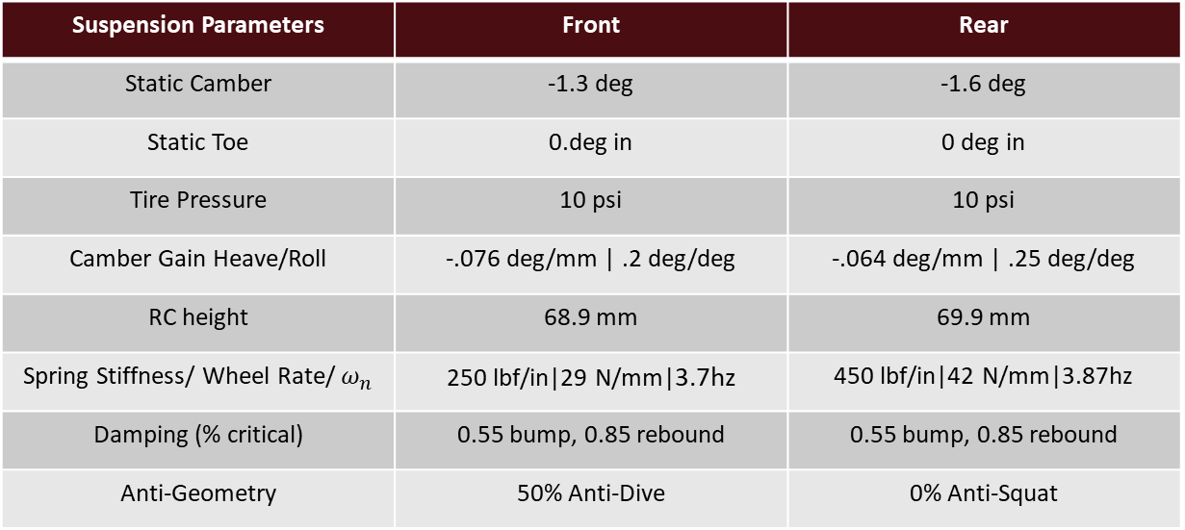
Vehicle Dynamics Setup
Suspension Parameters | Front | Rear
Static Camber | -1.3 deg | -1.6 deg
Static Toe | 0.deg in | 0 deg in
Tire Pressure | 10 psi | 10 psi
Camber Gain Heave/Roll | -.076 deg/mm | .2 deg/deg | -.064 deg/mm | .25 deg/deg
RC height | 68.9 mm | 69.9 mm
Spring Stiffness/ Wheel Rate/ $ω_{n}$ | 250 lbf/in|29 N/mm|3.7hz | 450 lbf/in|42 N/mm|3.87hz
Damping (% critical) | 0.55 bump, 0.85 rebound | 0.55 bump, 0.85 rebound
Anti-Geometry | 50% Anti-Dive | 0% Anti-Squat
Steering Parameters
Caster | 6.8 deg
Kingpin Inclination | 4.1 deg
Scrub Radius | 13.7 mm
Mechanical Trail | 10 mm
Offset | 37.9 mm
Ackermann | 0%
Bump Steer | 0.01 deg/mm

Slide 7
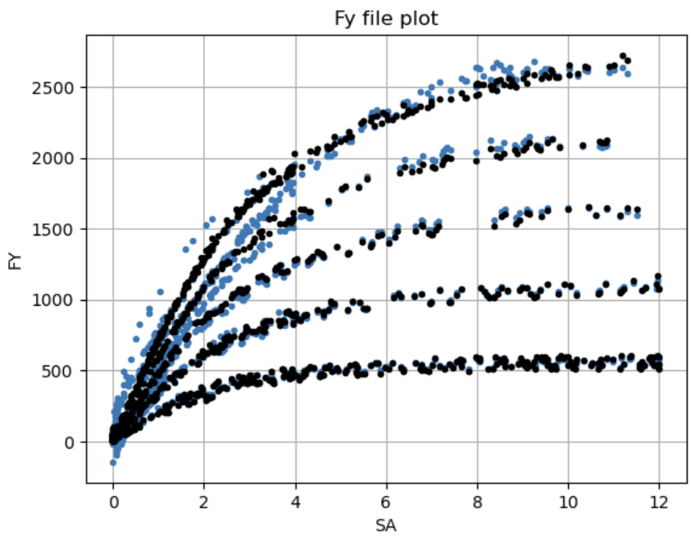
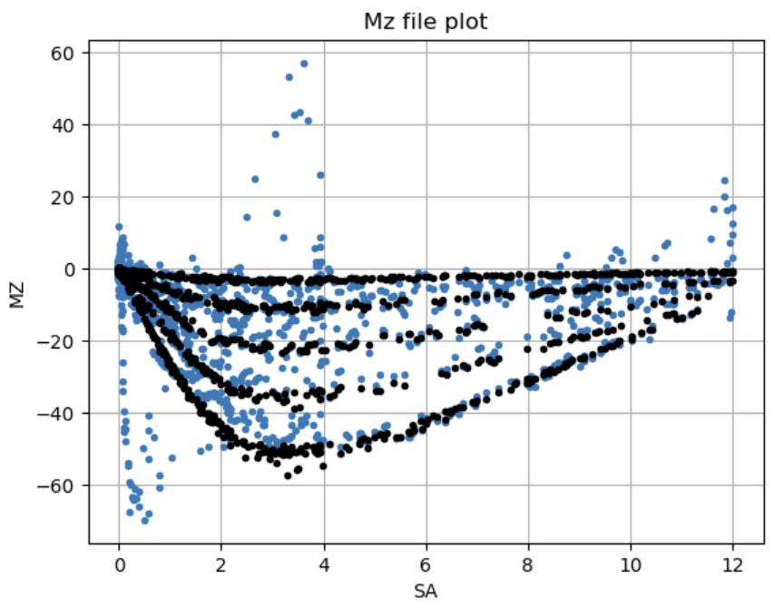
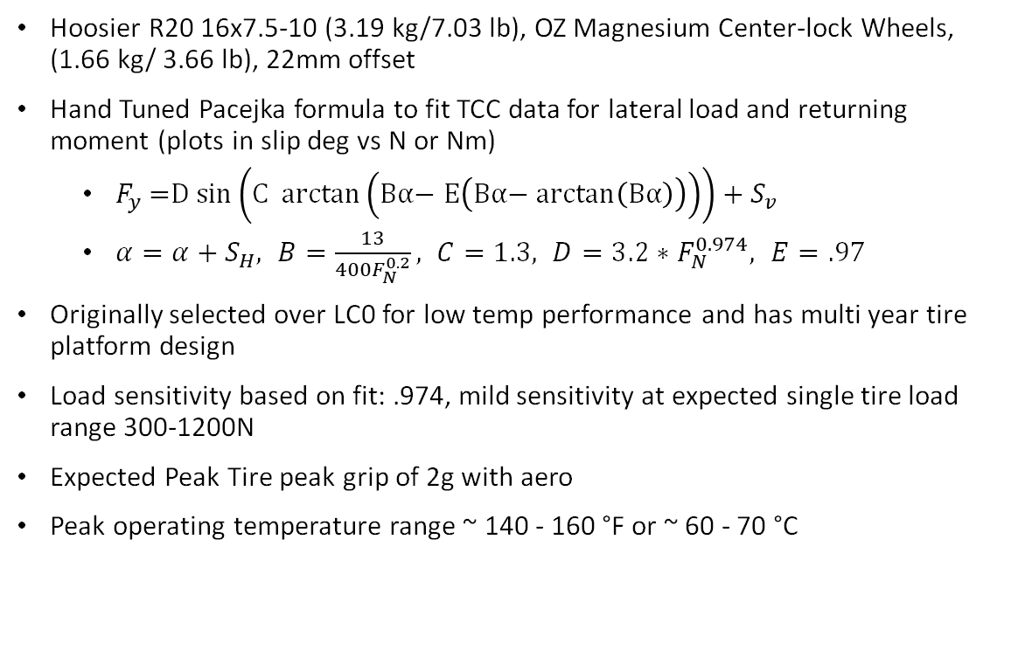
Vehicle Dynamics Tires
Hoosier R20 16x7.5-10 (3.19 kg/7.03 lb), OZ Magnesium Center-lock Wheels, (1.66 kg/ 3.66 lb), 22mm offset
Hand Tuned Pacejka formula to fit TCC data for lateral load and returning moment (plots in slip deg vs N or Nm)
$F_{y}\text{ =}\text{D} \text{sin}\left(\text{C} \text{arctan}\left(\text{Bα}\text{− }\text{E}\left(\text{Bα}\text{− }\text{arctan}\left(\text{Bα}\right)\right)\right)\right)+S_{v}$
$α=α+S_{H}, B=\frac{13}{400F_{N}^{0.2}}, C=1.3, D=3.2∗F_{N}^{0.974}, E=.97$
Originally selected over LC0 for low temp performance and has multi year tire platform design
Load sensitivity based on fit: .974, mild sensitivity at expected single tire load range 300-1200N
Expected Peak Tire peak grip of 2g with aero
Peak operating temperature range ~ 140 - 160 °F or ~ 60 - 70 °C
(MZ: Moment about Z axis, FY: Lateral Force, SA: Slip Angle)

Slide 8
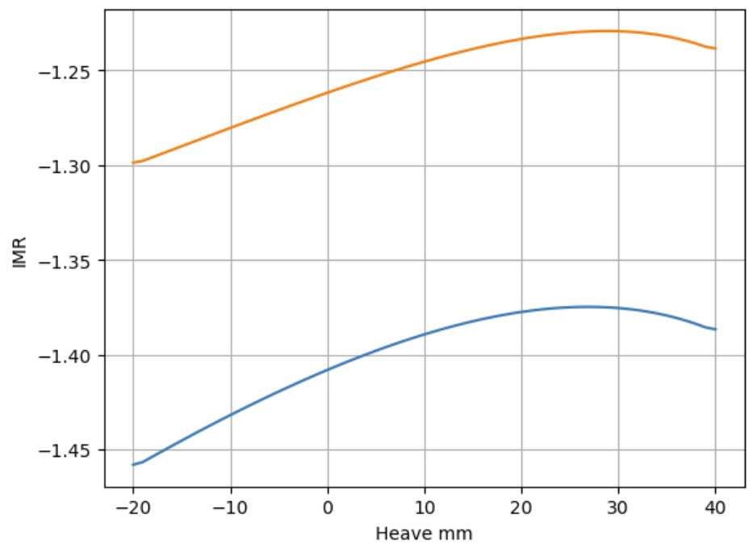
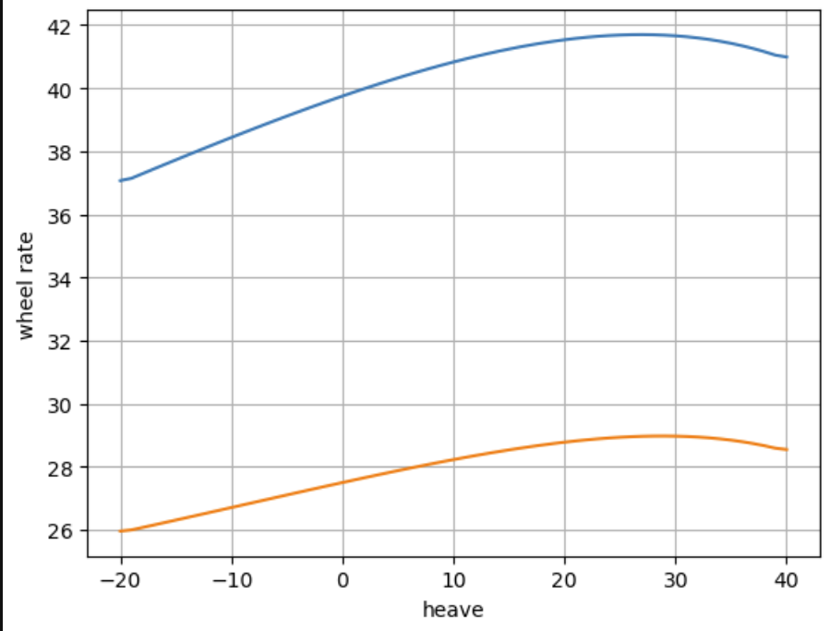
Vehicle Dynamics Ride and Roll Rates
Spring adjustability with 25 lb/in increments, waterjet bellcranks, and Ohlins TTX25 Mk2 4-way dampers.
Weights F/R 43/57 with driver and 40/60 static.
Progressive motion ratio.
Higher rear ratio than fronts, compensated by rear stiffer springs.
Skidpad setup targets oversteer handling for driver preference.
With 43/57 split this leads to peak wheel rates of 29N/mm / 42 N/mm and peak natural frequencies of 3.7hz/3.87hz f/r.
Roll stiffness distribution is .414, in behind of CG dictating slight oversteer
Softer setup (without aero scaling) based on tire mild load sensitivity allowing higher load transfer with limited loss
(IMR: ratio of heave to damper travel) (Blue: Rears, Orange: Fronts)

Slide 9
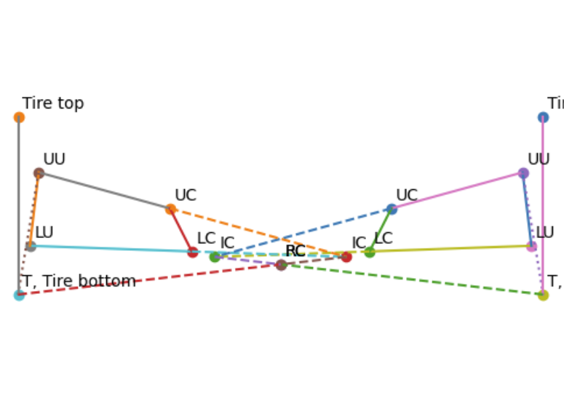
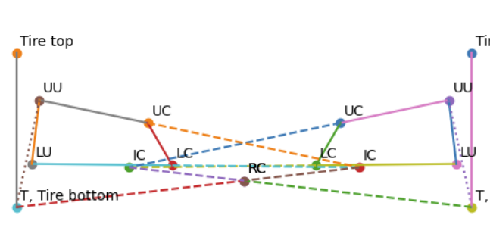
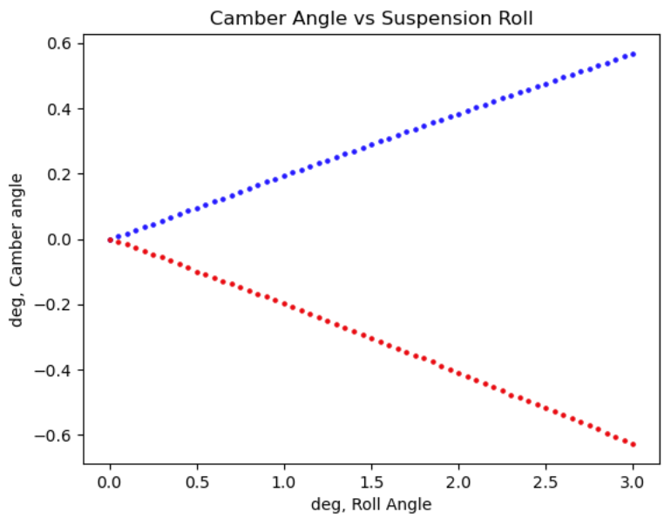
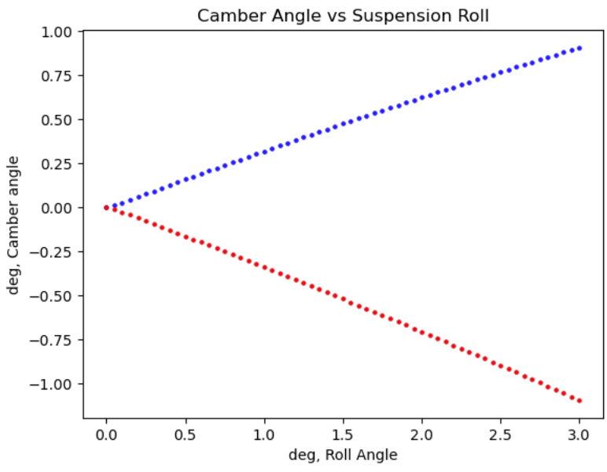
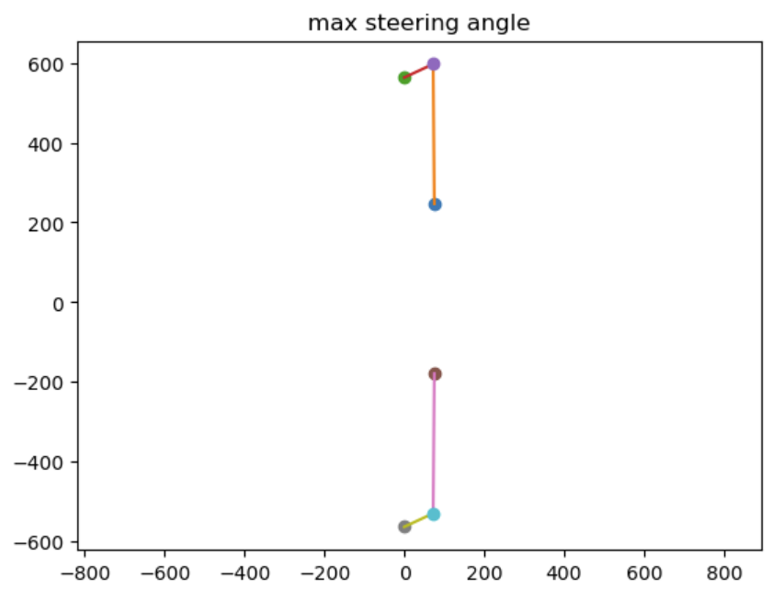
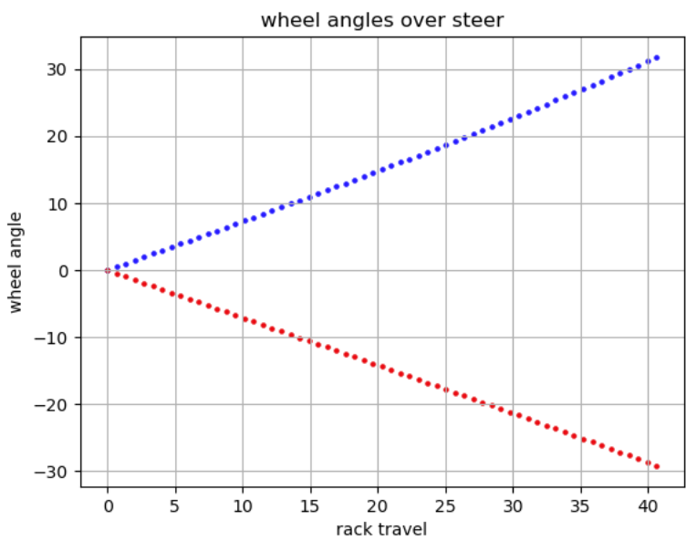
Vehicle Dynamics Kinematics
F R
Targeting aggressive camber gain in heave/low net camber gain in roll to remain tire contact patch up to ~ 3° roll.
Front:
-.076 deg/mm | .2 deg/deg
RC height 68.92mm
RC lateral migration under roll: 28.8mm/g
Rear:
-.064 deg/mm | .25 deg/deg
RC height: 69.93mm
RV lateral migration under roll: 21.1mm/g
0% Ackermann, driver preference, and no toe, predictable slip
(Blue: outside loaded tire, Red: inside loaded tire)
(Blue: inside steering tire,
Red: outside steering tire)

Slide 10
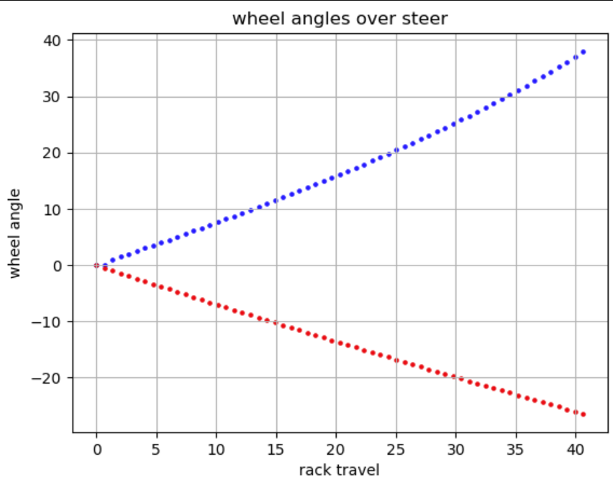
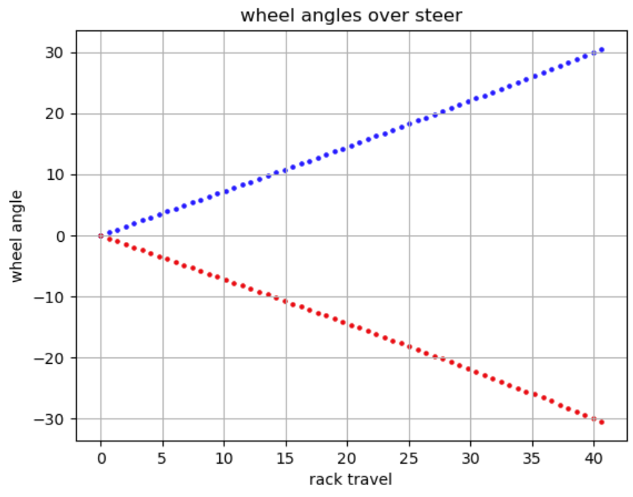
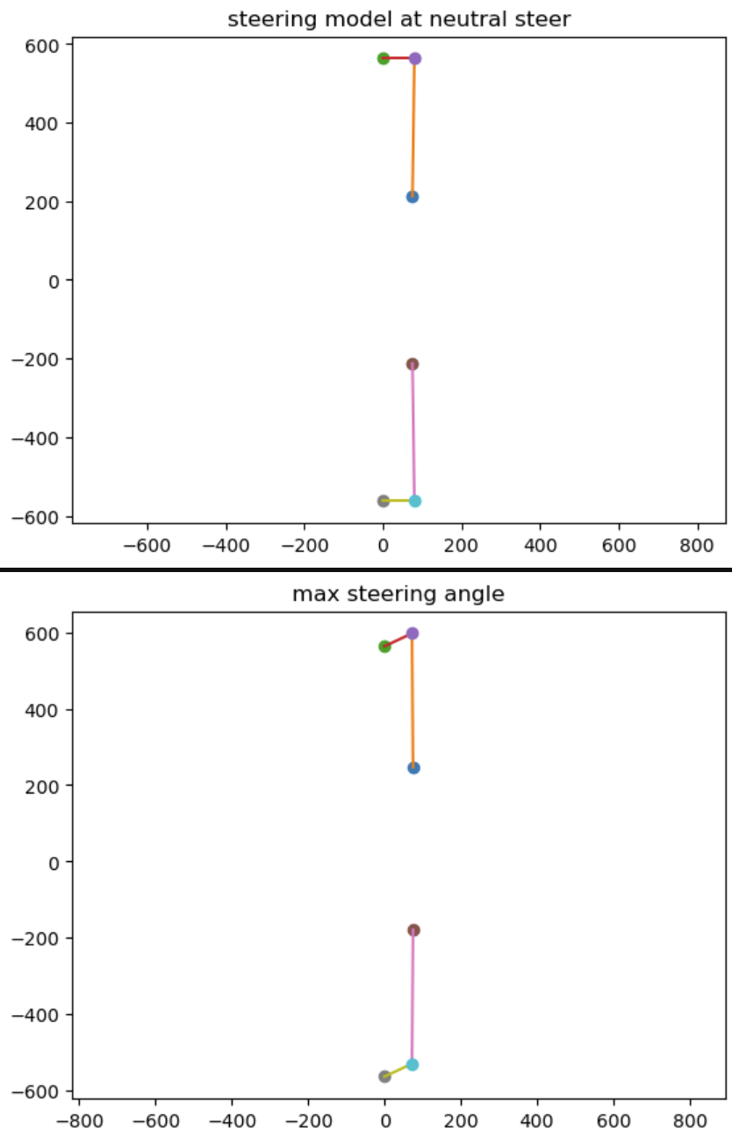
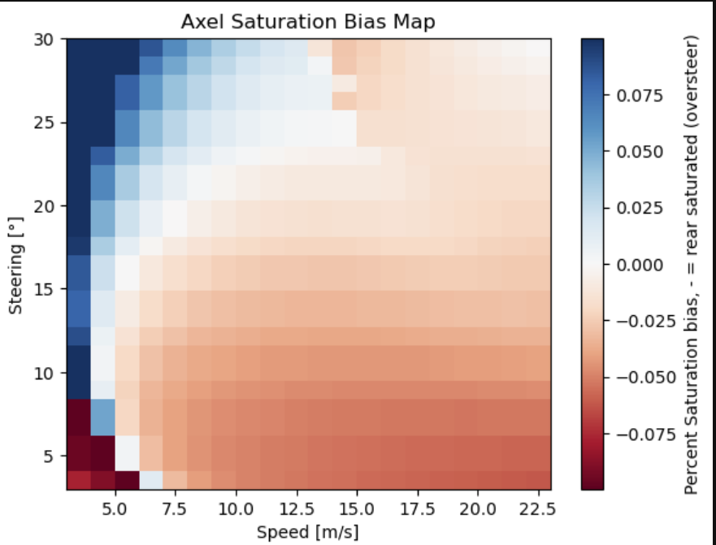
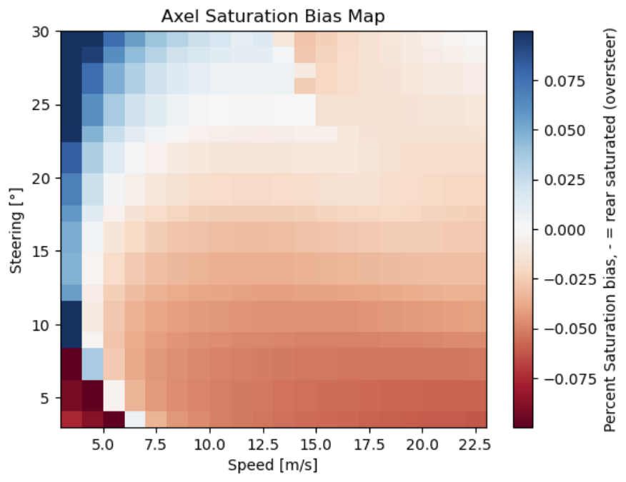
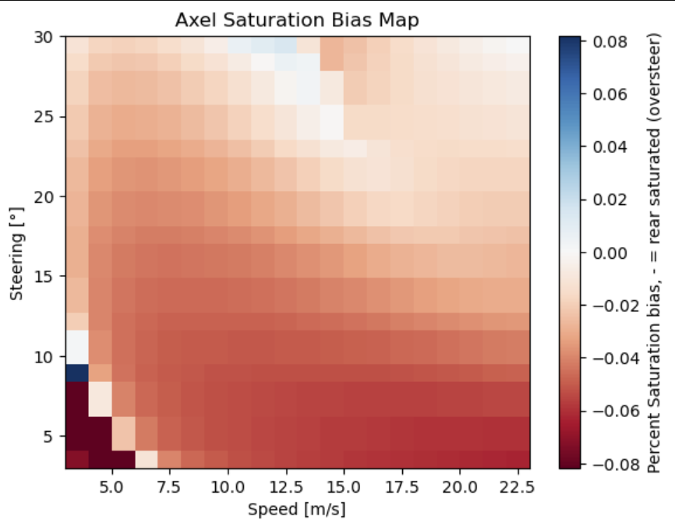
0% ackerman
25% ackerman
100% ackerman
Anti ackerman was avoided for low speed understeer with hairpins. Drivers preferred balance of oversteer slight bias on 0%

Slide 11
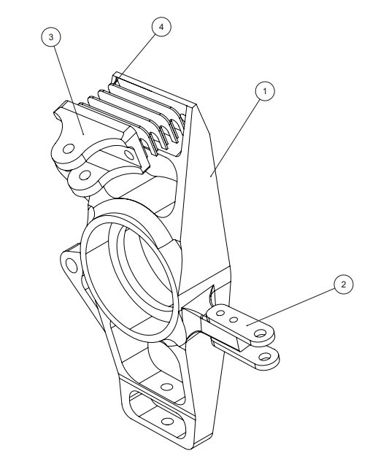
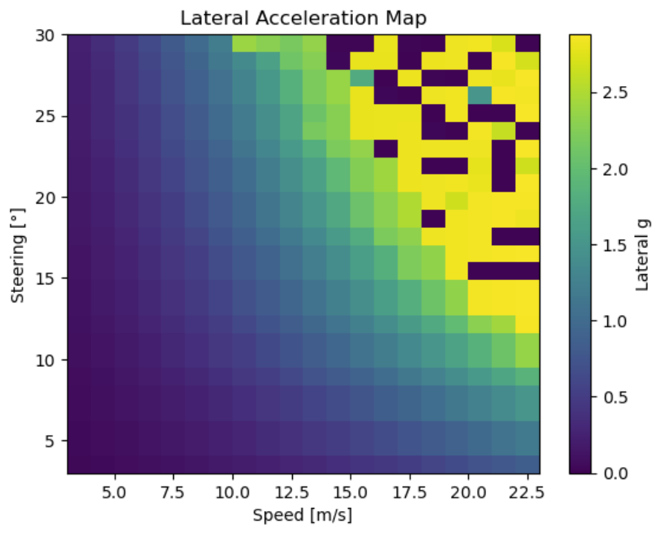
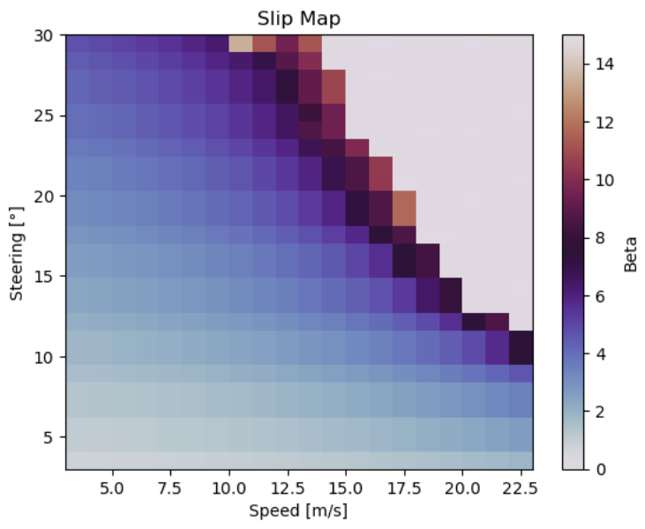
Vehicle Dynamics Adjustability, Data, and Simulation
Adjustability:
Outboard camber adjustment tabs
Interchangeable Ackerman brackets
Variable length pushrods and tie rods
Spring stiffnesses from 125-500 lbf/in
Ohlins TTX25 Mk2 4-way dampers
Data Acquisition:
Stopwatch
Tire Pyrometer
Accelerometer/Datalogger
Steering Angle Sensor
Utilized for lap times, camber and tire utilization, and parameters for simulations
Simulation
Steady State 4-wheel-coupled-bicycle 5-motion-DOF physics model targeted for skidpad (excluding pitch)
Integrated Pacejka hand tuned tire coefficients, weight transfer, aero, and dynamic toe
Purpose is a baseline setup for further tuning of stiffness/Ackermann/toe
Used for aero sideslip (beta) simulations providing proper bearing for cornering for cfd simulations
Tires overfit slip after the grip limit leading to model overcalculating forces and slip

Slide 12
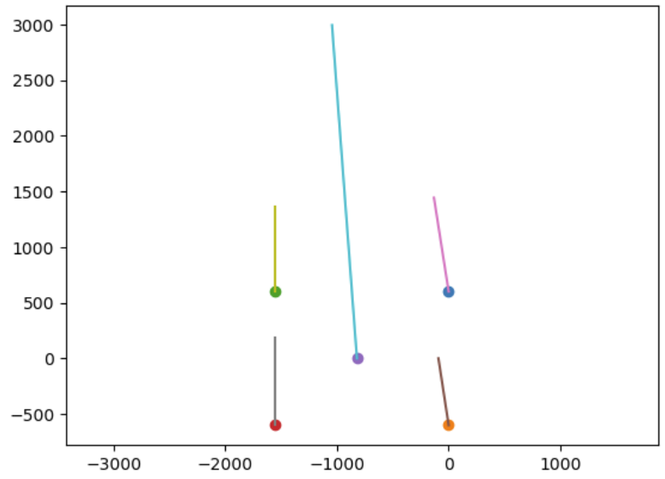
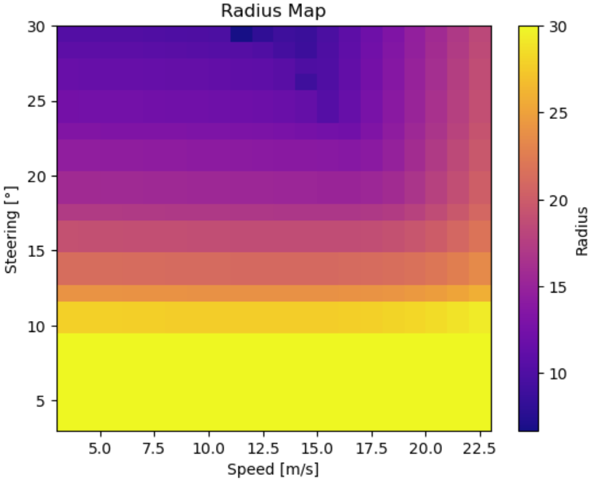
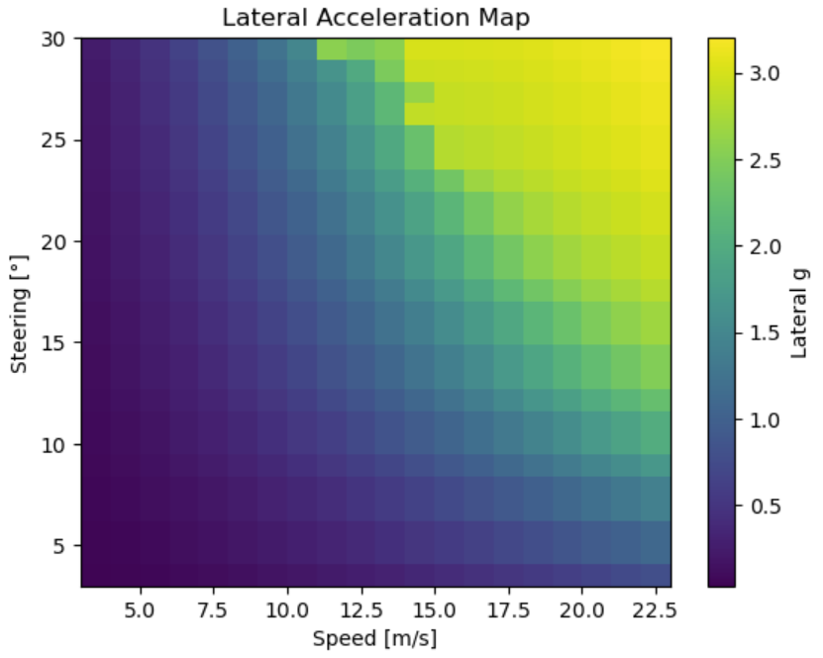
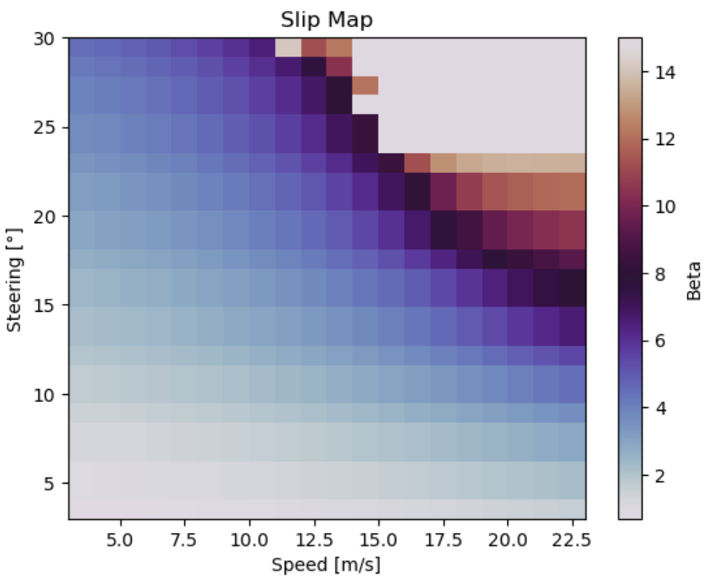
Our simplified model limitations:
Smooth MF5 Tires with no tire drop-off past threshold (grip beyond peak slip)
Beta converges very high from the MF tires, see beta map for realistic operation conditions
Assumed pure lateral slip, no combined slip to target for steady state at apex, skidpad, and mechanical balance
Red is more oversteer bias, Blue is Understeer Bias

Slide 13
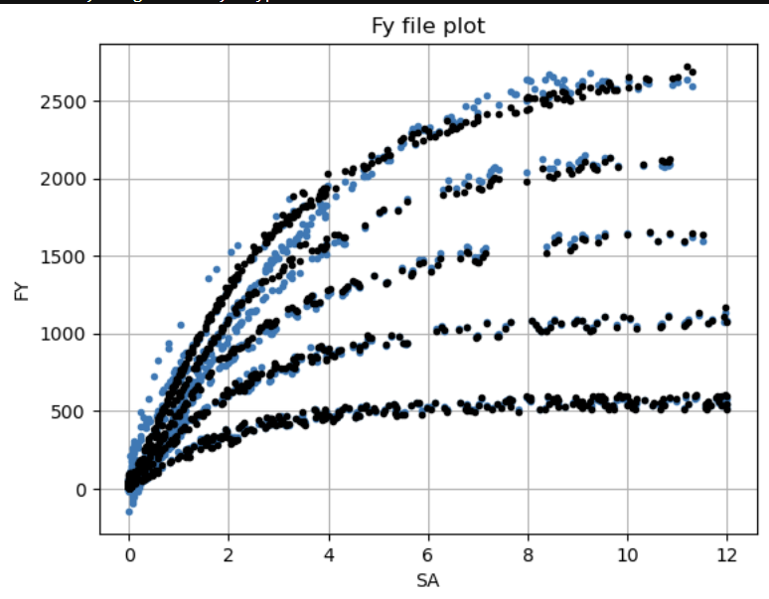

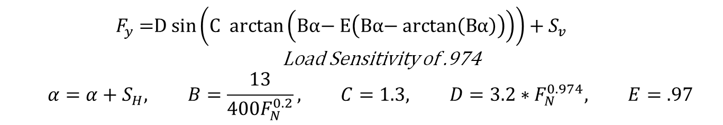
$$F_{y}\text{ =}\text{D} \text{sin}\left(\text{C} \text{arctan}\left(\text{Bα}\text{− }\text{E}\left(\text{Bα}\text{− }\text{arctan}\left(\text{Bα}\right)\right)\right)\right)+S_{v}$$
Load Sensitivity of .974
$$α=α+S_{H}, B=\frac{13}{400F_{N}^{0.2}}, C=1.3, D=3.2∗F_{N}^{0.974}, E=.97$$

Slide 14

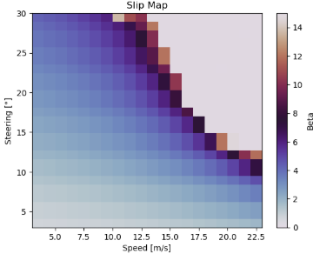
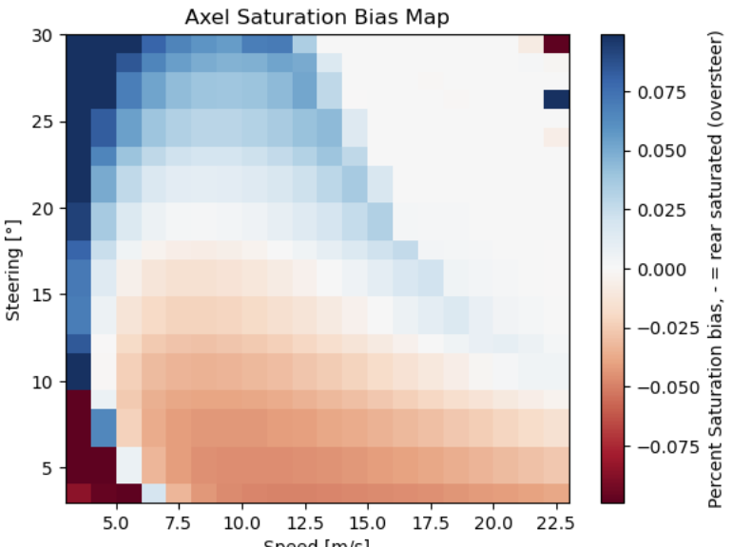
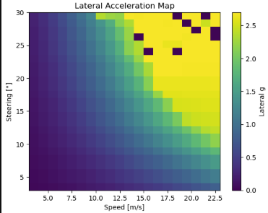
Aero justification- dramatically helps midspeed corners (lowspeed is tire limited, highspeed is engine and drag

Slide 15
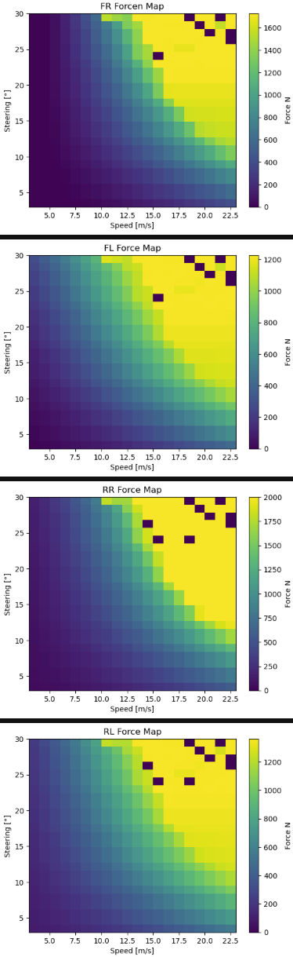
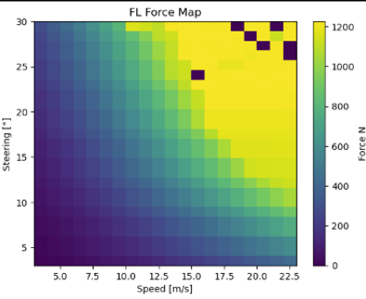
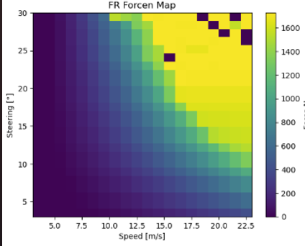
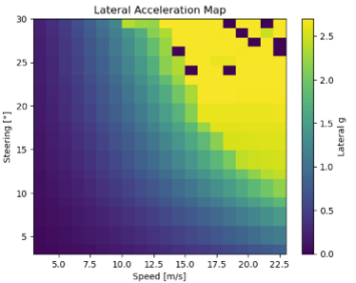
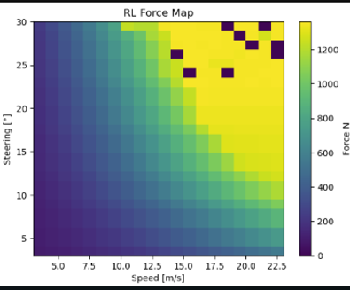
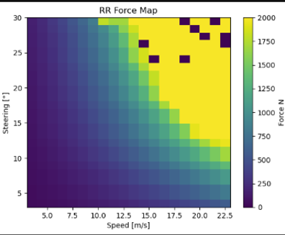
No Aero Operating condition

Slide 16
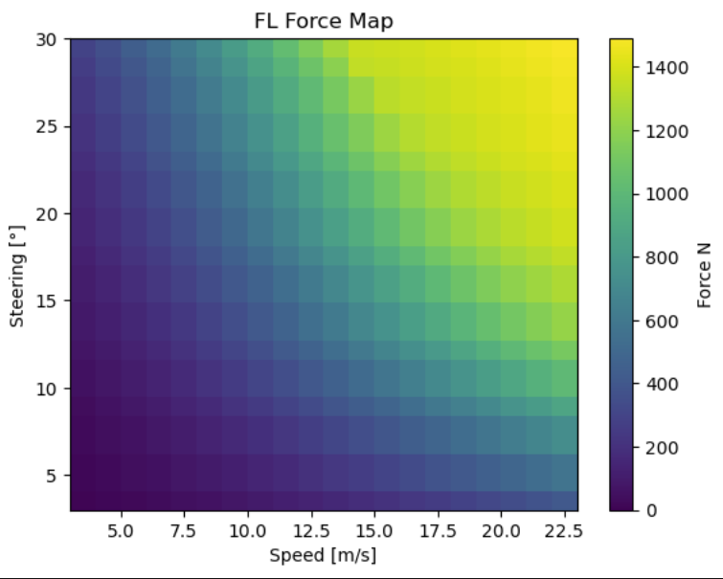
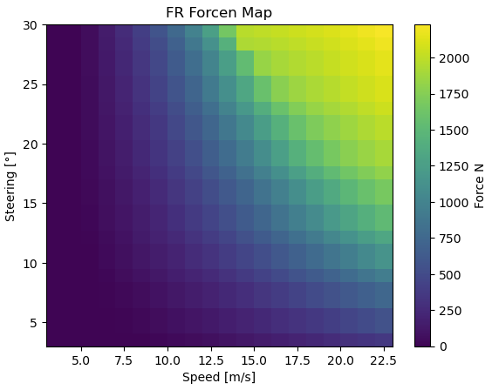
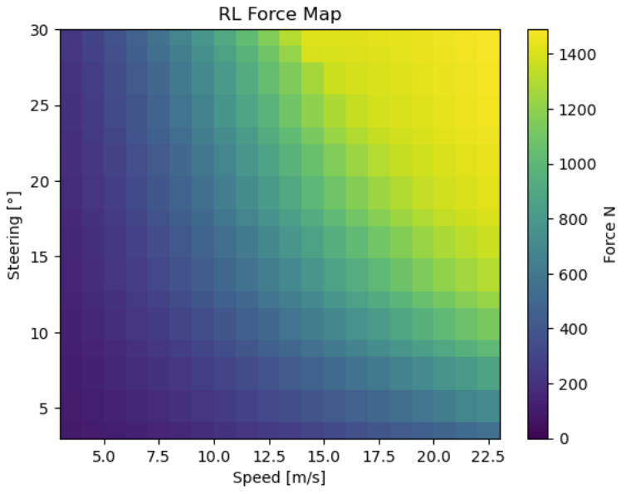
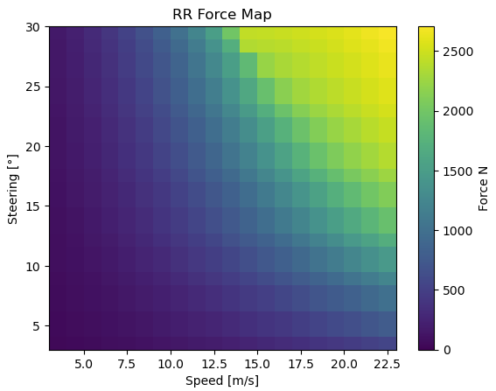
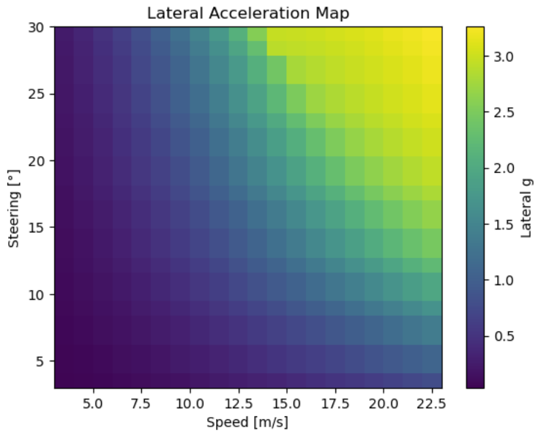
Operating condition

Slide 17
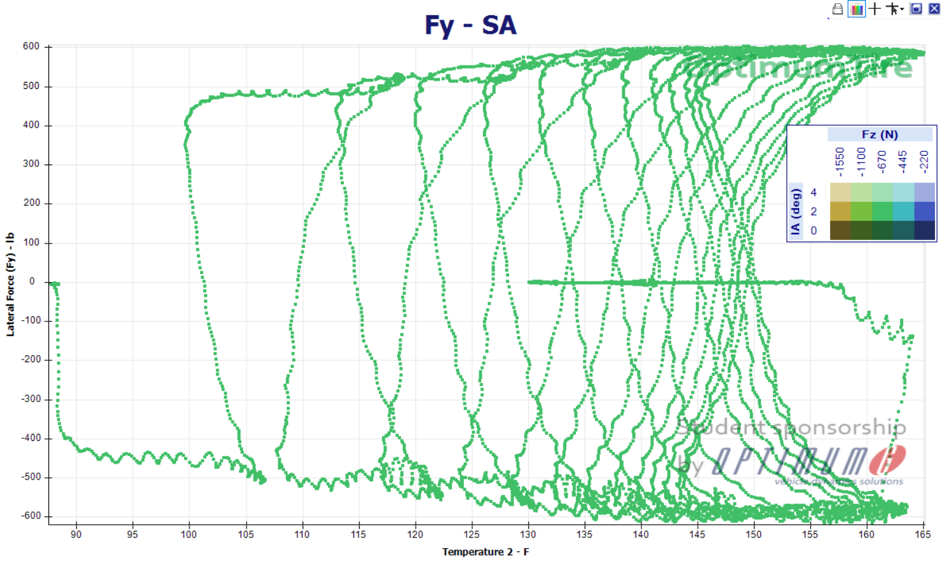
Tire Temps
skidpad 4-18-26, left side (skidpad is symmetric track)
FI | FM | FO |  | RI | RM | RO
Cold rest
39.5 | 41.4 | 39.6 |  | 43 | 43.9 | 41.5
41.5 | 42.7 | 41.9 |  | 42.3 | 45.3 | 43.2
41.4 | 43 | 42 |  | 41.7 | 45.4 | 43.3
41.3 | 43.3 | 42.8 |  | 44.8 | 45.9 | 42.6
42.6 | 43.8 | 42.8 |  | 46 | 47 | 45
43.2 | 44.5 | 43.4 |  | 46.9 | 47.8 | 45.8
Cold
37.3 | 43.8 | 42.2 |  | 41.9 | 43.8 | 41.1
42.6 | 43.8 | 41.9 |  | 45 | 46 | 44.2
Cold
36.4 | 40.6 | 40.3 |  | 41.1 | 41.1 | 39.1
Cold
37.4 | 38.8 | 37.9 |  | 39 | 39.6 | 38.1

Slide 18
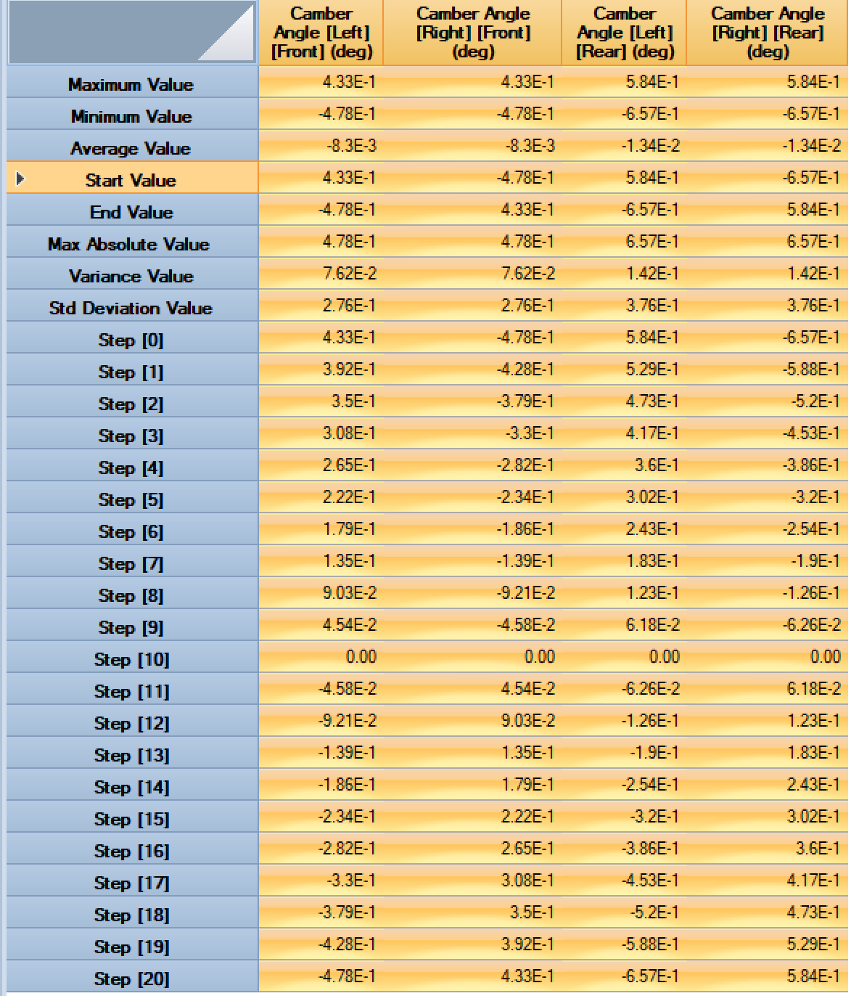
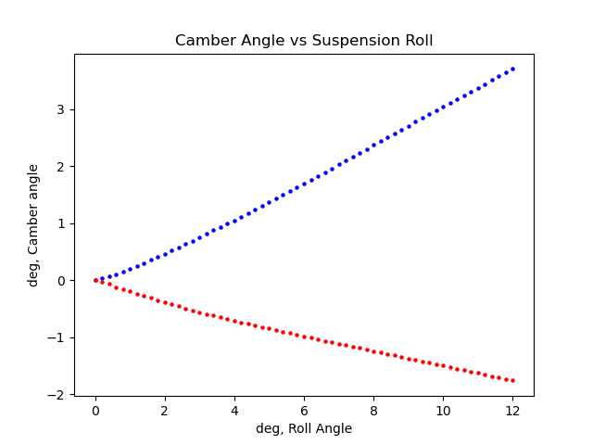
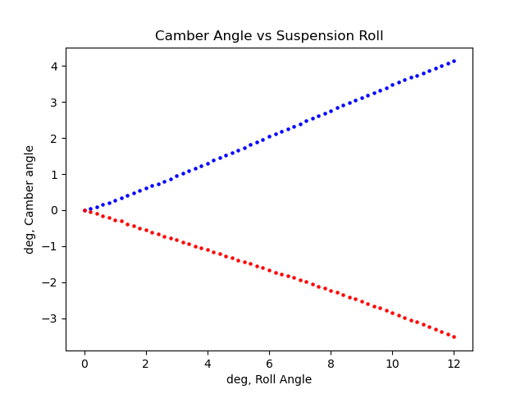
Optimum K Camber Changes in Roll -2 to 2 2025 car
Front
Rear

