Slide 1

AGILE A-Z - CHAPTER 1
AGILE

Slide 2
PRACTICAL INFORMATION
▸ New Location and Sponsors
▸ Agile A-Z Chapters
▸ Certificate of Participation

Slide 3
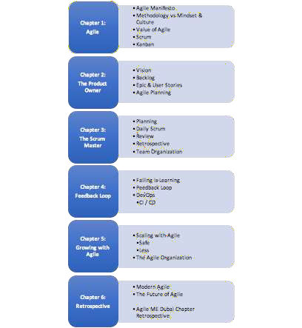
AGILE A-Z CHAPTER 1: AGILE
THE CHAPTERS

Slide 4
CERTIFICATE OF PARTICIPATION
AGILE A-Z CHAPTER 1: AGILE
▸ GOLD: 5-6 Meetups
▸ Will be handed over at the Lean and Agile ME Summit 2018 conference in March
▸ SILVER: 3-4 Meetups
▸ BRONCE: 1-2 Meetups
Remember to fill in the participation list!

Slide 5
TODAYS AGENDA
AGILE A-Z CHAPTER 1: AGILE
▸ What is Agile?
▸ The Value of Agile
▸ Agile Processes

Slide 6
WHAT IS AGILE TO YOU?

Slide 7
THE AGILE MANIFESTO
AGILE A-Z CHAPTER 1: AGILE
▸ Individuals and interactions over processes and tools
▸ Working software over comprehensive documentation
▸ Customer collaboration over contract negotiation
▸ Responding to change over following a plan
That is, while there is value in the items on the right, we value the items on the left more.

Slide 8
WHY DO YOU WANT TO BE

Slide 9
THE VALUE OF AGILE
AGILE A-Z CHAPTER 1: AGILE
▸ The ability to inspect and adapt in an ever changing world
▸ But how does Agile help you with that?

Slide 10
WHAT IS AN AGILE PROCESS?

Slide 11
AGILE A-Z CHAPTER 1: AGILE
AGILE PROCESSES
Are you doing Agile, or are you being agile?

Slide 12
AGILE A-Z CHAPTER 1: AGILE
SCRUM AND KANBAN
Releasing software early
+
Collaborative and self- managed teams.

Slide 13

AGILE A-Z CHAPTER 1: AGILE
SCRUM

Slide 14
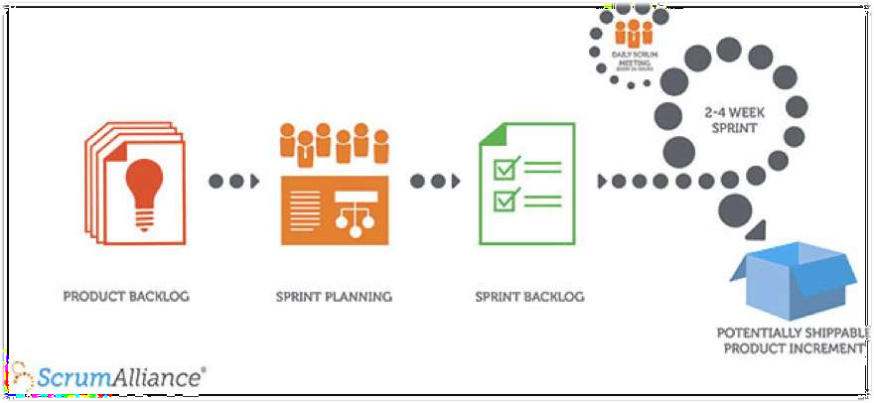
AGILE A-Z CHAPTER 1: AGILE
SCRUM

Slide 15
SCRUM
AGILE A-Z CHAPTER 1: AGILE
▸ Backlog of user stories
▸ Planning
▸ Sprint
▸ Daily Standup
▸ Review
▸ Retrospective
▸ Product Owner
▸ Scrum Master
▸ Team Members
▸ Stakeholders

Slide 16
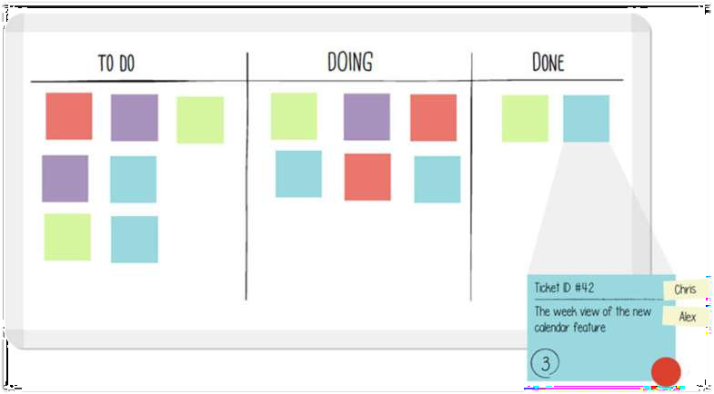
AGILE A-Z CHAPTER 1: AGILE
KANBAN
Lean Software Development

Slide 17
KANBAN
AGILE A-Z CHAPTER 1: AGILE
▸ Transparency by visualizing what you are doing right now
▸ Keep Work In Progress at a minimum
▸ Optimized flow

Slide 18
KANBAN
AGILE A-Z CHAPTER 1: AGILE
SCRUM
▸ No prescribed roles
▸ Continuous Delivery
▸ Single Piece Flow
▸ Can change at any time
▸ Cycle time
▸ Scrum master, PO etc.
▸ Time boxed sprints
▸ Sprint backlog
▸ No changes mid-sprint
▸ Velocity

Slide 19
WHAT DO I TAKE HOME

Slide 20
WHAT IS AGILE?
AGILE A-Z CHAPTER 1: AGILE
▸It’s not a process - It’s a mindset and a general way of working
▸ Frequent deliveries, enabling a strong and quick feedback loop is key to be truly agile
▸ Be transparent - Why are you doing what you’re doing
▸ SCRUM and KANBAN are tools and processes that can be followed to become agile as long as it adds value

