Slide 1
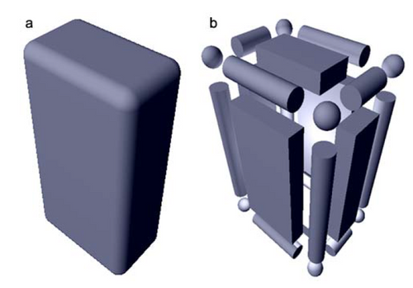
point ↔ mesh proximity
p
?
p

Slide 2
Point↔face proximity
p
p
N
N
N
a
p
a
a
|d|<dmax
|d|>dmax
p’
u+v+w≠1
p’
p’
b
c
b
c
b
c
OUI
NON
NON
given a distance dmax, p is detected as « near » triangle abc is its unsigned distance to plane
Pabc, containing a,b and c, is less than dmax and if p’, the projection of p onto Pabc lies inside
triangle abc. In other words, if p’ barycentric coordinates u,v,w are such that u+v+w=1 and
each of u,v and w are in [0;1]. p will be flagged as « behind » if its signed distance to Pabc < 0

Slide 3
Point↔edge proximity
p
p
p
|d|>dmax
|d|<dmax
a
b
a
b
p’
p’
a
b
p’
OUI
NON
NON
given a distance dmax, p is detected as « near » edge ab if its unsigned distance to line
Lab, passing through a and b, is less than dmax and if p’, the projection of p onto Lab lies inside ab. p’ is such that pp’ is orthogonal to Lab.
triangle abc. In other words, if p’ barycentric coordinates u,v,w are such that u+v+w=1 and
each of u,v and w are in [0;1]. p will be flagged as « behind » if its signed distance to Pabc < 0

Slide 4
Point ↔ vertex proximity
p
p
|d|<dmax
|d|>dmax
v
v
YES
NO
given a distance dmax, p is detected as « near » vertex v if its distance to v is less than dmax

Slide 5
Point↔mesh proximity functor
Called for each point p with the nearest element (triangle, edge or vertex) to p.
Edges and vertices may be disabled, then only triangles are considered
Functor always called with vertex indices v0, v1 and v2
  V1 and v2 are -1 for vertex proximlity (consider only v0)
  V2 is -1 for edge proximity (consider only v0 and v1)
  all three indices are = -1 for triangle proximity
see src/mesh/trimesh_particle_proximity.cu for example usage

