Slide 1
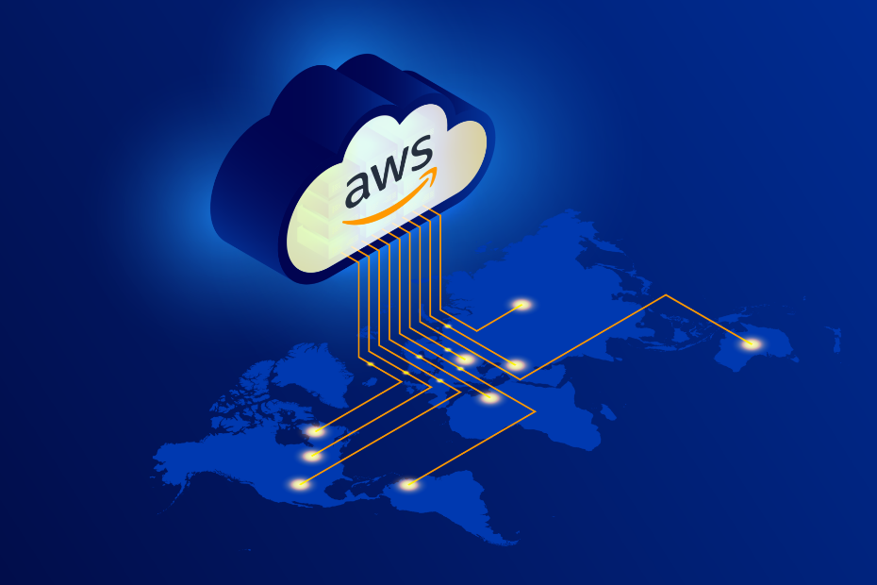

AWS Elastic Beanstalk
A managed platform for deploying, managing, and scaling applications.

Slide 2
Challenges Before Elastic Beanstalk
- Manual EC2 setup
- Complex load balancing & scaling
- Hard CI/CD setup
- Time-consuming server management

Slide 3
Elastic Beanstalk’s Approach
- Automates infrastructure
- Deploy code directly
- Built-in monitoring
- Easy integration with AWS tools

Slide 4
Architecture Overview
- Upload code
- EB provisions EC2, LB, Auto-scaling
- Optional RDS
- Health Monitoring
- Provides URL

Slide 5
Supported Platforms
Java, Python, Node.js, PHP, Ruby, Go, .NET, Docker

Slide 6
Key Features
- Auto-scaling & Load balancing
- Managed environment
- Monitoring & Logs
- Versioning and rollback
- AWS integrations

Slide 7
Pricing
Elastic Beanstalk is free.
You only pay for underlying AWS resources (EC2, S3, RDS, etc.)

Slide 8
EB vs Other AWS Services
EB = PaaS
EC2 = IaaS
ECS = CaaS
Lambda = FaaS
EB automates infra, others give more control

Slide 9
Why Choose Elastic Beanstalk
- Fast deployment
- Developer-friendly
- Optional deep control
- Great for small/medium apps

Slide 10
Use Cases
- Startups web apps
- Developer teams
- Educational projects
- Internal enterprise apps

Slide 11
Limitations
- Not ideal for complex microservices
- Limited deep infra control
- Slower deployments vs CI/CD tools

