Slide 1


Guidelines To fill Synergy Timesheet
Notes:
1

Slide 2
Timesheet Overview
F.A.Q’s
What is Timesheet?
→Timesheet is actually your attendance during your working days and week offs. We will be handling your attendance records for the dates on which you have taken leaves, Comp-offs, etc.
(Please consider Log in credentials provided by Wipro HR/Back-end team.)
2) Why to fill timesheets?
→We will always require your approved timesheet to process your payroll from your Date of joining to Date of leaving you for that you need to fill timesheets on Synergy portal.
3) How to fill timesheet on Synergy Portal?
→Please consider link of Synergy portal for timesheet.
https://synergy.wipro.com/synergy/SynergyLogin.jsp
4)How to share timesheets?
→You have to notify us on APAC.Timesheet@collabera.com and gaurav.talreja@collabera.com by attaching PDF format of timesheet.

Slide 3
Synergy timesheet- Introduction
Points To TAKE CARE:-
You have to fill timesheet on 1st of every month for previous month and request your PM/RM to approve the same. Deadline for submitting timesheets will be 5th of every month for previous month.
You always need to fill 9 Hours in timesheet. {Hours less than 8.45 will lead to your Half day.}
Please check your current month week-offs are shown properly while submitting timesheet, if your week-offs are not mentioned properly please notify your RM at earliest.
E.g. Last month your week-offs were Mon-Tue, but current month week-offs were Sat-Sun.
Please mark your leaves and holidays properly to avoid any discrepancies in your payroll as incorrect timesheets will be rejected by PM.
Please go through below instructions while marking…
Leave →Drop down in particular day/field →Mark Leave
Comp-off→ Drop down in particular day/field →Mark Comp-off or put standard hours i.e. 9.30 Hours
Client Holiday(CH)→Put standard hours i.e. 9.30 Hours or Mention Company Holiday(CH)/Public Holiday(CH).
Color codes in Synergy:-

Slide 4
Synergy- Introduction
Log in to “Synergy”
Log in onto “Synergy”
Welcome to synergy
Select Wipro Technologies.
My Timesheet
Select Timesheet.
Consider the Log in credentials provided to you.
Change/ Select project location{Normally this should be client location}

Slide 5
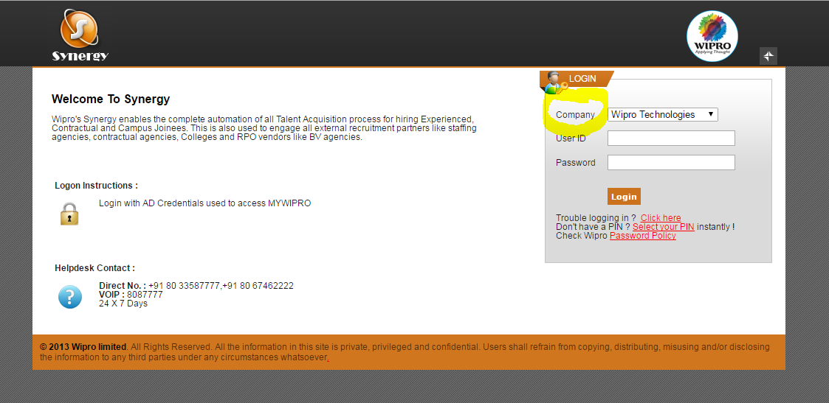
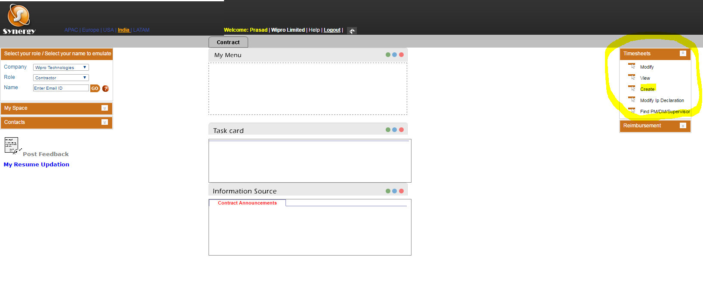
This is how your I timesheet will look like:
1) Click on the URL below page will open, select Company as ‘Wipro Technologies', then provide your User ID and password.
2) Once you logged in the below page will appear, then Expand Timesheet and Click on Create timesheet.

Slide 6
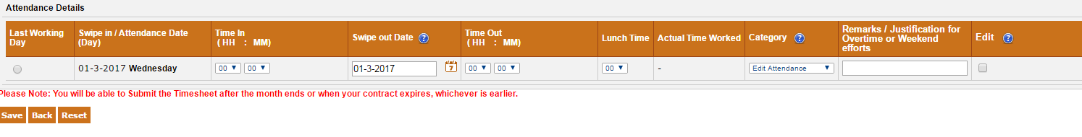
3) Select Project Location or Wipro Location or Client Location (Normally this should be Client location).
4) Fill In-out time and lunch time.
5) Please check you are always filling 9 Hours in timesheet. {Hours less than 8.45 will lead to your Half day.}
6) Please note below points when you need to mark ….
5
Need to Mark Leave
Drop down in particular day→ Mark Leave.
Drop down in particular day→ Mark Comp-off
Or put standard Hours i.e. 9 Hours
Need to Mark Client Holiday
Please standard Hours i.e. 9 Hours
Or In remarks column mention Company Holiday or Public Holiday
Need to mark Comp-off

Slide 7
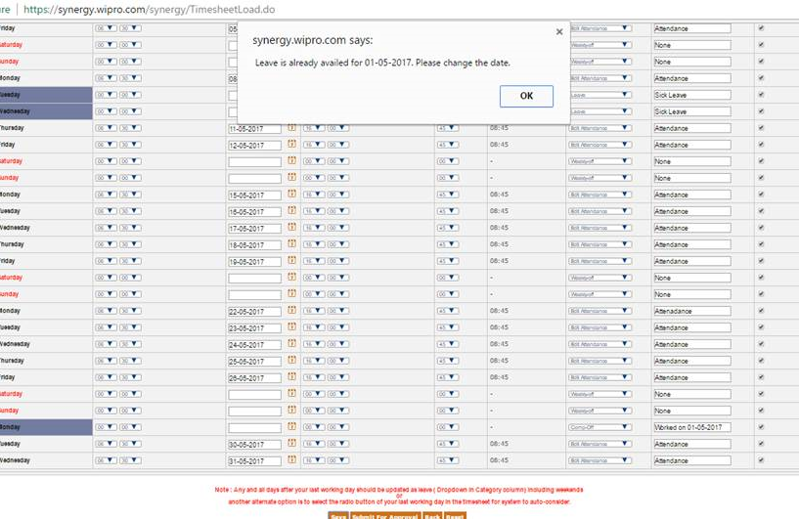
Issues & Resolution.
Please check if you are getting any Error on Synergy due to any reasons.
E.g. Leave is already availed for any particular day.(Please find below Error Snap) Location

Slide 8
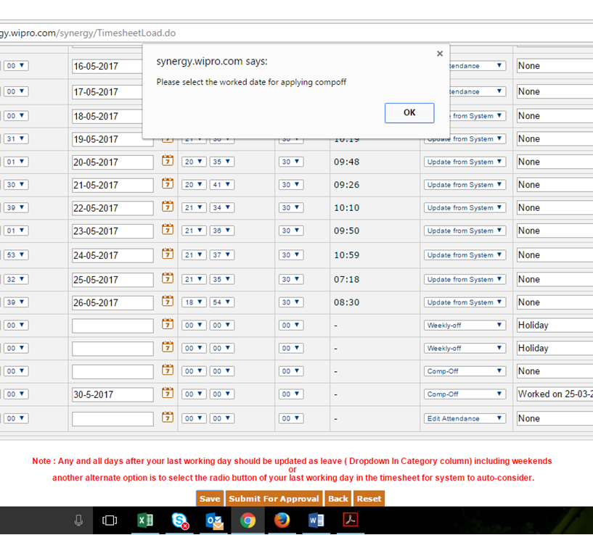
E.g. If you are getting Error while selecting Comp off on Synergy.

Slide 9
POINTS TO BE TAKEN CARE WITHOUT FAILURE
If you are getting any errors as shown above, please take a snapshot of error and share the same on below mail id’s on first instance in below format.
TO: arun.kumar47@wipro.com ; inayath.ullar@wipro.com; Your RM’s Mail Id.
Cc: gaurav.talreja@collabera.com; APAC.Timesheet.@collabera.com; vaibhavi.s@collabera.com
Please check on below points:
(i) Whether you have worked on any PUBLIC HOLIDAY or not:
→ If you have WORKED put/mark STANDARD WORKING HOURS.
→If you have NOT WORKED on PUBLIC HOLIDAY put/mark HOLIDAY.{Not worked due to WEEK-OFF, SICK LEAVE, PUBLIC HOLIDAY ETC.}
(ii) Any leaves taken- If you have taken leaves in entire month then put LEAVES in that particular day.
(iii) Comp off- Please put Comp-off in any day where you want to take leave in case when you have worked on any PUBLIC HOLIDAY and mention in remarks box “Comp-off against___Day”.
(iv) Once you are done with filling timesheet, please check “SAVE FOR APPROVAL” option is reflecting or not.
(v) If Synergy is not allowing you to put Holiday/Leave/Comp-off etc.. please do let us know on first instance by sharing snap of error.
Please Note:-
Don’t mark LEAVE in place of PUBLIC HOLIDAY or vice versa.
→ Please check Time In/Out details are properly submitted or not before Submitting for Approval.
.

Slide 10
Leave Policy
LEAVE POLICY
Privilege Leave (PL) | 15
Sick Leave (SL) | 3
Casual Leave (CL) | 3
PL can only be availed once the consultant finishes 6 months probation period.
All the leaves are calculated on Pro-rata basis.
If the consultant has no balance for a particular leave that will be marked as Loss of pay (LOP).
PL can be carried forward to next year but SL and CL can not be carried forward to next year.
Comp off Policy:-
Comp off cannot be carried forward next month.
If the consultant works on public holiday, he/she can avail the comp off against regular working day in the same month only as in month end comp off will be lapsed.

Slide 11
Point of Contact (POC)
Employee Relations- POC
Name | Location | Contact Details | E-Mail
Soubhik Das | All Locations | 7573027613 | soubhik.das@collabera.com
Timesheet-POC
Name | Contact Details | E-Mail
Rushi Prajapati | 7069140056 | rushi.prajapati@collabera.com APAC.Timesheet@collabera.com

Slide 12
SUMMARY
SUMMARY
1) Always fill your timesheet on 1st of every month for previous month.
2) If you are facing any issues regarding Synergy portal please drop mail to procurement team in below format.
TO:- arun.kumar47@wipro.com; inayath.ullar@wipro.com
Cc:- APAC.TIMESHEET@COLLABERA.COM; gaurav.talreja@collabera.com; vaibhavi.s@collabera.com
3) Please fill your timesheet properly as wrong filled timesheet will be rejected by system and it will require 7-8 working days for resolution of your issue.
“LET Us KNOW”
If you are facing any issues on below points
** At RM level [RM is on leave, RM not approving etc.],
** At Timesheet level [LOP marked, How to apply for leaves etc.],
** Portal Issue [Log in credentials blocked, Account Locked etc.]
Please do let us know so we can route your issues/queries to concerned team and help with resolution at earliest.
“Its humble request and gentle note, consultants should adhere to process religiously”.

Slide 13


