Slide 1
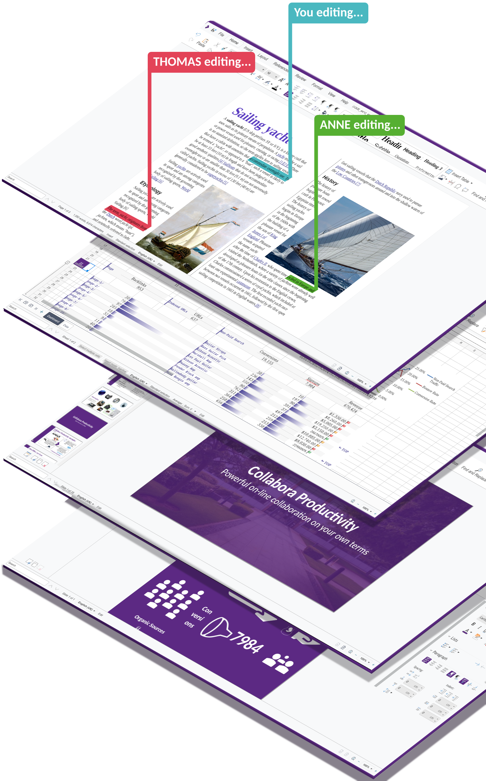


Collabora Online
Usability Optimization
Smooth & beautiful, collaborative editing for all
Michael Meeks and Caolán McNamara
CEO Principle Engineer
michael.meeks@collabora.com caolan.mcnamara@collabora.com
“Stand at the crossroads and look; ask for the ancient paths, ask where the good way is, and walk in it, and you will find rest for your souls...” - Jeremiah 6:16

Slide 2
Overview:
How Collabora Online works
  Getting a feel for latency
How we measure performance
Typical wins
  Deltas
  Tile rendering
  Memory
  Miscellaneous sillies
Usability features
  Accessibility improvements
  The latest bits for everyone.
Future work
How to get involved
Conclusions
Notes:
To introduce LibreOffice-from-Collabora
First allow me to introduce
Collabora
and
Collabora Productivity...

Slide 3
How Collabora Online works:

Slide 4
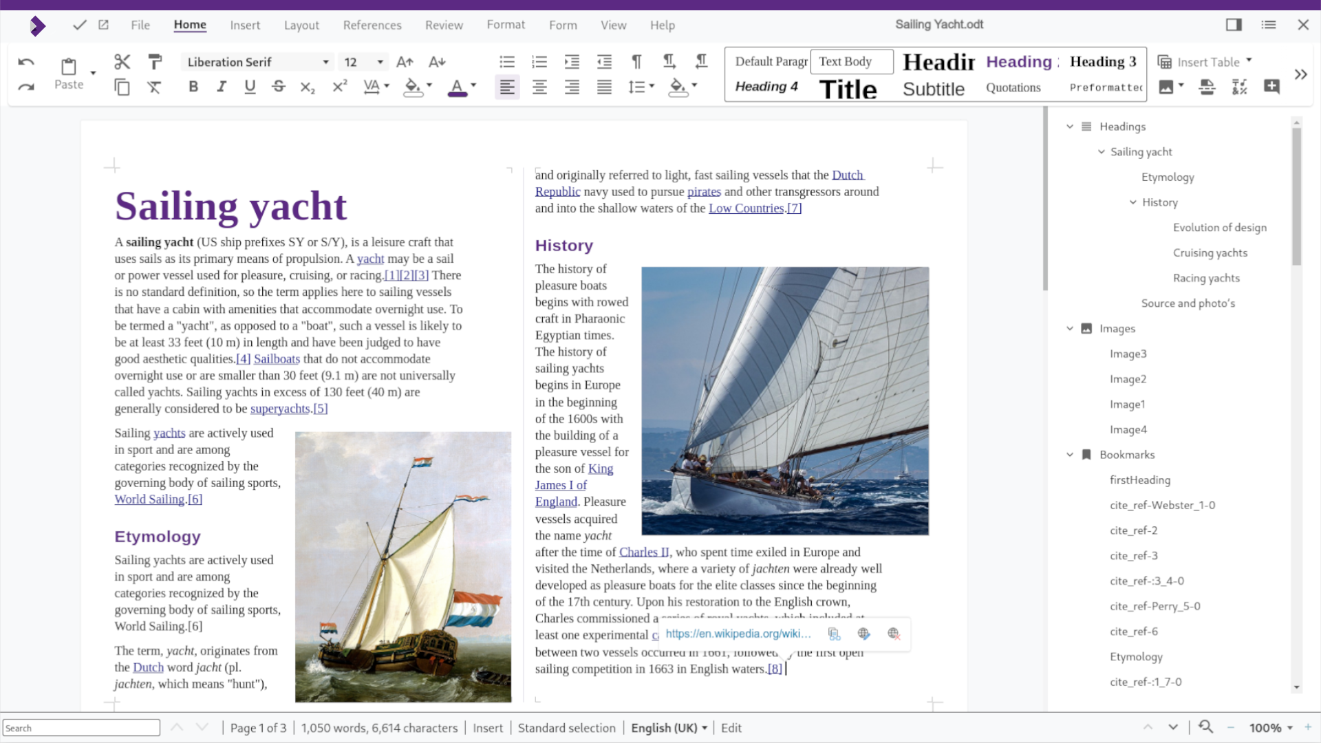

The various pieces:
Websocket
http/https
Browser: light Javascript
coolwsd: connection & process mgmt, admin, document lifecycle
Websocket protocol over local Unix socket
Simple REST API
Many of:
coolforkit: LibreOfficeKit based core process – event processing, document load/save, tiled-rendering, delta compression etc.
native JS/CSS chrome: dialogs, sidebar, toolbar etc.
Tiles pre-loaded & cached for larger area. Drawn on canvas
File storage &
authentication server
Notes:
To introduce LibreOffice-from-Collabora
First allow me to introduce
Collabora
and
Collabora Productivity...

Slide 5
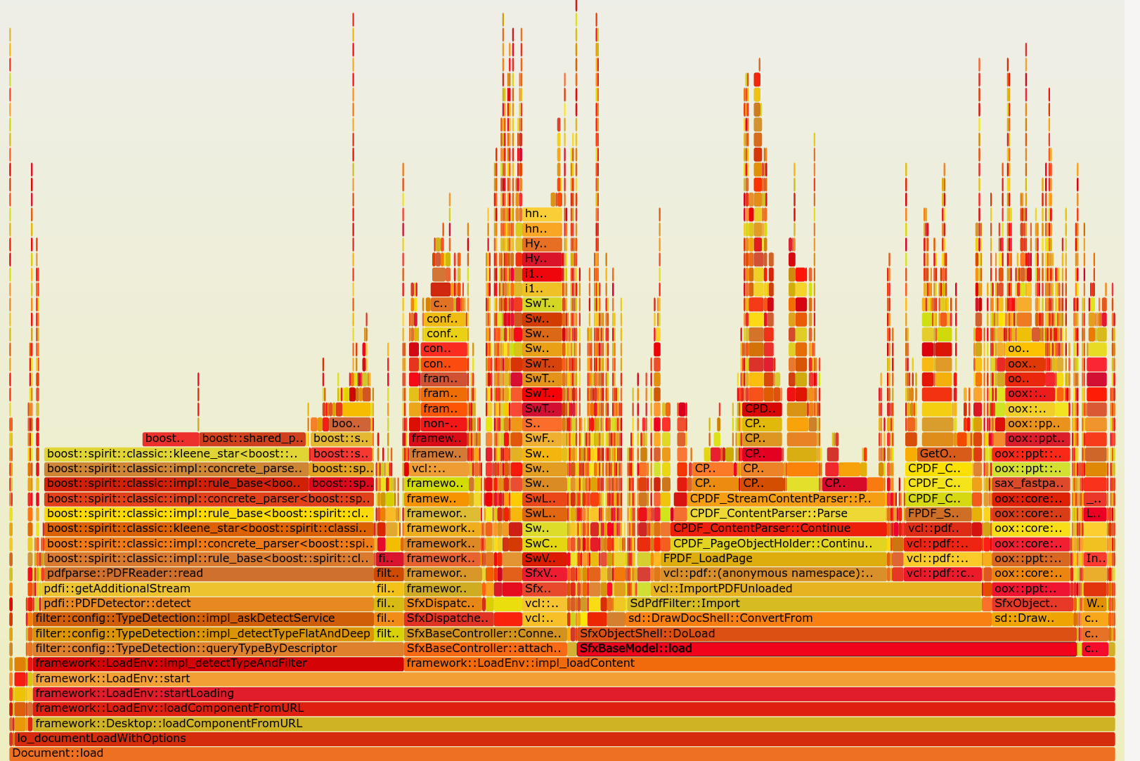
Demo profiling: example flame-graph
What does it mean ?
17%+ of a
week of
profiling:
  Detecting:
  ”is it Hybrid
  PDF”?
  Unbelievably
  wasteful
  Scan last 4k block
  ‘AdditionalStreams’
  +17%
Width is proportional time
Stack of function callers

Slide 6
The magic of AVX2 – branch free RLE
prepend ‘last’
pixel of the
last block
Block of next four pixels to RLE …
RGBA
RGBA
RGBA
RGBA
Next time’s
‘last’ pixel:
Build comparison
register:
RGBA
RGBA
RGBA
RGBA
RGBA
Compare:
cmpeq_epi32
NB. really 8 pixels at a time, not four and more 0’s and f’s needed ...
ffffffffffff
ffffffffffff
ffffffffffff
ffffffffff
0000000
000000
Magic: floating
point sign mask:
movemask_ps
1
1
0
0
This is our RLE mask.
How many pixels to copy? popcount(RLE mask)
Which ones ? RLE Mask → LUT + AVX2 gather
permutevar8x32_epi32 … is your friend

Slide 7
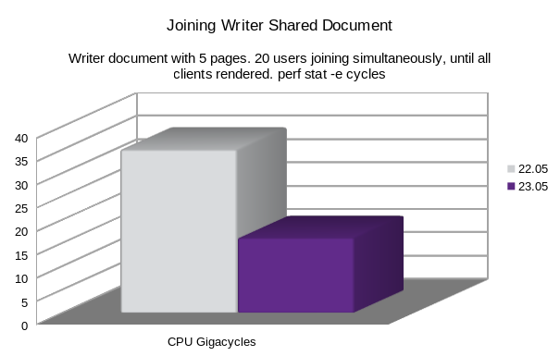
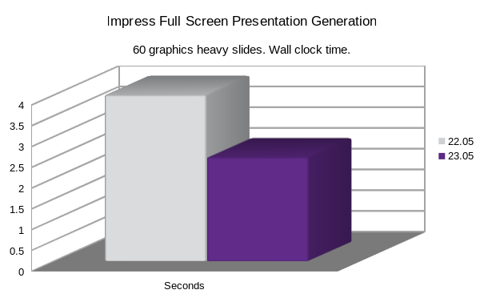
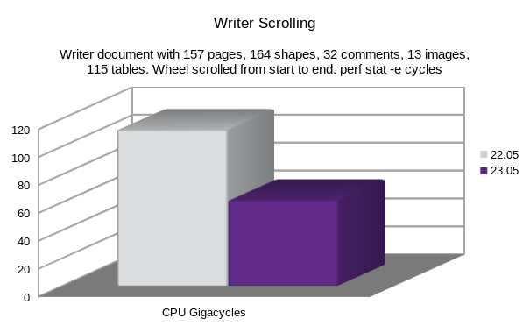
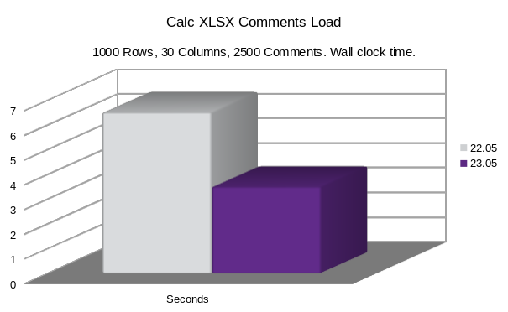
Some older numbers ...
Smaller is better!
Notes:
To introduce LibreOffice-from-Collabora
First allow me to introduce
Collabora
and
Collabora Productivity...

Slide 8


Thank you!
Oh, that my words were recorded, that they were written on a scroll, that they were inscribed with an iron tool on lead, or engraved in rock for ever! I know that my Redeemer lives, and that in the end he will stand upon the earth. And though this body has been destroyed yet in my flesh I will see God, I myself will see him, with my own eyes - I and not another. How my heart yearns within me. - Job 19: 23-27
@CollaboraOffice
hello@collaboraoffice.com
www.collaboraoffice.com

