Slide 1
Slide
This is a presentation file

Slide 2

Collabora Productivity
Collabora Productivity provides Collabora Online, the feature rich and compatible open source solution for editing and collaboration, and a range of other products and consulting to enterprise and government.

Slide 3


Support
Powered by the largest team of certified LibreOffice engineers in the world, it is a leading contributor to the LibreOffice codebase and community.

Slide 4
Collabora Office and Collabora Online
Collabora Office offers a comprehensive suite of word processing, spreadsheet management, and presentation tools.
Collabora Online extends these capabilities to the web, facilitating real-time collaboration and document editing from any device, anywhere

Slide 5
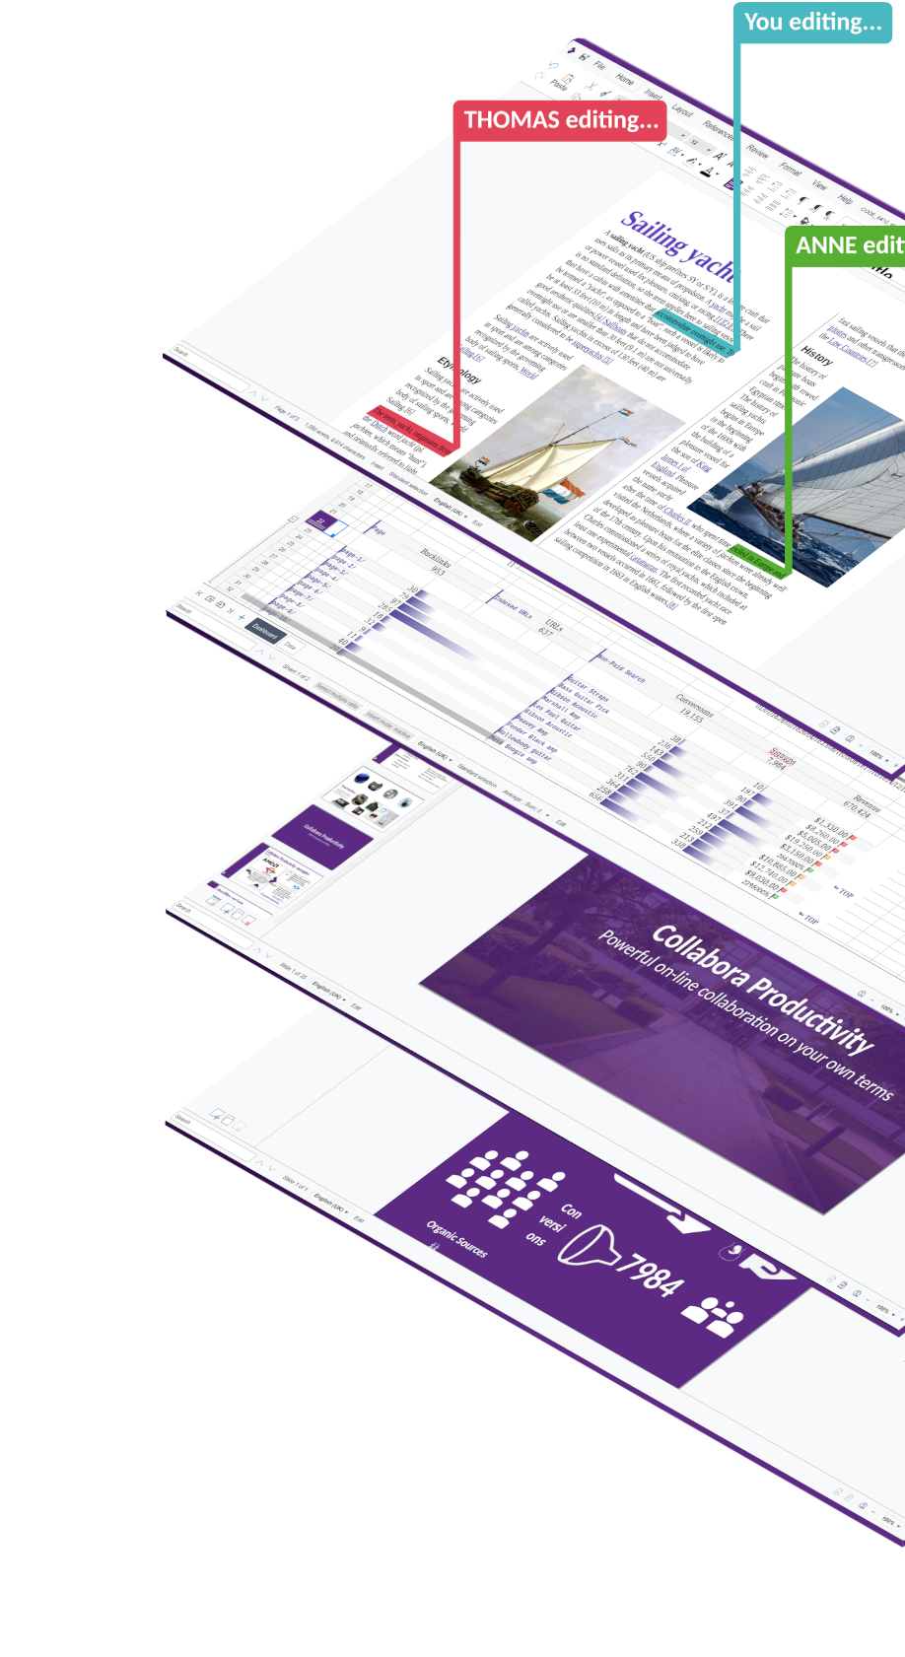

Slide 6
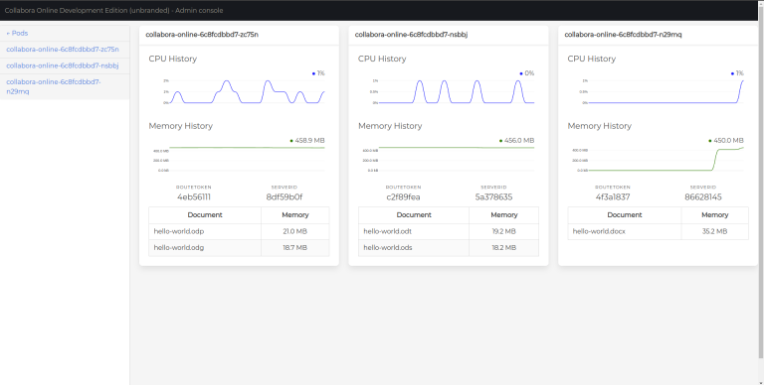
Improved Scaling and Load Distribution
The controller continuously monitors memory utilisation of pods, with a target utilisation percentage defined by administrators

Slide 7
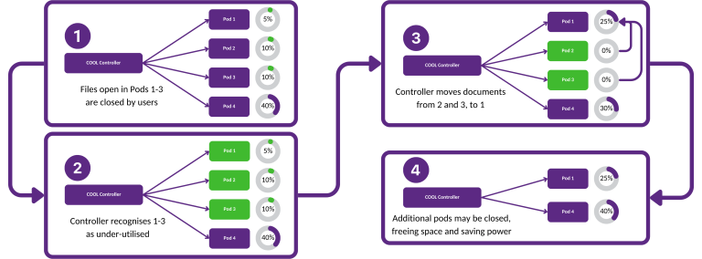
Controllers
Controller Down

Slide 8
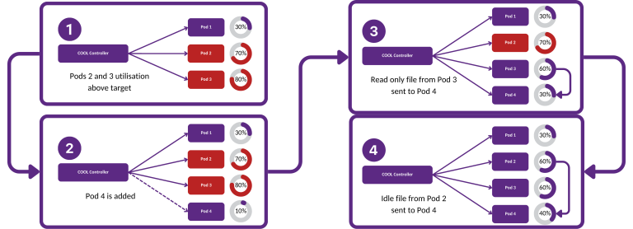
Controllers
Controller Up

Slide 9
Collabora Office
Collabora Office is an open-source office productivity suite developed by Collabora, designed to provide users with a comprehensive set of tools for word processing, spreadsheet management, presentation creation, and more. It is built upon the LibreOffice codebase, with enhancements and optimizations made by Collabora's team of experts

Slide 10
Collabora Office Feature Overview
Collabora Office offers a wide range of features to support various office tasks and workflows:
Word Processing:
Users can create, edit, and format text documents with a rich set of styling and formatting tools.
Features include text formatting, paragraph styles, page layout options, and support for images and graphics.
Spreadsheet Management:
Collabora Office includes powerful spreadsheet functionality for managing data, performing calculations, and creating charts.
Features such as formulas, functions, conditional formatting, and data validation enable users to analyze and visualize data effectively.
Presentation Creation:
Users can design professional presentations with Collabora Office's presentation tools, including slide layouts, transitions, animations, and multimedia support.
Collaborative editing features allow multiple users to work on presentations simultaneously.
Compatibility with Microsoft Office Formats:
Collabora Office is compatible with a wide range of document formats, including those used by Microsoft Office (e.g., DOCX, XLSX, PPTX). This ensures seamless interoperability with files created in Microsoft Office applications.

Slide 11




Benefits

Slide 12
Advantages of Collabora Office
Cost-effectiveness:
Collabora Office offers a budget-friendly solution with no licensing fees, making it a cost-effective choice for individuals and organizations.
Open-source nature:
Built on the LibreOffice codebase, Collabora Office benefits from collaborative development efforts, ensuring transparency, innovation, and interoperability.
Customization options:
Users can tailor Collabora Office to their workflows with customizable toolbars, shortcuts, and support for extensions, optimizing productivity.
Security features:
Collabora Office prioritizes security with encryption, access controls, and regular updates, ensuring the confidentiality and integrity of user data.
Integration capabilities:
Seamless integration with third-party applications and compatibility with Microsoft Office formats enable streamlined workflows and collaboration across platforms.

Slide 13
Collabora Online
Collabora Online is a cloud-based office productivity suite that extends Collabora Office to the web, enabling users to create, edit, and collaborate on documents directly from a web browser.
Benefits of using Collabora Online:
Flexibility: Users can work from anywhere with an internet connection, enhancing flexibility and productivity.
Real-time Collaboration: Collabora Online facilitates simultaneous document editing, promoting teamwork and efficiency.
Cost-effectiveness: Collabora Online offers a cost-effective solution without the need for expensive software licenses or infrastructure investments.
Scalability: Collabora Online scales easily to accommodate changing needs, ensuring adaptability and growth for businesses.

Slide 14
Benefits

Slide 15
Key differences from Collabora Office
Accessibility:
Collabora Online allows users to work from any device with an internet connection, promoting flexibility and remote work.
Real-time Collaboration:
Multiple users can edit documents simultaneously in Collabora Online, fostering teamwork and productivity.
Cloud-based Storage:
Collabora Online integrates with popular cloud storage platforms, facilitating seamless access to documents.
Browser Compatibility:
Collabora Online is compatible with various web browsers, ensuring accessibility across different devices.

Slide 16
Use cases
Education
Small Businesses
Enterprises
Nonprofits

Slide 17


Slide 18
Collabora in Education
Collaborative Learning Environments:
Collabora Office and Collabora Online facilitate real-time collaboration among students and educators, allowing them to work together on assignments and projects regardless of location.
Document Sharing and Editing:
These tools simplify document sharing and editing processes, enabling students to collaborate on group projects and research papers efficiently.
Integration with Learning Management Systems (LMS):
Collabora seamlessly integrates with Learning Management Systems, providing a centralized platform for managing course materials and assignments, enhancing workflow efficiency for educators and students.

Slide 19
Collabora in Small Businesses
Streamlined Document Workflows:
Collabora Office and Collabora Online streamline document workflows for small businesses by offering robust tools for creating, editing, and sharing documents. Features like real-time collaboration and version control enhance productivity and efficiency.
Cost-effective Office Suite Solution:
Collabora provides a cost-effective office suite solution for small businesses, eliminating the need for expensive licensing fees associated with proprietary software. Leveraging open-source technology, Collabora offers powerful productivity tools without high upfront costs.
Collaboration Among Remote Teams:
With Collabora Office and Collabora Online, remote teams can collaborate effectively. Cloud-based access enables real-time collaboration from anywhere, fostering teamwork, communication, and efficient operation for small businesses in today's remote work environment.

Slide 20
Collabora in Enterprises
Scalability:
Collabora Office and Collabora Online offer scalability, catering to the evolving needs of enterprises. Whether it's adding new users, expanding storage capacity, or integrating with additional systems, Collabora can seamlessly scale to accommodate enterprise-level requirements, ensuring flexibility and adaptability.
Security Features:
Security is paramount in enterprises, and Collabora prioritizes it with robust security features. From encryption and access controls to compliance standards, Collabora ensures the confidentiality, integrity, and availability of sensitive enterprise data, providing peace of mind for organizations dealing with sensitive information.
Integration with Existing Systems:
Collabora seamlessly integrates with existing systems within enterprises, facilitating interoperability and workflow efficiency. Whether it's integrating with document management systems, enterprise resource planning (ERP) software, or customer relationship management (CRM) platforms, Collabora enhances productivity by providing a cohesive ecosystem that leverages existing investments in technology infrastructure.
Customization Options:
Enterprises have unique requirements, and Collabora recognizes this by offering extensive customization options. From customizing user interfaces and workflows to developing tailored solutions and integrations, Collabora enables enterprises to adapt the software to their specific needs, enhancing productivity and efficiency across the organization

Slide 21
Collabora Subscriptions
CODE | Collabora for Business | Collabora for Enterprise
On-Premise | From 20 to 99 users Supported | Roadmap Input
Rolling Updates | Long Term Support (LTS) | Integration Support
For testing and home use | Service Level Agreement (SLA) And Signed Security Updates | Customisation and Desktop Version

Slide 22
Security Features
Encryption:
Collabora prioritizes data security with robust encryption mechanisms to safeguard sensitive information. By encrypting data both in transit and at rest, Collabora ensures that documents and communications remain confidential and secure from unauthorized access or interception.
Access Controls:
Collabora enables organizations to enforce granular access controls, allowing administrators to manage user permissions and restrict access to sensitive documents and features. Role-based access control (RBAC) ensures that users have appropriate access privileges based on their roles and responsibilities within the organization, minimizing the risk of data breaches and unauthorized access.
Compliance Standards:
Collabora adheres to industry best practices and compliance standards to meet the security and regulatory requirements of organizations across various sectors. By complying with standards such as GDPR, HIPAA, and SOC 2, Collabora helps organizations ensure data privacy, integrity, and regulatory compliance, providing assurance and peace of mind in today's complex regulatory landscape.

Slide 23
Collaboration tools
Real-time Editing:
Collabora facilitates real-time editing, allowing multiple users to collaborate on documents simultaneously. Whether working on a text document, spreadsheet, or presentation, users can see changes made by others in real-time, enabling seamless collaboration and eliminating version control issues.
Comments and Annotations:
Collabora enables users to add comments and annotations to documents, providing a means for feedback, discussion, and collaboration. Comments allow users to provide context, ask questions, or suggest revisions, fostering effective communication and collaboration among team members.
Chat Functionality:
Collabora includes built-in chat functionality, enabling users to communicate with collaborators directly within the document editing interface. Whether discussing project details, coordinating tasks, or seeking clarification, chat functionality promotes real-time communication and collaboration, enhancing teamwork and productivity.

Slide 24
Chart

Slide 25
Video

Slide 26
Comments
It is easy to add comments to documents
Save comments
Edit comments
Resolve Comments
Remove comments

