Slide 1
SDK: creating a new integration
By Marco Cecchetti
marco.cecchetti@collabora.com

Slide 2
Overview
WOPI host (provides data)
Webapp integrating the Online
Iframe with Collabora Online
WOPI client (provides editing)
(Collabora Online server side)
Notes:
To introduce LibreOffice-from-Collabora
First allow me to introduce
Collabora
and
Collabora Productivity...

Slide 3
Discovery Service
https://<WOPI client URL>:<port>/hosting/discovery
<wopi-discovery>
<net-zone name="external-http">
<!-- Writer documents -->
<app favIconUrl=... name="writer">
<action default="true" ext="odt" name="edit"
urlsrc="http://localhost:9980/loleaflet/067caa681/loleaflet.html?"/>
...
<!-- MS Word -->
<action default="true" ext="doc" name="edit"
urlsrc="http://localhost:9980/loleaflet/067caa681/loleaflet.html?"/>
...
<!-- Others -->
...
<action default="true" ext="rtf" name="edit"
urlsrc="http://localhost:9980/loleaflet/067caa681/loleaflet.html?"/>
<action default="true" ext="txt" name="edit"
urlsrc="http://localhost:9980/loleaflet/067caa681/loleaflet.html?"/>
...
</app>
...
</net-zone>
</wopi-discovery>
Notes:
To introduce LibreOffice-from-Collabora
First allow me to introduce
Collabora
and
Collabora Productivity...

Slide 4
Security Token
  To be able to access files securely, your application has to pass an authentication token to Collabora Online
  From the Collabora Online point of view, it can be any random number / string, that will be passed as part of the URL when accessing the document storage
  The token should be generated according to the requested file and the user who is logged in
Notes:
To introduce LibreOffice-from-Collabora
First allow me to introduce
Collabora
and
Collabora Productivity...

Slide 5
REST Endpoints
  GetFile
  GET - https://<WOPI host URL>/wopi/files/<id>/contents?access_token=<token>
  PutFile
  POST - https://<WOPI host URL>/wopi/files/<id>/contents?access_token=<token>
  PutRelativeFile
  POST - https://<WOPI host URL>/wopi/files/<id>?access_token=<token>
  CheckFileInfo
  GET - https://<WOPI host URL>/wopi/files/<id>?access_token=<token>
  A function that generates a unique token for a given file and user
Notes:
To introduce LibreOffice-from-Collabora
First allow me to introduce
Collabora
and
Collabora Productivity...

Slide 6
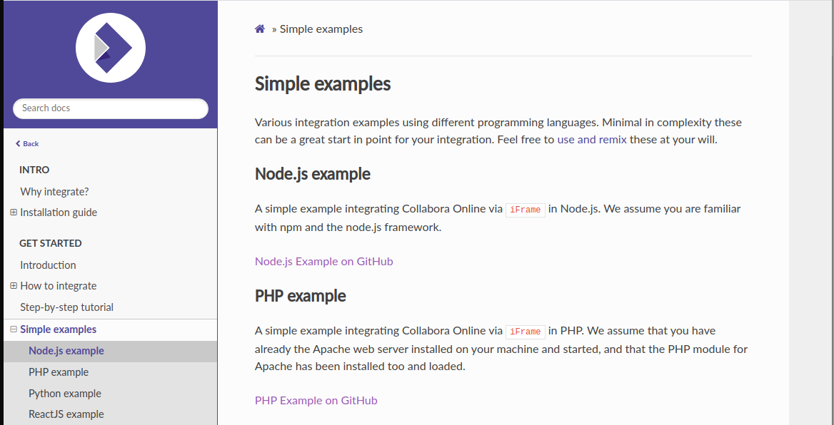
Collabora Online Integration Samples
https://productivity.pages.collabora.com/api/docs/examples.html
Notes:
To introduce LibreOffice-from-Collabora
First allow me to introduce
Collabora
and
Collabora Productivity...

Slide 7
Application front-end
Index.html
  A form where you have to enter the address of the dedicated server or vm where the Collabora Online wopi client has been deployed
  An iframe where the editing UI and a simple text document are going to be loaded
  A hidden form used for performing a POST request to the wopi client for initiating the iframe
App front-end (index.html)
Collabora Online Server
http://172.168.1.80:9980
Load
Iframe with Collabora Online UI
and a simple text document
JavaScript code
Hidden Form
Notes:
To introduce LibreOffice-from-Collabora
First allow me to introduce
Collabora
and
Collabora Productivity...

Slide 8
Embedded hidden form
<form
action=""
enctype="multipart/form-data"
method="post"
target="<iframe id>"
id="collabora-submit-form"
>
<input
value=""
type="hidden"
id="access-token"
/>
<input type="submit" value="" />
</form>
  action: <wopi client URL for text/plain document>?WOPISrc=https://<wopi host URL>/wopi/files/1
  /wopi/files/<id>: points to CheckFileInfo endpoint
  target: points to the embedded iframe
  value: the authentication token associated to the requested document
Notes:
To introduce LibreOffice-from-Collabora
First allow me to introduce
Collabora
and
Collabora Productivity...

Slide 9
Embedded JS code
  Make a request to the internal endpoint collaboraUrl?server=<wopi client URL>
  Use the response data for:
    Set the action form attribute to the wopi client URL for plain/text mime type document
    Set the value attribute for <input> access-token to the token for the requested document
  Submitting the hidden form
  $.getJSON("/collaboraUrl?server=" + wopiClientHost)
  .done(function( resp ) {
  // configuring and submitting the hidden form
  })
Notes:
To introduce LibreOffice-from-Collabora
First allow me to introduce
Collabora
and
Collabora Productivity...

Slide 10
Application back-end
App back-end (NodeJS)
Express routing
  / → index.html
  /collaboraUrl → {
  wopi client URL for simple text file
  token for requested document
  }
  /wopi/files/<document id>
  → CheckFileInfo
  /wopi/files/<document id>/content (GET)
  → GetFile
  /wopi/files/<document id>/content (POST)
  → PutFile
Load the sample app front-end
Request and parse discovery.xml
Generate a token for the requested file
Wopi endpoints implementation
Notes:
To introduce LibreOffice-from-Collabora
First allow me to introduce
Collabora
and
Collabora Productivity...

Slide 11
collaboraUrl endpoint
var request = https.get(
collaboraOnlineHost + '/hosting/discovery',
function(response) {
response.on('data', function(chunk) { data += chunk.toString(); });
response.on('end', function() {
var nodes = xpath.select(
"/wopi-discovery/net-zone/app[@name='text/plain']/action", doc);
var onlineUrl = nodes[0].getAttribute('urlsrc');
res.json({
url: onlineUrl,
token: 'test'
});
});
Notes:
To introduce LibreOffice-from-Collabora
First allow me to introduce
Collabora
and
Collabora Productivity...

Slide 12
CheckFileInfo Endpoint
The CheckFileInfo wopi endpoint is triggered by a request with a GET verb at
https://<WOPI host>/wopi/files/<document_id>
router.get('/files/:fileId', function(req, res) {
console.log('file id: ' + req.params.fileId);
res.json({
BaseFileName: 'test.txt',
Size: 11,
UserId: 1,
UserCanWrite: true
});
});
Notes:
To introduce LibreOffice-from-Collabora
First allow me to introduce
Collabora
and
Collabora Productivity...

Slide 13
GetFile Endpoint
The GetFile wopi endpoint is triggered by a request with a GET verb at
https://<WOPI host>/wopi/files/<document_id>/contents
router.get('/files/:fileId/contents', function(req, res) {
var fileContent = 'Hello world!';
res.send(fileContent);
});
Notes:
To introduce LibreOffice-from-Collabora
First allow me to introduce
Collabora
and
Collabora Productivity...

Slide 14
PutFile Endpoint
The PutFile wopi endpoint is triggered by a request with a POST verb at
https://<WOPI host>/wopi/files/<document_id>/contents
router.post('/files/:fileId/contents', function(req, res) {
console.log('wopi PutFile endpoint');
if (req.body) {
console.log(req.body.toString());
res.sendStatus(200);
} else ...
});
Notes:
To introduce LibreOffice-from-Collabora
First allow me to introduce
Collabora
and
Collabora Productivity...

Slide 15
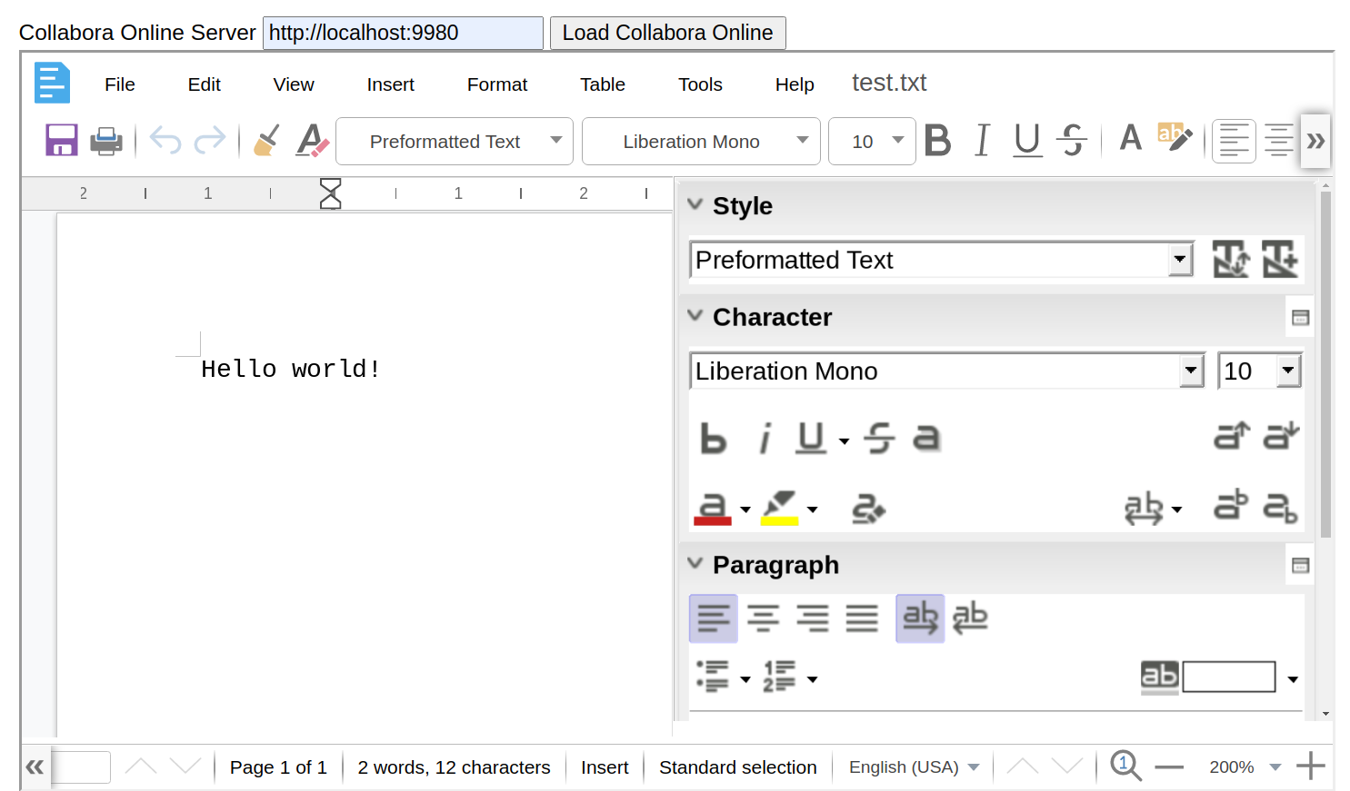
Final Result
Notes:
To introduce LibreOffice-from-Collabora
First allow me to introduce
Collabora
and
Collabora Productivity...

Slide 16
Thanks for watching !
@CollaboraOffice
hello@collaboraoffice.com
Collaboraoffice.com
By Marco Cecchetti

