Slide 1
Canvas For Rendering UX
By Gökay Şatır
Software Engineer
gokaysatir@collabora.com

Slide 2
Canvas For Rendering UX
Content
  Rendering The Tiles
  Rendering The UI
  Implementation
  Result
Notes:
To introduce LibreOffice-from-Collabora
First allow me to introduce
Collabora
and
Collabora Productivity...

Slide 3
Rendering The Tiles (Document)
Rendering The Tiles (Document)
  Collabora Online is now using an HTML canvas element for rendering the tiles. Benefits are:
    Easier to solve CSS related problems across different browsers: Like gaps between tiles & blurry images.
    Same look in different devices.
    Easier to maintain and improve.
    Implementation is very easy.
    It doesn't use hammer.js or other 3rd part libraries for event handling.
    It can remove the need for mCustomScrollbar and other libraries for scroll bar management & drawing.
    Sometimes events are fired more than once because of 3rd party libraries. This implementation fires events selectively, so we can re-draw only when we need to.
    It is touch ready, tested. I also read blogs about touch events to be sure of the implementation.
    We don't have to use only canvas drawing. For example we can use an image for blinking cursor. So we won't have to redraw canvas for every blink.
    We can draw markers, selections and objects easily. We can create different sections for them or we can draw them inside document section.
    Synchronising with cypress tests may be easier, we can define one central function inside SectionContainer, if applicable.
Notes:
To introduce LibreOffice-from-Collabora
First allow me to introduce
Collabora
and
Collabora Productivity...

Slide 4
Rendering The UI
Rendering The UI
  For some parts of the UI, we are now using the same canvas element we use for rendering the tiles. Benefits:
    UI may change too fast (like in Calc headers), HTML elements are not a good fit for fast redraws.
Notes:
To introduce LibreOffice-from-Collabora
First allow me to introduce
Collabora
and
Collabora Productivity...

Slide 5
Implementation
Implementation
  After deciding to use a canvas element for rendering some parts of the UI and the document itself, next step was implementing the idea.
  Tiles mean the document itself, user can click on it, write on it or scroll it. UI elements like row headers in Calc also can be scrolled, clicked etc. Handling these events are essential. UI elements and the document need their event handlers.
  At the end, we decided to centralize the event handling and drawings within a new class, which we call CanvasSectionContainer.
  This class would position the UI elements and the document inside the view (screen) automatically.
Notes:
To introduce LibreOffice-from-Collabora
First allow me to introduce
Collabora
and
Collabora Productivity...

Slide 6
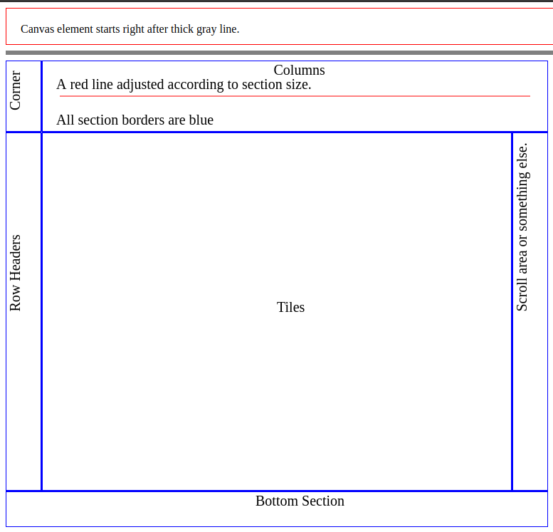
First Look Of The New Class
Layout
  Automatically managed by the section container.
  Every UI part and document has its own section.
Event Handling
  Events are caught by the section container.
  Events are propagated to the target sections.
  Sections implement the handlers according to their needs.
Notes:
To introduce LibreOffice-from-Collabora
First allow me to introduce
Collabora
and
Collabora Productivity...

Slide 7
Implementation
Features & Challenges
  Event Propagation:
    It is easy to handle events of the canvas element. We can always use something like:
      canvas.onclick = somefunction.
      canvas.addEventListener(‘click’, somefunction).
    But we needed layer-like structures that overlap entirely. For example:
      In Calc, tiles are drawn on a layer (in our terms, by a section).
      Cell cursor also needs to be drawn on tiles (the document) by another section. Cell cursor may be anywhere on the document, so It needs to cover entire document.
Notes:
To introduce LibreOffice-from-Collabora
First allow me to introduce
Collabora
and
Collabora Productivity...

Slide 8
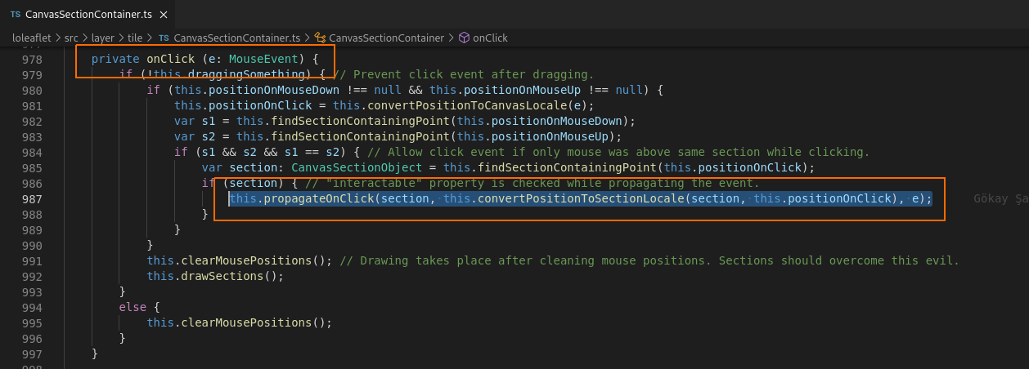
Implementation
Features & Challenges
  Event Propagation:
    In the end, we needed to propagate events not only to sections but also between the sections.
Notes:
To introduce LibreOffice-from-Collabora
First allow me to introduce
Collabora
and
Collabora Productivity...

Slide 9
Implementation
Features & Challenges
  Devices With Mouse & Touch Screen:
    Collabora Online supports multiple device types, including mobile phones and tablets. Tablet devices can be used with mouse and keyboard support as well as via their touch screen. Before using canvas element and implementing CanvasSectionContainer class, we were using Hammer.js and other 3rd party libraries, in order to support touch & mouse usage. These libraries always come with their advantages and disadvantages. For example, it was a bit difficult to support touch screen & mouse at the same time.
    While we change our direction towards canvas drawings and event handling with sections, we also solved these event handling problems.
Notes:
To introduce LibreOffice-from-Collabora
First allow me to introduce
Collabora
and
Collabora Productivity...

Slide 10
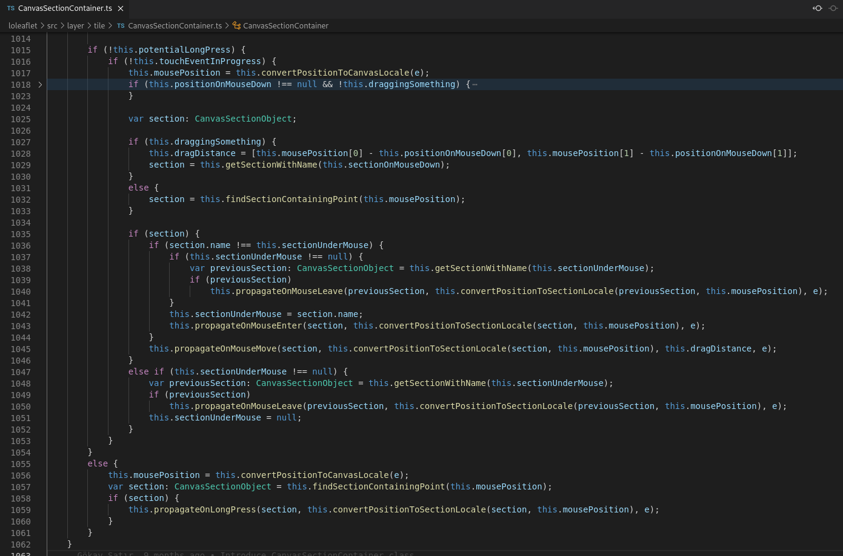
Implementation
Features & Challenges
  Devices With Mouse & Touch Screen:
    We now support tablet devices with keyboard and touch screen, without a third party library.
Notes:
To introduce LibreOffice-from-Collabora
First allow me to introduce
Collabora
and
Collabora Productivity...

Slide 11
Implementation
Features & Challenges
  Crisp Images:
    This was the most challenging part. I spent quite good time while implementing this. Thanks to Michael and Jan (Kendy) for their patient:) and leadership.
      Making the images (tiles) look crisp on every device that Collabora Online works, was the main target.
      Because of “window.devicePixelRatio” property of the browser (indeed, related to device), crisp images were difficult to render.
      We have tiles with dimensions 256X256 pixels.
      When we draw these tiles onto a device (let’s say) with device pixel ratio “2”, they are drawn half-sized.
Notes:
To introduce LibreOffice-from-Collabora
First allow me to introduce
Collabora
and
Collabora Productivity...

Slide 12
Implementation
Features & Challenges
  Crisp Images:
    We kept the 256X256 px dimensions and we increased the number of tiles when the devicePixelRatio is above 1. So the resolution of the document/tiles/images become good once again.
    Explaining the solution took only one line but implementing was difficult, really:)
Notes:
To introduce LibreOffice-from-Collabora
First allow me to introduce
Collabora
and
Collabora Productivity...

Slide 13
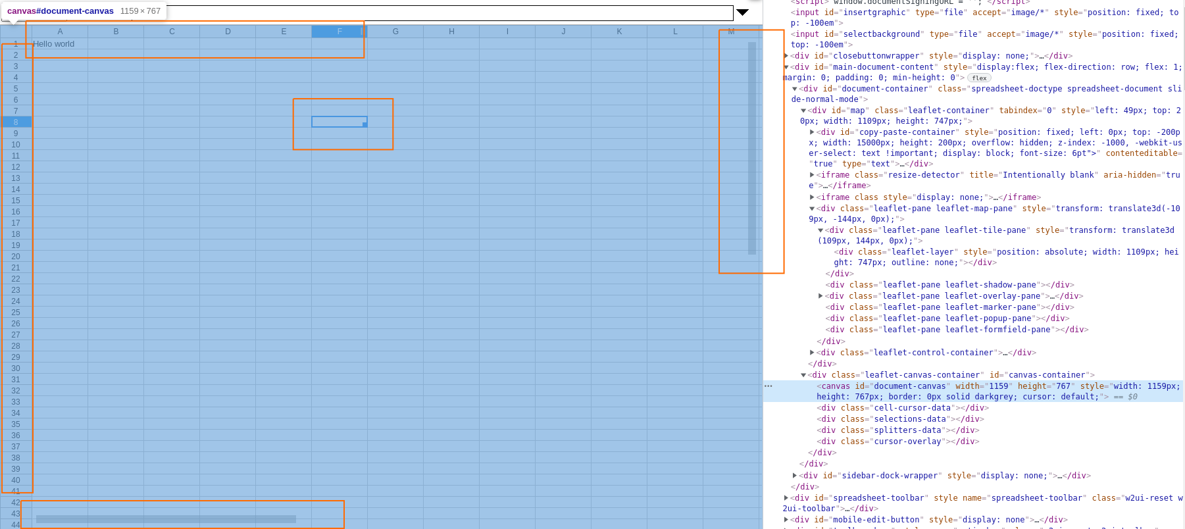
Document and UI On Canvas
Layout
  Automatically managed by the section container.
  Every UI part and document has its own section.
Event Handling
  Events are caught by the section container.
  Events are propagated to the target sections.
  Sections implement the handlers according to their needs.
Notes:
To introduce LibreOffice-from-Collabora
First allow me to introduce
Collabora
and
Collabora Productivity...

Slide 14
Thanks!
@CollaboraOffice
hello@collaboraoffice.com
Collaboraoffice.com
Gökay Şatır

