Slide 1
Multi Page PDF Viewing
By Gökay Şatır
Software Engineer
gokaysatir@collabora.com

Slide 2
Multi-Page PDF Viewing
Content
  About PDF View
  Rendering The Tiles
  Positioning The Comments
  Changes
  Result
Notes:
To introduce LibreOffice-from-Collabora
First allow me to introduce
Collabora
and
Collabora Productivity...

Slide 3
Multi-Page PDF Viewing
About PDF View
  With Collabora Office and Collabora Online, users can view and edit PDF documents. But the editor is page based, one can view only one page at a time.
  For reading PDF files, one needs to see the whole document at once and scroll between the pages.
  Our users need to be able to view the PDF files with Collabora Online. A few months ago, we added the PDF Viewing feature into Collabora Online. Since this is not supported on the core side, it had its own challenges inside.
Notes:
To introduce LibreOffice-from-Collabora
First allow me to introduce
Collabora
and
Collabora Productivity...

Slide 4
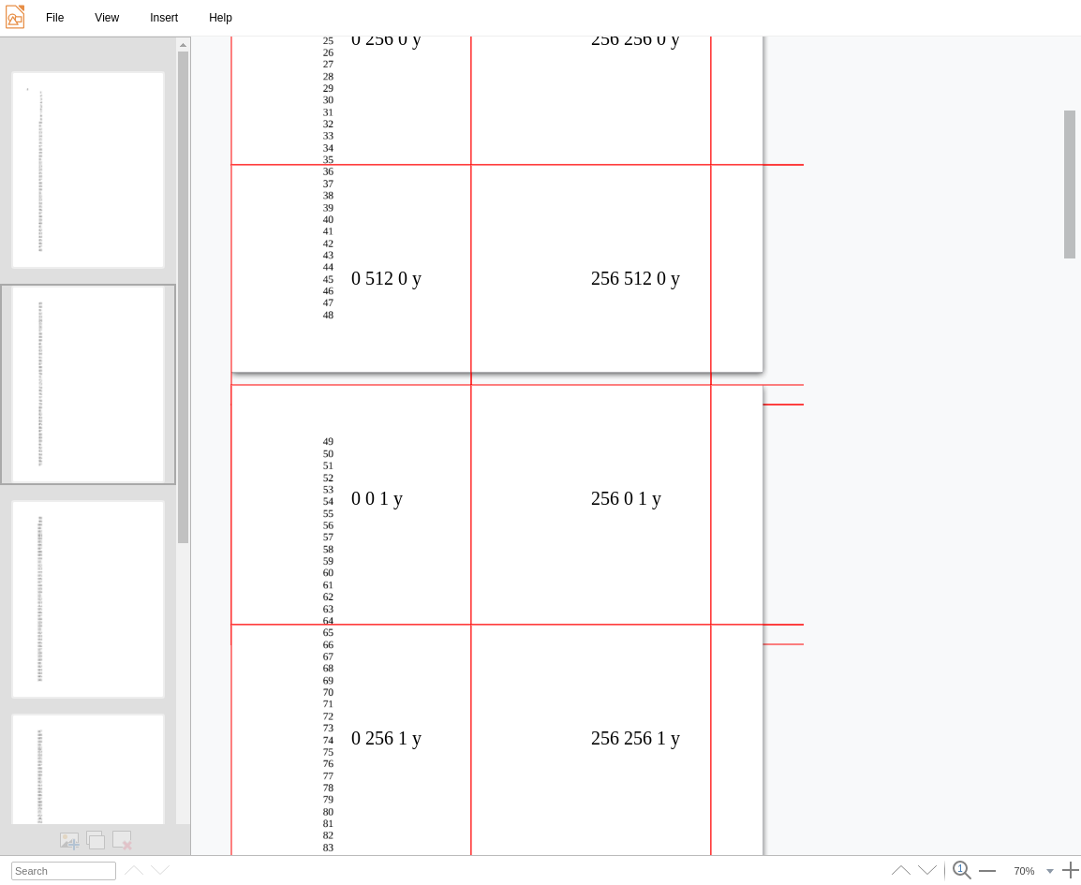
Rendering The Tiles
Repositioning the tiles.
  On the Core side, the viewed page doesn’t change.
  While user is viewing the 2nd page on the client side, core side still thinks that the user is on page 1.
  So we needed to calculate the position of the viewed page and send the relevant information to the core.
  For testing, we prepared a document with numbers with the aim that none of the numbers would be missing in the end.
Notes:
To introduce LibreOffice-from-Collabora
First allow me to introduce
Collabora
and
Collabora Productivity...

Slide 5
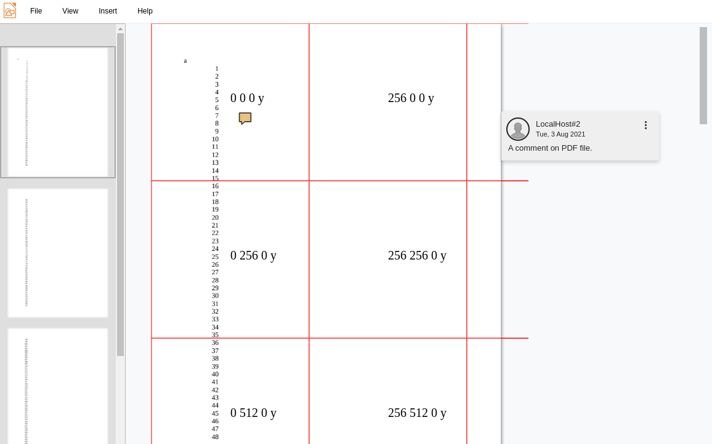
Positioning The Comments
Repositioning the comments.
  Comments also needed special care for PDF view feature.
  In other document types, a comment is not shown unless its part is selected. But we needed to show them all.
  Comment positions are saved into document, relative to their respective page’s top point, which is Point(0, 0).
  We put all comments in their places, by re-calculating their positions according to 1st page’s top position.
Notes:
To introduce LibreOffice-from-Collabora
First allow me to introduce
Collabora
and
Collabora Productivity...

Slide 6
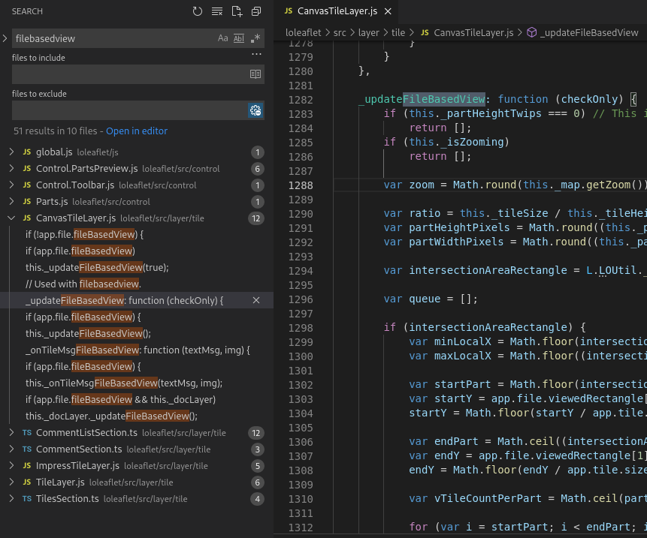
Code Changes
Changes
Notes:
To introduce LibreOffice-from-Collabora
First allow me to introduce
Collabora
and
Collabora Productivity...

Slide 7
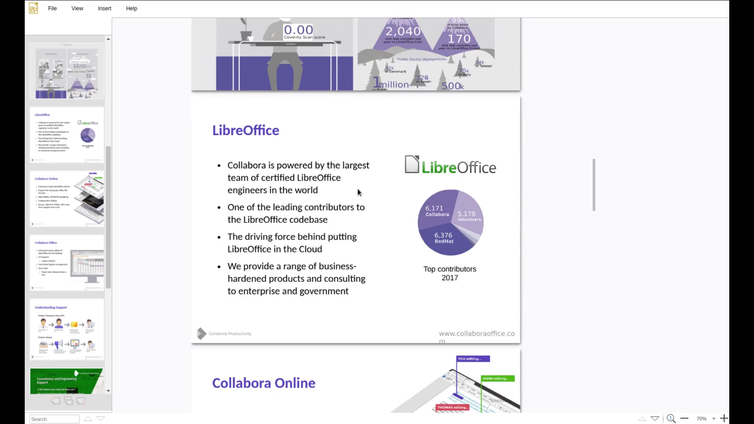
The PDF View Feature
Notes:
To introduce LibreOffice-from-Collabora
First allow me to introduce
Collabora
and
Collabora Productivity...

Slide 8
Thanks!
@CollaboraOffice
hello@collaboraoffice.com
Collaboraoffice.com
Gökay Şatır

