Slide 1

Android New Features & Improvements
By Mert Tümer
Consultant Software Engineer
mert.tumer@collabora.com

Slide 2
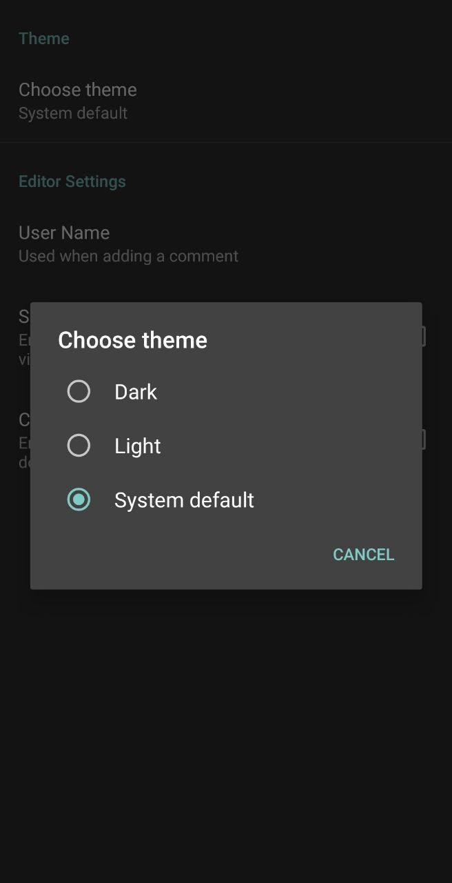
Dark Theme
  Light and Dark Theme are now optional.
Notes:
To introduce LibreOffice-from-Collabora
First allow me to introduce
Collabora
and
Collabora Productivity...

Slide 3
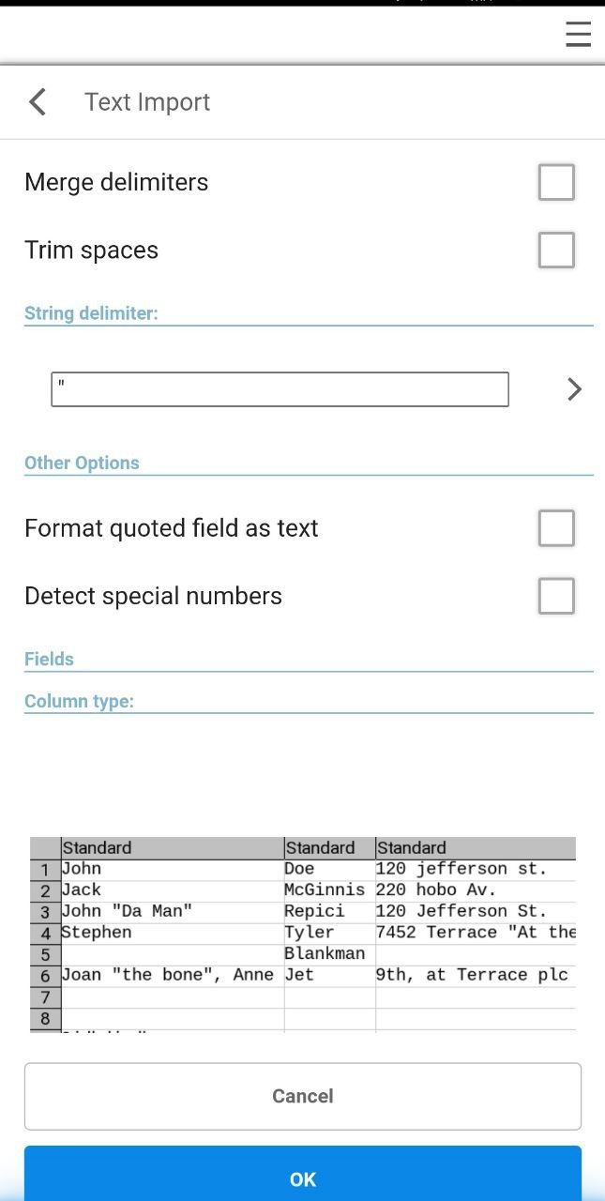
CSV Files
  CSV Files are now supported
  Possible to format the data on first load
Notes:
To introduce LibreOffice-from-Collabora
First allow me to introduce
Collabora
and
Collabora Productivity...

Slide 4
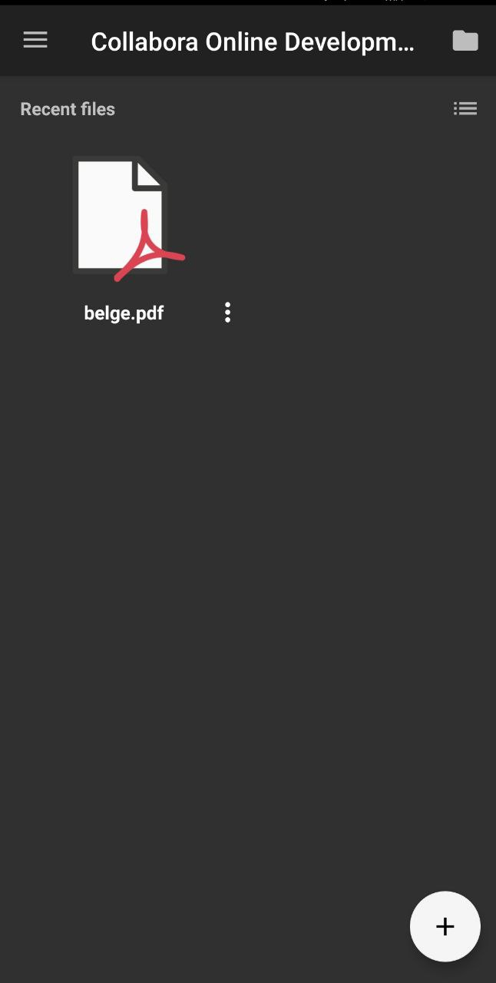
PDF Viewer
  The app now can be used as a PDF viewer too
  Ability to export to Draw Document Type
Notes:
To introduce LibreOffice-from-Collabora
First allow me to introduce
Collabora
and
Collabora Productivity...

Slide 5


Draw Files (Graphics)
Notes:
To introduce LibreOffice-from-Collabora
First allow me to introduce
Collabora
and
Collabora Productivity...

Slide 6

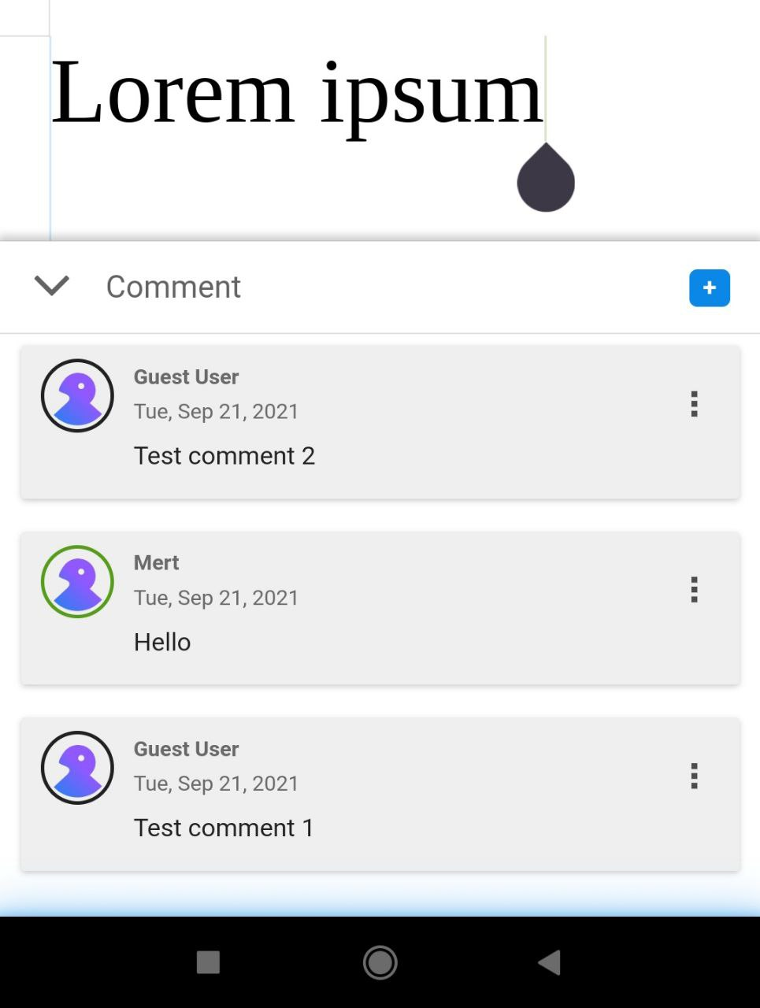
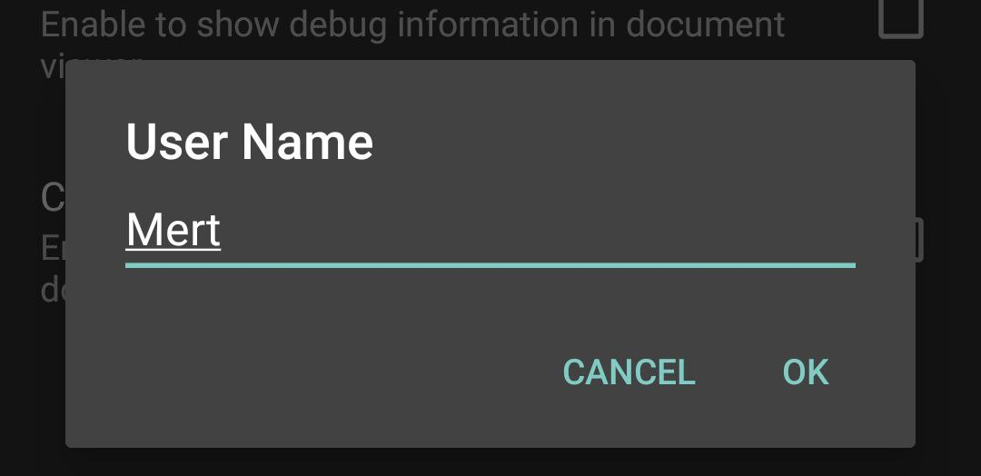
Comments
  Comments now have their own place in mobile wizard (lpranam)
  Username can be set on the app settings (vmiklos)
Notes:
To introduce LibreOffice-from-Collabora
First allow me to introduce
Collabora
and
Collabora Productivity...

Slide 7
Bug fixes and improvements
ChromeOS
  Trackpad scrolling
  Keyboard focus issues
  Calc keyboard shorcuts improvements
  Copy/Paste improvements
Android
  Password protected documents now can be opened!
  Network storage provider fixes
  And much more!
Notes:
To introduce LibreOffice-from-Collabora
First allow me to introduce
Collabora
and
Collabora Productivity...

Slide 8

Thanks !
By Mert Tümer
Consultant Software Engineer
@CollaboraOffice
hello@collaboraoffice.com
Collaboraoffice.com

