Slide 1
Leveraging plant diversity to infer microbial communities for phenotypic predictions
STD12

Slide 2
Objectives and challenging questions
Which datatype correlates with fresh weight?
Are the SNP / ASV data predictive for fresh weight?
Which ASVs are associated with fresh weight?
What causal interactions exist between the ASVs?

Slide 3
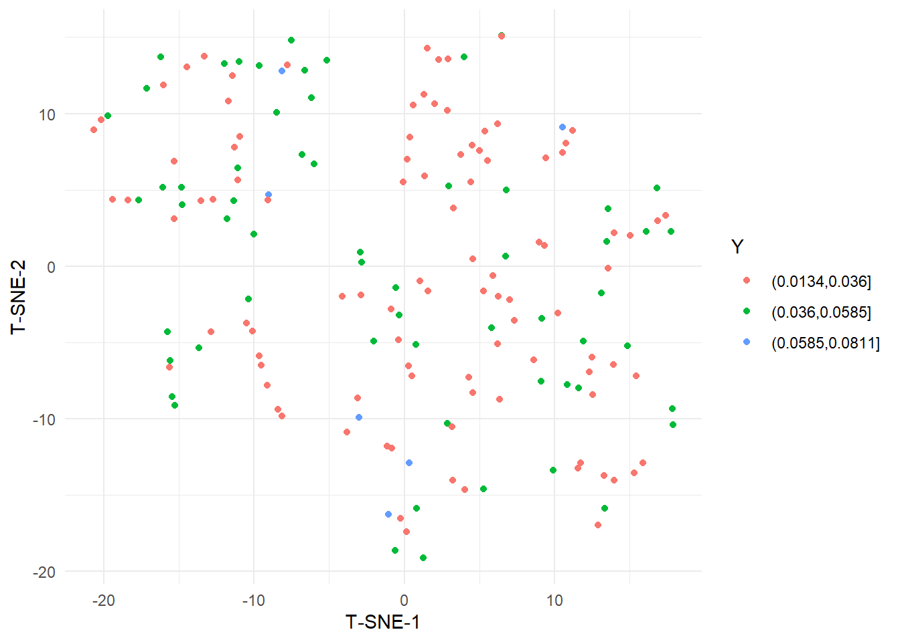
T-SNE with isolates abundance show some structure but unrelated to phenotype
Phenotypic binning
Near-zero variance variables were removed

Slide 4
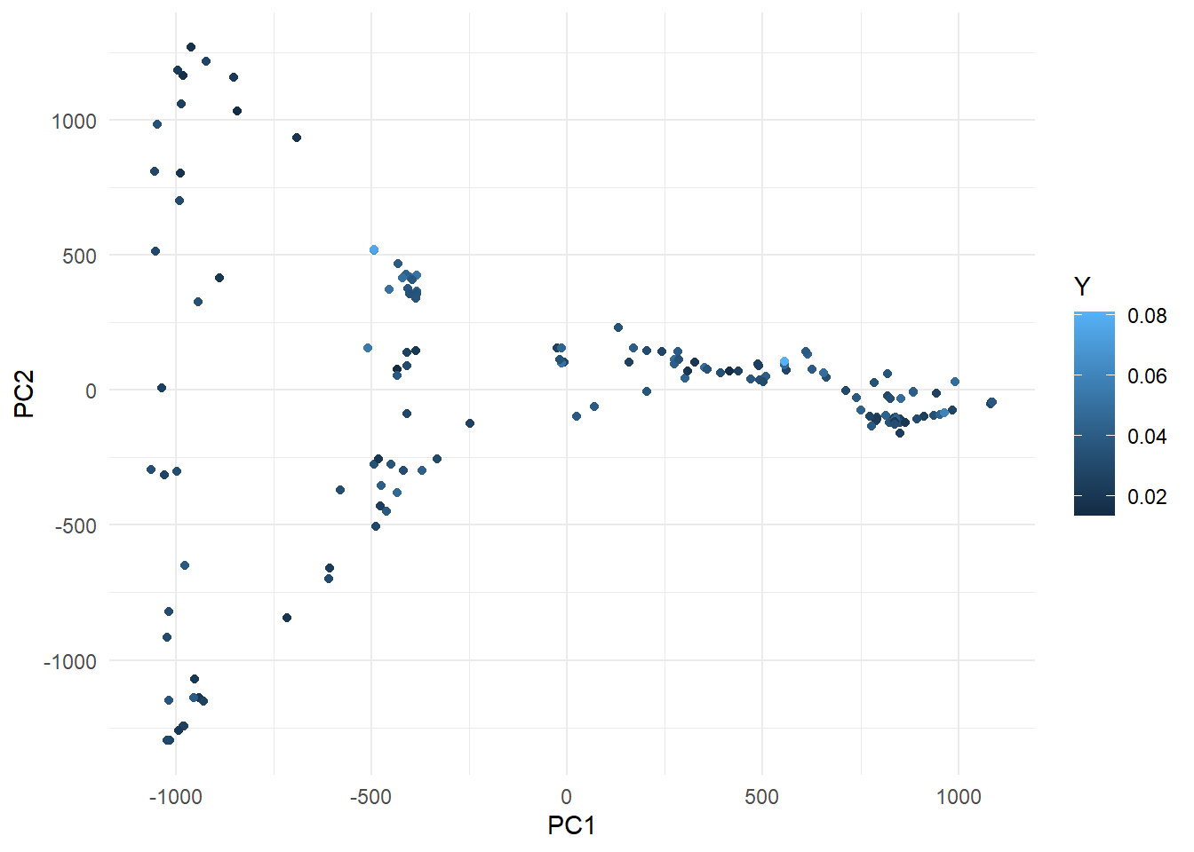
PCA of SNPs shows some population structure, but unrelated to phenotype
Phenotypic output
PCA was performed with default parameters using smartsnp

Slide 5
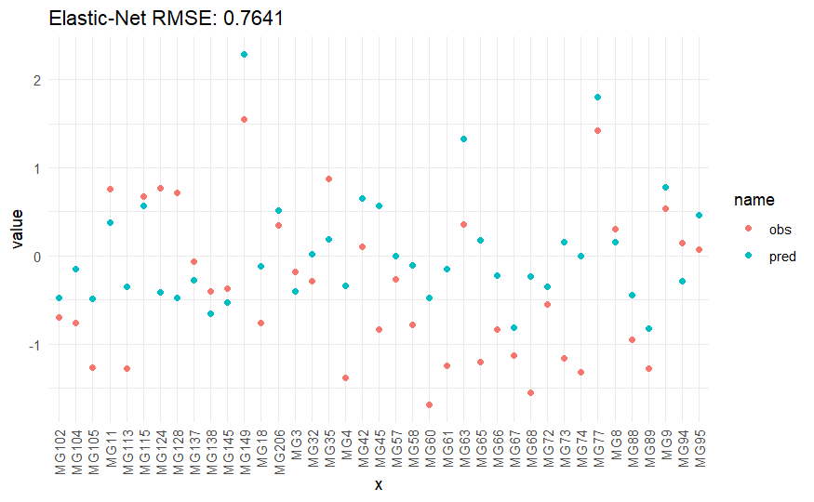
Elastic-net regression works poorly, but better than other flexible methods (ASVs)
Model selection:
Elastic-net
Random forest
KNN
Gradient boosting
Test set
ASV normalized compared to stick + standardization
Phenotype standarized
DF: 122
397 explanatory variables

Slide 6
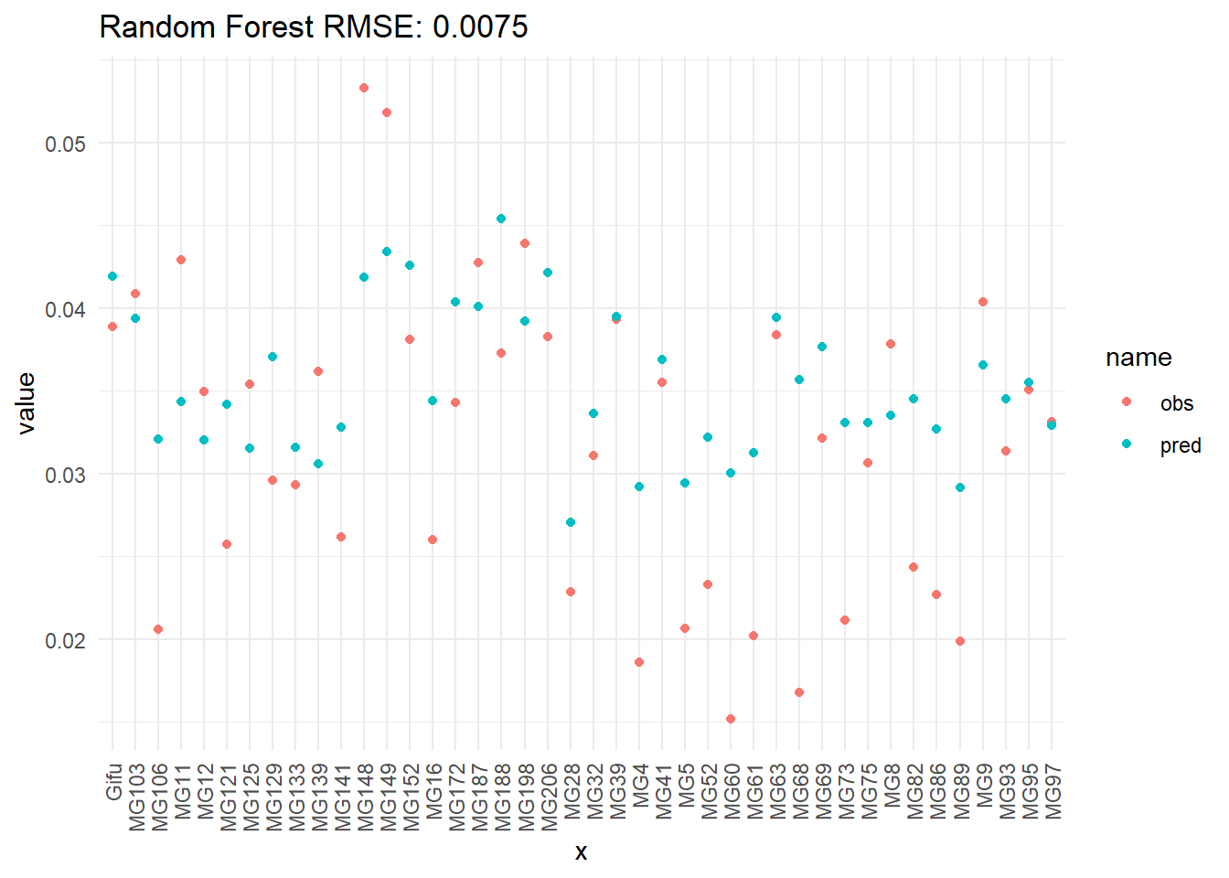
Adding PCA from SNPs data only makes assembly-methods perform worse
Test set

Slide 7
Microbial group association study
Selection
For isolates: counts > 100
For phenotype: NAs were removed
Distance matrix
Per isolate
165 x 165
Kernel
Kernel machine regression
Association
Covariate possible, but not performed
Small-sample correction
Multiple testing correction

Slide 8
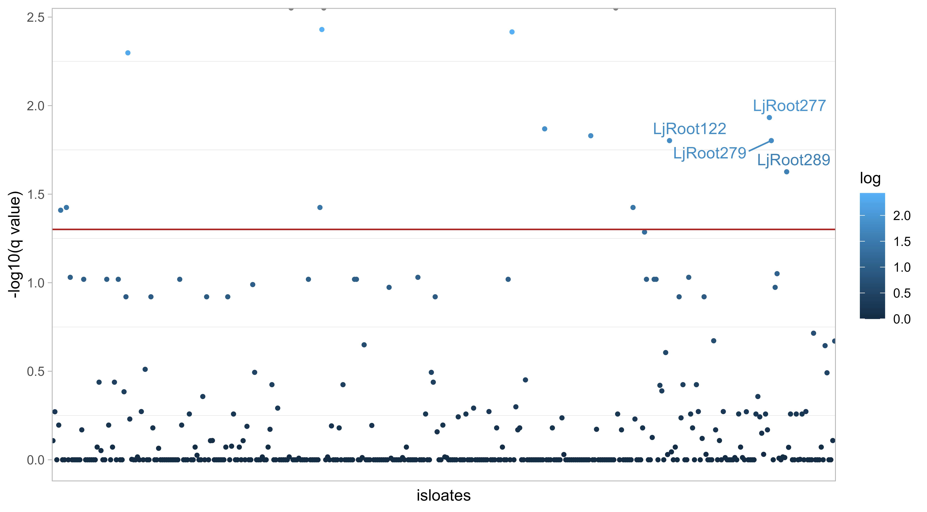
Significant associated isolates

Slide 9
To improve/consider for MAS
Adding covariants such as the similarity between genotypes based on SNPs
Normalizations
Contaminants are still included

Slide 10
Building graphs that describe microbe interaction across batch

Slide 11
Methods
STID12 was broken out across batch
Only isolates that were supposed to be in the sample were used
Synthetic community starter and the the stick samples were removed
The microbes that explain 75% ore more of the variance were used
Center log ration was applied across plant
A hill climb search with k2 score were used to predict graphs

Slide 12
All graphs were different across batches
When comparing graphs across batch each of the graphs were unique
Within batch 1 the highest betweenness centrality nodes were
LjRoot243, LjRoot80, LjRoot17, LjRoot28, LjRoot289, LjRoot220
Within batch 2 the highest betweenness centrality nodes were
LjRoot283, LjRoot223, LjRoot288, LjRoot281, LjRoot270
Within batch 3 the highest betweenness centrality nodes were
LjRoot254, LjRoot259, LjRoot67, LjRoot78, LjRoot131, LjRoot248

Slide 13
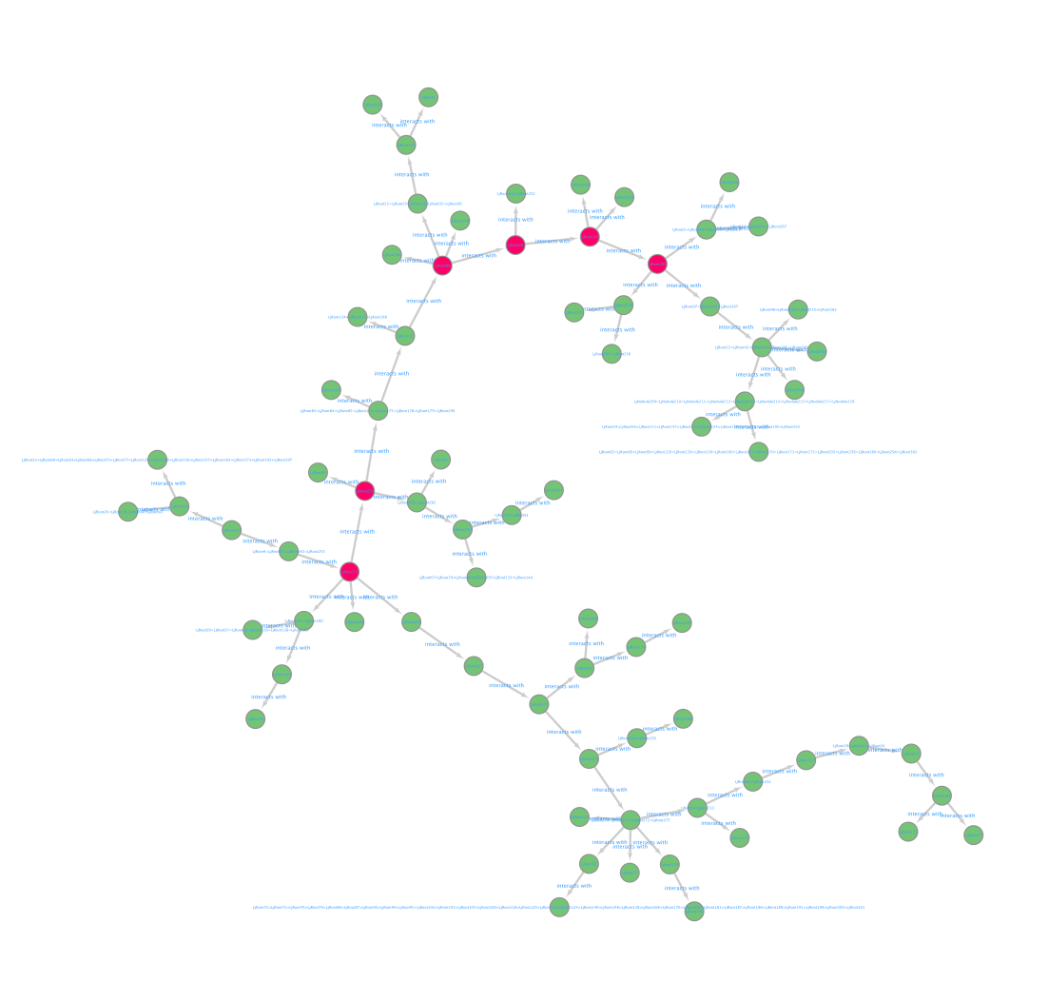
Batch 1 Network

Slide 14
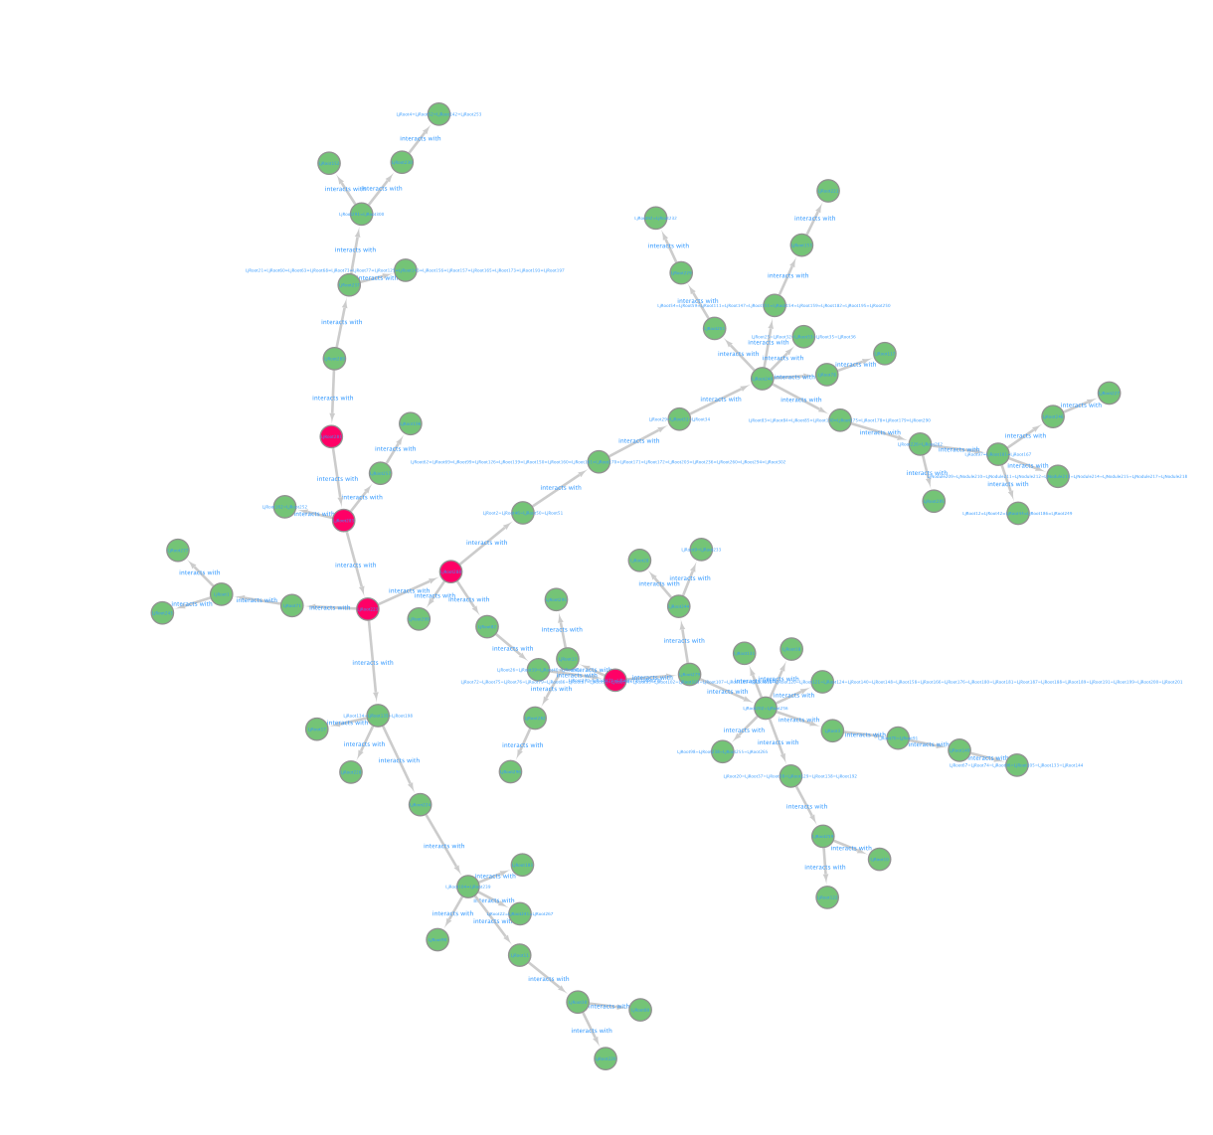
Batch 2 Network

Slide 15
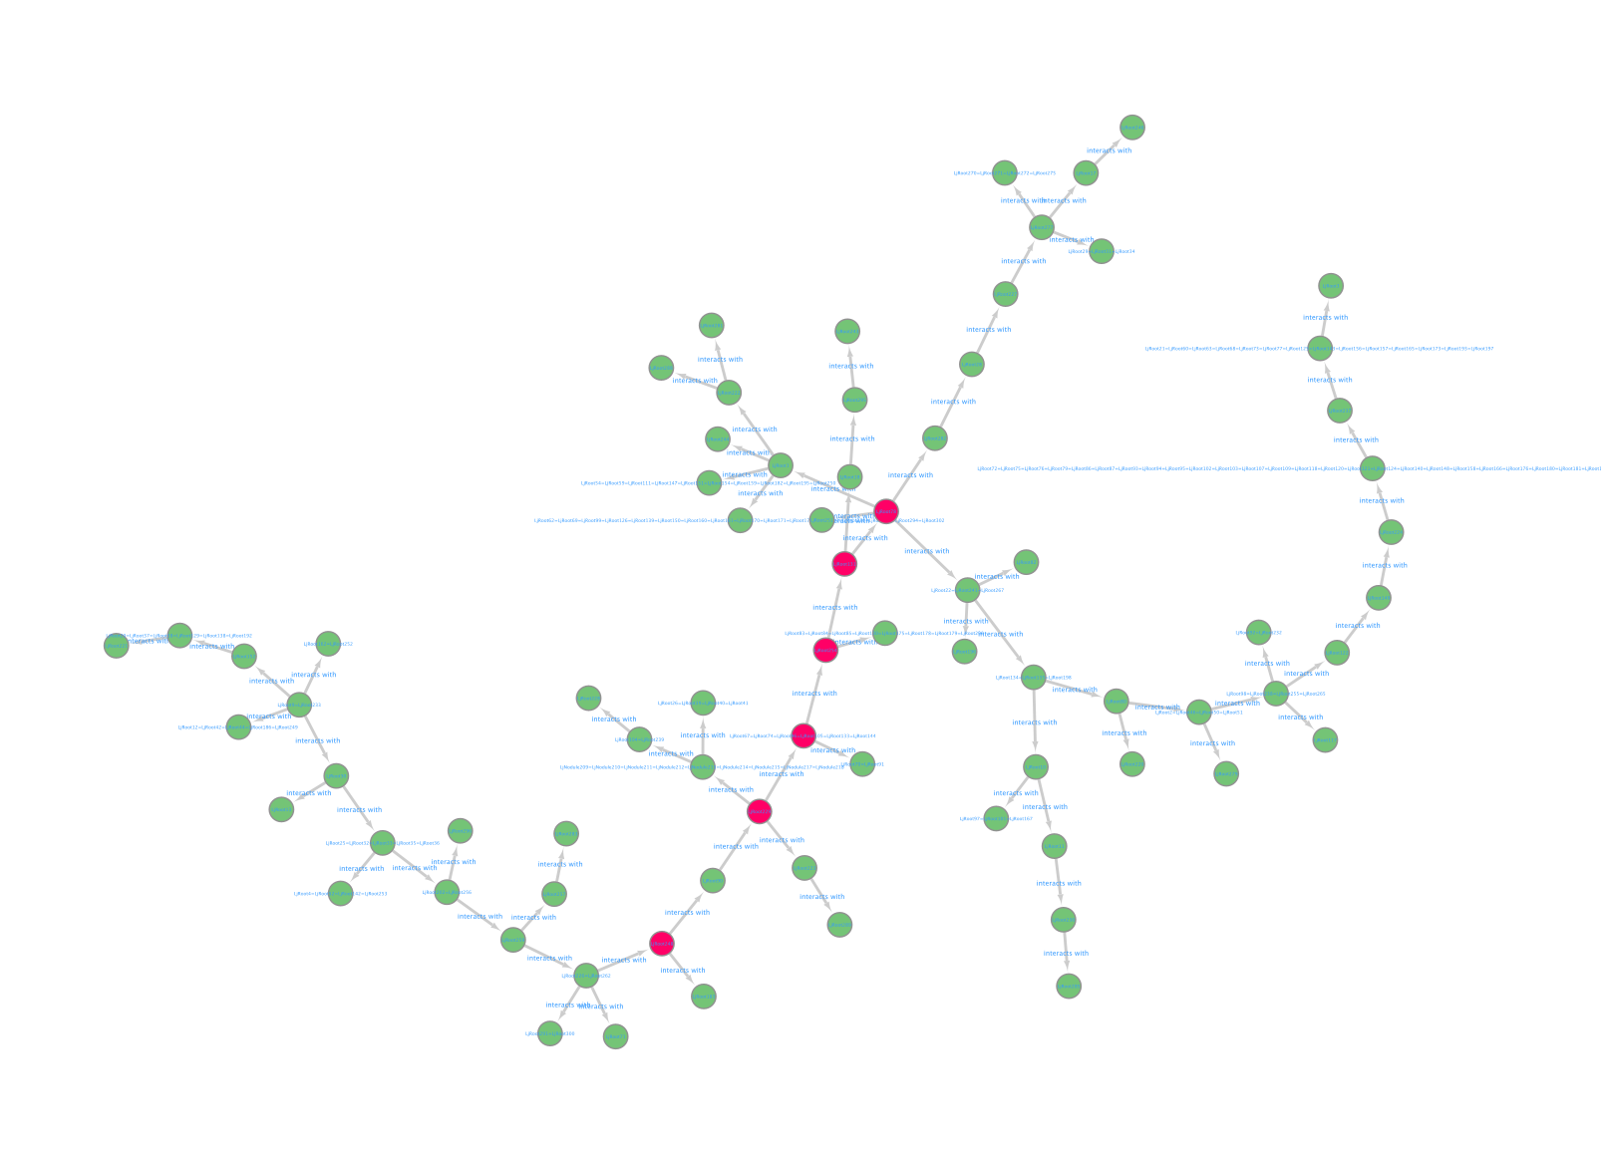
Batch 3 Network

Slide 16

Merged Graph highest Betweenness Centrality
Highest betweenness Centrailty Nodes on the merged Graph
LjRoot30, LjRoot223, LjRoot70, LjRoot277, LjRoot1, LjRoot227, LjRoot283

Slide 17
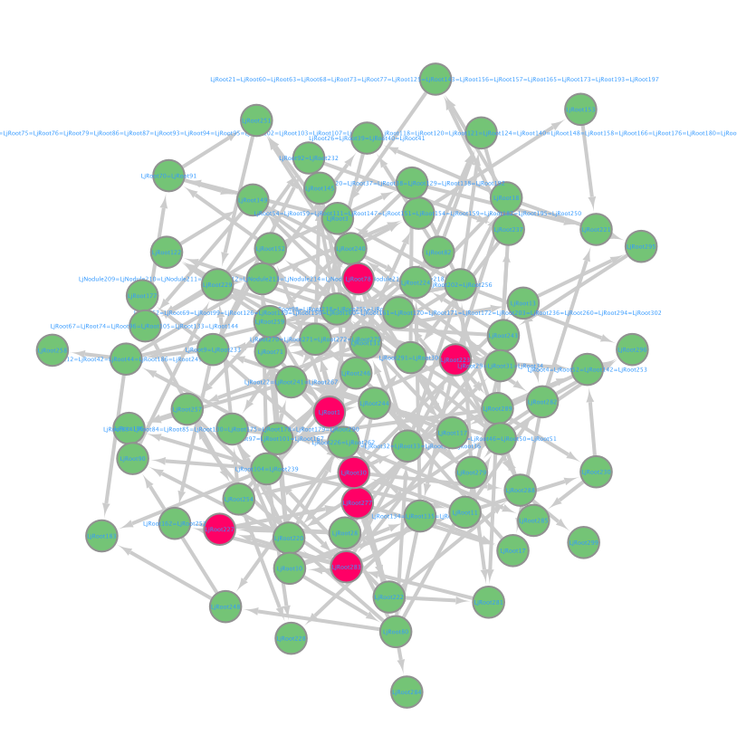
Merged Graph

