Slide 1
Hackhaton Team 4
Team 4
Adrian, Matthew, Thomas , Florian

Slide 2
Objectives
Looking for an effect of Lotus natural variations on the microbial community structure
Create categories of Lotus ecotypes based on kinship
Is there a similar community structure in similar ecotype categories ?
Can we compare the microbial association networks between replicates ?

Slide 3
Kinship matrix of Lotus ecotypes using SNPs table
3
4
1
2
4 distinguishable groups among the lotus ecotypes

Slide 4
Lotus ecotypes grouped in 4 categories

Slide 5
Beta diversity plot, all ASVs
R2 splits into two populations on this first axis

Slide 6
Beta diversity plot, facet by Replicate, color by Lotus ecotype group
No visible pattern between ecotype category and microbial community structure

Slide 7
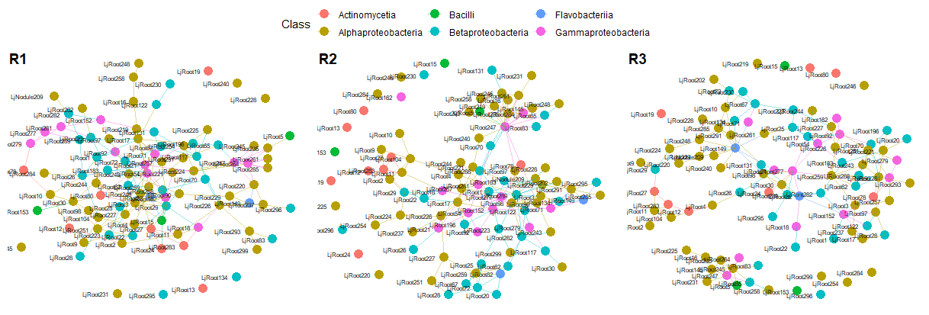
Microbial association networks, per replicate

Slide 8
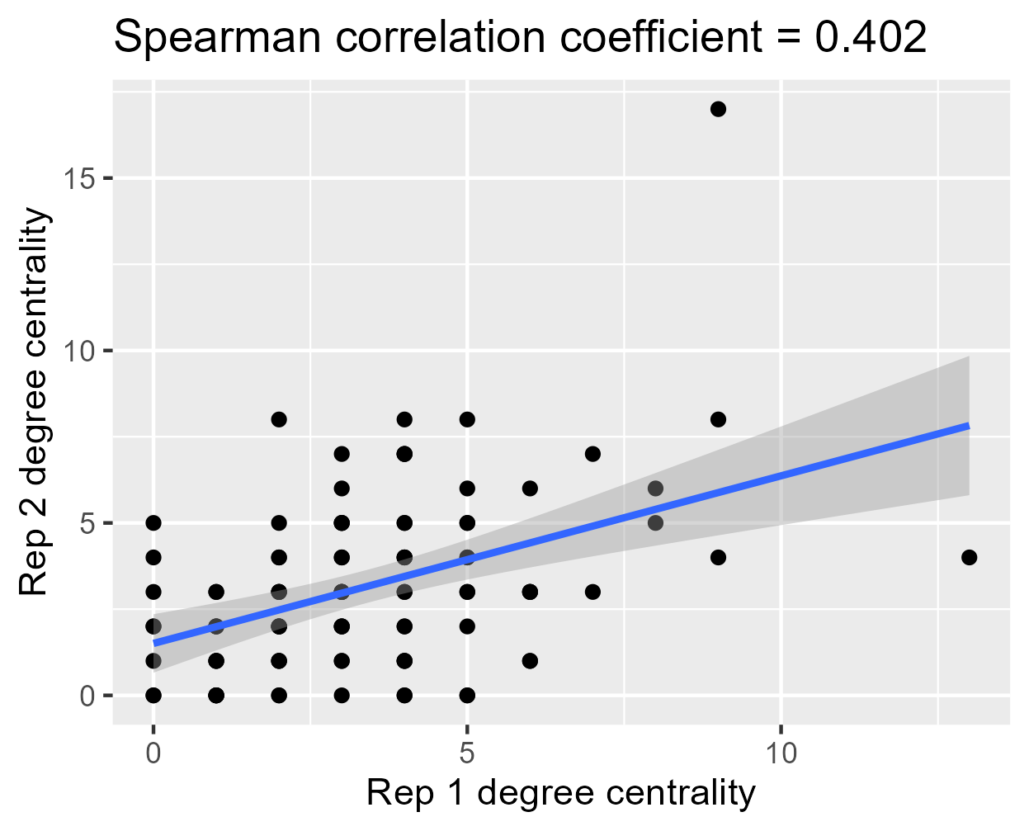
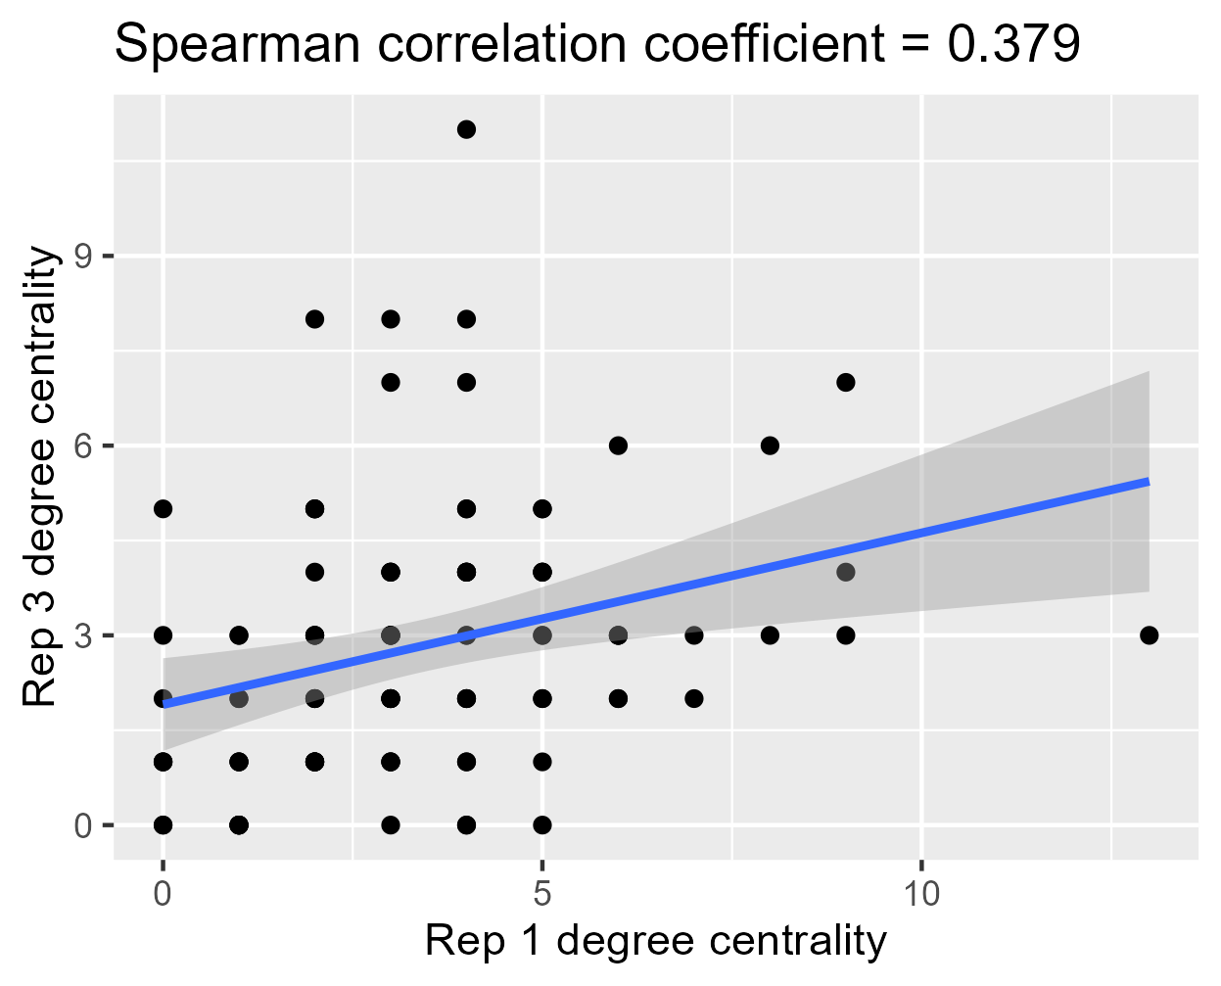
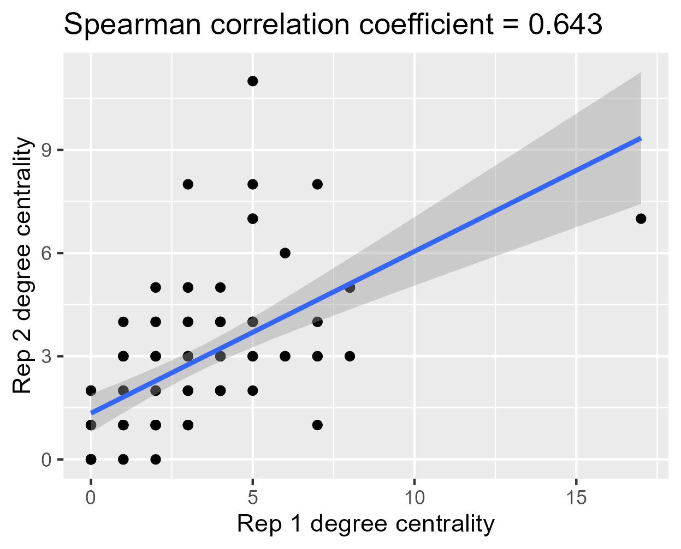
Correlations between networks
R1 vs R2
R1 vs R3
R2 vs R3

Slide 9
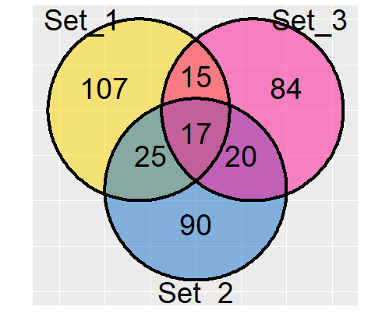
Venn diagram of shared edges in observed networks between replicates
17 pairs that always connect to each other in all Replicates
Member 1 | Member 2
LjRoot247 | LjRoot264
LjRoot247 | LjRoot235
LjRoot245 | LjRoot247
LjRoot65 | LjRoot247
LjRoot283 | LjRoot27
LjRoot29 | LjRoot224
LjRoot243 | LjRoot90
LjRoot11 | LjRoot27
LjRoot11 | LjRoot283
LjRoot227 | LjRoot251
LjRoot259 | LjRoot62
LjRoot282 | LjRoot289
LjRoot21 | LjRoot26
LjRoot67 | LjRoot72
LjRoot221 | LjRoot183
LjRoot223 | LjRoot25
LjRoot54 | LjRoot92

Slide 10
Taxonomy of robust paired associations
LjRoot247 Xanthomonadaceae Pseudoxanthomonas
LjRoot264 Pseudomonadaceae Pseudomonas
LjRoot247 Xanthomonadaceae Pseudoxanthomonas
LjRoot235 Rhizobiaceae Rhizobium
LjRoot245 Rhizobiaceae Rhizobium
LjRoot247 Xanthomonadaceae Pseudoxanthomonas
LjRoot65 Comamonadaceae Acidovorax
LjRoot247 Xanthomonadaceae Pseudoxanthomonas
LjRoot283 Micrococcaceae Arthrobacter
LjRoot27 Intrasporangiaceae
LjRoot29 Burkholderiaceae Burkholderia
LjRoot224 Rhizobiaceae Rhizobium
LjRoot243 Bradyrhizobiaceae Bradyrhizobium
LjRoot90 Bradyrhizobiaceae Bosea
LjRoot11 Rhizobiaceae Rhizobium
LjRoot27 Intrasporangiaceae
LjRoot11 Rhizobiaceae Rhizobium
LjRoot283 Micrococcaceae Arthrobacter
LjRoot227 Sphingomonadaceae Sphingomonas
LjRoot251 Rhizobiaceae Rhizobium
LjRoot259 Caulobacteraceae Asticcacaulis
LjRoot62 Comamonadaceae Variovorax
LjRoot282 Oxalobacteraceae Massilia
LjRoot289 Oxalobacteraceae Massilia
LjRoot21 Xanthomonadaceae Pseudoxanthomonas
LjRoot26 Comamonadaceae Pseudorhodoferax
LjRoot67 Comamonadaceae Acidovorax
LjRoot72 Comamonadaceae Acidovorax
LjRoot221 Rhizobiaceae Rhizobium
LjRoot183 Oxalobacteraceae Duganella
LjRoot223 Burkholderiaceae Burkholderia
LjRoot25 Oxalobacteraceae Herbaspirillum
LjRoot54 Pseudomonadaceae Pseudomonas
LjRoot92 Pseudomonadaceae Pseudomonas

Slide 11
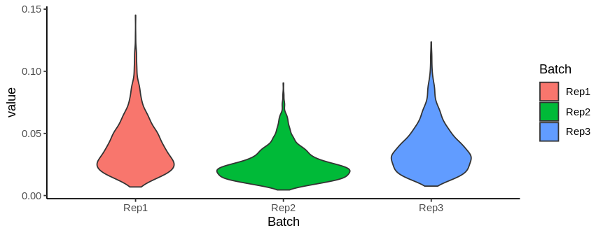
Shoot weight plot
R2 shows different shoot weight pattern, smaller plants in general

Slide 12
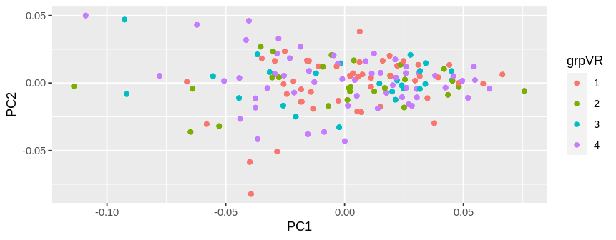
PCA : Shoot weight per ecotype category R1

Slide 13
Beta diversity plot, only LjRoot identified ASVs
R2 splits into two populations on this first axis
Very visible outliers that increase the variance

