Slide 1

SMART INDIA HACKATHON 2026
TITLE PAGE
Problem Statement ID SIH26228
Problem Statement Title Trustworthy Computer Vision Integrity Assurance for Data, Models and Inference Outputs in Multi-Contributor Pipelines
Theme Blockchain & Cybersecurity
PS Category Software
Team ID 179631
Team Name Team Collectors
Offline integrity assurance for contributed data, models and inference records — measured, not asserted.
Evidence base: CVIAF worktree 2fda6eab (branch task3-real-backbone); reviewed main 6cddfe0e. Every figure names its file and denominator.

Slide 2
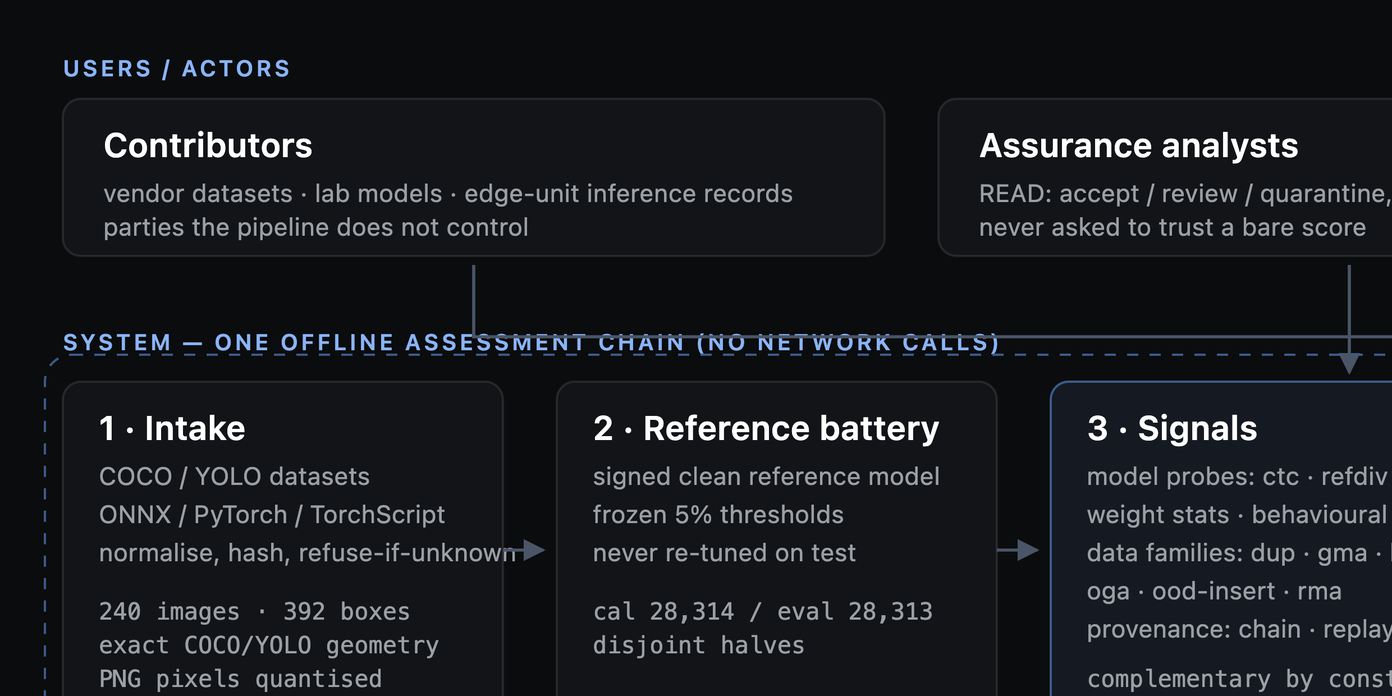
CVIAF — Computer Vision Integrity Assurance Framework
Team Collectors
Problem & insight
• Datasets, models and inference logs arrive from parties we do not control — each can be poisoned, swapped or edited.
• Today's checks cover one link each, none covers the chain, and none works when the network is gone.
• Classifier-era defences do not transfer: phantom boxes and cloaked objects have no classifier analogue.
Architecture — who uses it and what the chain computes offline
Our solution
• One offline engine assesses data, model, inference records and drift, then merges every flag into one signed report.
• Ground truth first: a laboratory plants known attacks, so every detector is scored, not asserted.
• Every score is a conformal p-value against a signed reference battery we control; sample flags roll up per contributor.
Innovation & measured proof
• Calibrated, not tuned: an explicit error guarantee, and accept is forbidden when an applicable check did not run.
• Image-level AUROC 0.9866 (fused_bonf, OGA fabrication) / 0.9062 (ODA cloaking); clean control 0.500.
• Provenance 8/8 attacked records vs 4/8 for the enrolled-digest baseline; 0/2 genuine false alarms.
• Detection is measured, not asserted: at the frozen 5% false-alarm threshold RefDiv-mean catches 45/94 substitution attacks at dose 0.25 and 92/99 weight tamper at dose 1.00; CTC-mean at the same threshold catches almost none.
• One end-to-end report: 17 findings, CRITICAL → quarantine, 27.1 s audit-trail span.
AUROC is an image-level ranking statistic on 8 laboratory models, not model-level recall. The provenance run was signed with the HMAC-SHA256 fallback, not Ed25519.
Everything inside the dashed boundary is computed offline from assets the team controls; contributors sit outside it. Source: runs/assurance/oda_s5, runs/merged_fpr_tpr_report.json, runs/tpr_ladder_at_frozen.json, runs/coverage.json @ 2fda6eab.

Slide 3
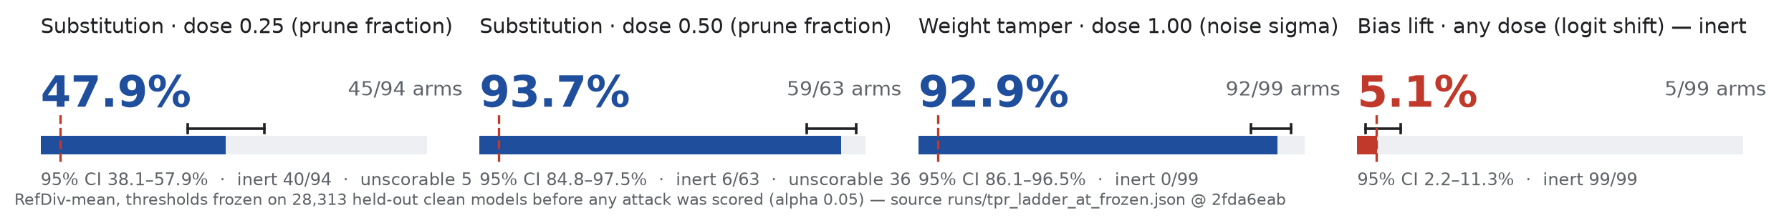
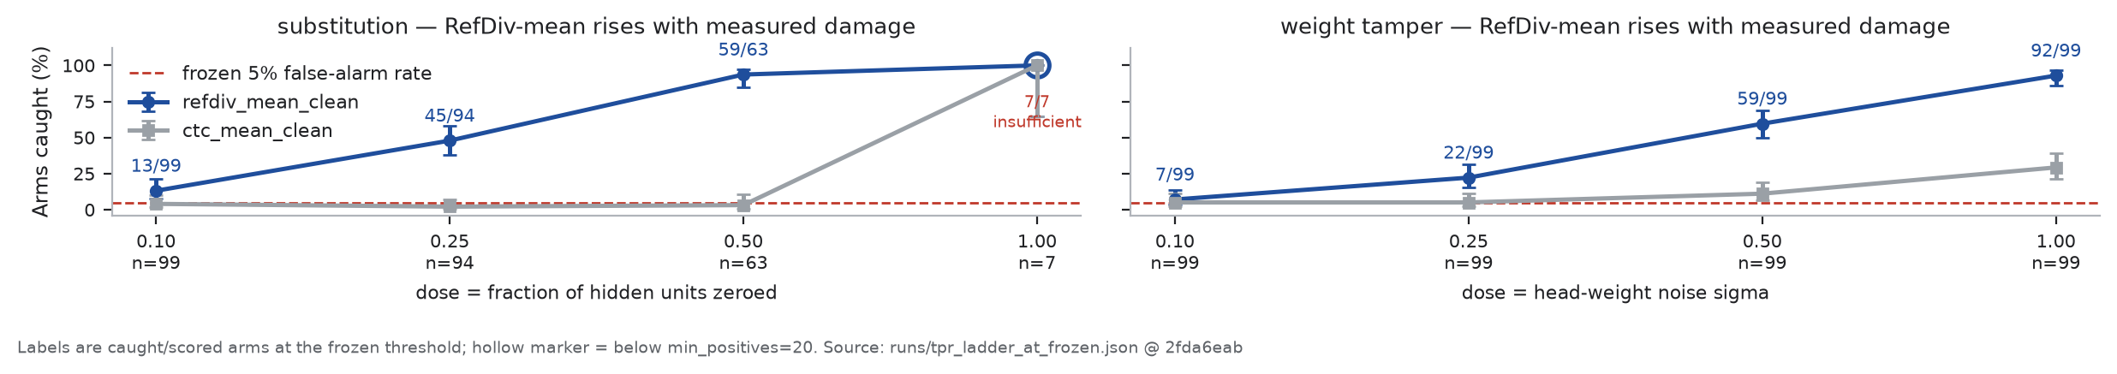
TECHNICAL APPROACH
Team Collectors
Every artefact entering a computer-vision pipeline — data, model, inference record — is measured against a reference we own, and every conclusion ships with its confidence and its limits. Detection is scored only at thresholds the clean ledger froze first: RefDiv-mean catches 47.9% of substitution attacks at dose 0.25 and 93.7% at dose 0.50, and 92.9% of weight tamper at dose 1.00.
intake • reference
signals
frozen calibration
attack scoring
findings • coverage
HEADLINE CELLS — the figures the repository's number audit enforces
Finding | Evidence | Limit
Worked: RefDiv sensitivity rises with measured damage | substitution 13/99 → 45/94 (47.9%) → 59/63 (93.7%); weight_tamper 7/99 → 92/99 (92.9%). CTC-mean catches 2–29% at the same threshold. | thresholds frozen from the clean ledger; arms are synthetic TinyDetector models
Did not work: bias lift stays at the false-alarm rate | 5/99 = 5.1% at every dose; 396/396 arms behaviour-inert (zero F1 change) | inert weight change, not a proven harmful backdoor — the blind spot is declared
Failure handled: unscorable arms are reported, not hidden | 1,188 built → 1,055 scored; 133 unscorable, all substitution | substitution dose 1.00 has n=7, below min_positives=20 — shown hollow, never as 100%
Clean-null FPR ledger, 28,313 held-out negatives: refdiv_mean_clean 5.18%, ctc_mean_clean 5.23% — both intervals include the 5% target; ctc_peak/q95 sit at the corpus ceiling (degenerate, not specific). Coverage 14 of 14 clauses measured, gate PASS. A passing gate is not proof of universal detection.

Slide 4
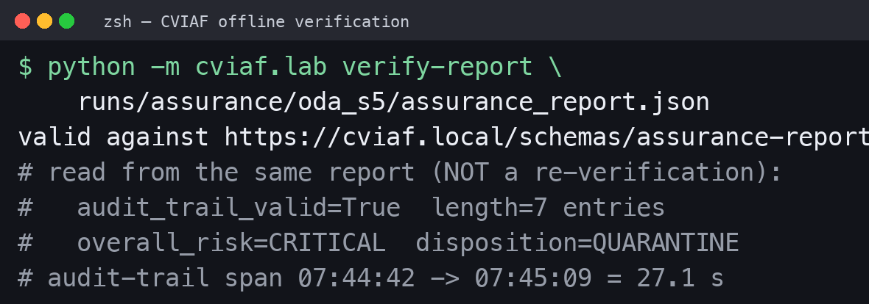
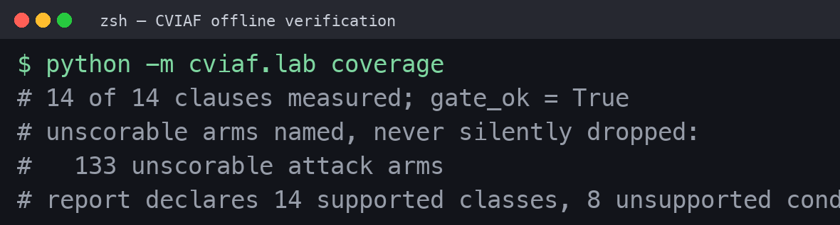
FEASIBILITY AND VIABILITY
Team Collectors
Claim | Actual evidence | Boundary
Runs offline, end to end | verify-report validates runs/assurance/oda_s5 against the shipped schema; audit chain 7 entries, valid=True | laboratory corpus; no network in the assurance path
Ingests real dataset formats | COCO and YOLO round trip: 240 images, 392 boxes, exact annotation geometry | PNG pixels are quantised — not byte-equal
Produces a signed, auditable report | 17 findings, CRITICAL → quarantine, 27.1 s; report schema-valid | HMAC-SHA256 fallback in this run — not Ed25519 non-repudiation
Named limits, not silent passes | 14 supported attack classes and 8 unsupported conditions declared in the report's coverage statement | the demo run skips white-box checks and is kept separate (run demo_assurance)
Planned: real-backbone benchmark and deployment-grade signing | [needs value from H200 run ledger] — not measured in this repository | planned work, deliberately not presented as capability
Left: a real verification run against the named report, executed on this build. Right: coverage resolved from live artefacts; unscorable arms are named, not dropped. Both captions carry the run and commit they came from.
Corpus inventories are kept apart: the 22,693-member 30 September export record is NOT additive with the 56,627-model study — its 1,056 and 11,637 components are the seed_10150_28385 and seed_10264_24607 shards already inside that study (docs/MODEL_INVENTORY.md §3). A byte-level image-overlap receipt is still outstanding, so no leakage-free claim is made.
[insert lab photo — AI Lab @ AU QUASAR; context only, not a benchmark]

Slide 5
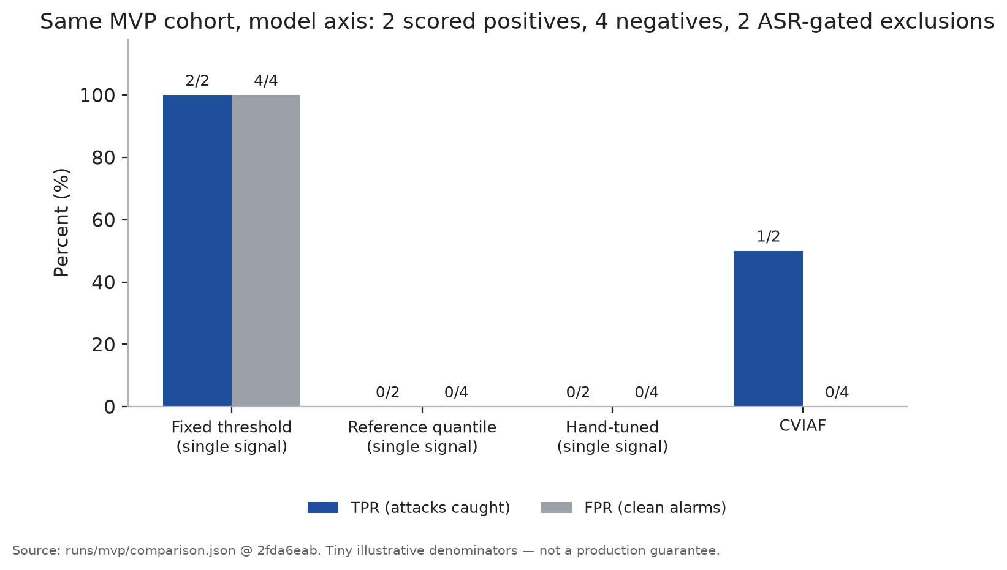
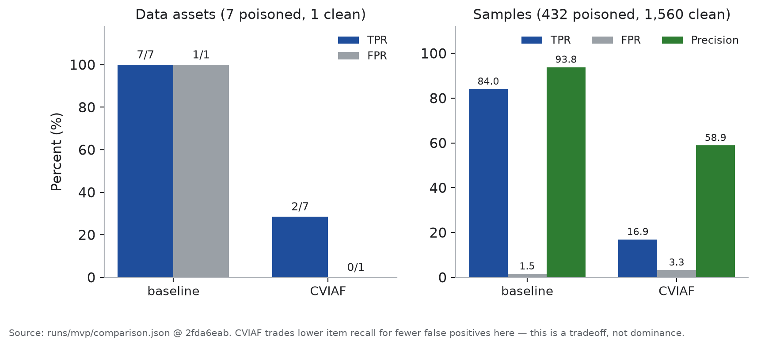
IMPACT AND BENEFITS
Team Collectors
Implemented baseline checks vs CVIAF on the same laboratory cases — a measured tradeoff on a small cohort, not universal superiority. Read as an engineering result: fewer asset false alarms and a richer evidence trail, paid for with lower item-level recall. No measured reduction in analyst hours, incidents, cost or readiness risk exists in this repository.
What changed | Before — implemented baseline | After — CVIAF | Boundary
Model axis | fixed threshold 2/2 TPR, 4/4 FPR | 1/2 TPR, 0/4 FPR | 2 positives, 4 negatives, 2 ASR-gated excluded
Inference tamper + replay | enrolled digest 4/8; abstains 2 attacked, 2 genuine | 8/8, FPR 0/2 | HMAC fallback; tamper check, not proof of origin
Data axis — assets | 7/7 TPR but 1/1 false alarm | 2/7 TPR, 0/1 false alarm | fewer asset false alarms, lower recall in this run
Data axis — samples | TP 363 / FP 24 · TPR 84.03% · precision 93.80% | TP 73 / FP 51 · TPR 16.90% · precision 58.87% | unfavourable to CVIAF and retained; asset and sample units are not interchangeable
Attribution | hash-only: top-1 undefined, 0/8 detected | top-1 2/2 on single-culprit classes | 2 scored classes; not universal source accuracy

Slide 6
RESEARCH AND REFERENCES
Team Collectors
Every link below opens the specific artefact in the project repository, at the commit this deck was built from. Read the receipt, not this slide.
Topic | Open in repository
Problem statement | PS 26228 — Trustworthy Computer Vision Integrity Assurance
Repository at this commit | Collectors-AU/CVIAF @ 2fda6eab (branch task3-real-backbone)
Same-cohort comparison | runs/mvp/comparison.json — model, data and provenance axes
Large clean-null FPR receipt | runs/merged_fpr_tpr_report.json — 56,627 models
Fleet ledger | runs/fleet_fpr_ledger_report.json — 7,503 models, 3,751 held-out
Dose-ladder receipt | runs/tpr_ladder_at_frozen.json — 1,188 built / 1,055 scored
Coverage and as-built matrix | runs/coverage.json · docs/COVERAGE_STATEMENT.md · docs/PS26228_ALIGNMENT_MATRIX.md
Report example | runs/assurance/oda_s5/assurance_report.json — schema-valid, 17 findings
Model inventory | docs/MODEL_INVENTORY.md — where every model came from
Reproduce offline | docs/REPRODUCE.md — no network, bundle install
Evidence manifest: evidence/evidence_manifest.json — every slide number maps to a file, field and denominator. All figures are laboratory / synthetic scope; field validation is pending. docs/PS26228_REQUIREMENT_TRACE.md is historical design intent, not as-built evidence.

