Slide 1
Data Management for Smart Cities
BigQuery-Based Infrastructure for Road Condition Monitoring
Colleen Li • Aadit Khurana • Tran Le Ngoc Vo
Mentors: Nikkhil Vijaya Sankar, Mohammad Reza Jahanshahi
VIP Program | Purdue University | November 18, 2025

Slide 2
The Problem: Managing Massive Road Data
Challenge:
- Computer vision for road detection generates massive data volumes
- Our project: 2.9 million images with 2 million classifications
- Data spread across 2,624 road segments in Fort Wayne, IN
- Need to efficiently store, query, and visualize relationships:
segments → drives → cameras → images → classifications
→ How do we manage this at scale while enabling ML workflows?

Slide 3
Our Solution: Cloud Data Warehouse
Technology Stack:
• Google Cloud BigQuery: Cloud-native data warehouse, columnar storage, built-in optimization
• Python ETL Pipeline: Process 315 MB JSON files → normalized schema
• 7 Relational Tables: segments, drives, cameras, images, camera_images, categories, image_categories
• Streamlit Dashboard: Interactive web app with Tableau embedding
• Folium Heatmap: Geospatial visualization using Fort Wayne shapefiles

Slide 4
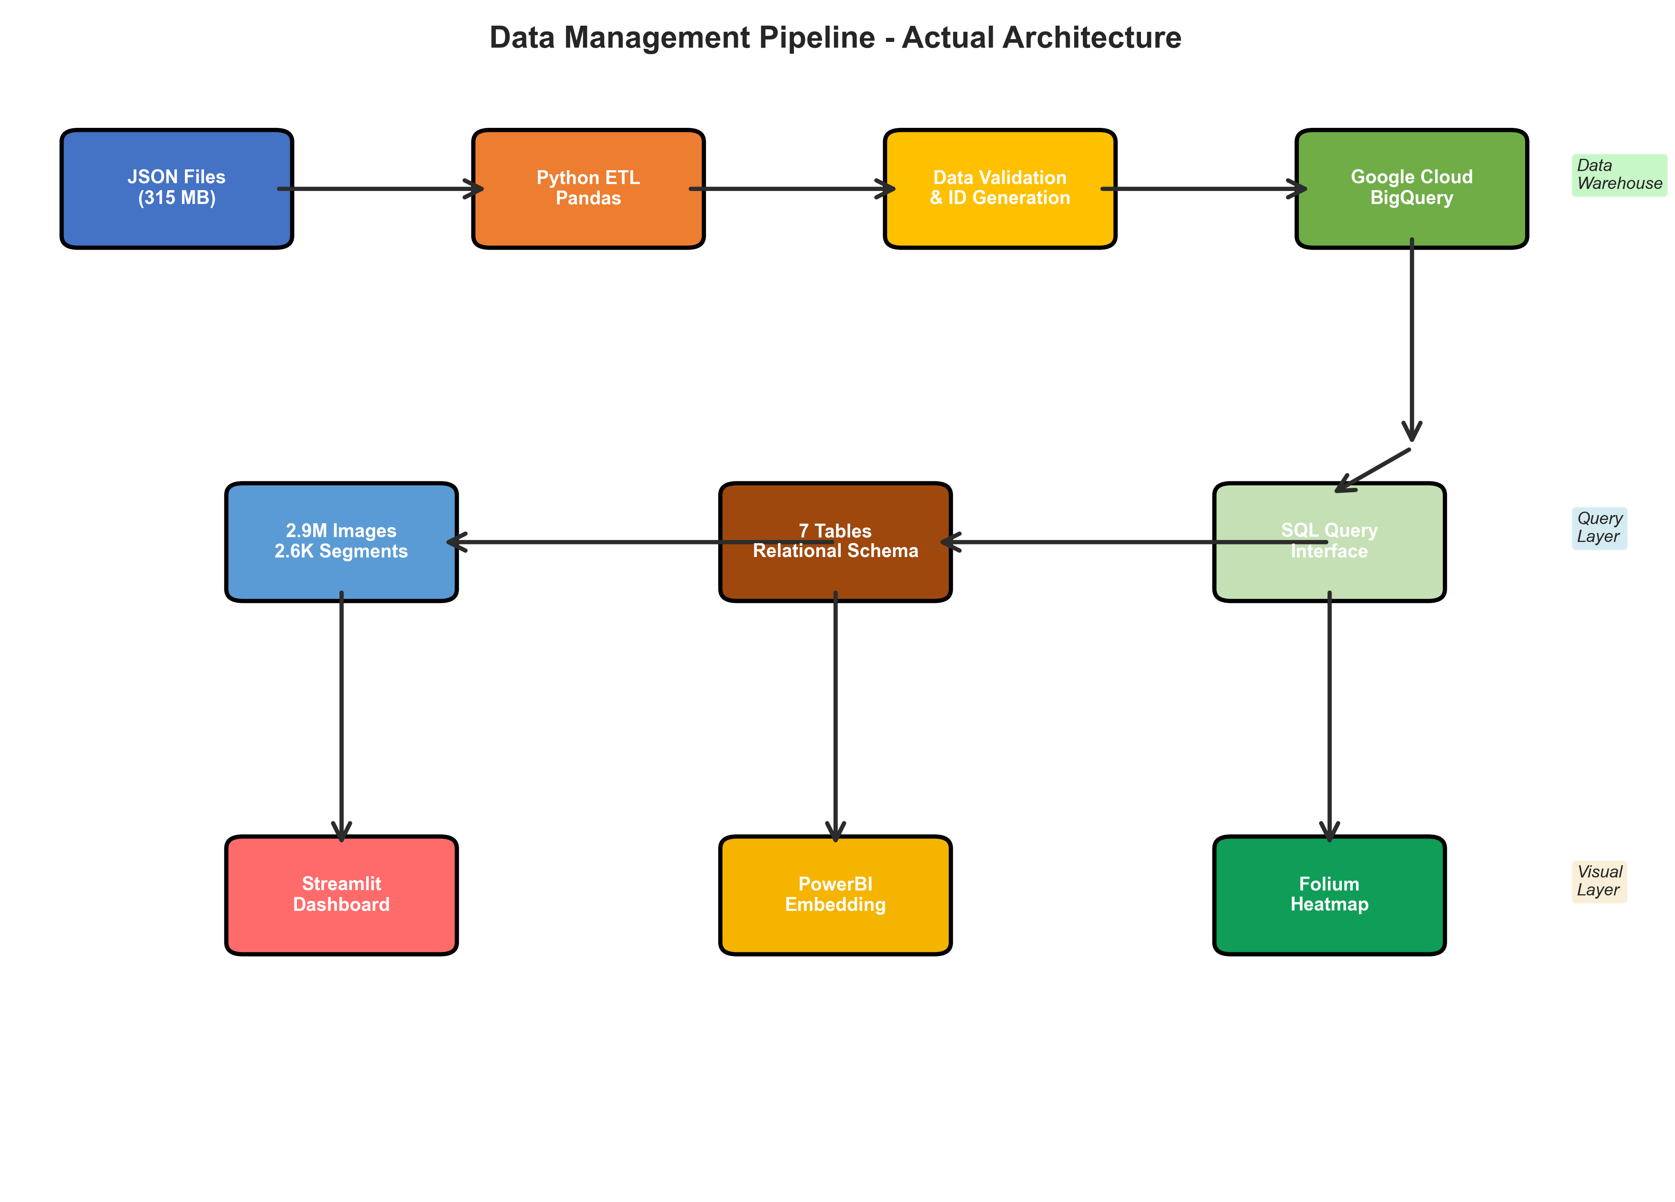
System Architecture
[Insert: actual_visuals/actual_architecture.png]

Slide 5
ETL Data Pipeline
Input Data:
- 4 JSON files (315 MB total)
from Classification_Swin model
- 2.9M images (color + depth)
- 8 classification categories: Alligator, Health, Longitudinal, Manhole, Openjoint, SD, Sealed, Transverse
Processing Steps:
1. Load JSON files
2. Generate consistent IDs
(hash-based across files)
3. Extract timestamps
from image filenames
4. Build relationships
5. Validate schema
6. Upload to BigQuery
Result: 7 normalized tables

Slide 6
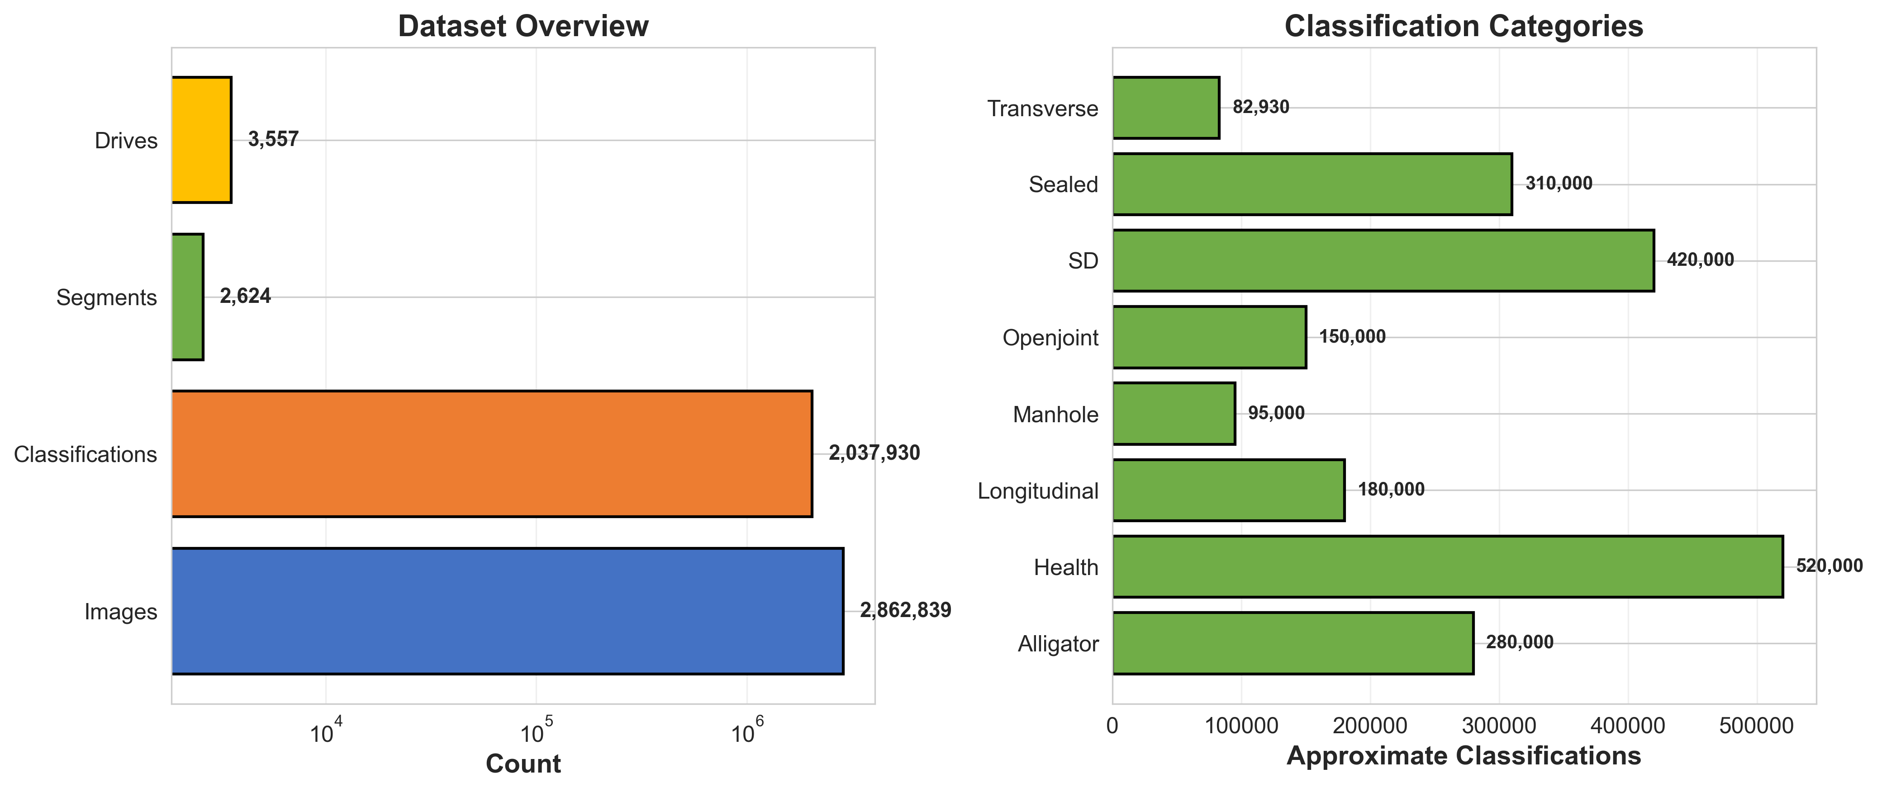
Results: Data Volumes
[Insert: actual_visuals/data_volume.png]
Key Metrics:
✓ 2,862,839 total images processed ✓ 2,037,930 classifications generated
✓ 2,624 road segments across Fort Wayne ✓ 3,557 driving sessions

Slide 7
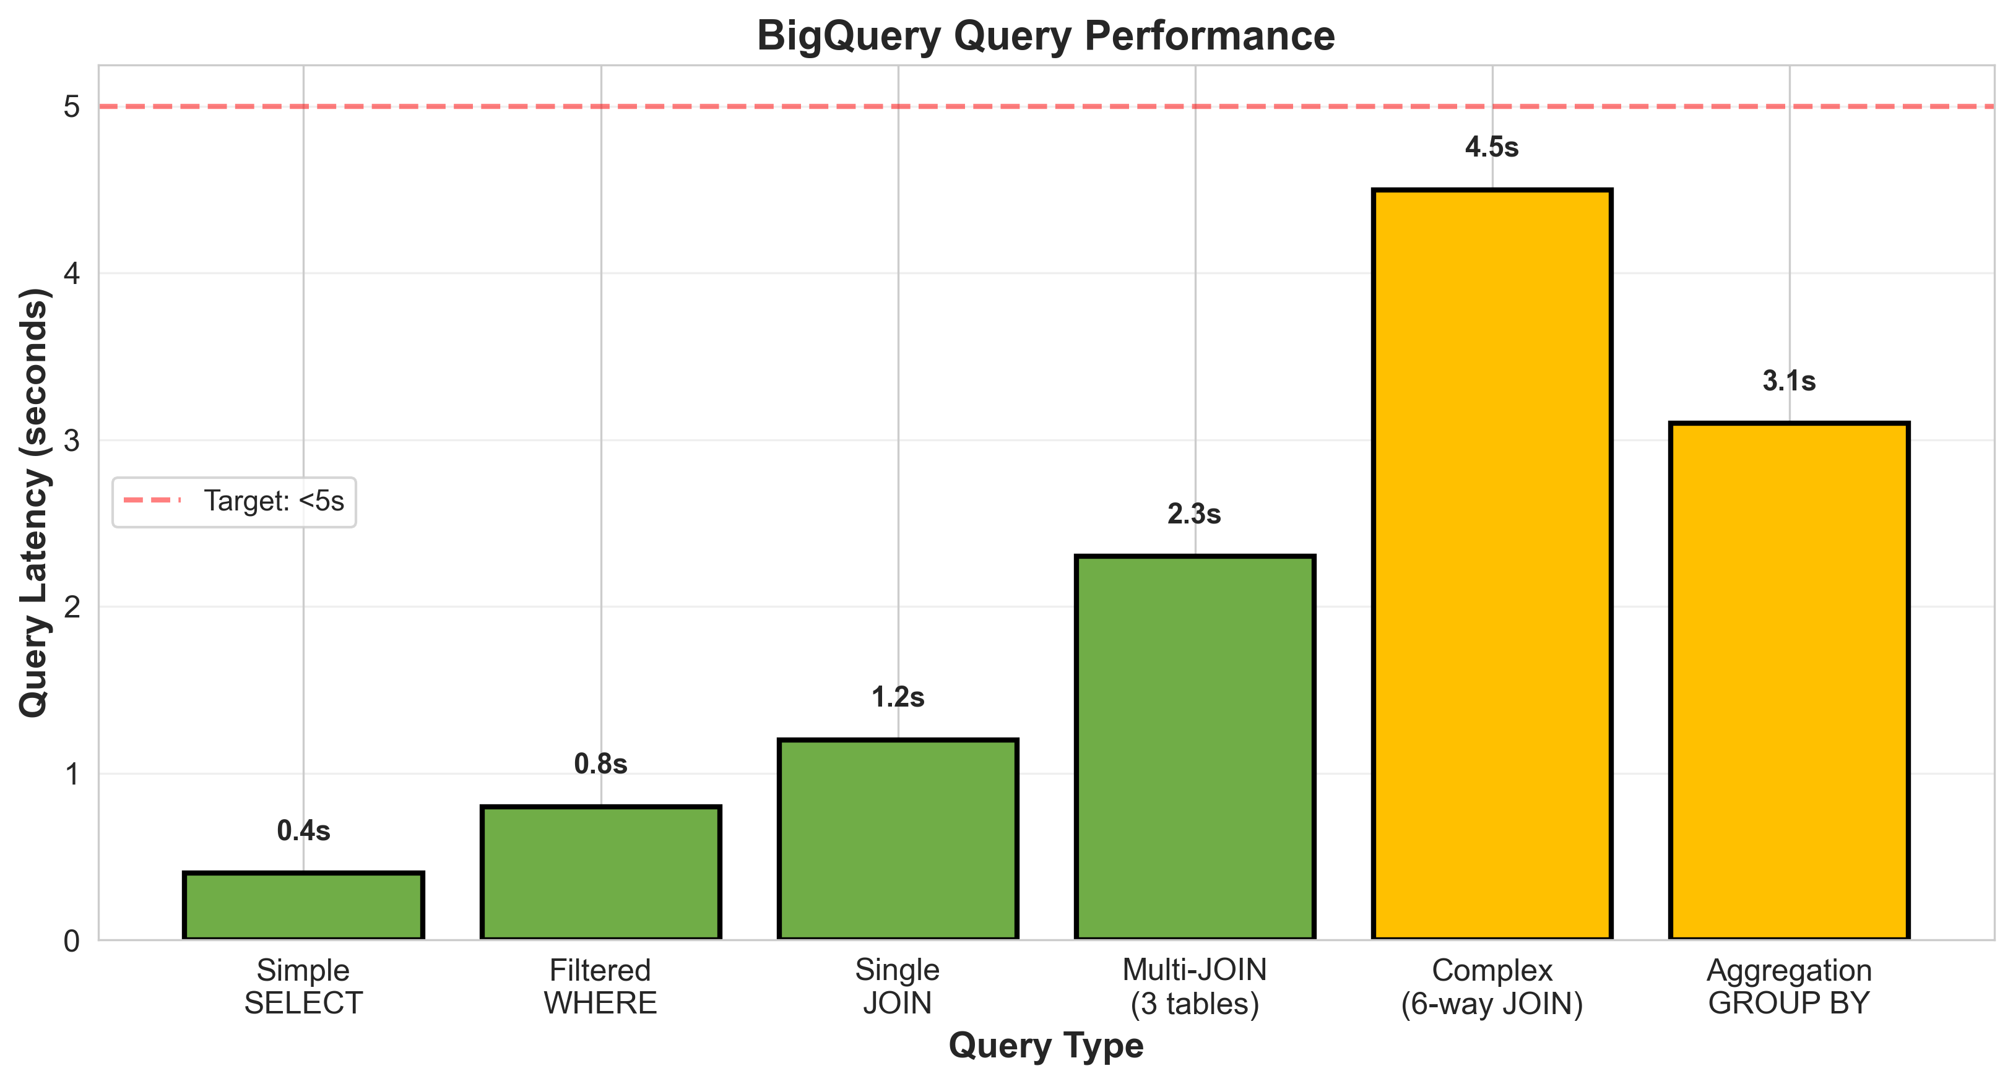
Query Performance Analysis
[Insert: actual_visuals/query_performance.png]
BigQuery Performance:
• Simple queries: <0.5s • Maintains performance at scale (2.9M images)
• Complex 6-way JOINs: <5s • Columnar storage optimizes analytics workloads

Slide 8
Interactive Visualization Dashboard
[INSERT YOUR STREAMLIT DASHBOARD SCREENSHOT]
Features: Folium heatmap • SQL query interface • Tableau charts • Real-time updates

Slide 9
Impact & Applications
Contributions:
✓ Scalable cloud-based data warehouse for road condition data
✓ Efficient ETL pipeline processing millions of images
✓ Interactive dashboard for infrastructure monitoring
✓ SQL interface for ad-hoc data exploration
✓ Export capabilities for ML training datasets
Real-World Applications:
• Smart city infrastructure planning
• Predictive maintenance scheduling
• Insurance risk assessment
• ML model training pipelines
• Multi-city deployment potential

Slide 10
Next Steps & Future Work
Future Enhancements:
→ Real-time streaming ETL from ongoing data collection
→ Automated classification pipeline integration
→ Multi-city deployment (Indianapolis, other IN cities)
→ Advanced analytics: trend detection, severity scoring
→ Edge computing for on-device processing

Slide 11
Acknowledgments
We would like to thank:
• Mentors: Nikkhil Vijaya Sankar & Mohammad Reza Jahanshahi
• Purdue VIP Program
• College of Engineering

Slide 12
Thank You!
Questions?

