Slide 1

Cyclistic: Bike-Share Analysis
By: Colleen Freeman
Last Updated: September 19th 2023

Slide 2
Guiding Question
How do annual members and casual riders use Cyclistic bikes differently?

Slide 3
Business Task
Analyze the Cyclistic trip data from the last six months to identify trends in how each customer type uses Cyclistic bikes.

Slide 4
Preparation
I have chosen to complete an analysis on the first two quarters of 2022
The data has been made available by Motivate International Inc. under this link.
It is organized in CSV (comma-separated values) format, comprising a total of 13 columns.
To ensure data integrity, I have taken several measures, including removing duplicates, implementing routine backups, and controlling access rights to the data.

Slide 5
The Data

Slide 6
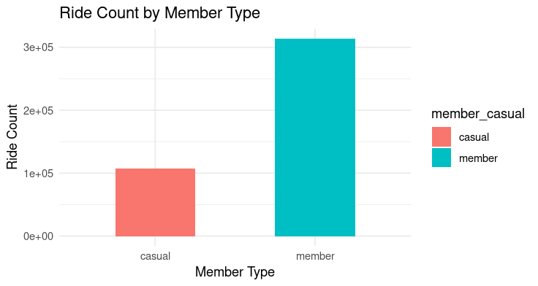
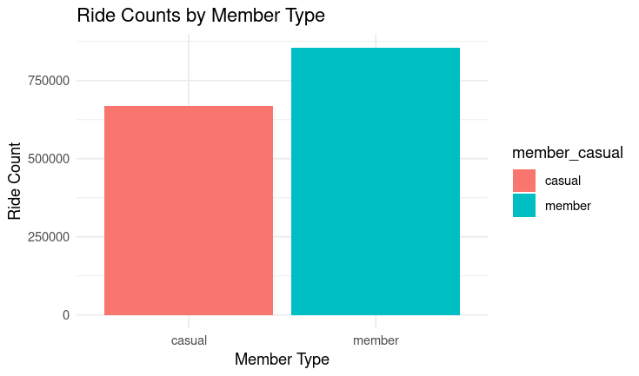
Casual vs Member Ride Count
Quarter One
Quarter Two
According to the data, members have a higher frequency of ride counts overall

Slide 7
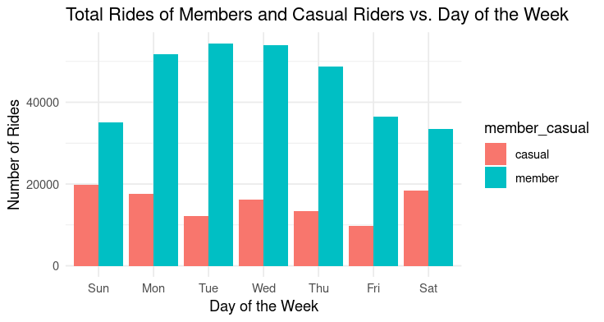
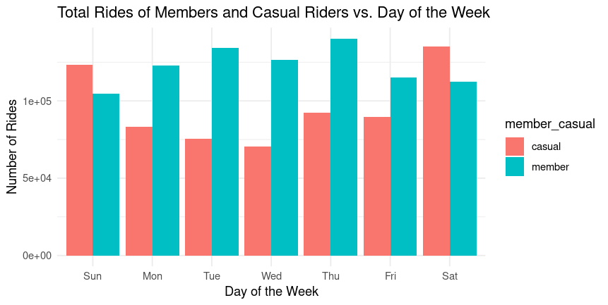
Total Number of Rides for Casual vs Members for Each Day of the Week
Quarter One
Quarter Two
Within the first three months of the year, casual riders took fewer rides than members
As the year progressed, casual riders took more rides with the number of rides peaking on the weekend

Slide 8
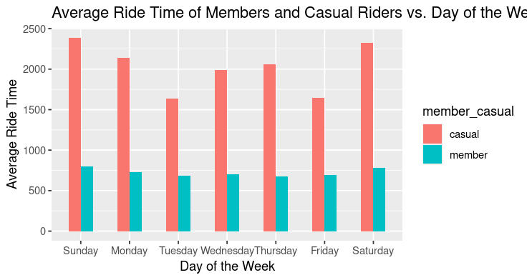
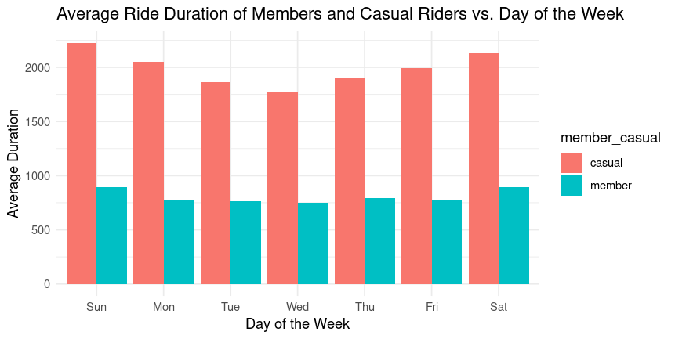
Average Duration of Rides for Casual vs Members for Each Day of the Week
Quarter One
Quarter Two
According to the data, casual riders tend to take longer rides than members

Slide 9
Conclusion
members tend to take more rides
casual riders embark on longer journeys in terms of both distance and duration
members ride less frequently on weekends

Slide 10
Next steps…
How can we turn casual riders into members?
Weekend Membership Promotion: Launch a targeted marketing campaign that offers special weekend membership promotions.
Ride Rewards Program: Implement a loyalty program specifically designed for casual riders.
Personalized Recommendations: Utilize data analytics to provide personalized recommendations to casual riders based on their riding behavior.

