Slide 1
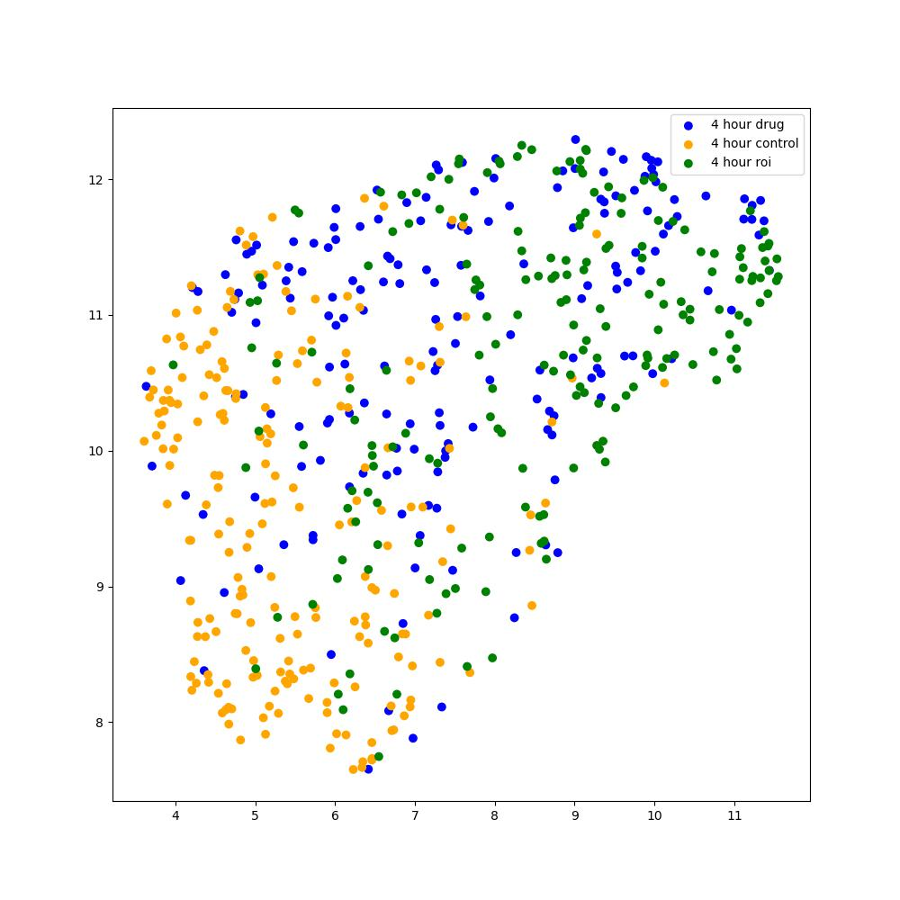
4h Feature Dimensionality Reduction (UMAP)

