Slide 1

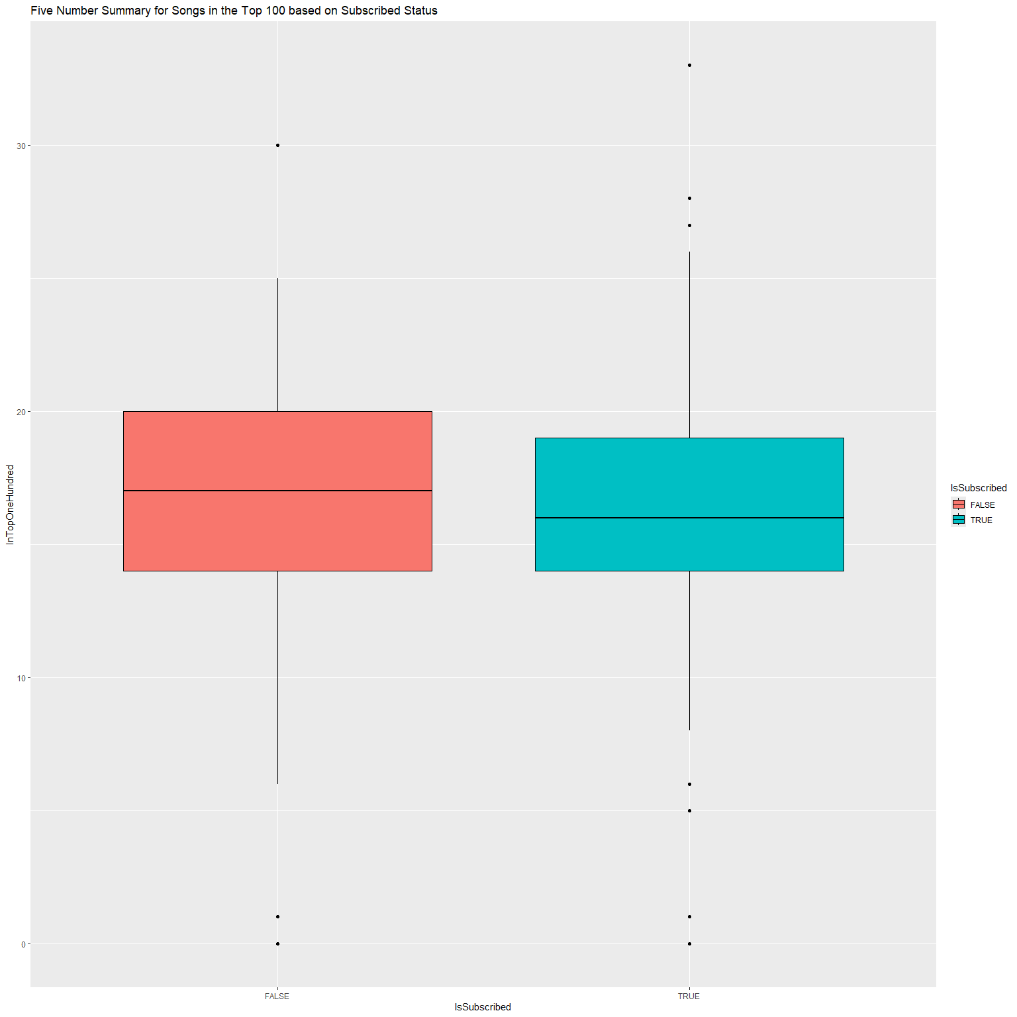
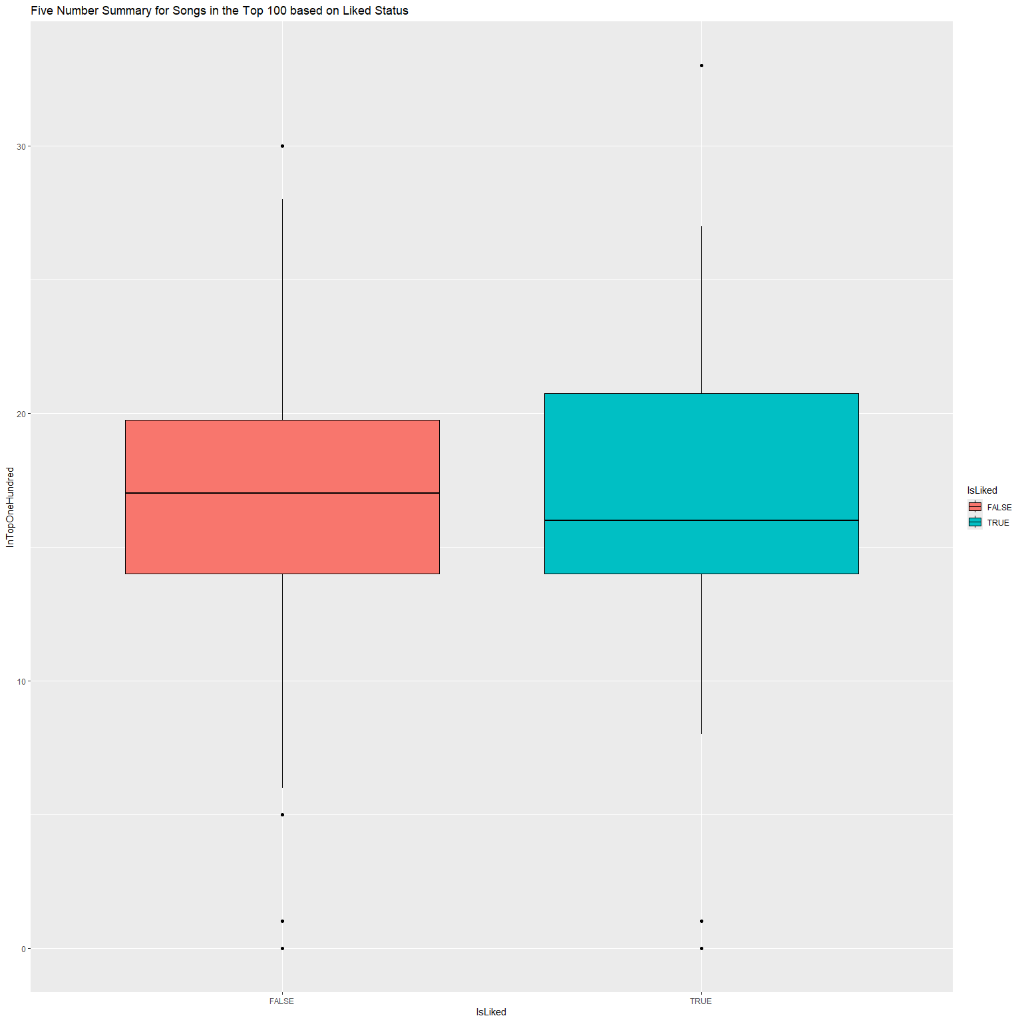
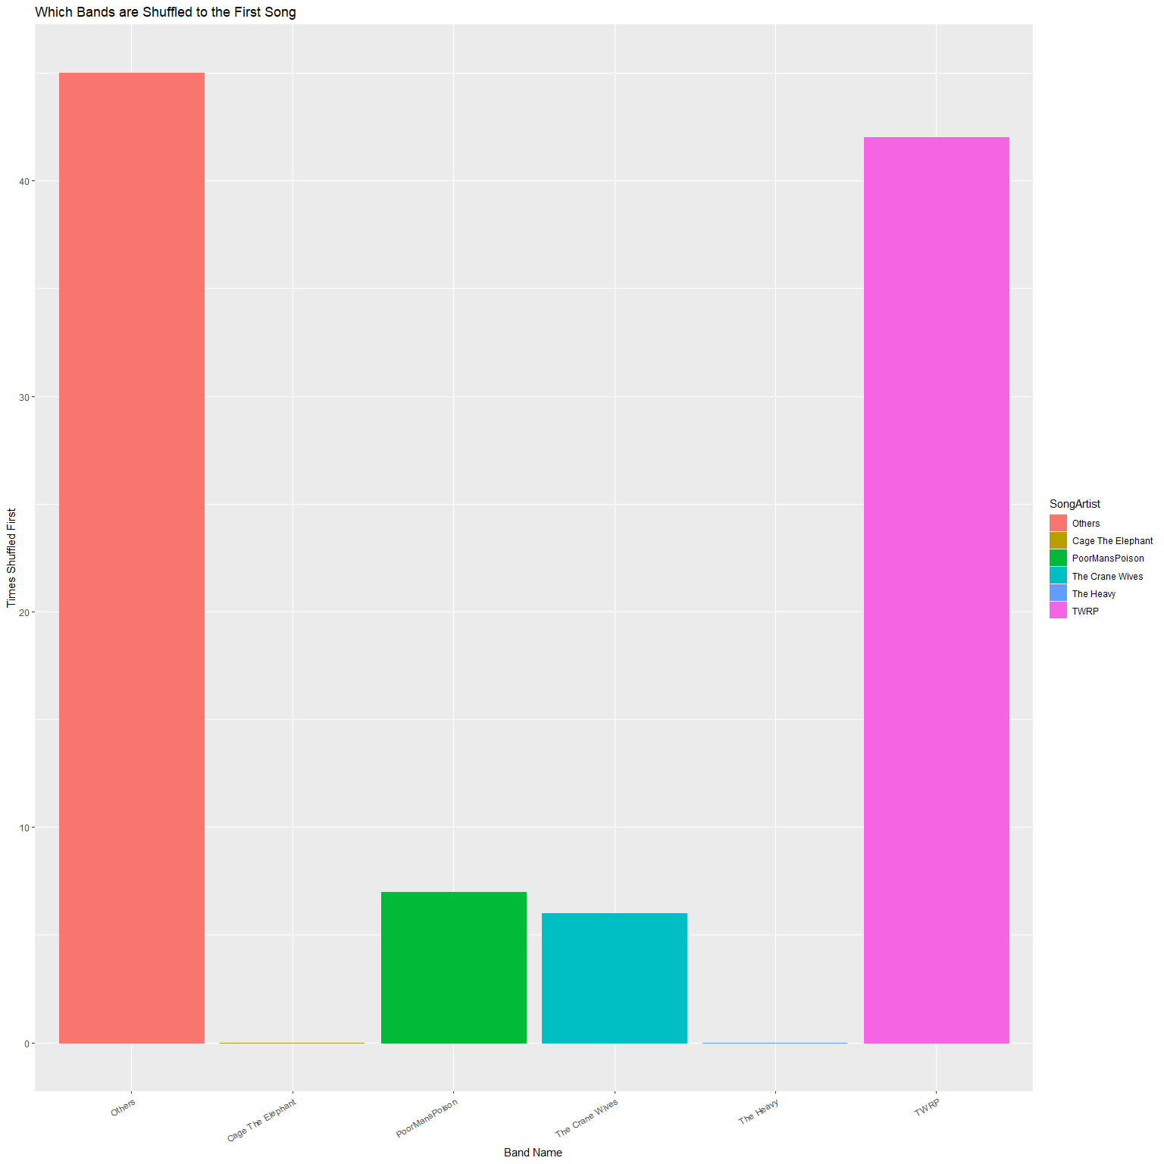
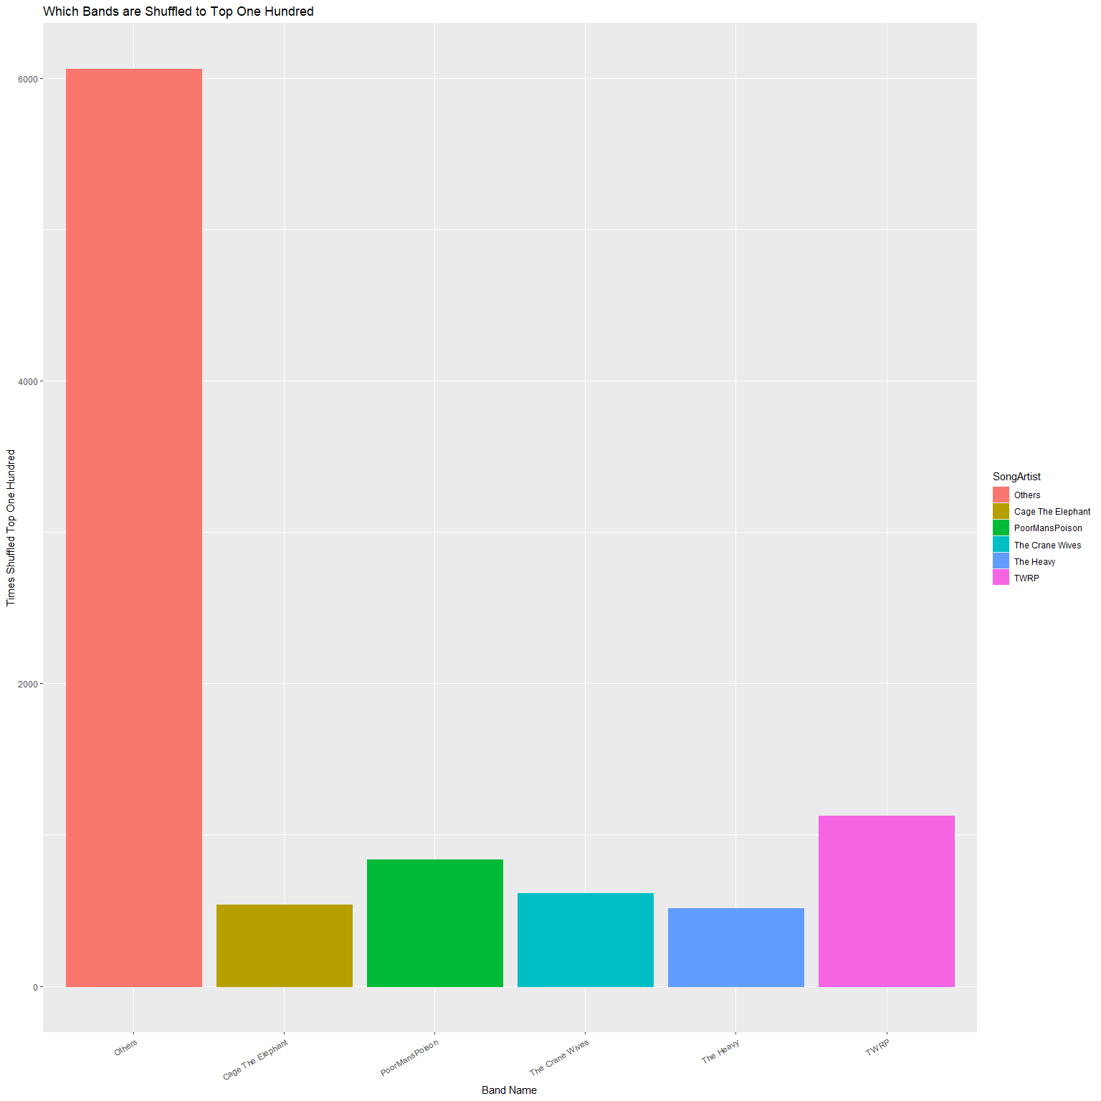
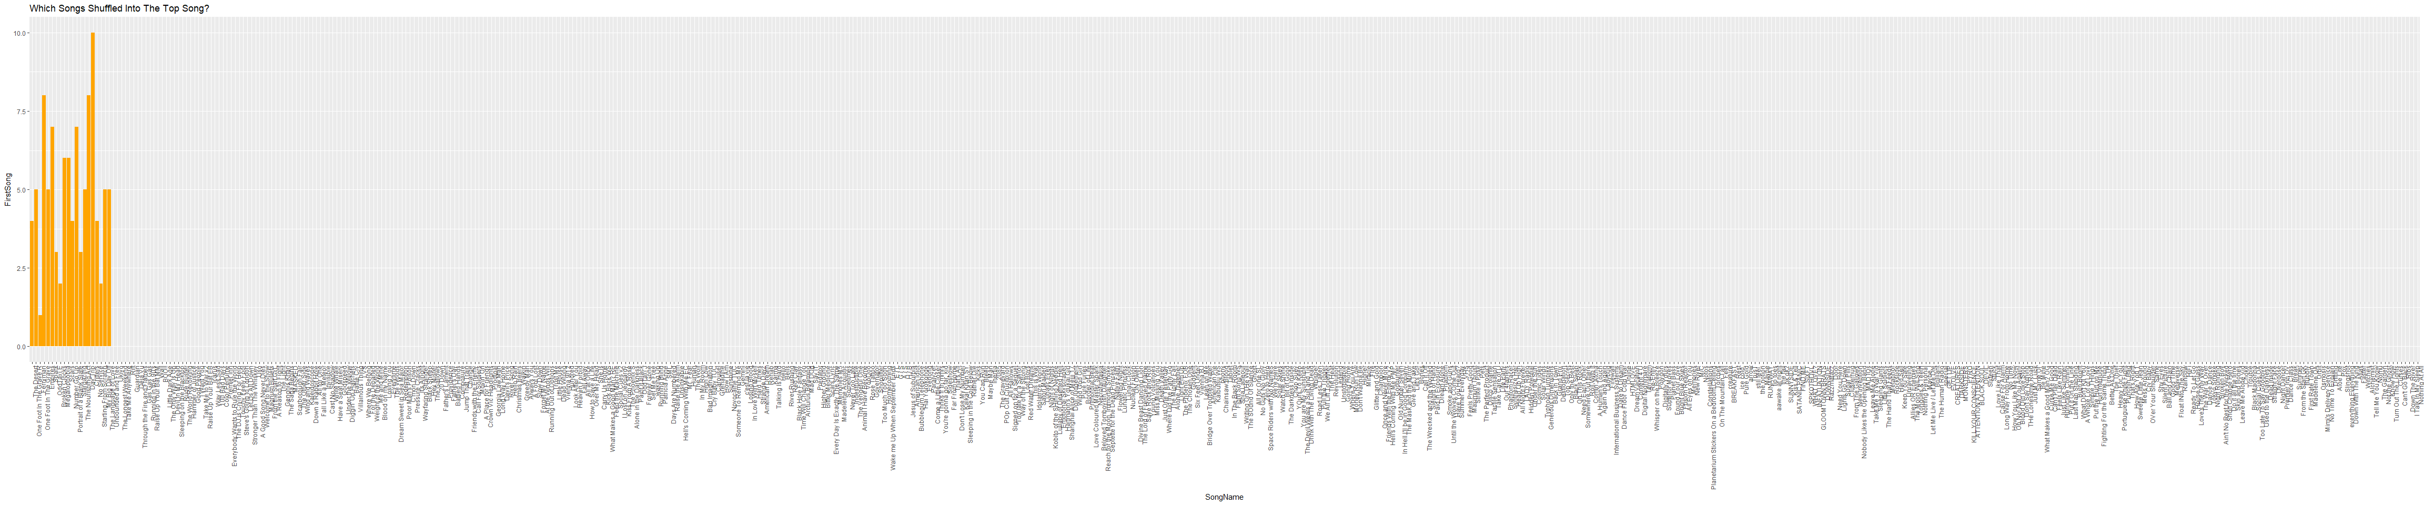
Is The Youtube Shuffle Feature Truly Random?
Alexander Voiovich and Metro State University
Methodology
Data was collected over the course of 21 days
Collection was performed logged onto a premium account using a mobile device
The Playlist was shuffled from a freshly loaded page from the list itself
One Hundred lists of One Hundred videos were recorded
Data Included the video’s: channel, subscriber and like count, if I’d subscribed or liked, and how many times it showed up over the course of the study and where it was
Data was then cleaned and processed in R with the following tools:
Base R functions to create a custom organizing function
forcats to condense the data for the statistical analysis
ggplot2 to graph the collected data
readxl to import and export from my data
Introduction
I, like many people, tend to listen to music to get through monotonous portions of the day like walking, exercising, or working on homework. To this end I have hand crafted a playlist of songs on Youtube with songs that I like listening to and have dubbed it my Work Playlist. It contains 588 songs currently from a variety of different channels and artists. Over time I got to thinking though, even though I shuffle the playlist each time it feels like the same songs are playing again and again. So, this study aims to see if that gut feeling is true or not.
Shown here is an assorted collection of my findings over a twenty-one-day stretch of ten thousand data points to see if the Youtube shuffle feature is possibly deterministic.
Key Findings
The first video of each shuffle was always chosen to be from the first 20 videos
The data evened out back to random the further away from the first video it got
Being subscribed to the channel in question or liking the video
did not appear to influence the data in any way
Figure 1a.
Boxplots to show the observed distribution of videos in the top 100 over if the channel associated was subscribed to or not.
Figure 1b.
Boxplots to show the observed distribution of videos in the top 100 over if the video associated was liked or not.
Hypothesis
H₀: There is no deterministic reasoning when Youtube shuffles a playlist.
H_{A}: There could be some deterministic reasoning when Youtube shuffles a playlist.
Limitations
Due to the structure of Youtube as a platform, scraping the data off its site was made difficult
Access to the source code is prohibited, so any definite conclusions can’t be made as we can’t control many factors
The data was collected using the only account I had access to, and may be different from account to account
Figure 2a.
Bar graphs to show the observed frequency of the First Song in each shuffle based on their Artist.
Figure 2b.
Bar graphs to show the observed frequency of the Top 100 Songs in each shuffle based on their Artist.
Analysis
The primary methodology used was a Chi-Squared Goodness of Fit test as I was testing against random chance.
The P-Value chosen was 0.05, as it was not too restricting nor was it too open ended.
The only metric to fail the Goodness of Fit test was the First Song category, with a recorded 2.43_{E}-19
Each other metric sat comfortably with a value well above at least 0.80
Visually this can be seen on the visuals on either side with the left being for the First Song and right being for the
Top 100.
Artist | Expected Frequency
Cage The Elephant | 33 / 5.62%
Poor Man’s Poison | 48 / 8.16%
The Crane Wives | 35 / 5.95%
The Heavy | 35 / 5.95%
TWRP | 68 / 11.56%
All Other Artists | 369 / 62.76%
Conclusion
While no proper definitive statements can be made, there does appear to be a very strong correlation between the order of the playlist and the very first song it shuffles into. As such I believe it possible to reject the null hypothesis for the scope of this project.
Later on, I’d like to increase the scope of this idea to possibly account for more factors. Speaking with my fellows has yielded their own observations that included factors outside the initial scope I set for the project to be done in a timely manner, the primary one being their account or lack there of.
On a final more personal note, it was interesting to see my gut feeling be shown to have merit to it. As like the music itself, thoughts of mine like that usually get put on the back burner as my focus goes to the task at hand.
Figure 3
Bar graphs to show how many times an individual song appeared as the First Song in a playlist shuffle.

