Slide 1
Riak
Sandeep Jagtap
Amar Potghan
ThoughtWorks Inc
Notes:
Hello Guys, Pramod has spoken about why we should use NoSql. Now we are going to see how different nosql databases can be used together to solve common set of problems. So me and Sandeep going to present Riak. Hopefully we all have riak installation on our machines! If not just sit with a person having the installation. So this is going to a hands on session...Please help us making it interactive.
- Many types of Nosqls :- Document, KV, Columnar,Graph . Riak falls under KV category- KV is the simplest in the API perspetive. Querying KV database has only GET PUT and DELETE operations

Slide 2
What
dynamo based
open sourced
key/value datastore
scale predictably and easily
Notes:
So what is Riak? Riak is a dynamo based data store. Amazon published dynamo paper in 2007. Riak is open source. That does mean source code is available and it is written in Erlang.
KV data stores are the simplest NoSql data stores in API perspective. Either get a value or Put a value. Else Delete. Value can be anything

Slide 3
An open sourced dynamo based data store built to scale predictably and easily

Slide 4
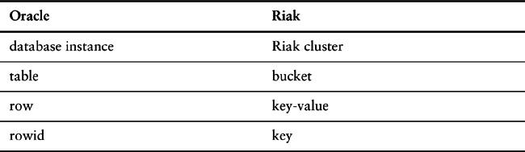
Relational To Riak
Notes:
Lets relate relational database terminology to Riak terminology

Slide 5
Why
Data doesn’t fit on single server (need of distribution)
Downtime is unacceptable
Notes:
Guys I must mention here that Riak is not Jack of all. It doesn’t solve all your problems but it fits best in some of use cases: So where riak fits…? when data don’t fit on a server that means you are in need of distributing data to many servers. And Downtime is unacceptable for your system. That means you can not afford your system is down for certain time. for example amazon.com what happen when system goes down when hundred of people creating their carts? Amazon revenue will go down by millions…

Slide 6
Why not
You don’t know that you need a distributed database
Relationship among the data
Query by data
Operations on Multiple keys
Performance > Availability
Notes:
And in all of the above situation, please stay away from Riak.If you are not sure if you want a distributed database, Riak is out of choice for you
If you have a normalized data, Relational is probably what you looking for.
If your system is more performance intensive that you can overlook availability for gaining performance, probably you are looking for something like in memory databases … example is Redis.

Slide 7
Features
Availability
Scalability
Operational Simplicity
Fault Tolerance
Notes:
So lets go through some interesting features of Riak->

Slide 8
Availability
Masterless, every node can service client
Fallbacks are used when nodes are down
Always accepts read/write requests
Notes:
1. Availability :- Availability ensures that data is available to users at most of the time. Riak replicates and retrieves data intelligently so it is available for read and write operations, even in failure conditions.

Slide 9
Scalability
Default configuration is cluster
Linear improvement in the performance when more nodes are added
Notes:
Scalability : You should able to increase performance by adding resources at any point of time. Riak automatically distributes data around the cluster and yields a near-linear performance increase as you add capacity.

Slide 10
Operational Simplicity
Built for web
HTTP/REST
Add nodes easily without downtime
Notes:
Operational Simplicity: You should be able to add new machines to riak cluster without incurring existing setup.

Slide 11
Fault Tolerance
All nodes participate equally
All data is replicated
Cluster transparently survives:
Node failure
Network Partitioning
Notes:
Fault Tolerance: There are some situations where some of nodes in a cluster go down. In the any of such a situation you should not lose the data.

Slide 12
cluster?
Connected computers that can be viewed as one system!
Notes:
Cluster is nothing but connected computers logically viewed as a system

Slide 13
Why cluster?
more computers -> faster processing
can add nodes as system grows (scalability) improves
system works even if one/two/three/N-1 go down (Availability)
Increasing processor speed no more possible
Notes:
So why do you need a cluster..because: the number of computers is faster the processing ...can add nodes as system grows..System will work even if certain amount of nodes go down..

Slide 14
Concepts
Buckets
Keys
Values
Notes:
Buckets are used to define a virtual keyspace and provide the ability to define isolated non-default configuration. Buckets might be compared to tables or folders in relational databases or file systems, respectively.

Slide 15
Example
<bucket: sessionData>
<key: sessionId>
<value: object>
UserProfile
SessionData
CartItem
CartItem

Slide 16

Let’s play with Riak

Slide 17
Start Single Riak Node
> dev/dev1/bin/riak start

Slide 18
Lets Ping Riak
> dev/dev1/bin/riak ping
pong

Slide 19
Lets go database way!
Insert
Delete
Update
Select

Slide 20
Insert (POST)
Lets add some buckets/keys
curl -v -XPOST -d 'ABCDEFGHIJKLM' -H "Content-Type: application/json" http://localhost:10018/buckets/user-sessions/keys/sandeep?returnbody=true | format-json
curl -v -XPOST -d '{"cart":{"books":[{"name":"nosql","quantity":10}]}}' -H "Content-Type: application/json" http://localhost:10018/buckets/shop-carts/keys/pramod?returnbody=true | format-json

Slide 21
List Keys (GET)
curl -v http://localhost:10018/buckets/user-sessions/keys?keys=true |format-json
curl -v http://localhost:10018/buckets/shop-carts/keys?keys=true |format-json

Slide 22
List Values
curl -v http://127.0.0.1:10018/buckets/user-sessions/keys/sandeep
curl -v http://127.0.0.1:10018/buckets/shop-carts/keys/pramod

Slide 23
Update (PUT)
Lets add some buckets/keys
curl -v -XPUT -d '{"cart":{"books":[{"name":"nosql","quantity":11}]}}' -H "Content-Type: application/json" http://localhost:10018/buckets/shop-carts/keys/pramod?returnbody=true | format-json

Slide 24
Delete (DELETE)
Lets delete some Key
curl -v -X DELETE http://127.0.0.1:10018/buckets/user-sessions/keys/sandeep
Lets see if they are deleted
curl -v http://127.0.0.1:10018/buckets/user-sessions/keys/sandeep

Slide 25
Start 5 node cluster
cd dev
ls
dev1 is already started : ps -ef | grep smp
dev2/bin/riak-admin cluster join dev1@127.0.0.1
repeat for dev2,dev3,dev4 nodes

Slide 26
Concepts
- Ring
- Node
- Partitions
- VNode

Slide 27
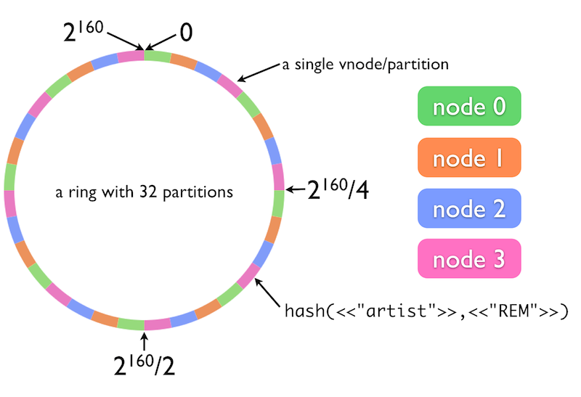
Ring
* This is taken from riak docs on riak website.
Notes:
Data is distributed across nodes using consistent hashing. Consistent hashing ensures data is evenly distributed around the cluster and makes possible the automatic redistribution of data as the cluster scales.How does consistent hashing work? Riak stores data using a simple key/value scheme. These keys are associated with a namespace called a bucket. When you perform key/value operations in Riak, the bucket and key combination is hashed. The resulting hash maps onto a 160-bit integer space. You can think of this integer space as a ring used to determine what data to put on which physical machines.How? Riak divides the integer space into equally-sized partitions. Each partition owns a range of values on the ring, and is responsible for all buckets and keys that, when hashed, fall into that range. Central to any Riak cluster is a 160-bit integer space which is divided into equally-sized partitions.Physical servers, referred to in the cluster as “nodes,” run a certain number of virtual nodes, or “vnodes”. Each vnode will claim a partition on the ring. The number of active vnodes is determined by the number of physical nodes in the cluster at any given time.Riak's client interface speaks of buckets and keys. Internally, Riak computes a 160-bit binary hash of the bucket/key pair, and maps this value to a position on an ordered “ring” of all such values. This ring is divided into partitions. Each Riak vnode is responsible for a partition (we say that it “claims” that partition)

Slide 28
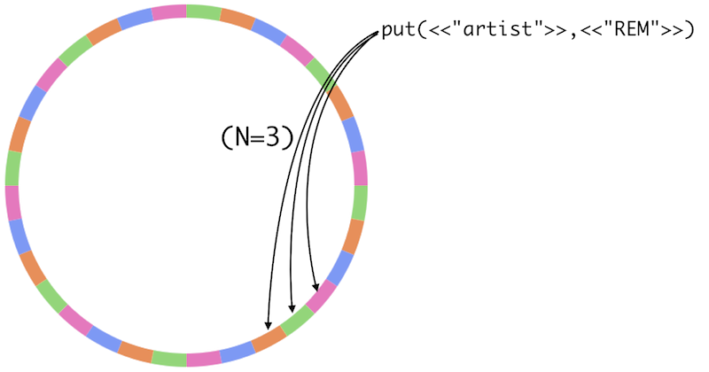
Replication
Intelligent Replication
* This is taken from riak docs on riak website.
Notes:
Riak's replication scheme means that if nodes go down, you can still read, write and update data. Riak allows you to set a replication number, “n”. An n value of 3 (default) means that each object is replicated 3 times. When an object's key is mapped onto a given partition, Riak won't stop there - it automatically replicates the data onto the next two partitions as well.

Slide 29
W
Number of nodes written to before returning success
Notes:
But you may not wish to wait for all nodes to be written to before returning. You can choose to wait for all 3 to inish writing (w=3 or w=all), which means my values are more likely to be consistent. Or you could choose to wait for only 1 complete write (w=1), and allow the remaining 2 nodes to write asynchronously, which returns a response quicker but increases the odds of reading an inconsistent value in the short term. This is the W value.In other words, setting w=all would help ensure your system was more likely to be consistent, at the expense of waiting longer, with a chance that your write would fail if fewer than 3 nodes were available (meaning, over half of your total servers are down) ..A failed write, however, is not necessarily a true failure. The client will receive an error message, but the write will typically still have succeeded on some number of nodes smaller than the W value, and will typically eventually be propagated to all of the nodes that should have it.-- Little Riak Book

Slide 30
R
Number of nodes read from before returning success
Notes:
Reading involves similar tradeoffs. To ensure you have the most recent value, you can read from all 3 nodes containing objects (r=all). Even if only 1 of 3 nodes has the most recent value, we can compare.all nodes against each other and choose the latest one, thus ensuring some consistency. Remember when I mentioned that RDBMS databases were write consistent ? This is close to read consistency. Just like w=all, however, the read will fail unless 3 nodes are available to be read. Finally, if you only want to quickly read any value, r=1 has low latency, and is likely consistent if “w=all”
In general terms, the N/R/W values are Riak’s way of allowing you to trade lower consistency for more availability. -- From Little Riak Book

Slide 31
Bucket Properties
curl -v http://127.0.0.1:10018/buckets/shop-carts/props | python -mjson.tool

Slide 32
Conflict Resolution
Last update automatically wins (Implicit)
All versions are returned to user-User will decide which version to choose

Slide 33
Lets play with cluster
bring down one node and still it works!
write even if one node is alive
Notes:
Find the default configuration

Slide 34
Link Walking
Link is an One way relationship
Link walking is a query option
Notes:
A link is a one-way relationship from one object to another. Link walking is a convenient query option for retrieving data when you start with the object linked from.

Slide 35
Search
distributed and full text search
Solr-like interface via HTTP
Exact match queries
Wildcards
Inclusive/exclusive range queries o AND/OR/NOT support
Grouping
Prefix matching
Proximity searches
Term boosting

Slide 36
Case Studies
Best Buy
Ideeli
Amazon dynamo
Notes:
Show them amazon cart

Slide 37
References
NoSql Distilled by Pramod Sadalage and Martin Fowler
Little Riak by Eric Redmond
http://docs.basho.com/riak/latest/

