Slide 1
SHAP explains model predictions, with limits
CSCI 373 SENIOR RESEARCH SEMINAR · SPRING 2025
Emily Hed · Computer Science · [How to reach you]

Slide 2
The one thing to remember
TAKEAWAY
SHAP exposed a pattern my earlier analysis missed, yet its math can still mislabel which features matter. Pair it with other methods.

Slide 3
Decisions need reasons
MOTIVATION
Models now help decide loans, hiring and medical care. The EU AI Act and GDPR expect meaningful information about automated decisions. To find bias and errors, we must see why a model predicted what it did.

Slide 4
Useful, but not sufficient
THESIS
SHAP is a valuable explanation tool, but its Shapley-based attributions can diverge from logical relevance, so it should be used with complementary methods.
SCOPE
TreeSHAP applied to an XGBoost survival model on the Titanic dataset, with a review of the fairness axioms and their limits.

Slide 5
Shapley values split the credit
FOUNDATIONS
Each feature is a player in a cooperative game. Its Shapley value is its average marginal contribution across every coalition.
TreeSHAP computes these values exactly for tree models.

Slide 6
XGBoost plus TreeSHAP
EXPLORATION
I trained XGBoost to predict survival for 887 Titanic passengers, then explained it with SHAP in a Jupyter notebook. SHAP ranked the features:
1 Sex · 2 Class · 3 Age · 4 Fare

Slide 7
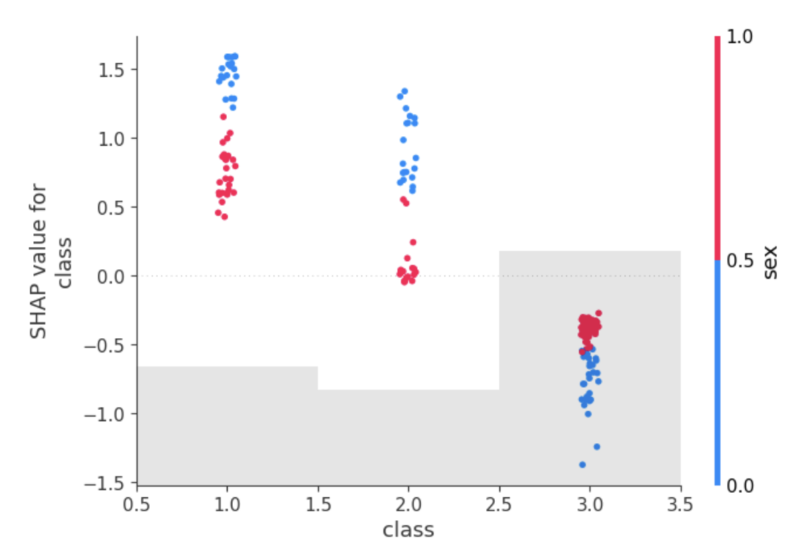
What SHAP added: class matters more for women
CENTRAL VISUAL
SHAP values from the XGBoost model show class moving predictions more for women: first and second class raised their odds more, and third class lowered them more than it did for men.
Each dot is one passenger. Blue: women. Red: men. Figure 11 of the paper.

Slide 8
Where SHAP can mislead
LIMITS
Huang and Marques-Silva (2023) show that Shapley values can:
Score an irrelevant feature above zero
Rank an irrelevant feature over a relevant one
Score a relevant feature at zero
Mathematical impact is not logical relevance.

Slide 9
More rules, more built-in tools
FUTURES
Within a year, SHAP-type tools grow as the EU AI Act and GDPR push transparency, while explanation moves inside the models themselves.

Slide 10
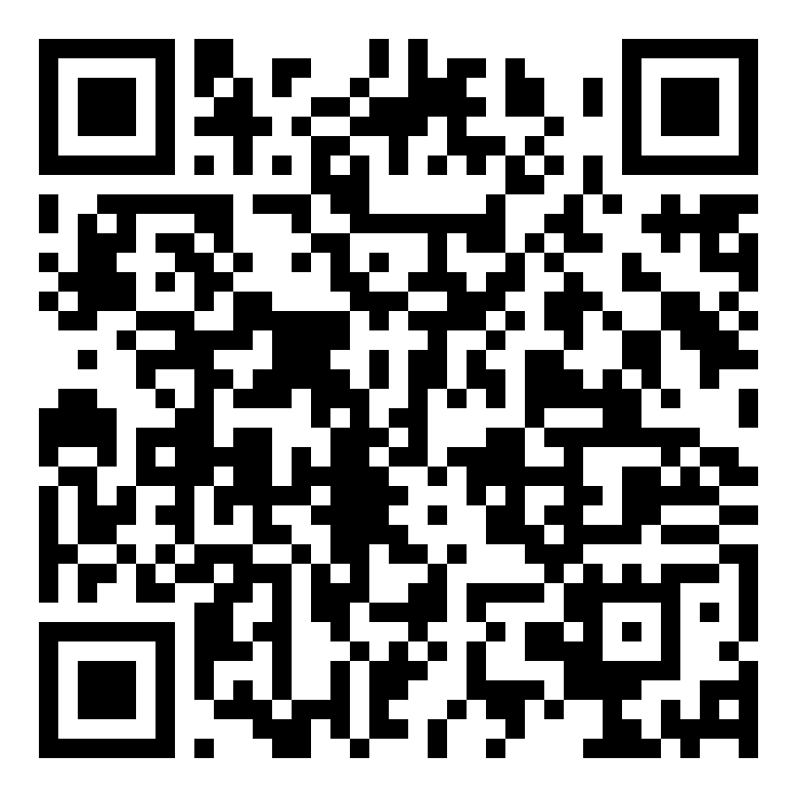
Scan for the full paper
GO DEEPER
SOURCES
Lundberg, Erion and Lee (2019). Huang and Marques-Silva (2023). Full list in the paper.
AI ACKNOWLEDGMENT
[Which tools you used and for what.]
THANKS
[Instructor, reviewers and others who shaped the work.]
Full State-of-the-Field paper
[90-second video]
[Notebook and code]

