Slide 1
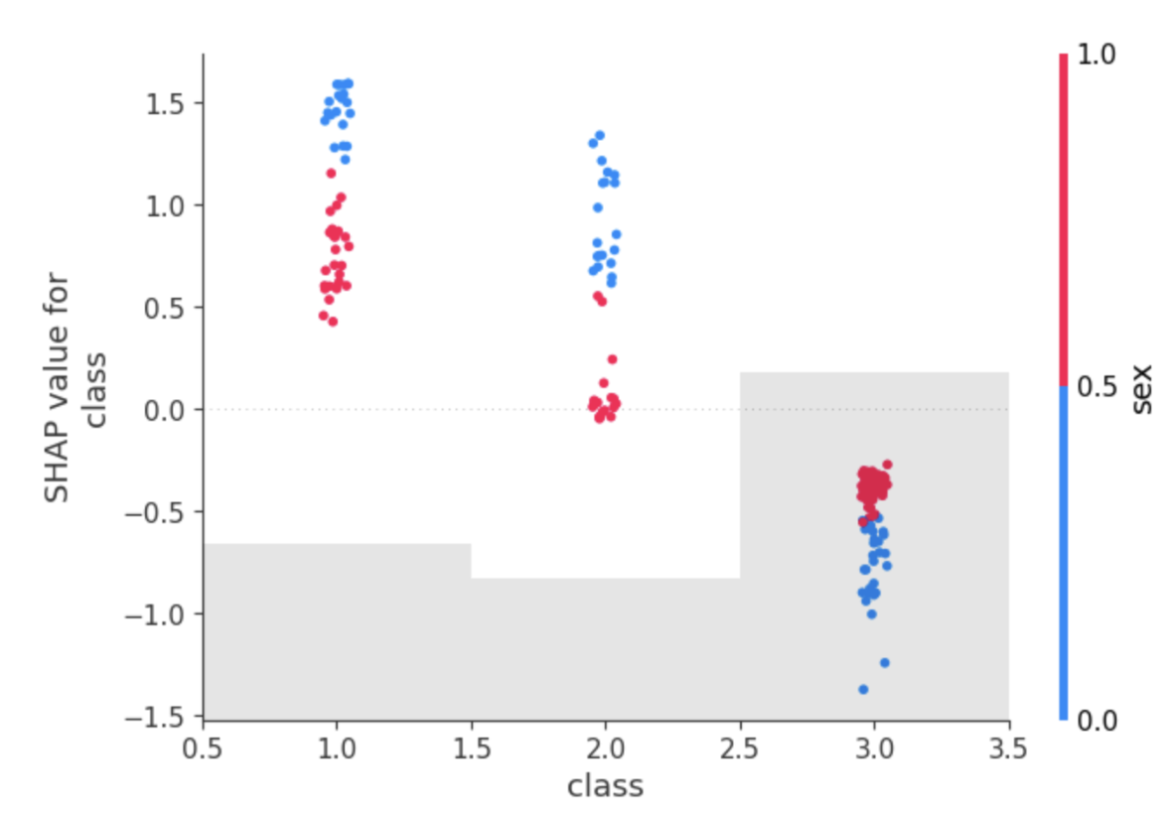

SHAP explains model predictions, with limits
CSCI 373 SENIOR RESEARCH SEMINAR · SPRING 2025
[CSB and SJU logo, from the official file]
Emily Hed · Computer Science · [How to reach you]
MOTIVATION
THE ONE THING TO REMEMBER
EXPLORATION
Decisions need reasons
SHAP exposed a pattern my earlier analysis missed, yet its math can still mislabel which features matter. Pair it with other methods.
XGBoost plus TreeSHAP
Models now help decide loans, hiring and medical care. The EU AI Act and GDPR expect meaningful information about automated decisions. To find bias and errors, we must see why a model predicted what it did.
I trained XGBoost to predict survival for 887 Titanic passengers, then explained it with SHAP in a Jupyter notebook. SHAP ranked the features:
1 Sex · 2 Class · 3 Age · 4 Fare
THESIS
What the lab analysis showed
What SHAP added: class matters more for women
LIMITS
Useful, but not sufficient
Where SHAP can mislead
SHAP is a valuable explanation tool, but its Shapley-based attributions can diverge from logical relevance, so it should be used with complementary methods.
Huang and Marques-Silva (2023) show that Shapley values can:
Score an irrelevant feature above zero
Rank an irrelevant feature over a relevant one
Score a relevant feature at zero
SCOPE
TreeSHAP applied to an XGBoost survival model on the Titanic dataset, with a review of the fairness axioms and their limits.
Mathematical impact is not logical relevance.
FOUNDATIONS
FUTURES
Shapley values split the credit
First-class women: about 95%. Third-class men: under 20%.
More rules, more built-in tools
Each feature is a player in a cooperative game. Its Shapley value is its average marginal contribution across every coalition.
Within a year, SHAP-type tools grow as the EU AI Act and GDPR push transparency, while explanation moves inside the models themselves.
Each dot is one passenger. Blue: women. Red: men. Figure 11 of the paper.
WHAT THE FIGURES SHOW
The lab analysis (left) gave survival rates by sex and by class. SHAP values from the XGBoost model (right) show class moving predictions more for women: first and second class raised their odds more, and third class lowered them more than it did for men.
GO DEEPER
Scan for the full paper
Full State-of-the-Field paper
[90-second video]
[Notebook and code]
TreeSHAP computes these values exactly for tree models.
Sources. Lundberg, Erion and Lee (2019). Huang and Marques-Silva (2023). Full list in the paper.
AI acknowledgment. [Which tools you used and for what.]
Thanks. [Instructor, reviewers and others who shaped the work.]
Or type: [short link]
Notes:
Poster size: 44 x 25.5 in, which is four by three landscape letter sheets. Side panels each fill one sheet, so a draft can be printed on letter paper and taped together: export to PDF, then print with Adobe Acrobat Reader using Page Sizing > Poster at 100%. Keep the takeaway panel and the Go deeper panel; rename, resize, swap or drop the rest.

